Slide 1
Solar System Tour
Mars
With Jim Paradise
sun

Slide 2
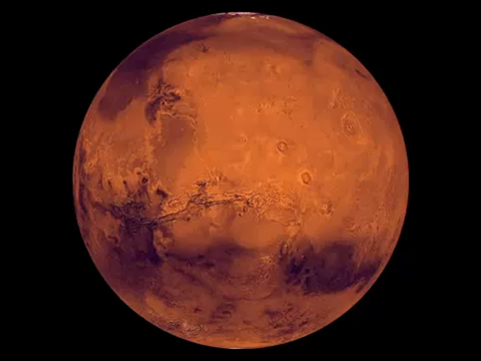
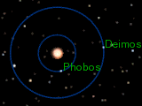
Average Distance From Sun:
142 Million Miles
Average Temp: -85ºF
Surface Temp: -220ºF to +80ºF
Atmosphere: 1% of Earth
Diameter: 4,200 miles
Orbital Period: 1.9 years
Rotation: 24.7 hours
Moons: 2
Mars
Mars data

Slide 3
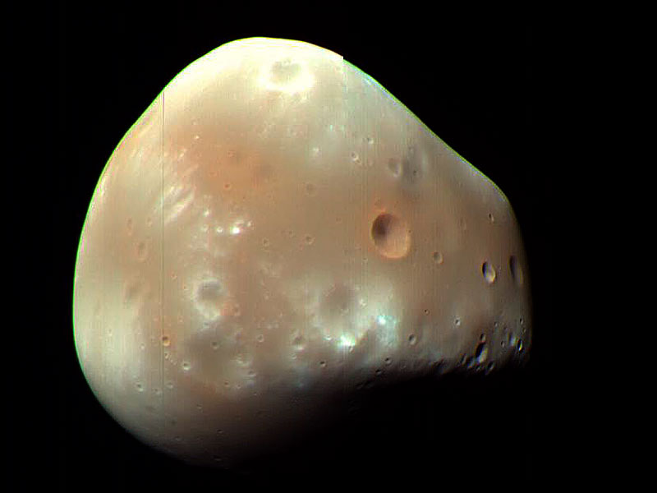
Deimos –Mars smallest moon (8 miles diameter)
Image credit: NASA/JPL-Caltech
Phobos

Slide 4
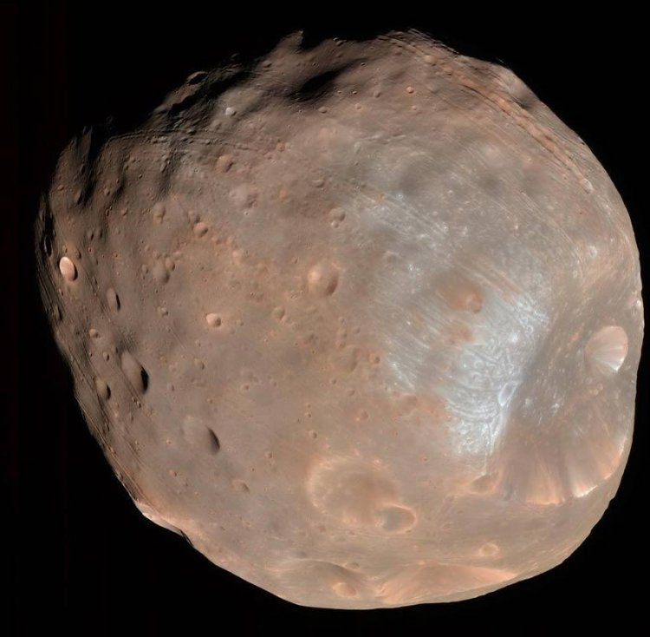
Phobos – Mars biggest moon (14 miles diameter)
Escape Velocity: 24 mph
March 3, 2010:
Previous flybys of Phobos have shown that it is not dense enough to be solid all the way through.
It must be 25-35% porous.
This has led planetary scientists to believe it is a dust covered ‘rubble pile’ circling Mars, or is hollow, or has caverns.
Image credit: NASA/JPL-Caltech
Mars from Phobos

Slide 5
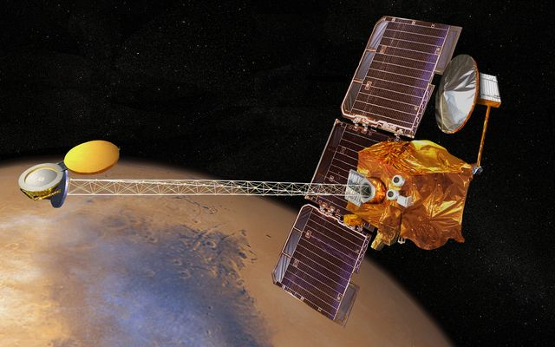
Mars Odyssey
Major Instruments:
Thermal Emission Imaging System (THEMIS)
Gamma Ray Spectrometer (GRS)
Mars Radiation Environment Experiment (MARIE)
Launched: April 7, 2001
MOI: October 24, 2001
Controlled from Denver, CO
Image credit: NASA/JPL-Caltech
Odyssey Photos - Melas

Slide 6
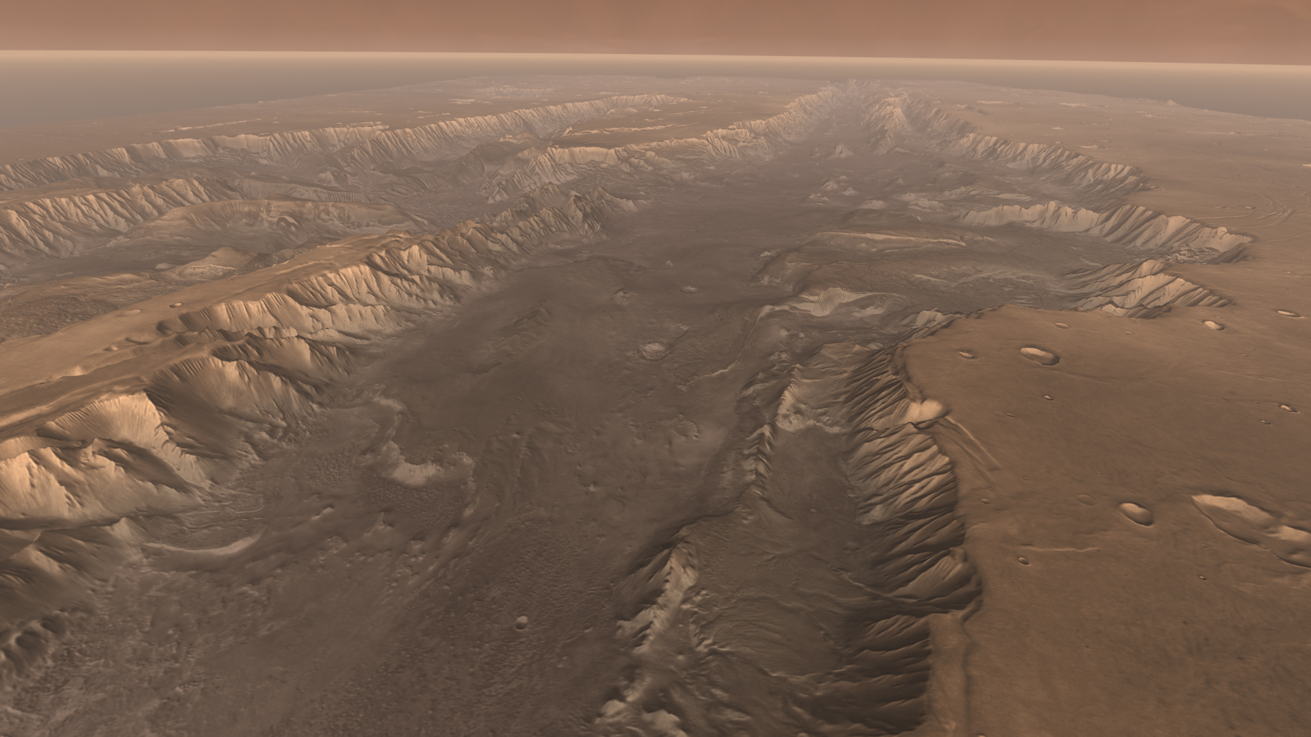
Melas - The Grand Canyon of Mars
Image credit: NASA/JPL-Caltech
Olympus Mons

Slide 7
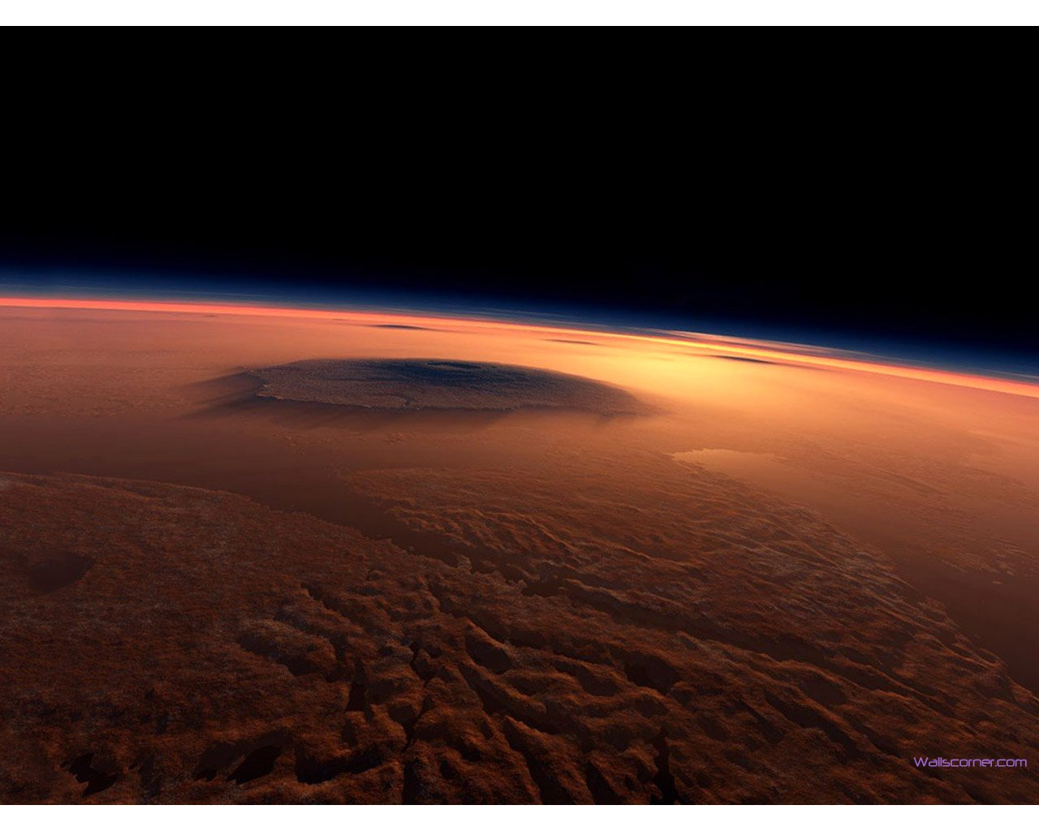
Olympus Mons
Largest Volcano in our Solar System: 100,000 feet tall
Image credit: NASA/JPL-Caltech
MRO

Slide 8
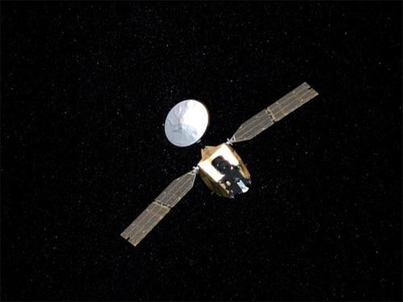
Mars Reconnaissance Orbiter (MRO)
Launched: August 12, 2005
Arrived: March 10, 2006
10x resolution over Odyssey
Controlled from Denver, CO
Major Instruments:
Context Camera (CTX)
Mars Color Imager (MARCI)
High Resolution Imaging Science Experiment (HiRISE)
Compact Reconnaissance Imaging Spectrometer for Mars (CRISM)
Shallow Radar (SHARAD) (can see up to 1 km into ground)
Image credit: NASA/JPL-Caltech
dunes

Slide 9
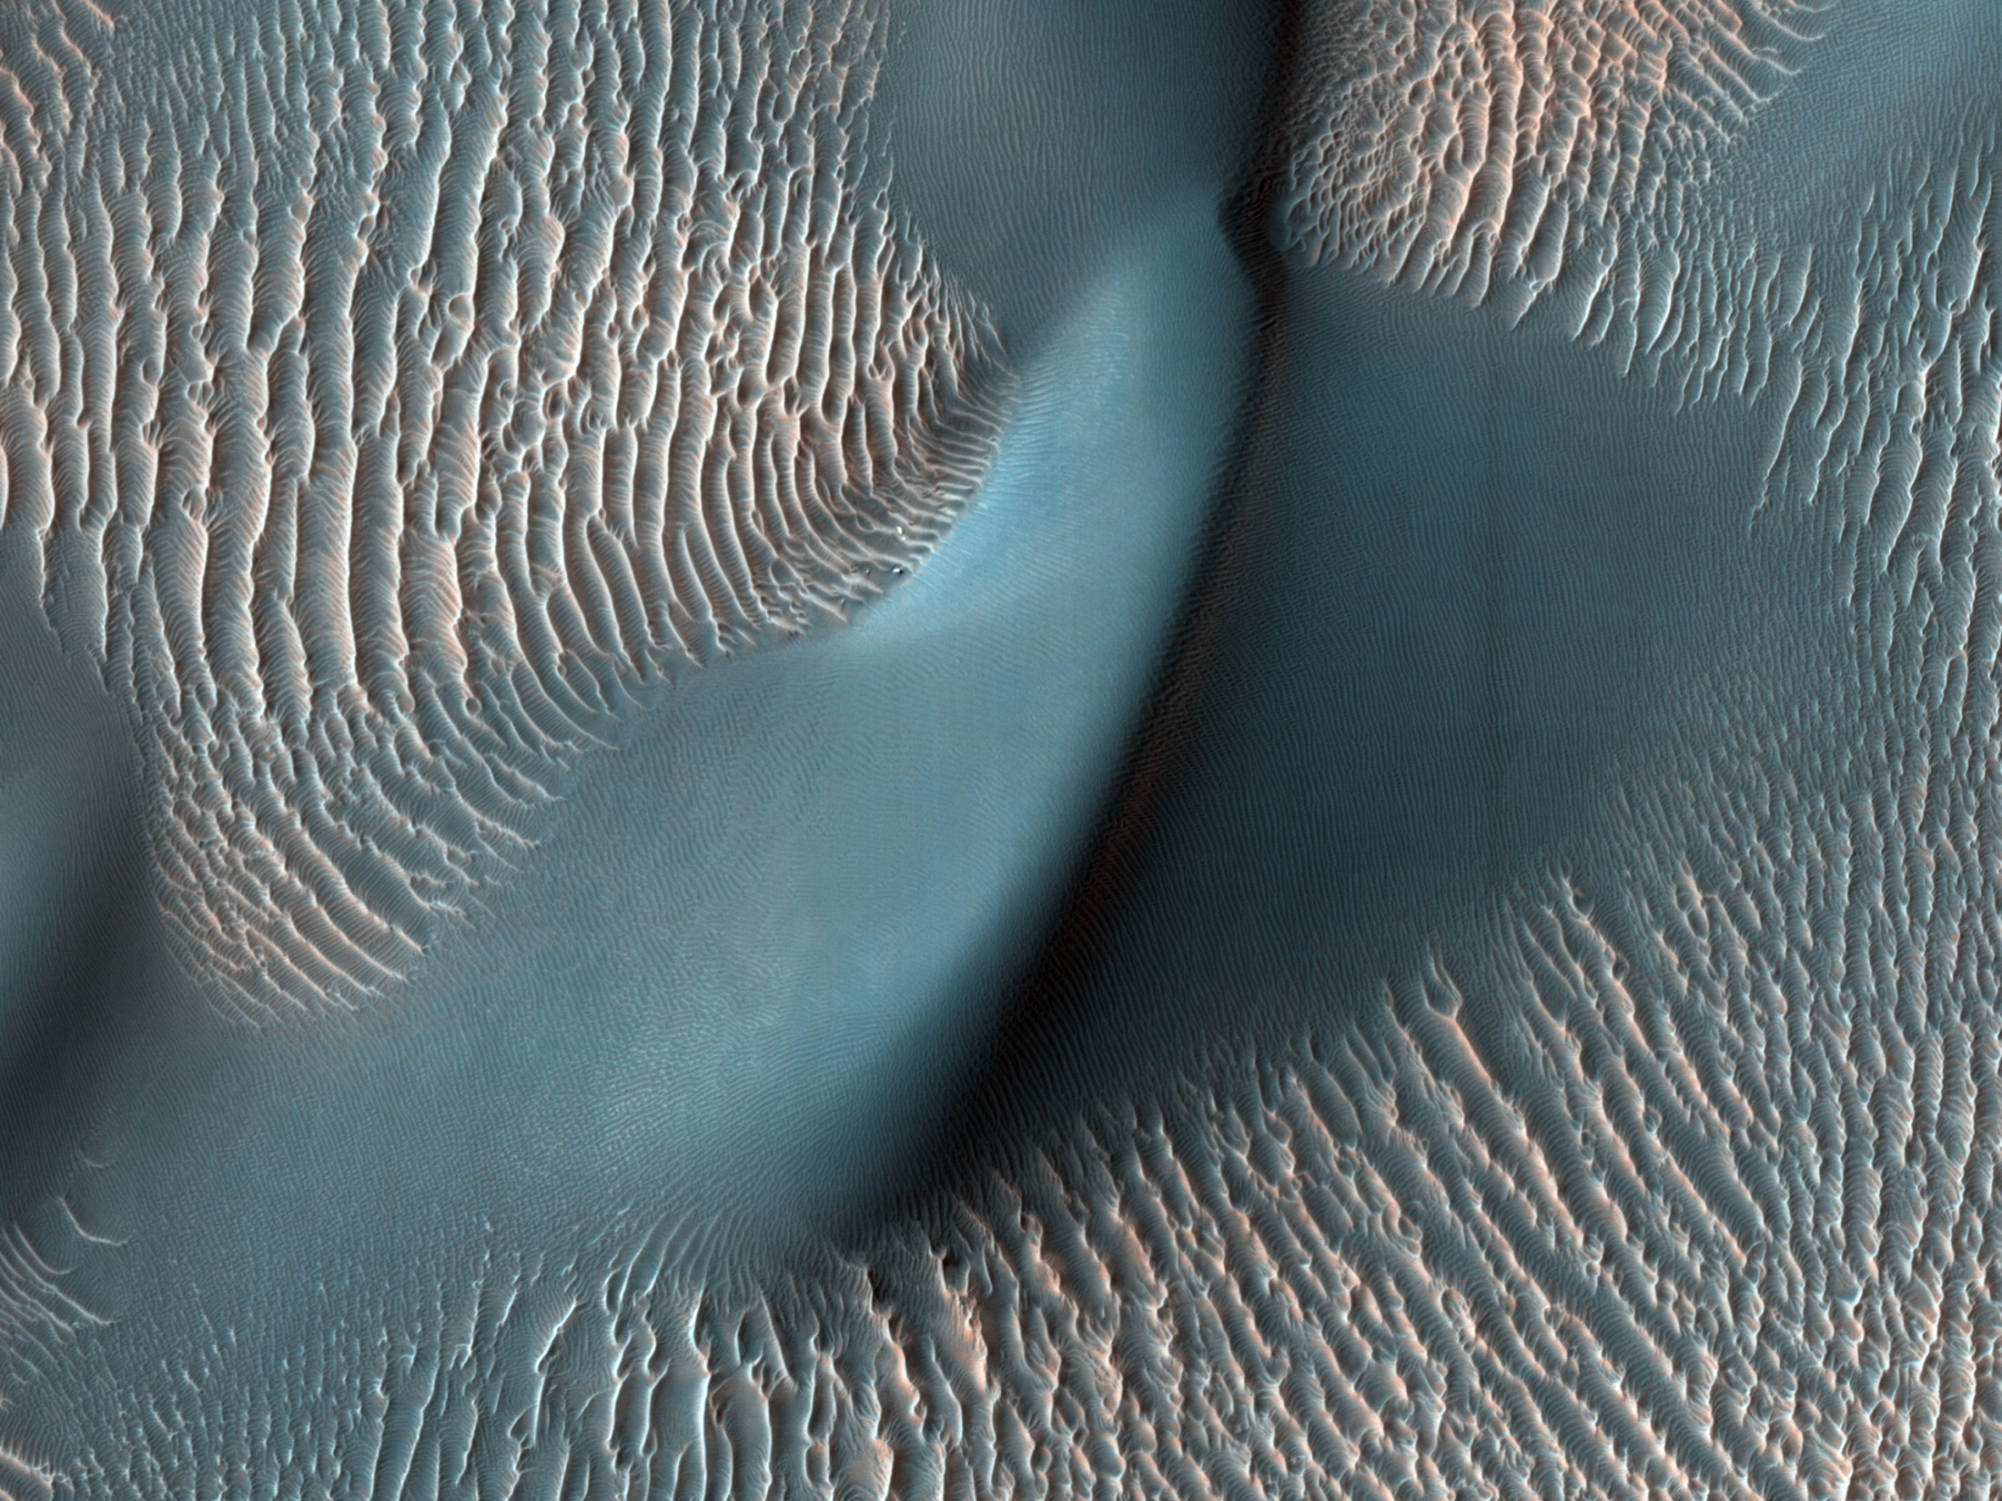
Sand Dunes / Ripples
Notes:
Sand Dunes and Ripples in Proctor Crater, Mars This view from the High Resolution Imaging Science Experiment (HiRISE) camera on NASA's Mars Reconnaissance Orbiter shows two classes of aeolian bedforms within Proctor Crater. The relatively bright, small ridges are ripples. From their study on Earth, and close-up examination by the MER rovers (roving elsewhere on Mars), we know that ripples are composed of fine sand (less than 200 microns in diameter) or fine sand coated with coarser sand and granules. The larger, darker bedforms are dunes composed of sand, most likely of fine size. Ripples tend to move slower than dunes. Because of this, over time, ripples get covered with dust, possibly explaining the bright tone visible here. The dunes are dark probably because they are composed of basaltic sand (derived from dark, volcanic rock) that is blown by the wind enough that dust does not sufficiently accumulate to change their color. This area in Proctor Crater, at 47.8 degrees south latitude and 30.7 degrees east longitude, is being monitored by HiRISE to document any changes over time. This image is a portion of the HiRISE observation catalogued as ESP_011909, taken on Feb. 9, 2009. Image Credit: NASA/JPL-Caltech/University of Arizona

Slide 10
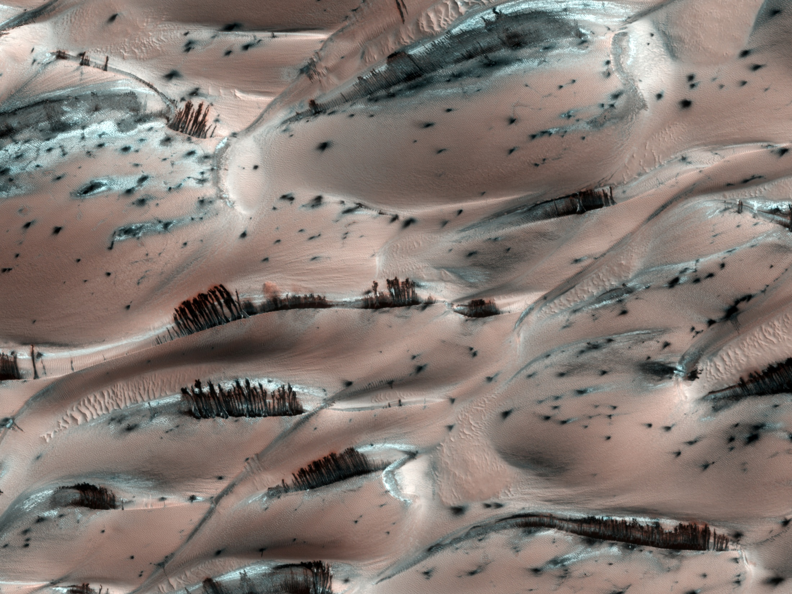
Notes:
Explanation: They might look like trees on Mars, but they're not. Groups of dark brown streaks have been photographed by the Mars Reconnaissance Orbiter on melting pinkish sand dunes covered with light frost. The above image was taken in 2008 April near the North Pole of Mars. At that time, dark sand on the interior of Martian sand dunes became more and more visible as the spring Sun melted the lighter carbon dioxide ice. When occurring near the top of a dune, dark sand may cascade down the dune leaving dark surface streaks -- streaks that might appear at first to be trees standing in front of the lighter regions, but cast no shadows. Objects about 25 centimeters across are resolved on this image spanning about one kilometer. Close ups of some parts of this image show billowing plumes indicating that the sand slides were occurring even when the image was being taken.

Slide 11
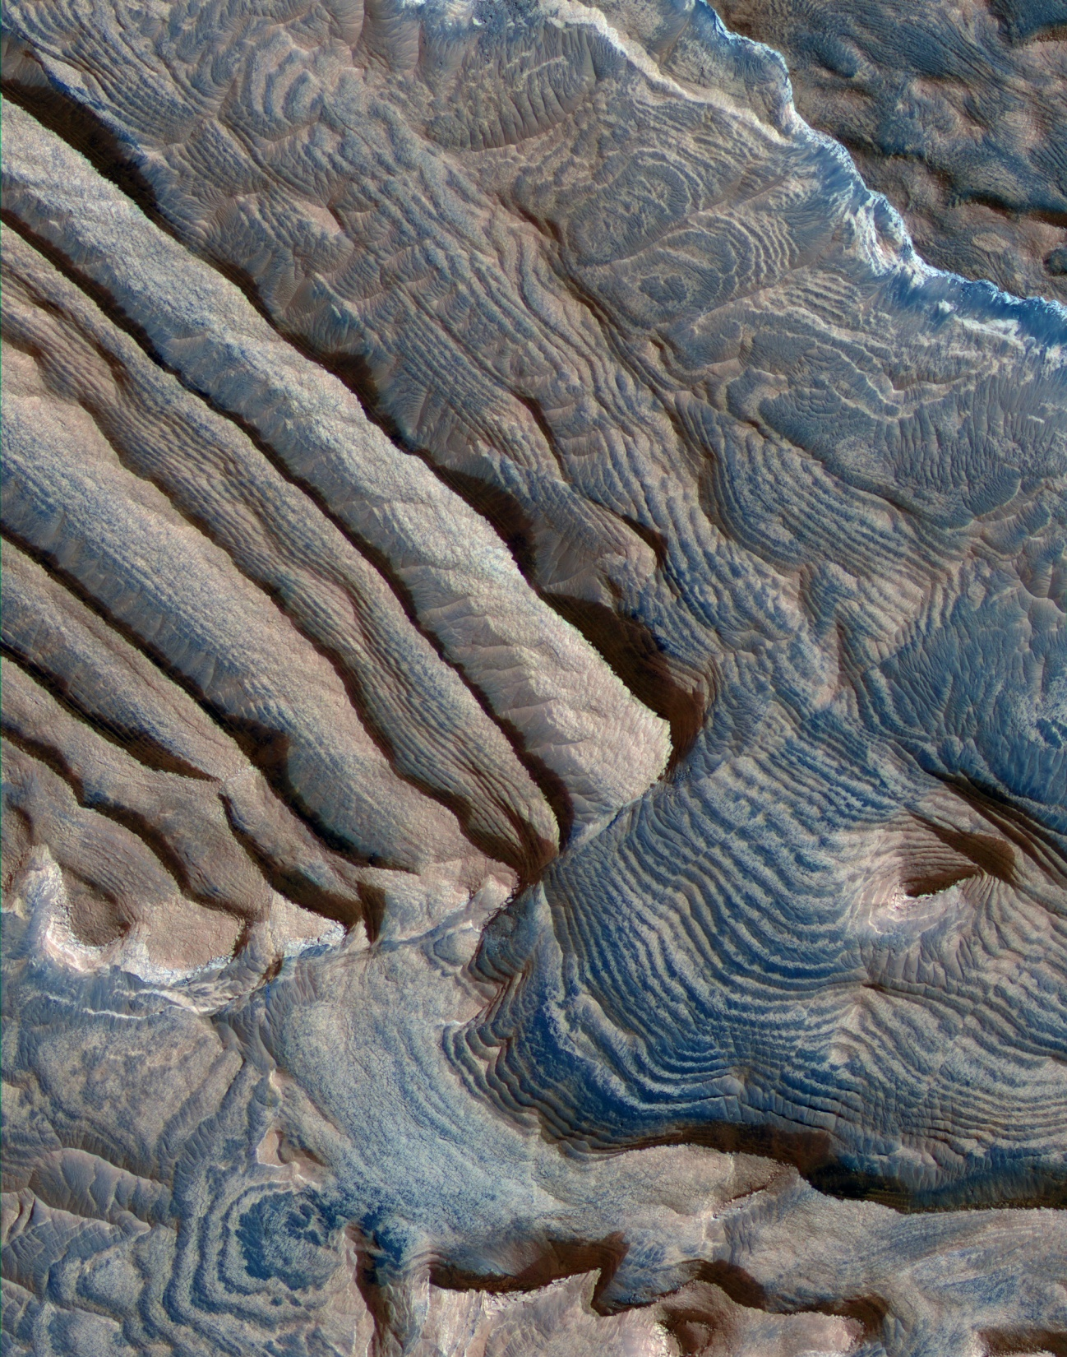
Dust devils
Notes:
December 4, 2008
NASA Orbiter Finds Martian Rock Record With 10 Beats to the Bar Periodic Layering in Becquerel Crater, Mars Image credit: NASA/JPL-Caltech/University of Arizona Related images Climate cycles persisting for millions of years on ancient Mars left a record of rhythmic patterns in thick stacks of sedimentary rock layers, revealed in three-dimensional detail by a telescopic camera on NASA's Mars Reconnaissance Orbiter. Researchers using the High Resolution Imaging Science Experiment camera report the first measurement of a periodic signal in the rocks of Mars. This pushes climate-cycle fingerprints much earlier in Mars' history than more recent rhythms seen in Martian ice layers. It also may rekindle debates about some patterns of rock layering on Earth. Layers of similar thickness repeat dozens to hundreds of times in rocks exposed inside four craters in the Arabia Terra region of Mars. In one of the craters, Becquerel, bundles of a 10-layer pattern repeat at least 10 times, which could correspond to a known 10-to-one pattern of changes in the tilt of the planet's rotation axis. "Each layer has weathered into a stair step in the topography where material that's more resistant to erosion lies on top of material that's less resistant to erosion," said Kevin Lewis of the California Institute of Technology, Pasadena, who is the lead author of a report on the periodic layering published in the Dec. 5 edition of the journal Science. Some periodic change in the environment appears to have affected how resistant the rock-forming sediments became, perhaps from changes in what size of sand or silt particles were deposited by the wind, or from how the particles were cemented together after deposition. Some of the individual layers are less than three feet thick. The camera, called HiRISE for short, took pairs of images of each site from slightly different angles in orbit, providing the stereo information necessary for determining each layer's thickness. "It's easy to be fooled without knowing the topography and measuring the layers in three dimensions," said Alfred McEwen of the University of Arizona, Tucson, principal investigator for the camera and a co-author of the new report. "With the stereo information, it is clear there's a repeating pattern to these layers." Geologists commonly find "rhythms," or repeating patterns, in sedimentary layers on Earth. Determining the source of the rhythms can be difficult. Some result from annual or tidal cycles, or from episodic flooding that may not be periodic at all, but the role of longer-term astronomical cycles has been debated. One step in showing that astronomical cycles can leave their mark in sediments came from finding repeating five-layer sets in some terrestrial bedrock, matching a known five-to-one ratio of two cyclical variations in Earth's orbit. Lewis and colleagues found something similar on Mars: "Our findings suggest that cycles of climate change led to the patterns we see recorded in the Mars rock layers today, possibly as a result of similar variations in Mars' orbit," he said. "Mars has a 10-to-one ratio in cycles of how its tilt changes -- smaller wobbles within larger packages. Sure enough, we see a 10-to-one ratio in one of these layered deposits. It's like trying to identify a song -- it's easier if there are multiple instruments playing different parts, rather than just a single rhythm." In addition to having rhythm of 10 beats to the bar instead of Earth's five-beat pattern, Mars has characteristics that make it a good laboratory for studying how astronomical cycles affect climate. The tilt of Mars' axis varies much more than the axis of Earth, because Earth's relatively large moon provides a stabilizing effect. And, at least for most of its history, Mars has lacked the oceans and thick atmosphere that, on Earth, modulate the effects of orbital variations and add their own cyclical patterns. The 10-beat pattern of Mars' wobble lasts about 1.2 million years. If the 10-layer bundles in Becquerel crater are indeed signatures of that cycle, the 10 or more bundles stacked on each other record about 12 million years when environmental conditions affecting sedimentation were generally steady except for effects of the changing tilt. NASA's Jet Propulsion Laboratory, a division of Caltech, manages the Mars Reconnaissance Orbiter for NASA's Science Mission Directorate, Washington. Lockheed Martin Space Systems, Denver, is the prime contractor for the project and built the spacecraft. The HiRISE camera was built by Ball Aerospace and Technologies Corp., Boulder, and is operated by the University of Arizona.

Slide 12
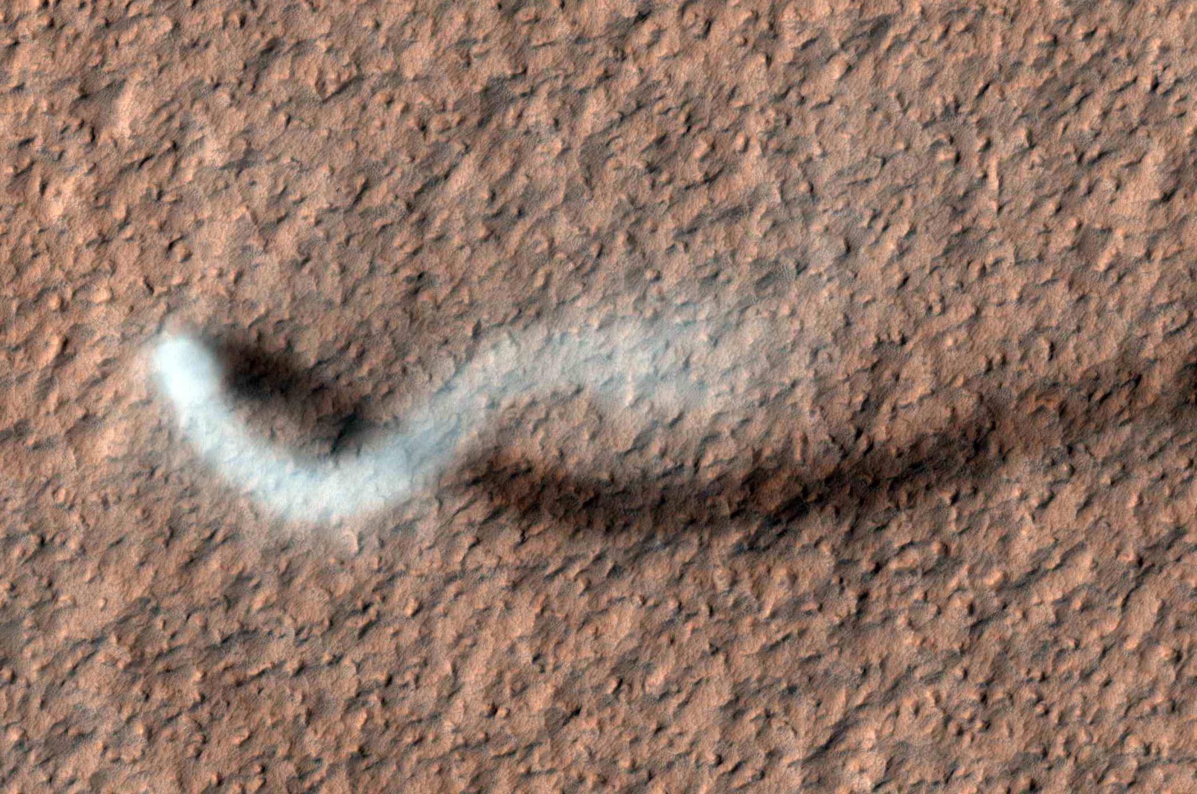
Sediments

Slide 13
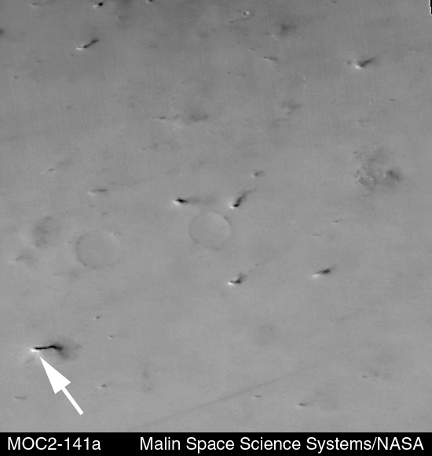

Slide 14
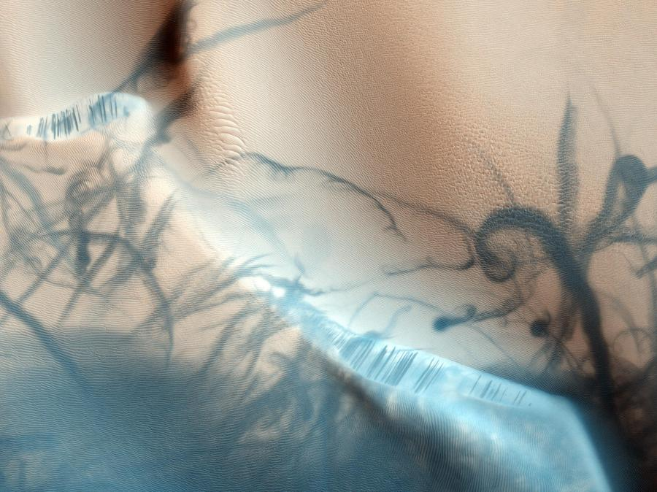
Spiders
Notes:
The HiRISE camera on board the Mars Reconnaissance Orbiter took this incredible image of dust churned up by wind vortices, or dust devils, on the Martian surface.

Slide 15
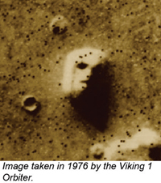
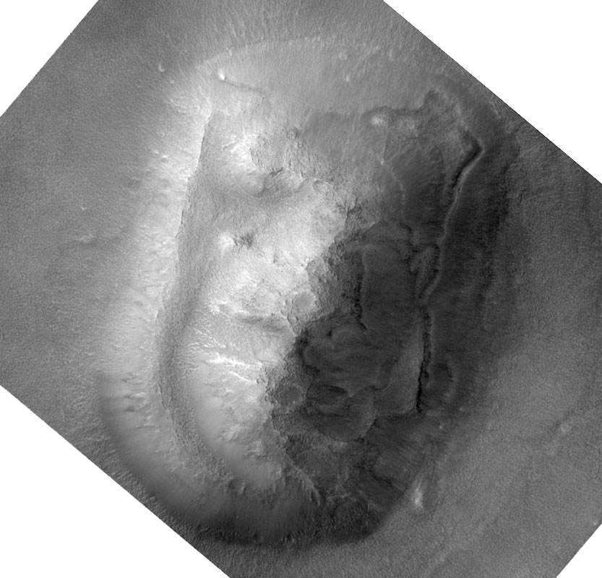
Face on Mars
Sojourner

Slide 16
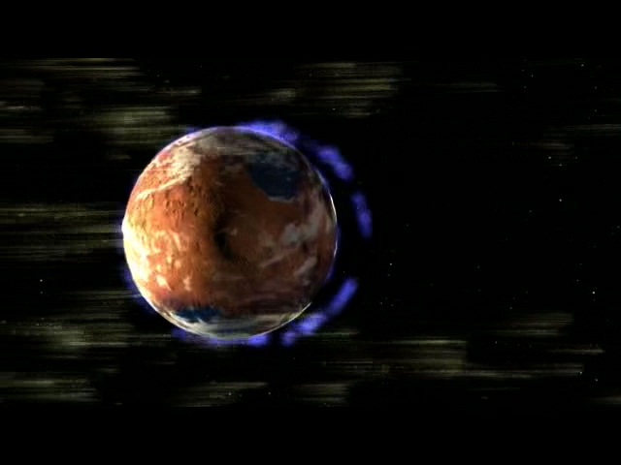
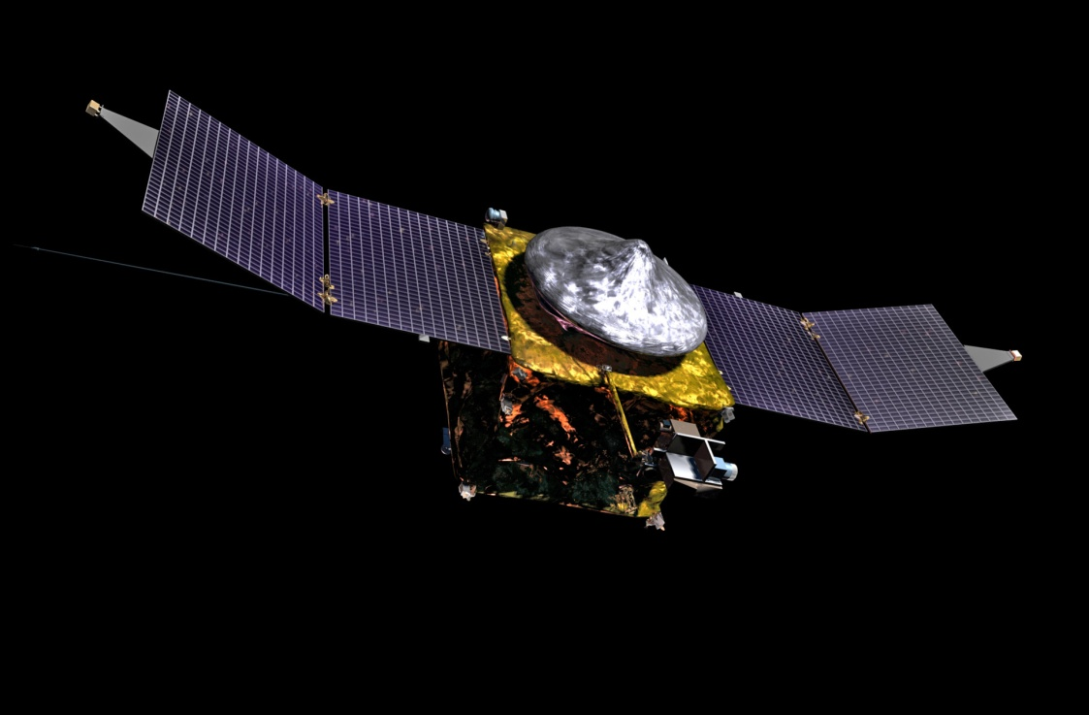
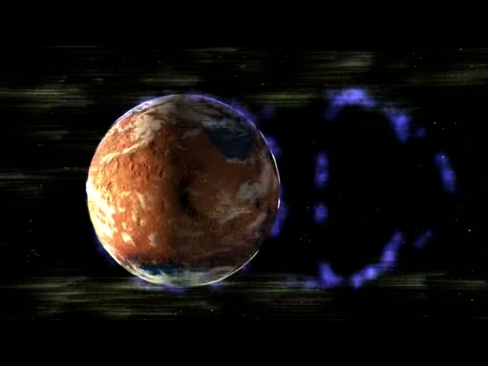
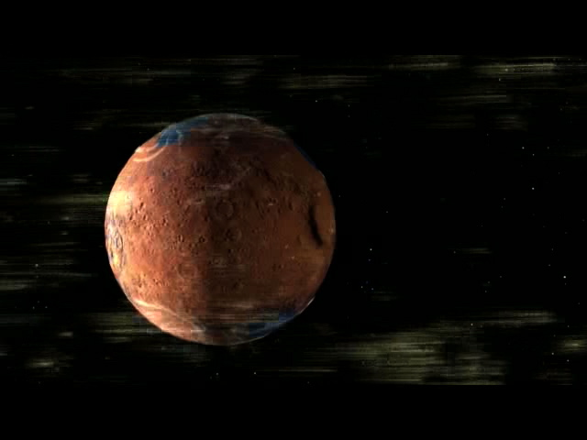
MAVEN Launched: Nov 18, 2013 Mars Orbit: Sept 21, 2014 Controlled from Denver, CO
Mars' loss of its protective magnetic field may have triggered the loss of its atmosphere.
Mars Atmosphere and Volatile Evolution Mission (MAVEN) will explore Mars' upper atmosphere, ionosphere and how it interacts with the Sun. The spacecraft will determine why Mars lost the denser surface atmosphere that once allowed it support the presence of liquid water on its surface.
insight
Image credit: NASA/JPL-Caltech
Asteroid Belt

Slide 17
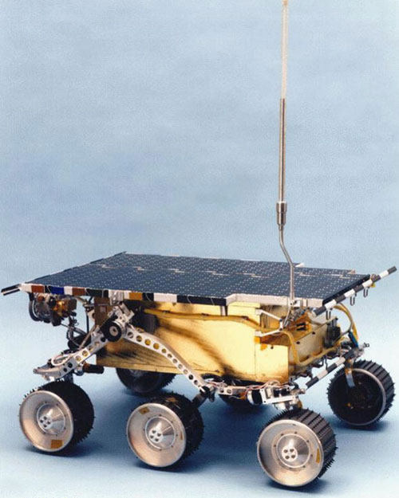
Mars 1997 Sojourner
Launched: Dec 4, 1996
Landed: July 4, 1998
Lasted: 92 days
Size
Small
Length: 20 inches
Height: 10 inches
Image credit: NASA/JPL-Caltech
Choosing landing site

Slide 19
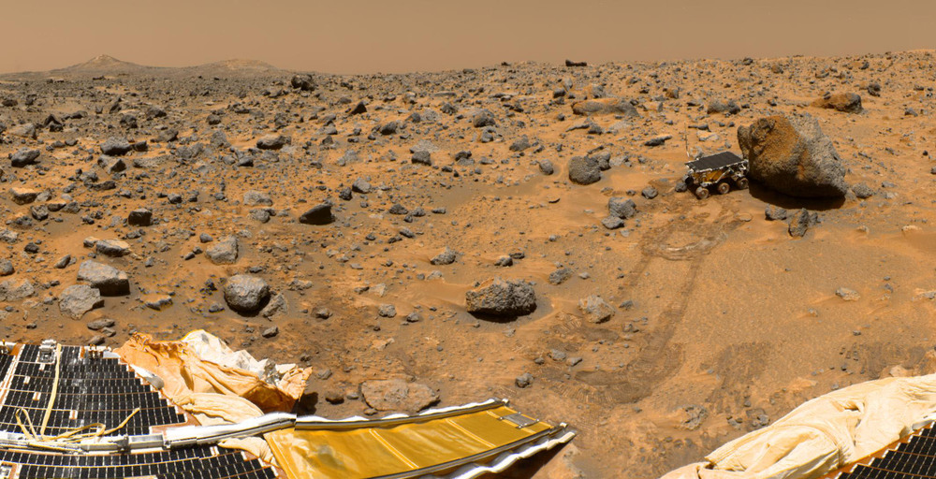
Image credit: NASA/JPL-Caltech
Sojourner on Mars
MER
Mer

Slide 20
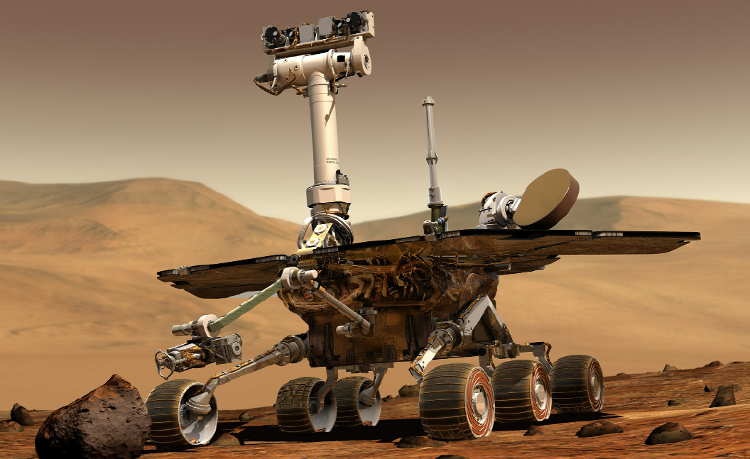
Mars 2003 Mars Exploration Rovers (MER)
Spirit: Opportunity:
Launched: June 10, 2003 Launched: July 7, 2003
Landed: January 4, 2004 at Gusev Crater Landed: January 24, 2004 at Meridian Planum
Got stuck at Troy 8/5/2009 Still rolling after more than 9.5 years
Traveled 4.8 miles total Traveled 14.3 miles so far
Last communication: 3/22/2010 Next Destination: Solander Point
Size: Golf Cart Size / 400 pounds
Landing sites on opposite sides of Mars.
The mission was planned to last for 90 days each.
The rovers were designed to travel up to 350 feet each Martian day, or sol (approximately 24 hours, 37 minutes).
Image credit: NASA/JPL-Caltech
video

Slide 21
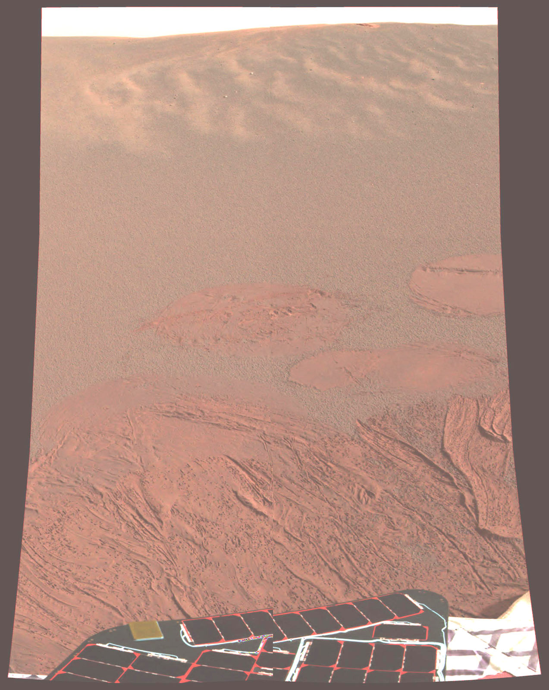
Mars 1/25/2004 Opportunity on Mars
Image credit: NASA/JPL-Caltech

Slide 22
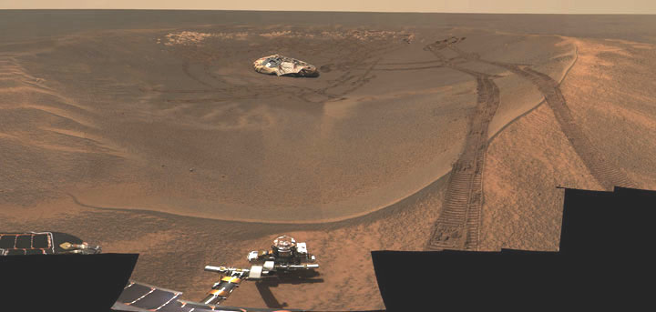
Opportunity checking out it’s landing airbag…
Image credit: NASA/JPL-Caltech

Slide 23
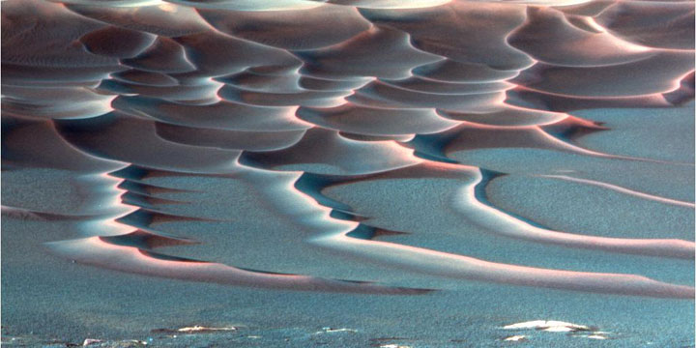
Sand Dunes
Image credit: NASA/JPL-Caltech
rocky outcrop

Slide 24
A rocky outcrop
Image credit: NASA/JPL-Caltech
Cleaning events

Slide 25
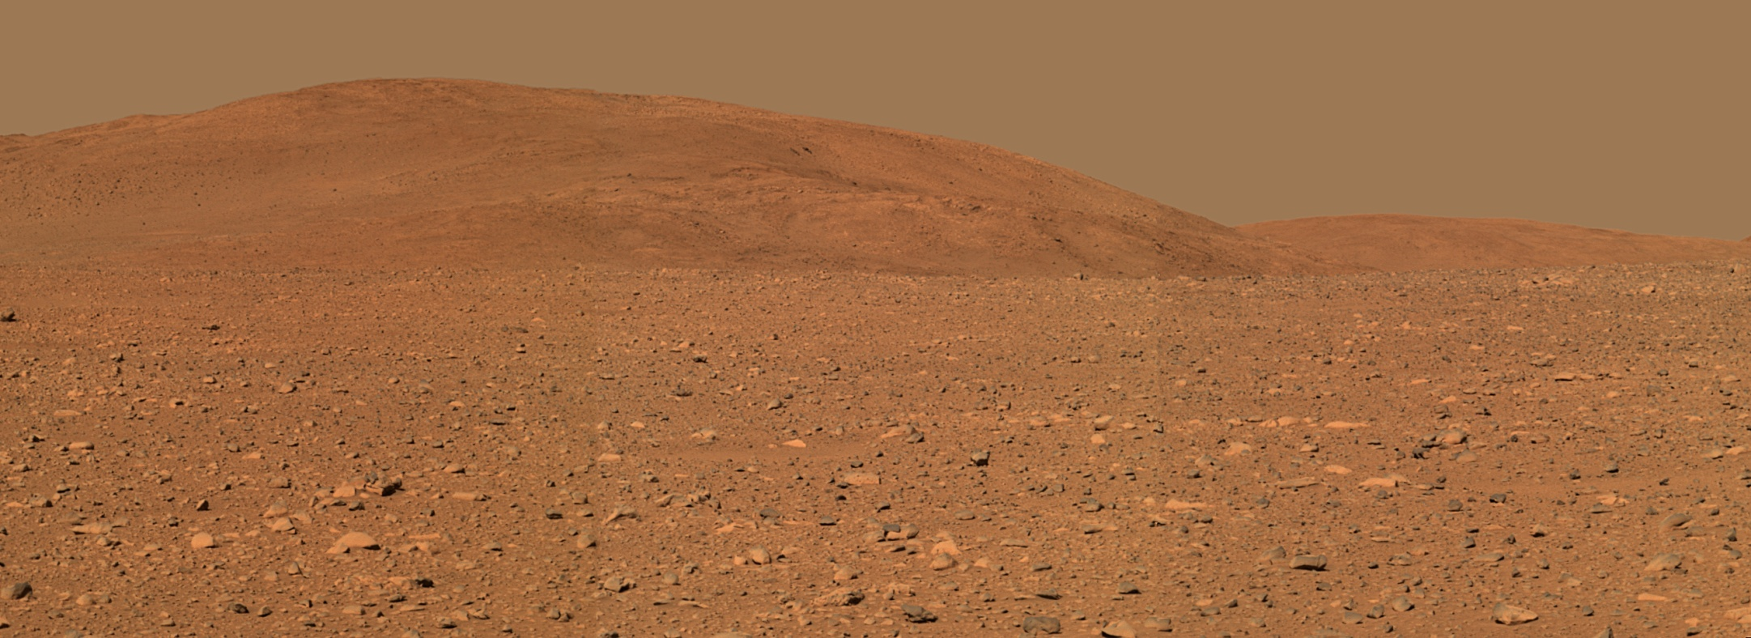
Spirit’s Landing Area on Mars
Image credit: NASA/JPL-Caltech
Volcanic hills

Slide 26
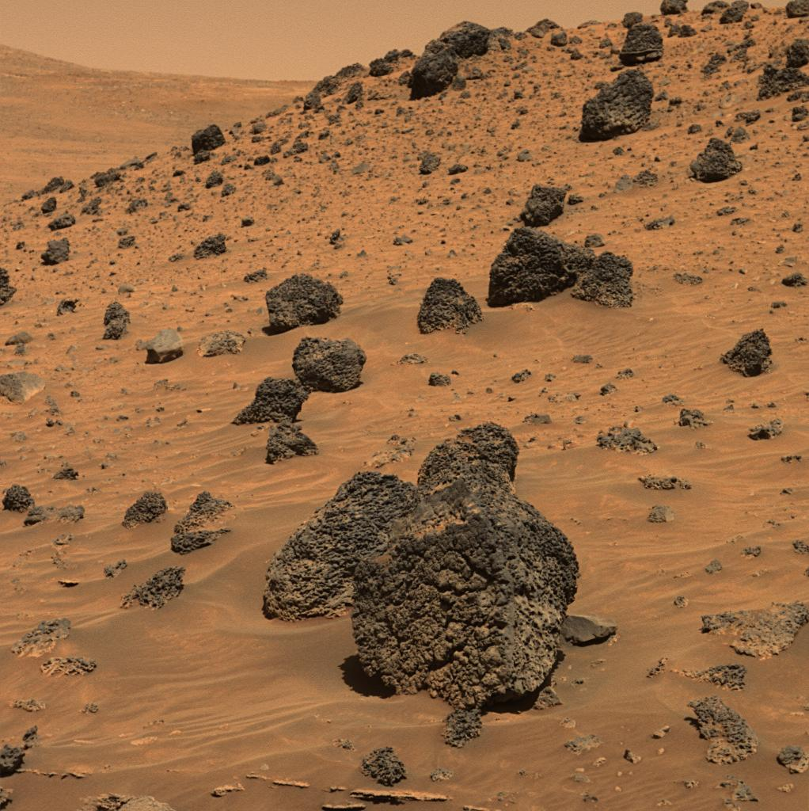
Comanche cliffs

Slide 27
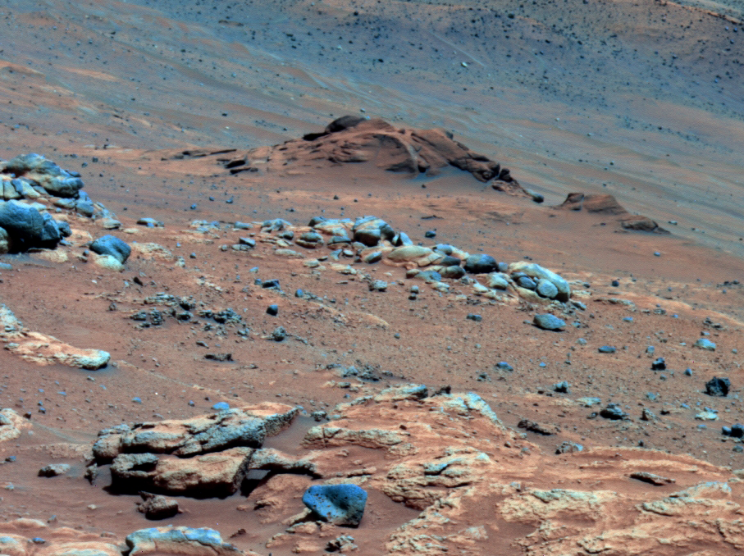
Spirit at Comanche Cliffs
Image credit: NASA/JPL-Caltech
Troy

Slide 28
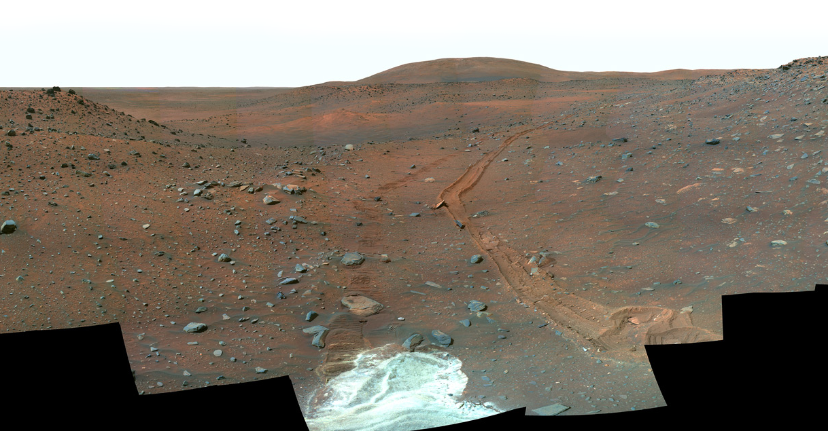
Spirit stuck in white dry powder at Troy
(final resting place)
Image credit: NASA/JPL-Caltech
What would you do different?
Curiosity

Slide 29
Curiosity Rover (Launched: Nov 26, 2011)
Image credit: NASA/JPL-Caltech
All 3

Slide 30
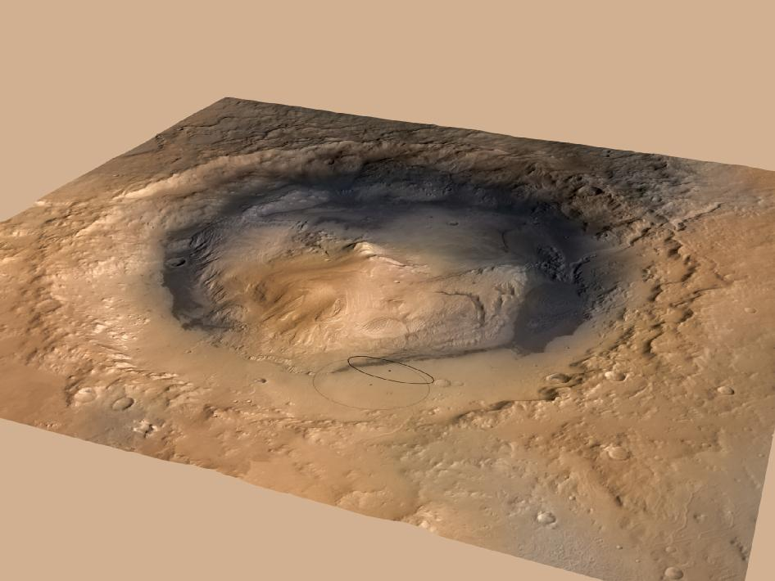
Landed in Gale Crater in August 5, 2012 Mount Sharp in the crater
MSL landing

Slide 32
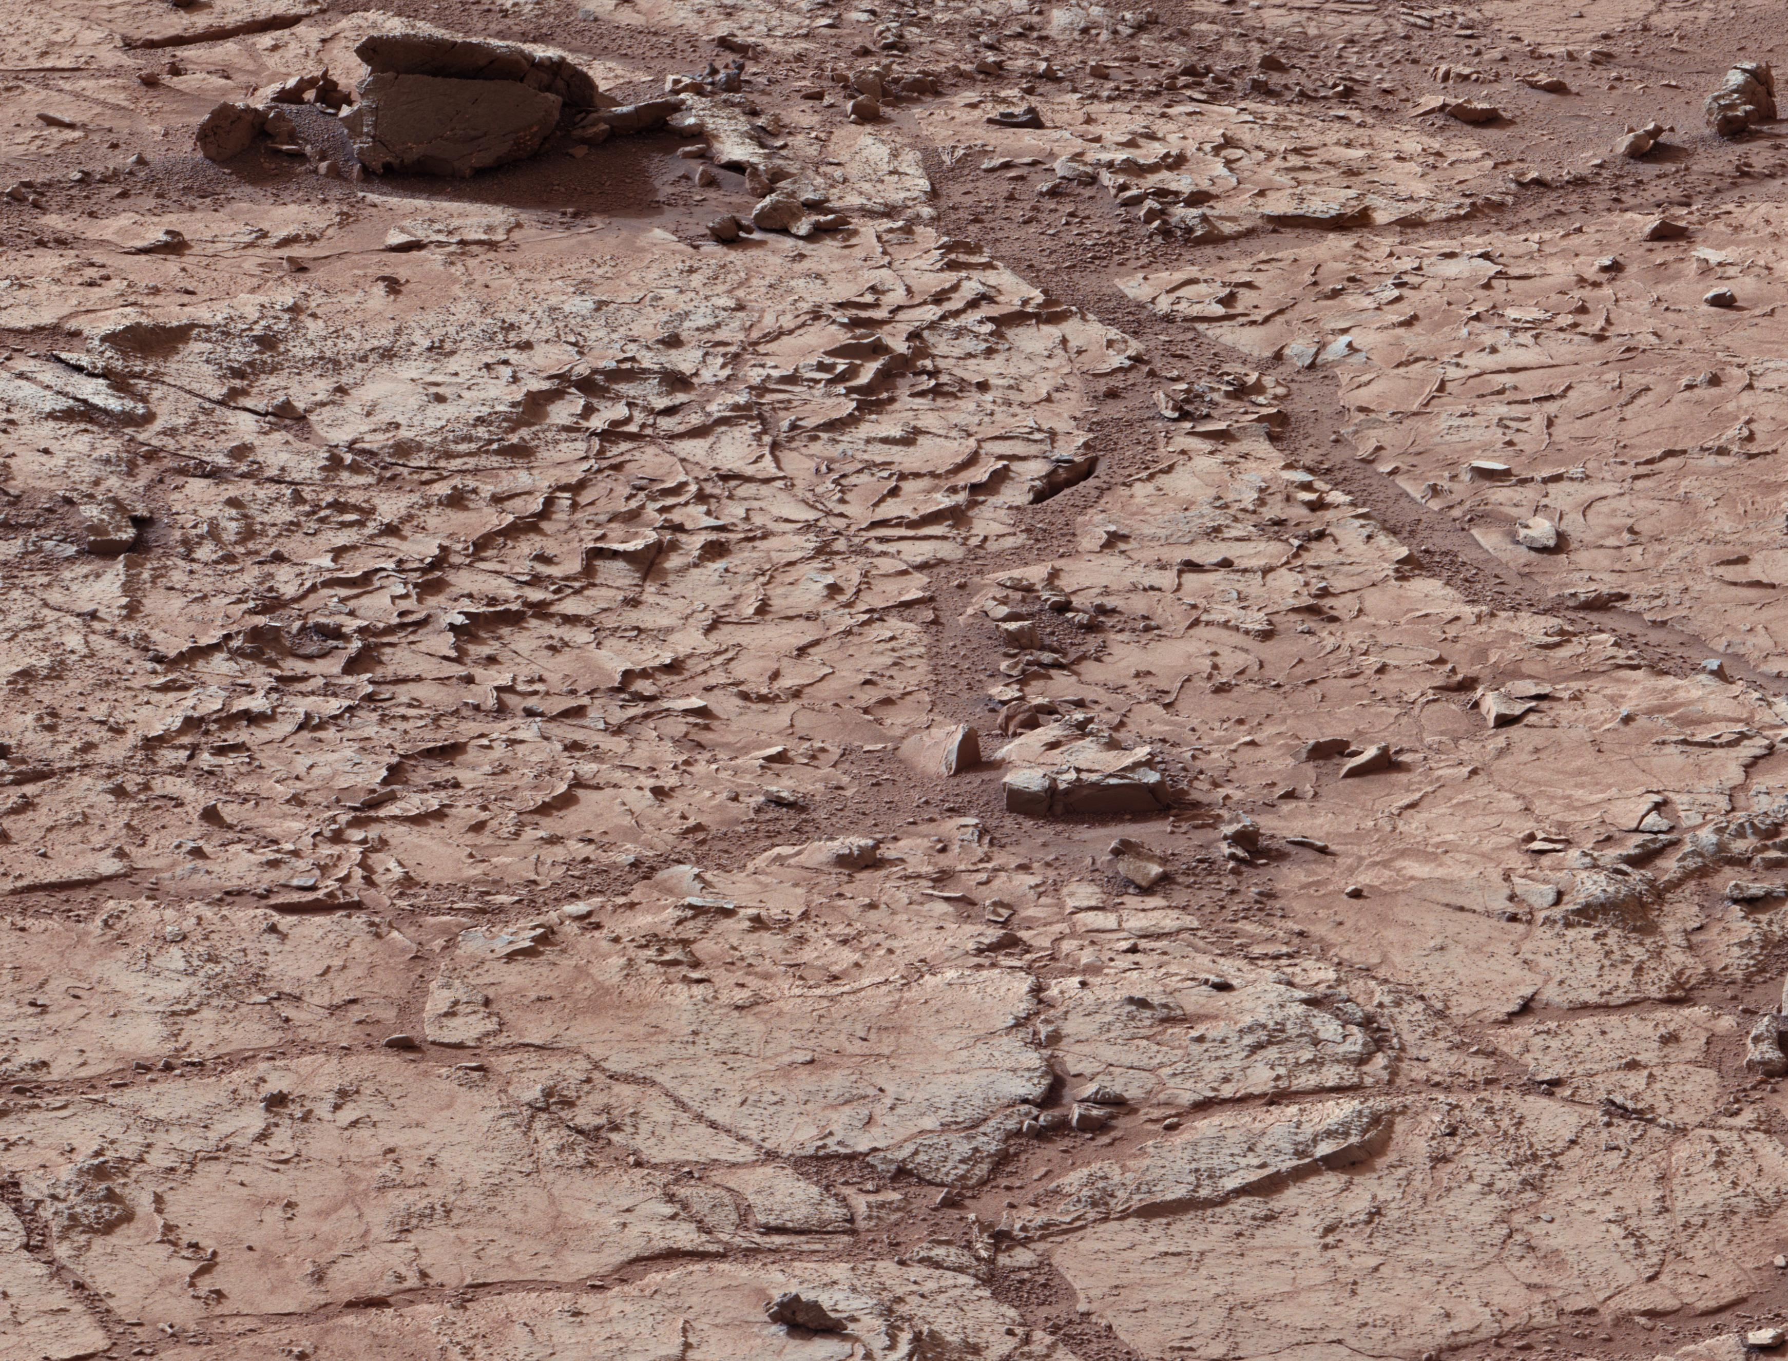
Spiders on Mars

Slide 33
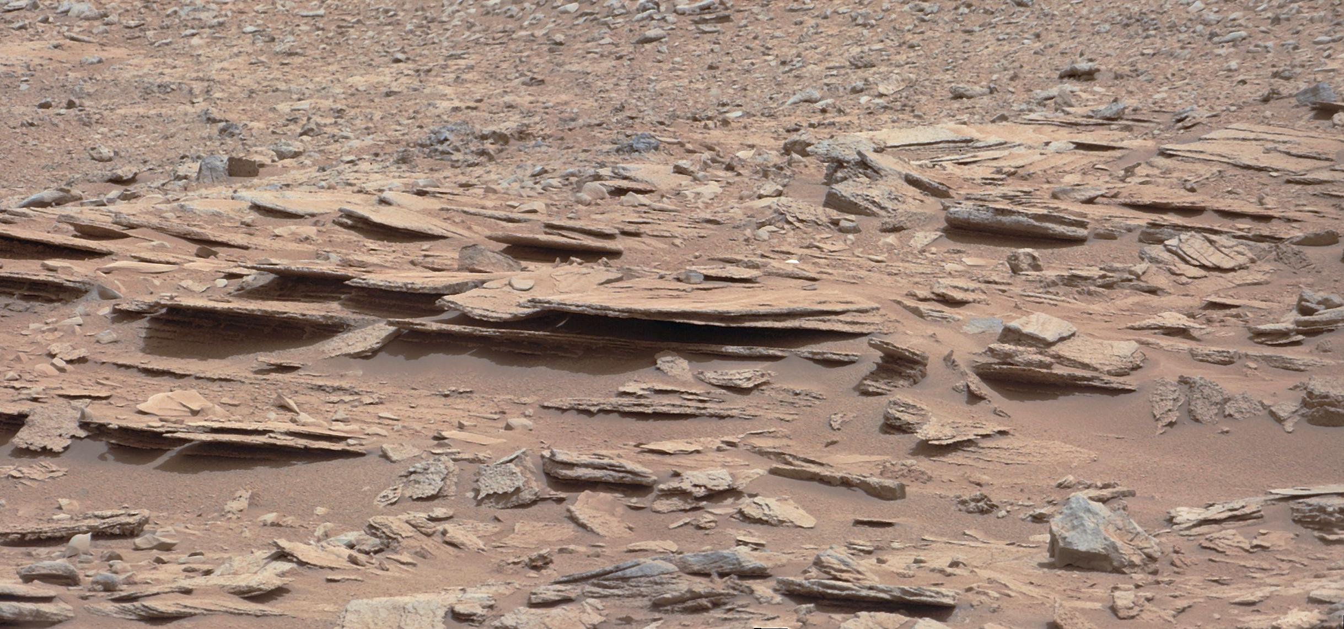
Sedimentary Layers at Yellow Knife Bay
Water in soil

Slide 34
Pebbles – Remnants of an ancient streambed on Mars Curiosity is now on a one year journey to the base of Mount Sharp, about 5 miles away
Maven

Slide 35
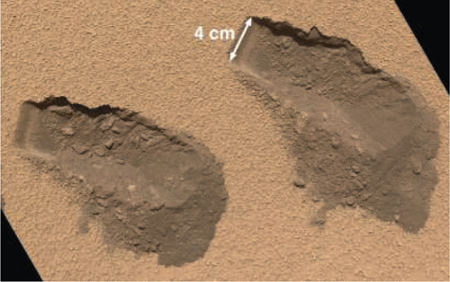
Curiosity used its scoop to collect two samples of a small aeolian deposit.
1 Liter of water per cubic foot of soil detected. Over 4% water.
Methane
Image credit: NASA/JPL-Caltech
Asteroid Belt

Slide 36
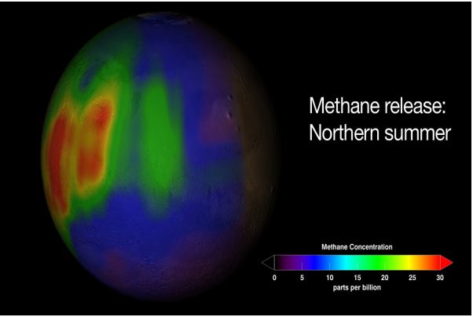
Methane Emissions / Plumes
Jan 19, 2009 - PASADENA, Calif. – A possible source of Methane Plumes is microbial life deep beneath the surface of Mars.
Are the methane concentrations observed evidence that life is currently present on the Red Planet? We do not yet know. But the regions where plumes of methane were detected on Mars now beckon to us, calling us to resolve their mystery. The next time we send out a spacecraft to the Red Planet to search for life, we will know exactly where to look.
Image credit: NASA/JPL-Caltech
Maven

Slide 37
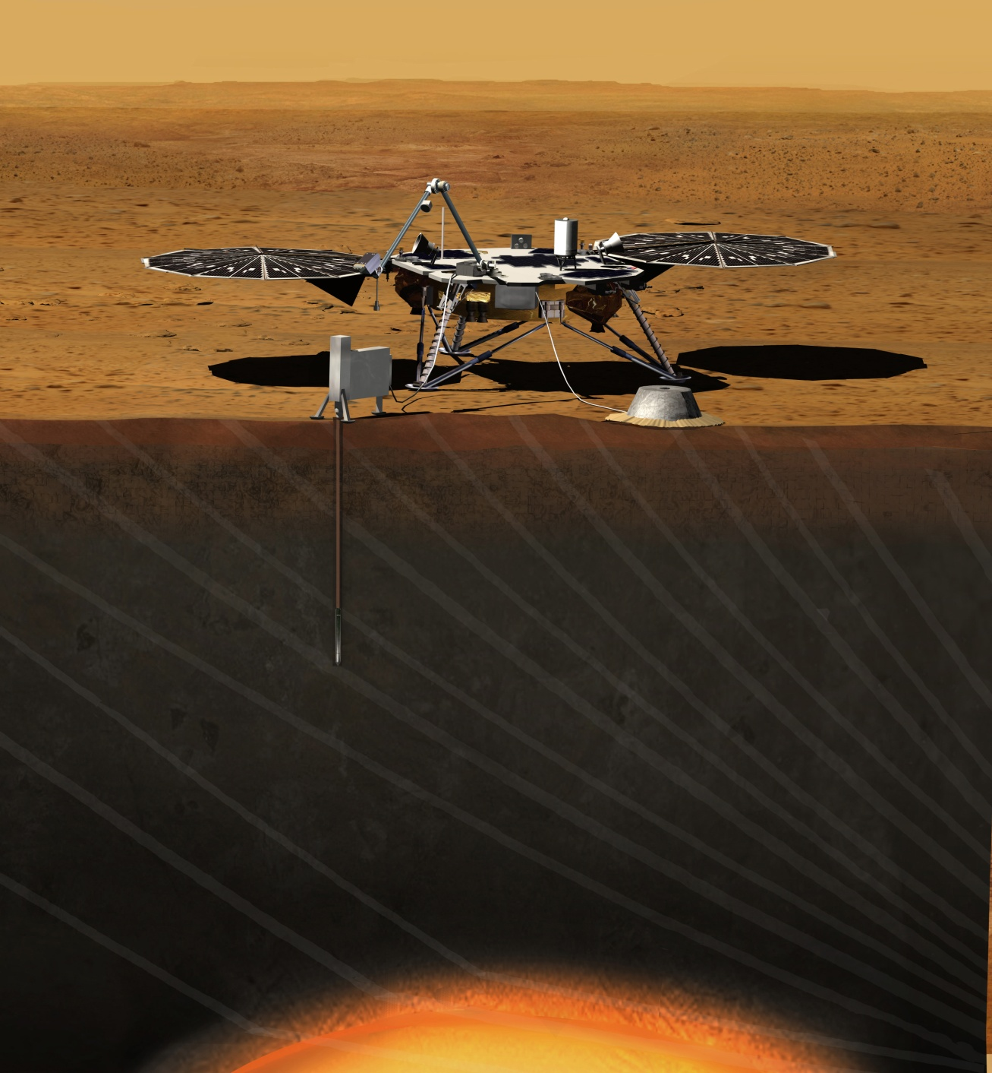
Launch: March, 2016
Landing: Sept 20, 2016
Surface Operations
1 Martian year (720 days)
Seismic Exp. for Interior Structure
Heat Flow & Physical Properties
Curiosity 2.0

Slide 38
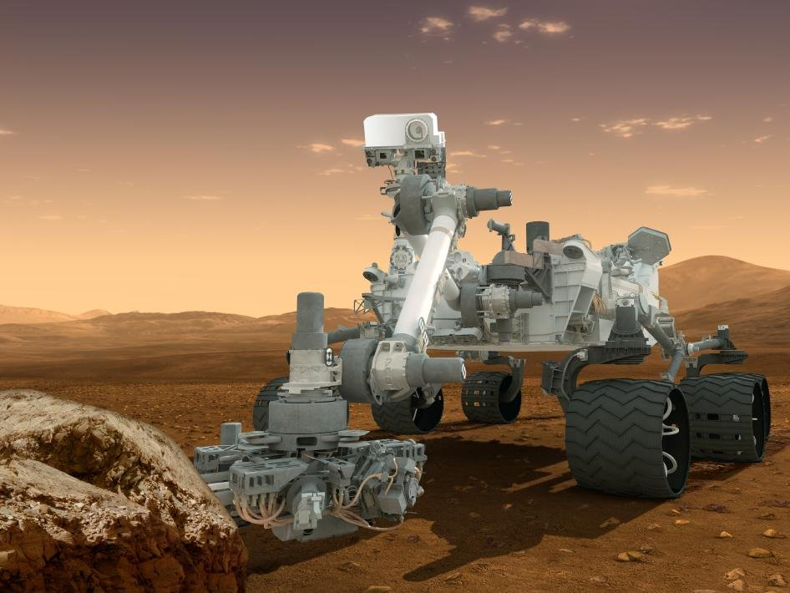
Curiosity 2.0 Launch Date: 2020
Image credit: NASA/JPL-Caltech
Asteroid belt
Ida

