Slide 1

Aerodynamics
Stef Petryszyn

Slide 2
Definition
Aeronautics is the study of the science of flight. Aeronautics is the method of designing an airplane or other flying machine. There are four basic areas that aeronautical engineers must understand in order to be able to design planes. To design a plane, engineers must understand all of these elements.
Aerodynamics – study of how air flows around the airplane
Propulsion - study of how to design an engine that will provide the thrust that is needed for a plane to take off and fly through the air
Materials and Structures - study of what materials are to be used on the plane and in the engine and how those materials make the plane strong enough to fly effectively
Stability and Control - study of how to control the speed, direction, altitude and other conditions that affect how a plane flies

Slide 3
Careers in Aerospace
Scientists
Engineers
Technicians

Slide 4
Scientists
Astronomy
Biology
Chemistry
Computer
Economics
Geology
Materials
Mathematics
Medical Doctor
Meteorology
Nutrition
Oceanography
Psychology
Physics
Physiology
Sociology
Statistics
Systems Analysis

Slide 5
Engineers
Aerospace
Architectural
Astronautics
Biomedical
Chemical
Civil
Computer
Electrical
Environmental
Industrial
Metallurgical
Mechanical
Nuclear
Petroleum
Safety
Systems

Slide 6
Technicians
Aerospace
Aircraft
Avionics
Communications
Electrical
Electronic
Engineering
Fabrication
Materials
Mechanics
Modeling
Pattern Making

Slide 7
Preparing for an Aerospace Career Courses to Take
Algebra
Biology
Calculus
Chemistry
Computer Applications / Programming
English
Fine Arts / Humanities
Foreign Language
Geometry
Physics
Social Studies
Trigonometry

Slide 8
Dynamics of Flight
Newton’s 3 Laws of Motion
“Every object persists in its state of rest or uniform motion in a straight line unless it is compelled to change that state by forces impressed on it.”
  This is normally taken as the definition of inertia
    The key point here is that if there is no net force acting on an object (if all the external forces cancel each other out) then the object will maintain a constant velocity. If that velocity is zero, then the object remains at rest. If an external force is applied, the velocity will change because of the force.
“Force is equal to the change in momentum (mass times velocity) per change in time. For a constant mass, force equals mass times acceleration F=m * a
  Explains how the velocity of an object changes when it is subjected to an external force. The law defines a force to be equal to change in momentum (mass times velocity) per change in time. For an object with a constant mass m, the second law states that the force F is the product of an object's mass and its acceleration
“For every action, there is an equal and opposite re-action”
  if object A exerts a force on object B, then object B also exerts an equal force on object A. Notice that the forces are exerted on different objects. The third law can be used to explain the generation of lift by a wing and the production of thrust by a jet engine.

Slide 9
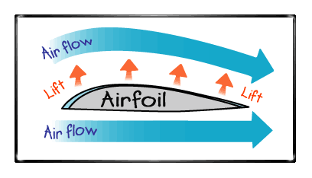
How Wings Lift the Plane
Airplane wings are shaped to make air move faster over the top of the wing. When air moves faster, the pressure of the air decreases. So the pressure on the top of the wing is less than the pressure on the bottom of the wing. The difference in pressure creates a force on the wing that lifts the wing up into the air.

Slide 10
Laws of Motion
1. If an object is not moving, it will not start moving by itself. If an object is moving, it will not stop or change direction unless something pushes it.
2. Objects will move farther and faster when they are pushed harder.
3. When an object is pushed in one direction, there is always a resistance of the same size in the opposite direction.

Slide 11
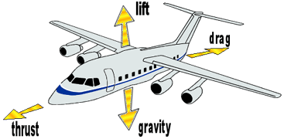
Four Forces of Flight
Lift – upward
Drag – backward
Weight – downward
Thrust - forward

Slide 12
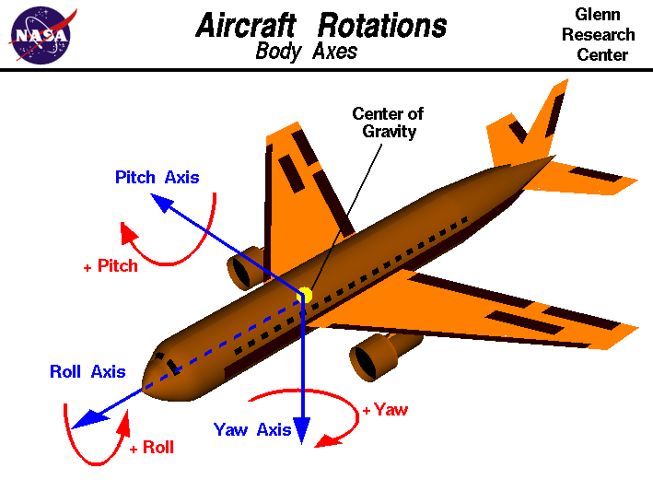
Three Moments
Pitch
Roll
Yaw

Slide 13
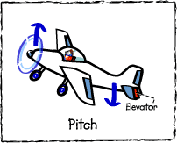
Flight Controls
Elevators
  The elevators which are on the tail section are used to control the pitch of the plane. A pilot uses a control to raise and lower the elevators, by moving it forward to back ward. Lowering the elevators makes the plane nose go down and allows the plane to go down. By raising the elevators the pilot can make the plane go up.

Slide 14
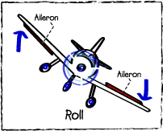
Flight Controls
Ailerons
  The ailerons raise and lower the wings. The pilot controls the roll of the plane by raising one aileron or the other with a control. Turning the control clockwise raises the right aileron and lowers the left aileron, which rolls the aircraft to the right.

Slide 15
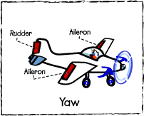
Flight Controls
Rudders
  The rudder works to control the yaw of the plane. The pilot moves rudder left and right, with left and right pedals. Pressing the right rudder pedal moves the rudder to the right. This yaws the aircraft to the right. Used together, the rudder and the ailerons are used to turn the plane.

Slide 16
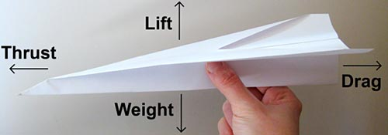
Paper Airplane

Slide 17
Basic Dart

Slide 18
Basic Dart

Slide 19
Basic Dart

Slide 20
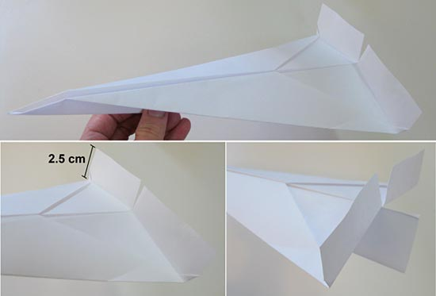
Procedure
Once you have flown plane 1 five times, change the plane to increase its drag. a.Look at the back of the plane, where the wings meet the ridge in the middle.
b.Using scissors, cut slits that are 2.5 cm long right where either wing meets the middle ridge.
c.Fold up the 2.5 cm cut section on both wings so that these sections are at about a 90 degree angle from the rest of the wing, as shown below.
Aerodynamics project: : Image of a paper plane with flaps up to increase drag.

