Slide 1
Flight Path: Exploring a Career in Aerospace Engineering
Sheldon Clark
Raytheon

Slide 2
Agenda
Today’s Activities:
Overview of Aerospace Engineering
What is a satellite?
Introduction to our mission
Satellite Subsystem overview
Final design preparation
Pre-launch checklist
Payload Launch!

Slide 3
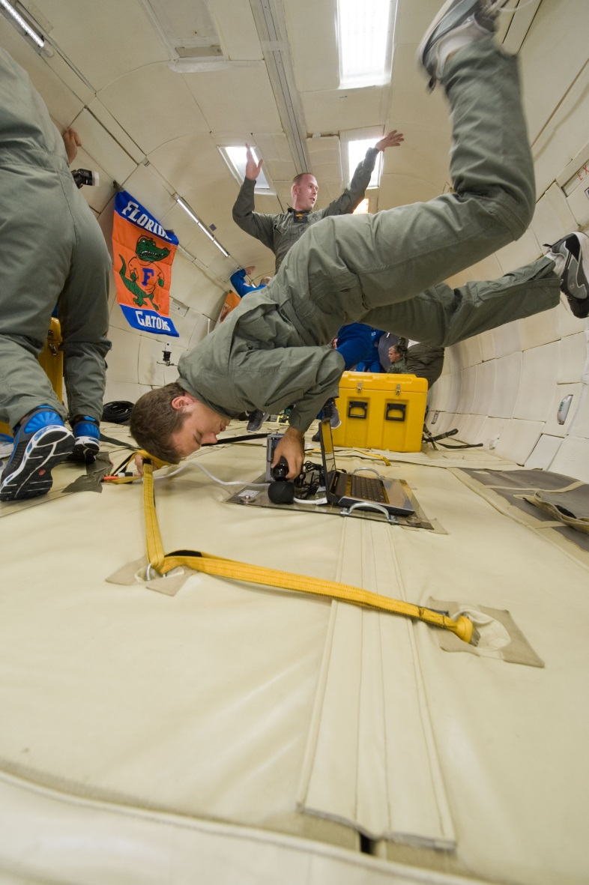
Introduction
Presenter – Sheldon Clark
Systems Engineer for Raytheon
Grew up in central Florida
B.S. and M.S. Aerospace Engineering from University of Florida
Previous work at NASA and Raytheon Missile Systems

Slide 4
What is Engineering?
Who and what are engineers? What do they do?
Engineers are problem solvers
We think creatively to find solutions
New, better, more efficient, quicker, and less expensive
Engineers are translators
We speak the language of math, science, and physics and translate into concepts of the world around us
We bridge the gap between theory and reality
Engineers come from all walks of life
Male, female, from all cultures and all nationalities

Slide 5
What is Engineering?
Engineers are team players
Engineers are most successful when their teams are successful
Can adapt to new problems, situations, and environments
Engineers help shape the future
New products and new technologies
Engineers are everywhere
Almost everyone can relate to breaking down and solving problems

Slide 6
Dive Deeper – What is Aerospace Engineering?
Space vs Planes – Which is it?
Modern term of aerospace engineer is a combination of the traditional Aeronautics and Astronautics disciplines
With obvious differences, both have their similarities
Both share the same origins
Both are heavily dependent on math and science
Both are rooted in the same culture and industry
Both serve a vast majority of the population in some way

Slide 7
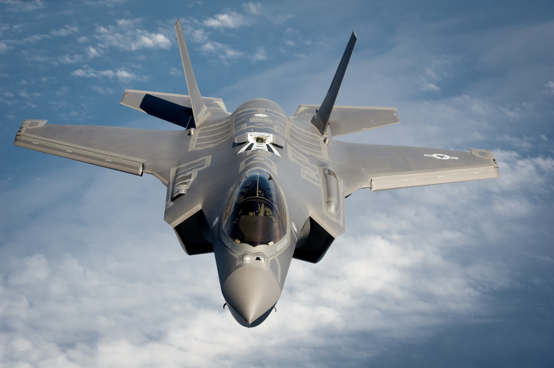
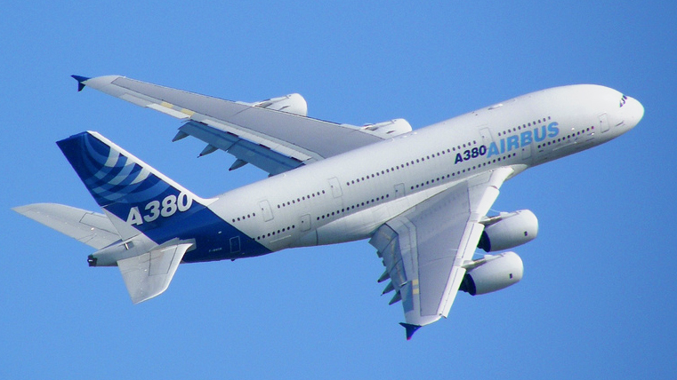
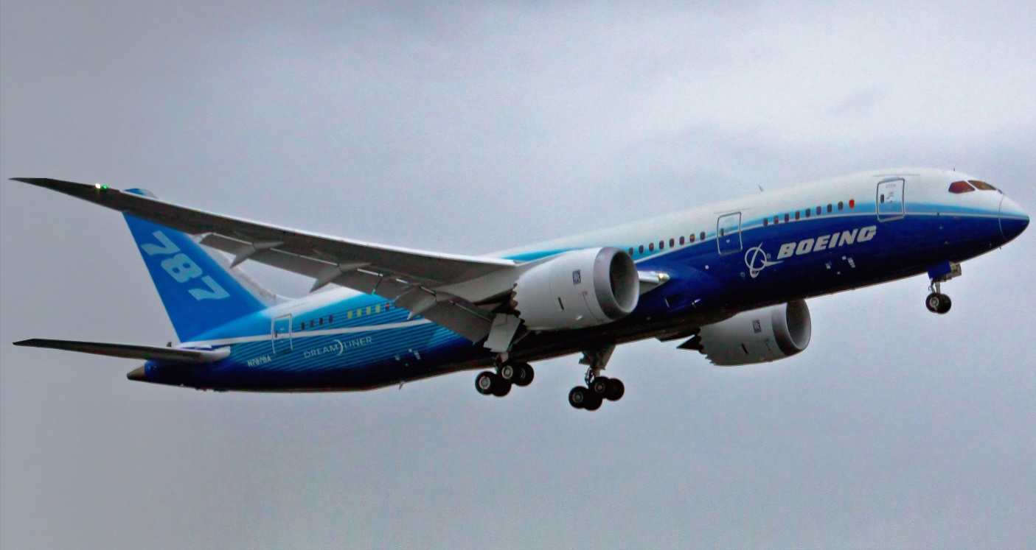
Aeronautics
Typically focuses on air breathing vehicles
Propeller vs jet aircraft
Commercial vs. Military aircraft
Includes most anything that flies
Planes, balloons, missiles, etc
Major projects:
F35 Joint Strike Fighter
NextGen Commercial Aircraft
Boeing 787 and Airbus A380

Slide 8
Aeronautics
What might an Aeronautical Engineer do?
Apply principles of science and technology to create aircraft, components and support equipment
Using computer-aided design (CAD) software to create designs and plans
Participating in flight test programs to measure take-off distances, rate of climb, stall speeds, maneuverability and landing capacities
maintaining aircraft for full operation including making regular inspections, maintenance and servicing
investigating aircraft accidents

Slide 9
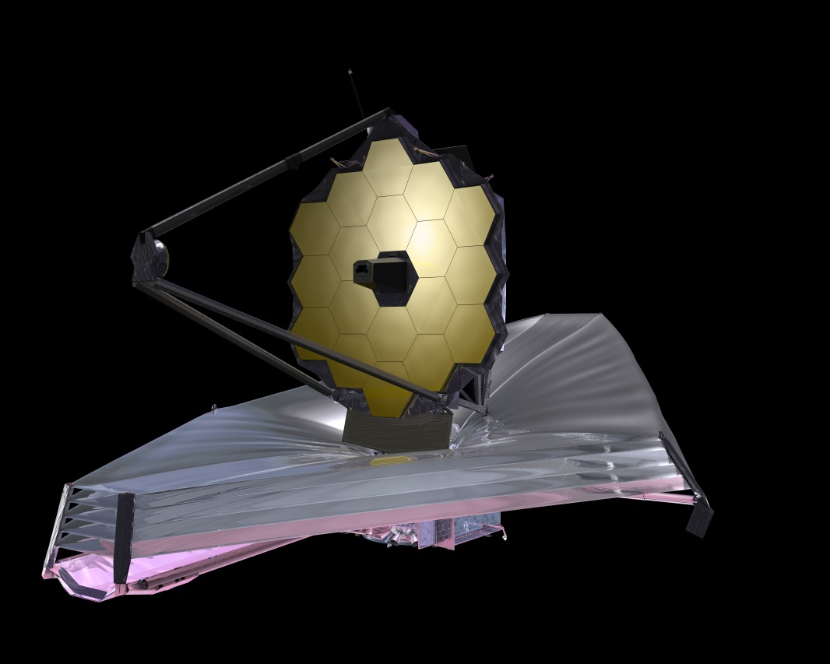
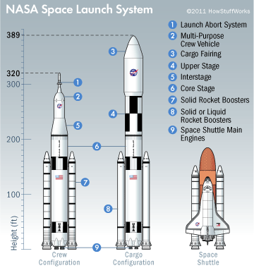
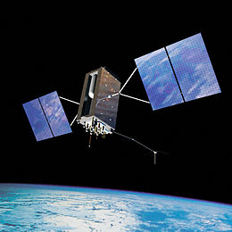
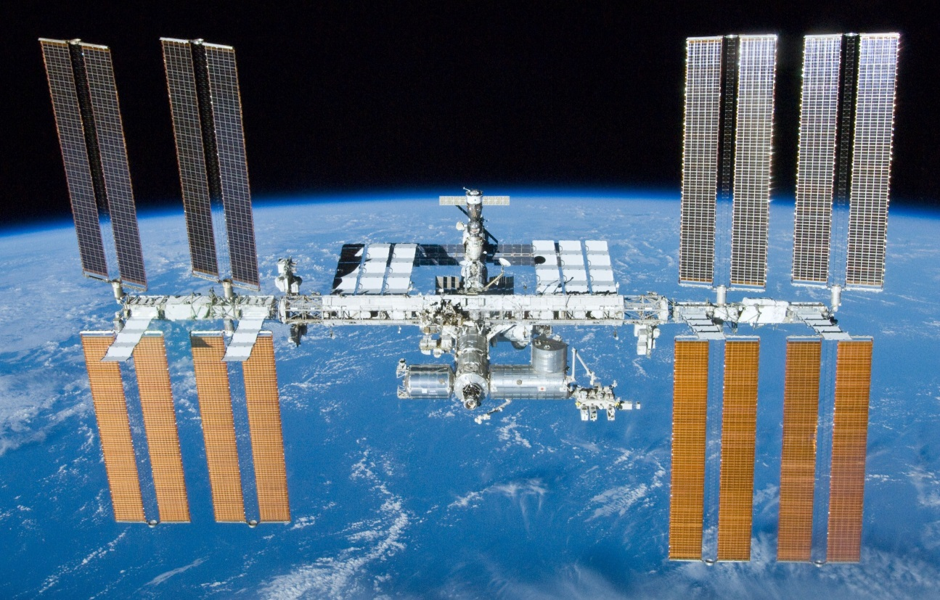
Astronautics
Typically focuses on vehicles operating out of Earth’s atmosphere
Manned vs. Unmanned
Commercial vs. Government vs. Military
Major projects:
Space Station
GPS-III
James Webb Telescope
Space Launch System

Slide 10
Multidisciplinary field
Aerospace engineering is a conglomerate of a huge number of studies and disciplines:
Fluid dynamics
Thermodynamics
Astronomy
Orbital and Celestial mechanics
Aerodynamics
Electrical engineering
Computer hardware engineering
Computer software engineering
Computer sciences
Manufacturing sciences
Robotics
Propulsion
Material Science
Nuclear physics and engineering
Systems engineering
Sales engineering
Structural sciences
Mechanical engineering

Slide 11
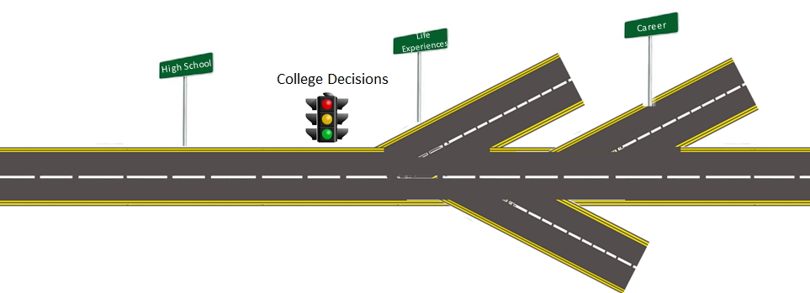
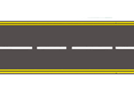
Aerospace Engineering Road Map
HS to College to Career
What can you do while still in High School?
How do you take full advantage of post-high school opportunities?

Slide 12
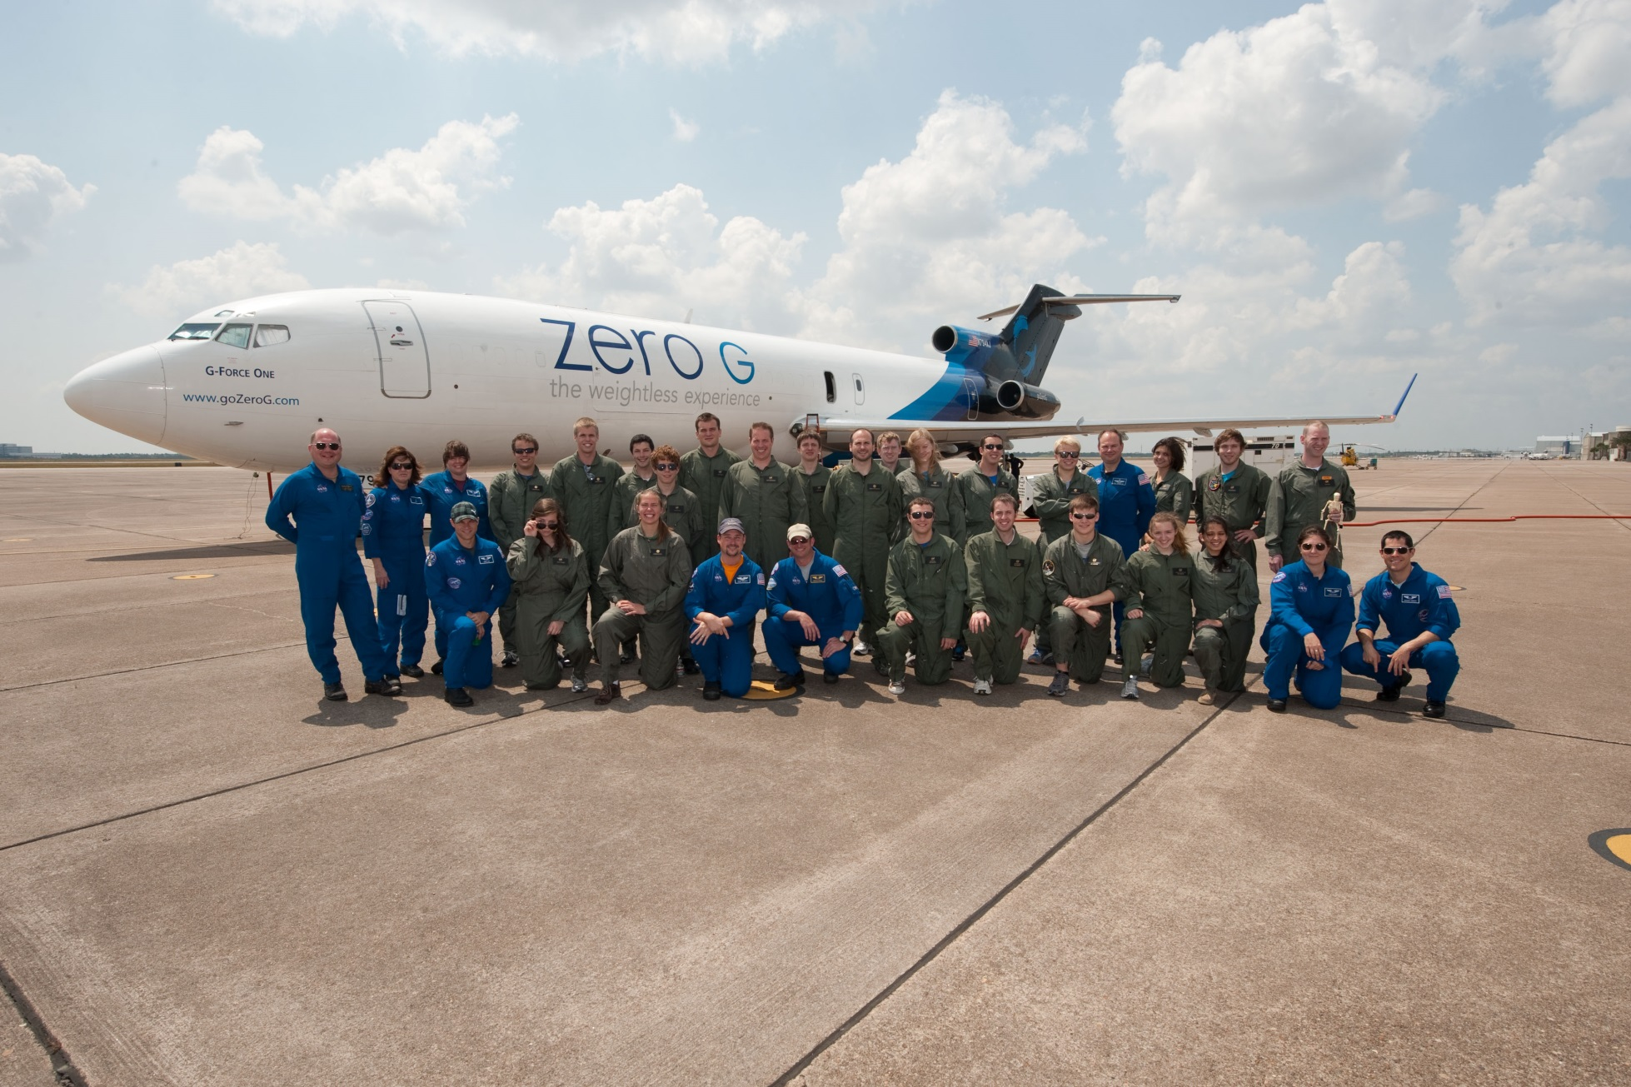
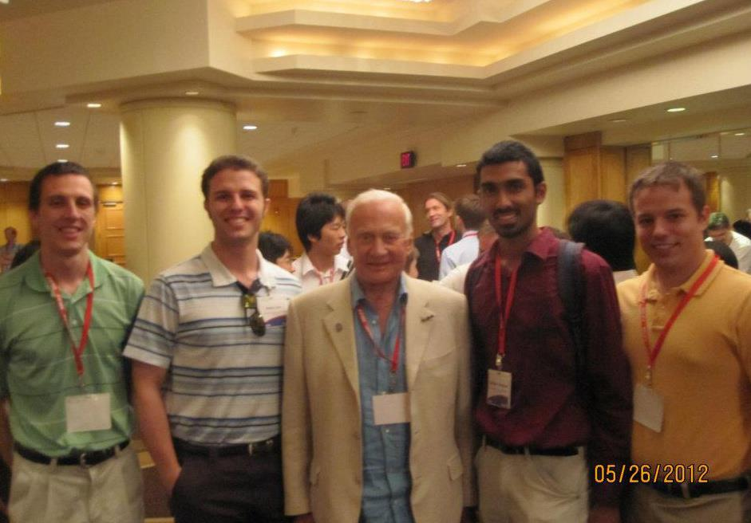
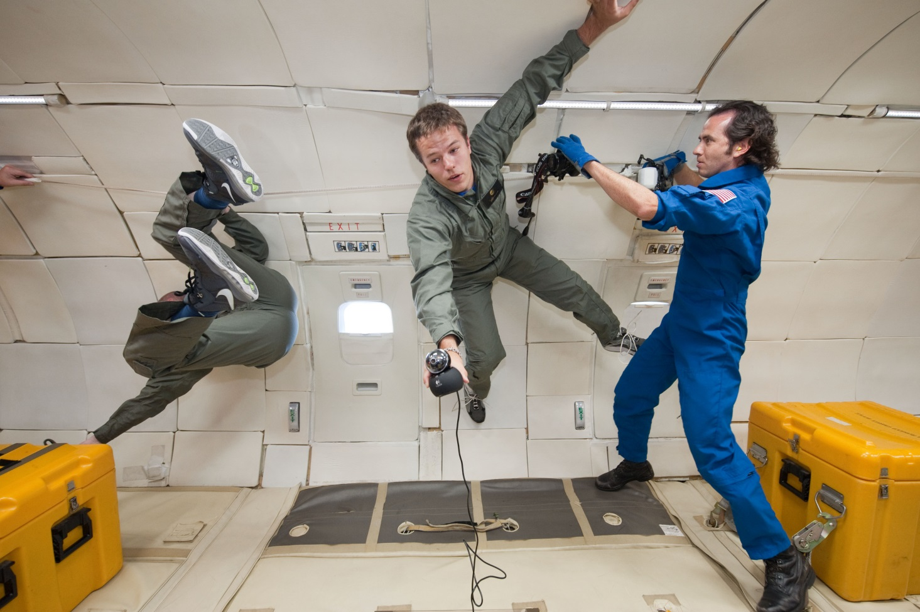
My Personal Road Map

Slide 13
Road Map – High School
Keep up your grades
Build strong study habits and academic discipline
Take as many math and sciences courses as possible!
Apply to college
Apply to multiple institutions and apply early!
Remain as active as possible
Get heavily involved in a wide variety of extra curriculars
Seek out leadership positions. Be more than just a “member”
Write a resume
One of the more important documents you’ll need over the next several years
Seek out differentiating experiences
High School Internships, space camps, precollegiate camps

Slide 14
Road Map - College
Build a strong academic profile
Grades are still the most important ! (but not the only) aspect of your college career
Find an opportunity to take a leadership role
Learn and practice your personal leadership style
The earlier the better – it’s never too soon!
Seek out diversity - broaden your horizons
Build yourself into a well rounded individual
Engineering is a global profession, so be ready to interact and communicate with many different cultures and personalities
Find a design team or project and get hands-on
Future employers like to see initiative and practical engineering skills

Slide 15
Road Map - College
Actively search out professional experience early
Professional experiences are available, even for freshman
Internships, lab assistant, research assistant all great choices
Join professional societies
Offer great support and opportunities to learn and get involved
Study abroad
Don’t listen to rumor – Yes there are opportunities for engineers to study abroad, and yes, it is worth it!
Never stop seeking opportunities
Experiences are one of the best

Slide 16
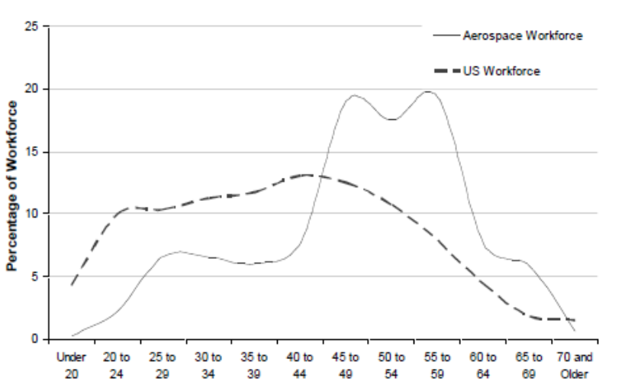
The Boomer Bubble
Career

Slide 17
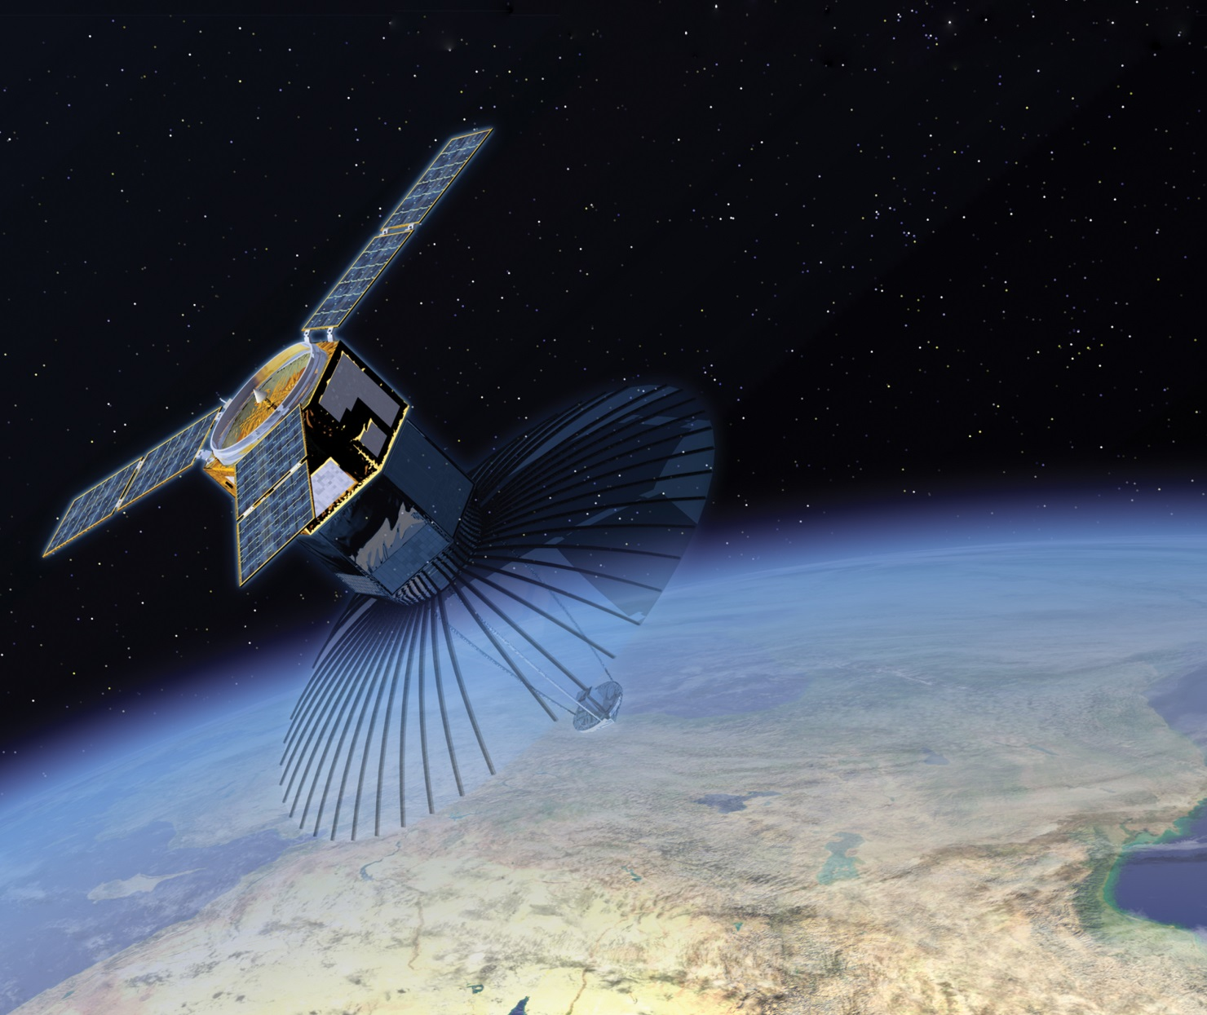
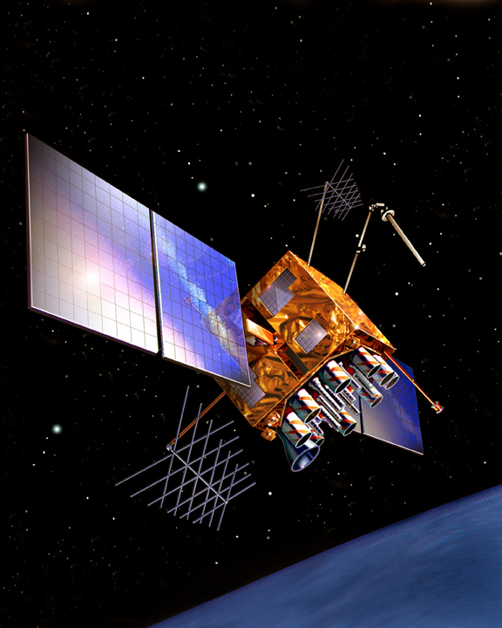
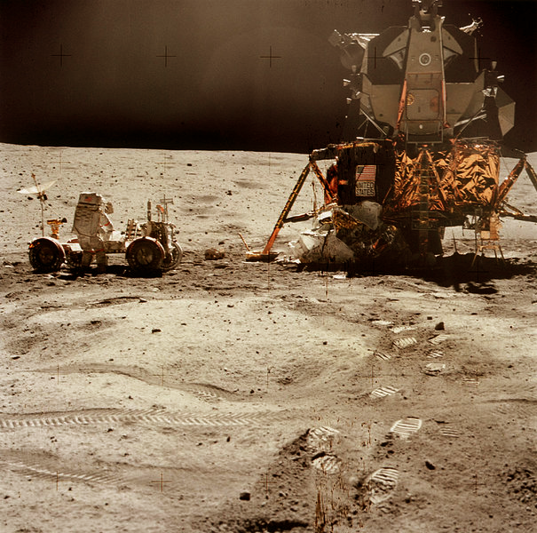
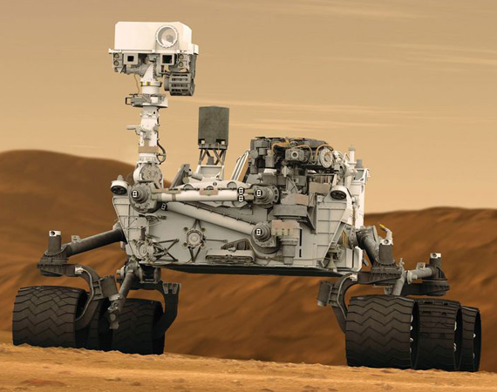
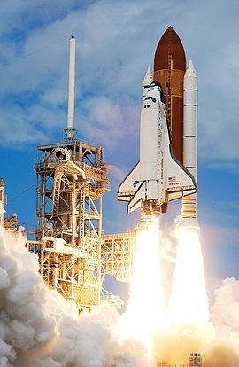
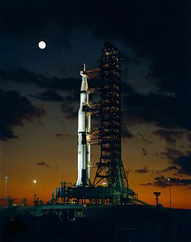
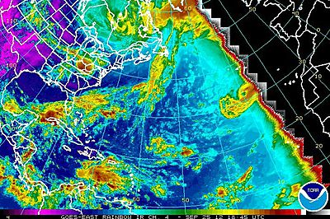
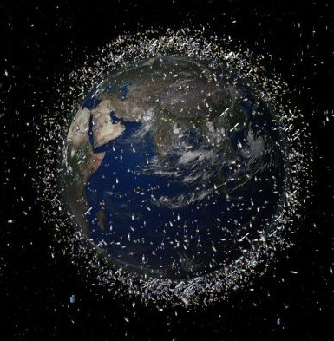
Why space?
Exploration
Technology advancement
Weather monitoring
Defense

Slide 18
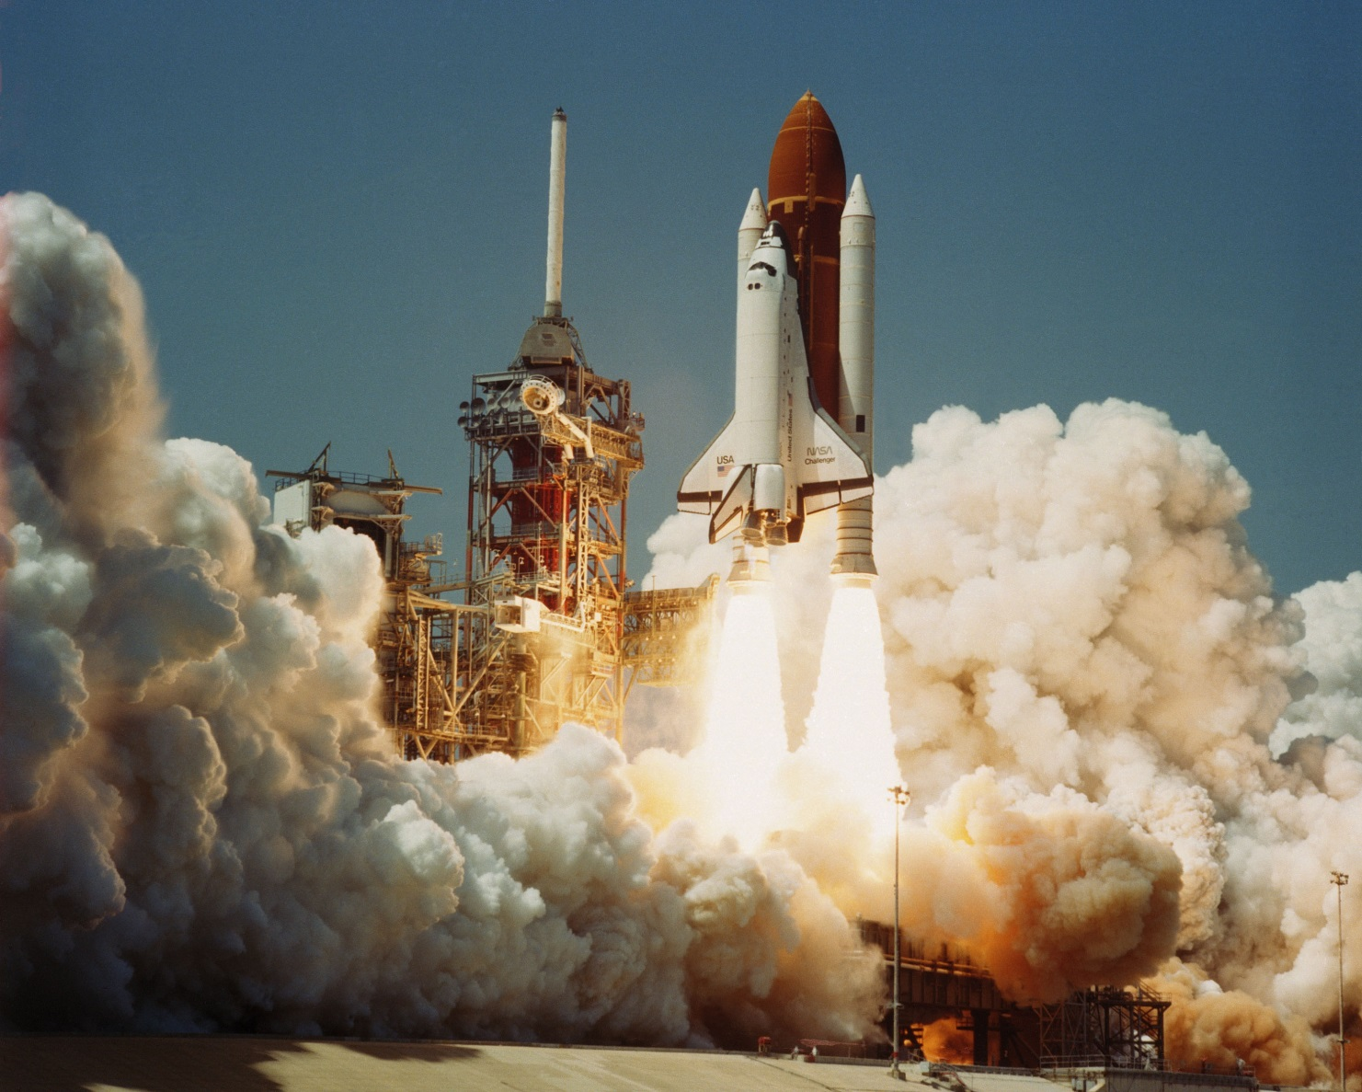
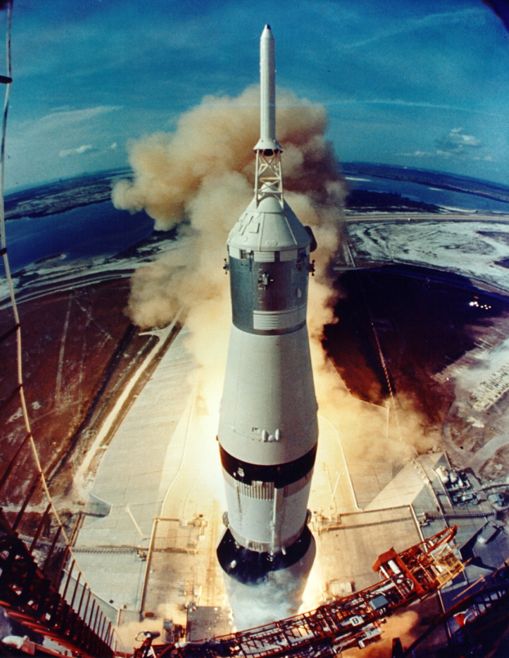
Where have we been?

Slide 19
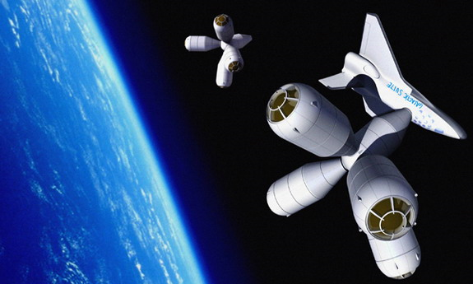
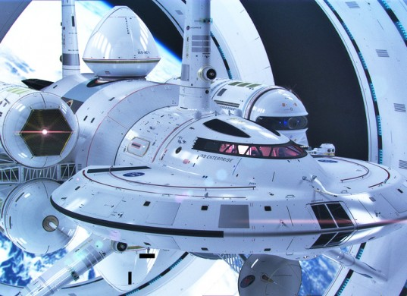
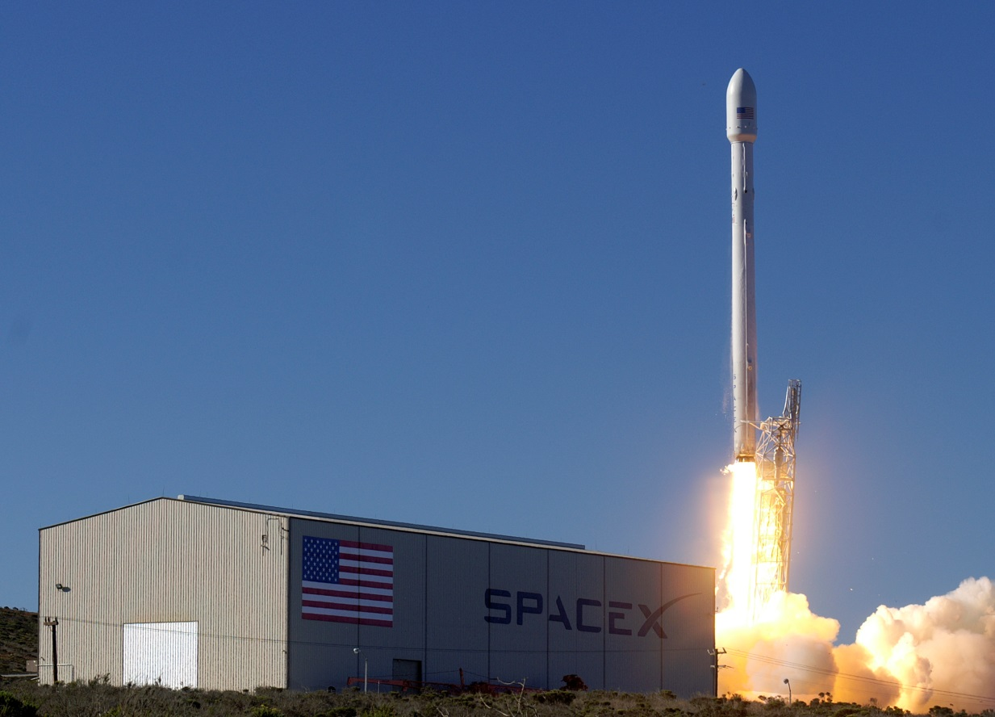
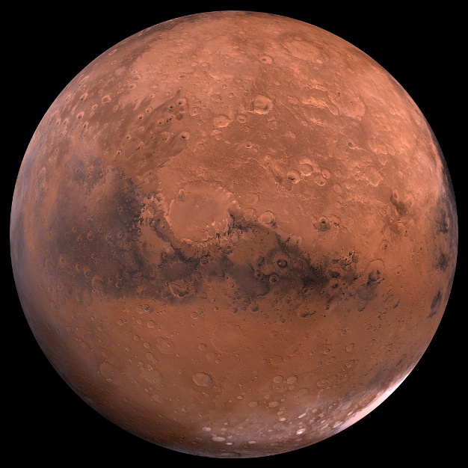
Where are we going?

Slide 20
Where are we going?
Space is Expanding
Privatization of many areas of the space network
Planned missions to Moon, Mars, and Asteroids
Replacing and improving older generations of satellites
Commercialization and expansion of space tourism
Miniaturization of satellite technology

Slide 21
Introduction to Satellites
Introduction
Satellite System
Engineering Procedure
Cases Study

Slide 22
Introduction to Satellites
MISSION AND PAYLOAD
Space mission: the purpose of placing in equipment (payload) and/or personnel to carry out activities that cannot be performed on earth
Payload: design of the equipment is strongly influenced by the specific mission, anticipated lifetime, launch vehicle selected, and the environments of launch and space.

Slide 23
What do Satellites do?
Possible missions
Communications
Earth Resources
Weather
Navigation
Astronomy
Space Physics
Space Stations
Military
Technology Proving

Slide 24
How does it all fit together?
Ground Segment
Space Segment
Payload
Bus
Command
Mission
Management
Structure
Attitude Determination
And Control
Thermal
Propulsion
Power
Command and
Telemetry
Data Handling

Slide 25
Satellite System
A satellite system is composed of the spacecraft (bus) and payload(s)
A spacecraft consists of the following subsystems
Propulsion and Launch Systems
Attitude Determination and Control
Power Systems
Thermal Systems
Configuration and Structure Systems
Communications
Command and Telemetry
Data Handling and Processing

Slide 26
SATELLITE SYSTEM (cont’d)
Propulsion and Launch Systems
Launch vehicle: used to put a spacecraft into space.
Once the weight and volume of the spacecraft have been estimated, a launch vehicle can be selected from a variety of the manufacturers.
If it is necessary to deviate from the trajectory provided by the launch vehicle or correct for the errors in the initial condition, additional force generation or propulsion is necessary
On-board propulsion systems generally require a means to determine the position and attitude of the spacecraft so that the required trust vectors can be precisely determined and applied.

Slide 27
SATELLITE SYSTEM
Attitude Determination and Control System (ADCS)
ADCS are required to point the spacecraft or a component, such as solar array, antenna, propulsion thrust axis, and instrument sensor, in a specific direction.
Attitude determination can be accomplished by determining the orientation w.r.t. the star, earth, inertial space, geomagnetic field and the sun.
Attitude control can be either passive or active or combination.

Slide 28
SATELLITE SYSTEM
Power Systems
Spacecraft power can be obtained from the sun through solar cell arrays and thermal electrical generators and from on-board devices such as chemical batteries, fuel cell, and nuclear theem-electronic and therm-ionic converters.
Most satellites use a combination of solar cell array and chemical batteries.

Slide 29
SATELLITE SYSTEM
Thermal Control Systems
The function of the thermal control system is to maintain temperatures to within specified limit throughout the mission to allow the onboard systems to function properly and have a long life
Thermal balance can be controlled by using heaters, passive or active radiators, and thermal blankets of various emissivities on the exterior.

Slide 30
SATELLITE SYSTEM
Configuration and Structure Systems
The configuration of a spacecraft is constrained by the payload capability and the shape of the fairing of expendable launch vehicle.
Large structures, such as solar arrays and antenna are erected in the space through deployable components.
Explosive devices, activated by timing devices or command, are used to separate the spacecraft from the launch vehicles, release and deploy mechanisms, and cut cables.

Slide 31
SATELLITE SYSTEM
Command and Telemetry
The Command and Telemetry system provide information to and from the S/C respectively.
Commands are used to provide information to change the state of the subsystems of the S/C and to se the clock.
The Telemetry subsystem collects and processes a variety of data and modulates the signal to be transmitted from the S/C.

Slide 32
SATELLITE SYSTEM
Data Handling and Processing
Data processing is important to help control and reconfigure the spacecraft to optimize the overall system performance and to process data for transmission.
Consists of processor(s), RAM, ROM, Data Storage, and implemented by machine, assembly or high level language.
Low mass, volume, and power requirements, insensitivity to radiation, and exceptional reliability are important characteristics of processor.

Slide 33
SATELLITE SYSTEM
Communications
Radio frequency communication is used to transmit information between the S/C and terrestrial sites and perhaps other S/Cs.
Information transmitted from the S/C include the state and health of the subsystems in addition to data from the primary instruments.
Information transmitted to the S/C generally consists of data to be stored by on-board processors and commands to change the state of the on-board system either in real-time or through electronic logic that execute them as a function of time or as required.

Slide 34
Engineering Procedures
Space Systems Engineering
System Definition
System, Subsystem, Components, and Parts
A large collection of subsystems is called a segment.
In a space mission, the spacecraft, the launch vehicle, the tracking stations, the mission control center, etc., may each be considered a system or segment by their principle developers but are subsystems of the overall system.
Value of a System
System’s ability to satisfy criteria generally called system level requirements or standards for judgment.

Slide 35
Engineering Procedures
Engineering a Satellite
Mission Needs
Conceptualization and system requirements
Planning and Marketing
Research and Technology Development
Engineering and Design
Fabrication and Assembly
Integration and Test
Deployment, operation and phase-out

Slide 36
Engineering Procedures (Cont’d)
Mission Needs
Conceptualization and
system requirements
Planning and Marketing
Research and Tech. Development
Engineering and Design
Fabrication and Assembly
Integration and Test
Development, Operation
And Phase-out

Slide 37
What is a CanSat?
Why do we build cansats?
What can they do?
How are we going to build one?

Slide 38
Hands on Overview
What is Arduino?
What is the subsystems?
How do we emulate them?
How do we launch?

Slide 39
Mission
Your Mission
NASA is building the next generation manned rocket and is looking to update their Pressure and Temperature models for the upper atmosphere. They contract you to develop, build, and launch a cost effective payload to take accurate measurements of the upper atmosphere.

Slide 40
CanSat - Comms
Intro to comms systems
Comms on Cansats
Why are they important?
Completing a link budget
What is our comm system?
Roadmap
Disciplines

Slide 41
CanSat – C&DH
What is a C&DH?
What is Arduino?
Intro to coding
Walk through a program section by section
Determine some fill in the blank items that explains code/logic
Disciplines
Road Map

Slide 42
Launch Services
What is a launch service?
What does it mean to enter “operatons”?
What is the role of the GS?
Intro to balloons and high alt launches

Slide 43
Launching the Balloon/Payload
Intro to lift/buoyance
Trajectory
Recovery
Getting Data

Slide 44
Conclusions/Review
What to emphasize?
Closing remarks?
What is the takeaway?

