Slide 1
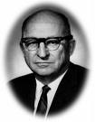
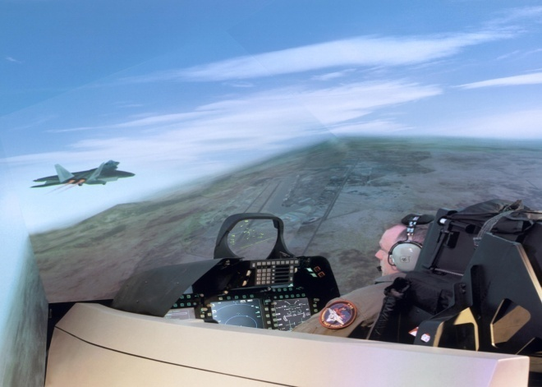
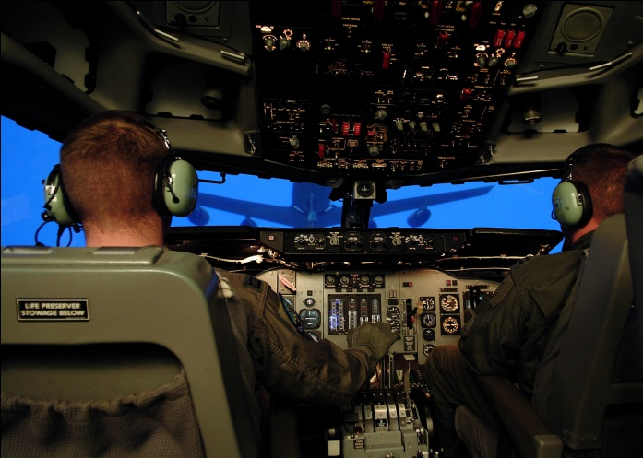
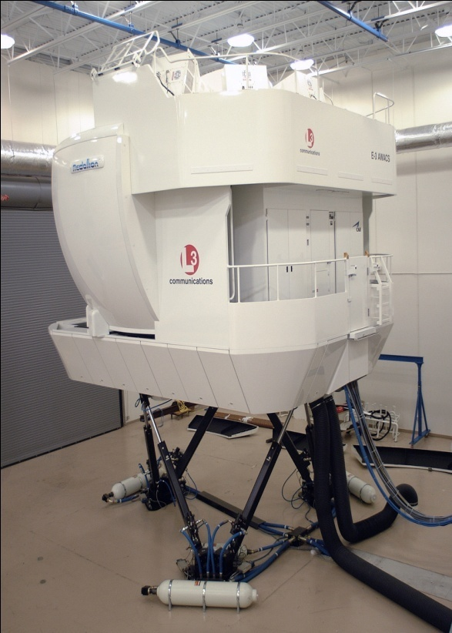
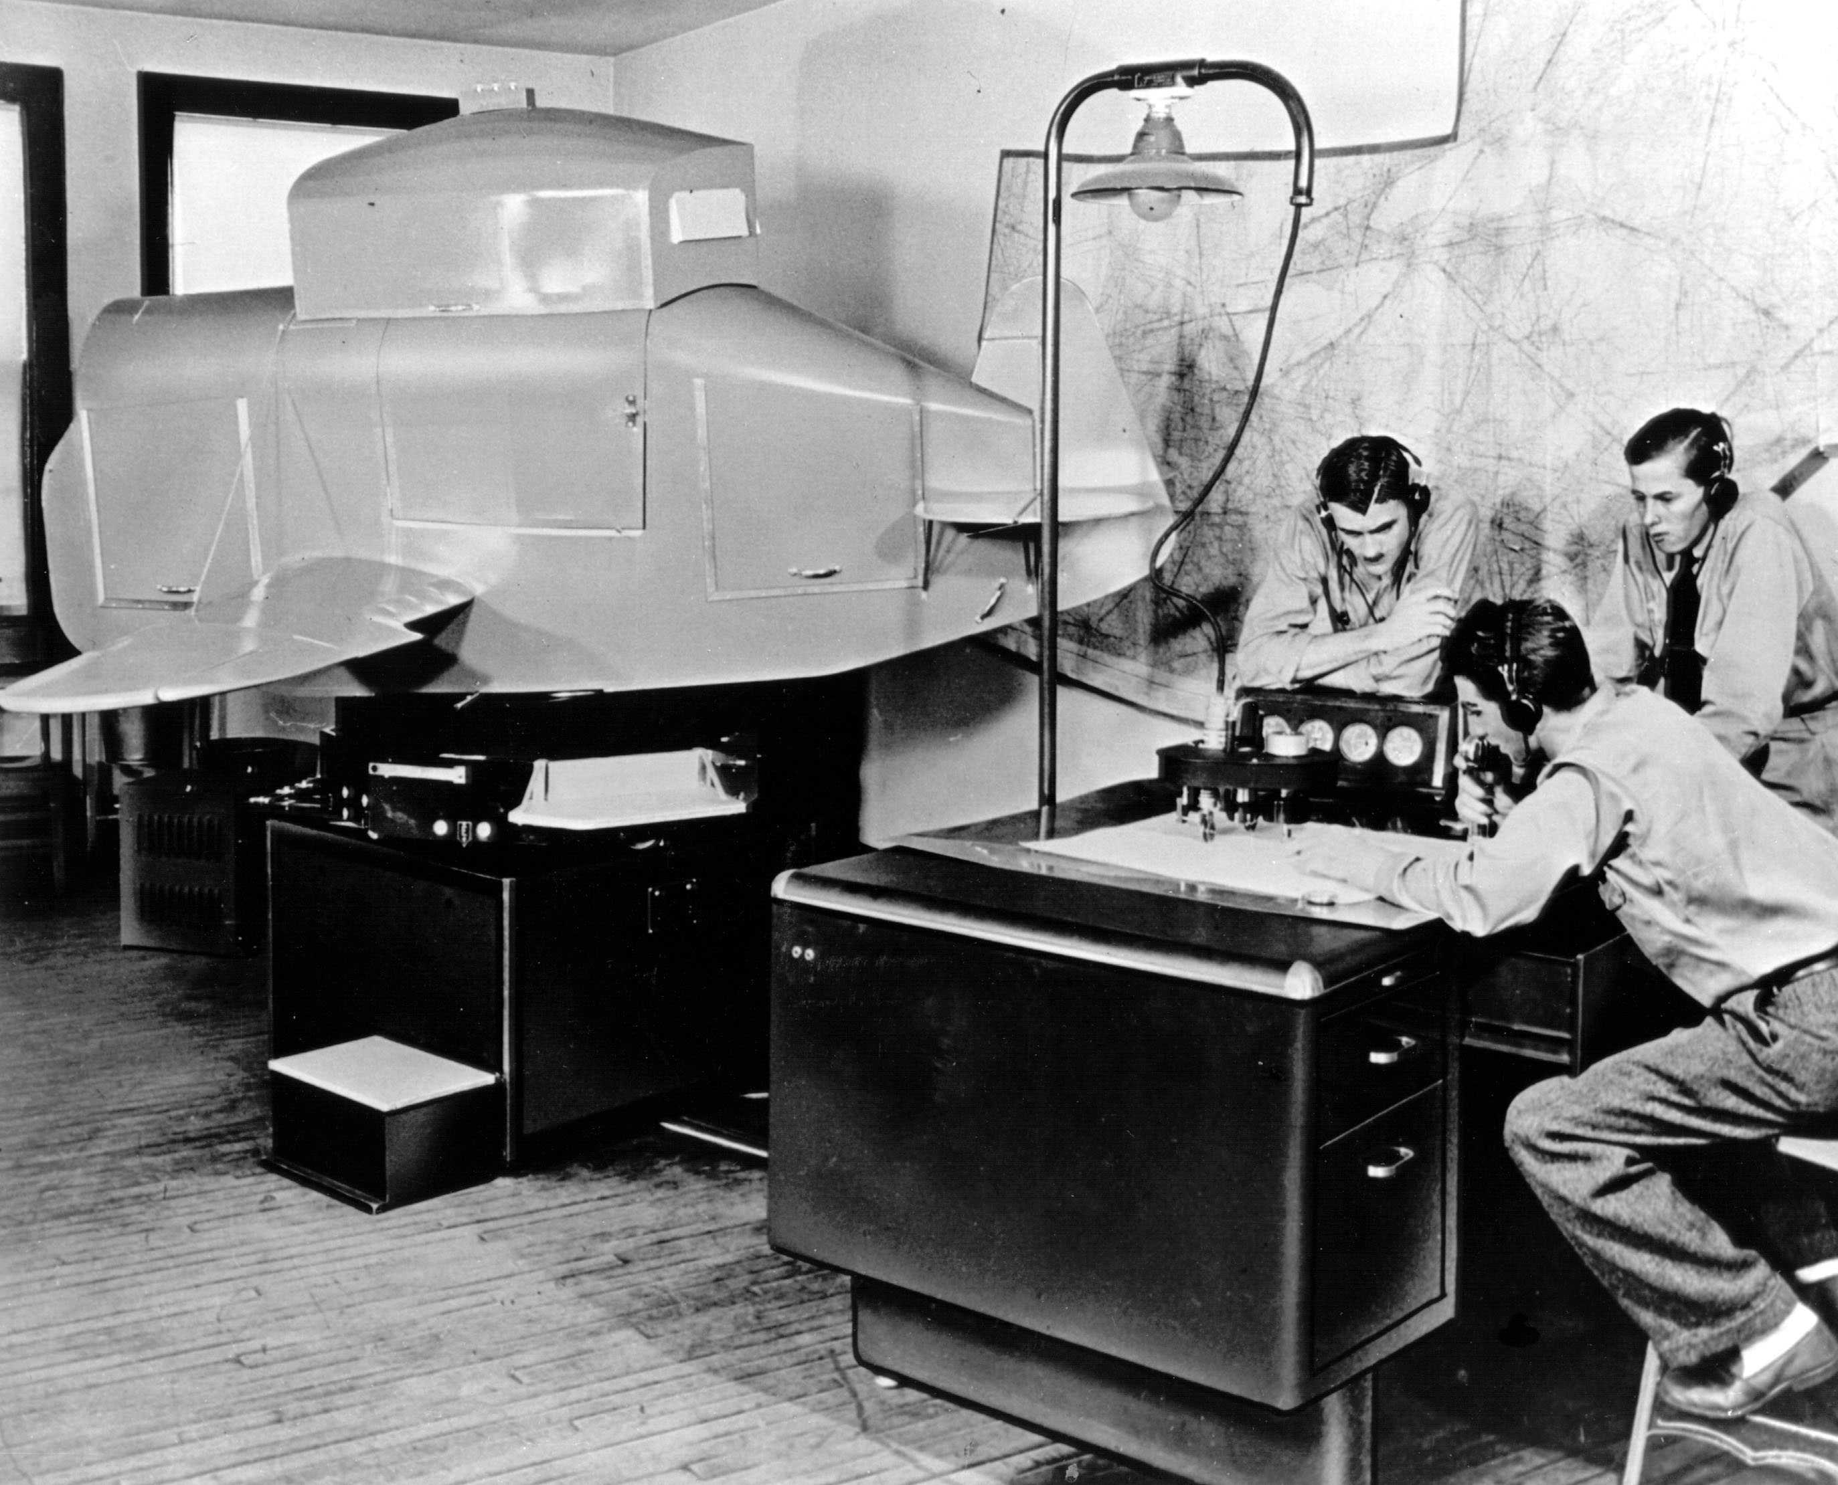
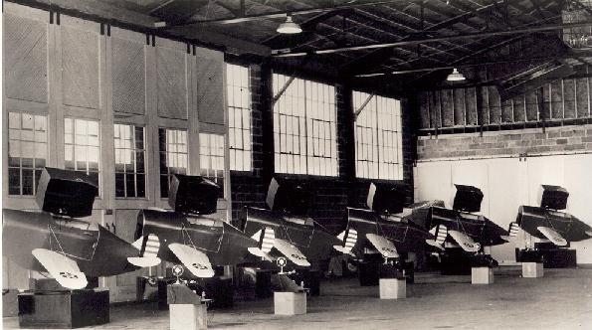
Flight Simulators (the ultimate video game)
Ed Link, Inventor
Stef Petryszyn

Slide 2
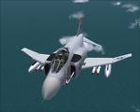
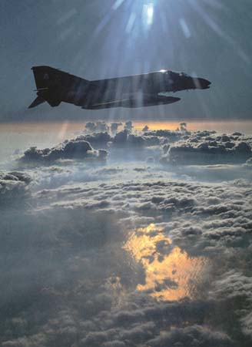

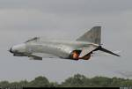
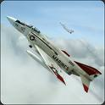
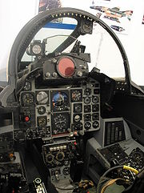

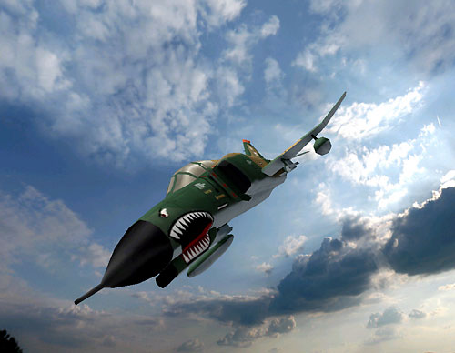
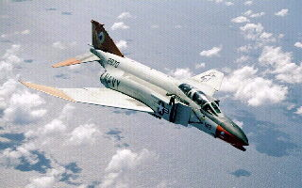
F-4 Phantom
McDonnell Douglas
Air Force / Navy / Multiple Countries
All weather fighter/bomber
2 engine
Crew: 2
Top Speed Mach 2.23
R/C 41, 300 ft/min

Slide 3
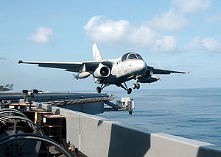
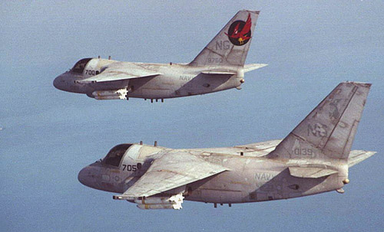
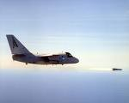

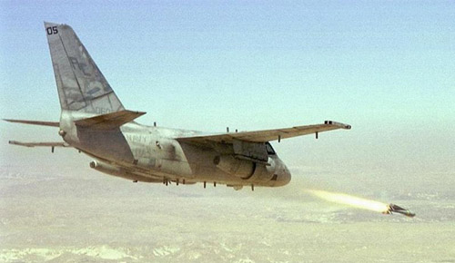
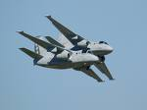
S-3A Viking
Lockheed
Navy
Ant-Submarine
2 engine
Crew: 4
Top Speed Mach .79
R/C 5, 120 ft/min

Slide 4
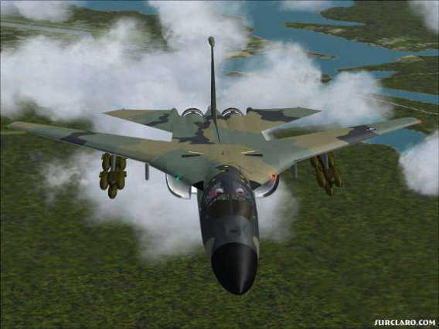

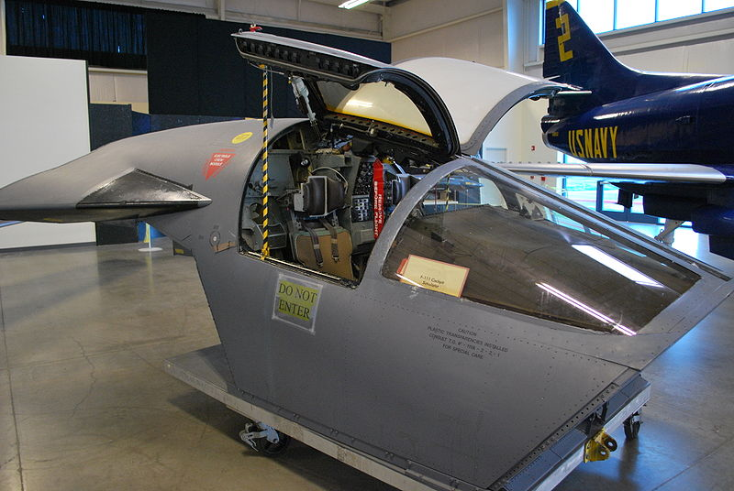


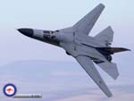
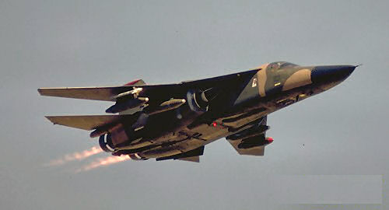
F-111 Aardvark
General Dynamics
Air Force
Variable Sweep fighter/bomber
2 engine
Crew: 2
Top Speed Mach 2.5
R/C 25, 890 ft/min

Slide 5
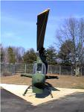
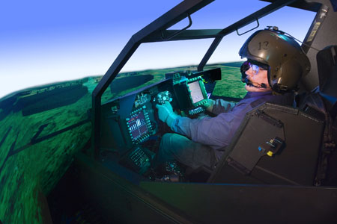
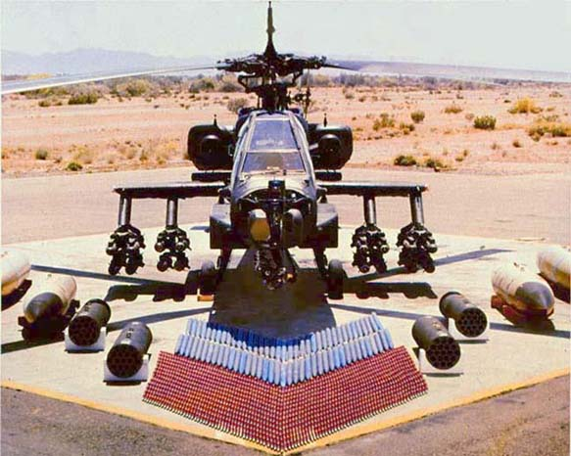

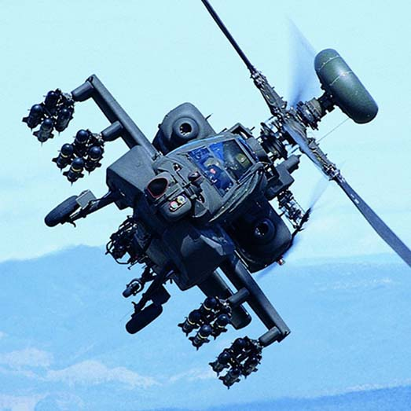
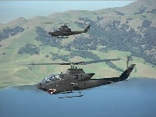
AH1 Huey Cobra/ AH64 Apache
Bell Helicopter Hughes
Army
Attack Helicopter
2 engines
Crew: 2
Cobra – Bell Helicopter
Apache - Hughes

Slide 6

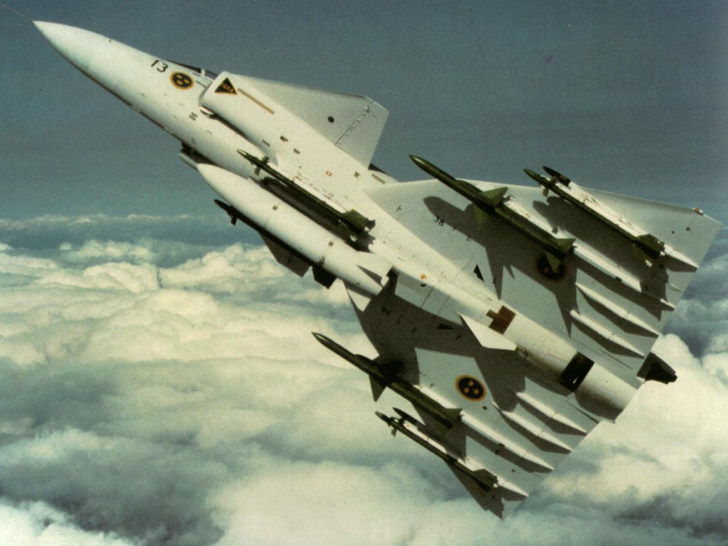

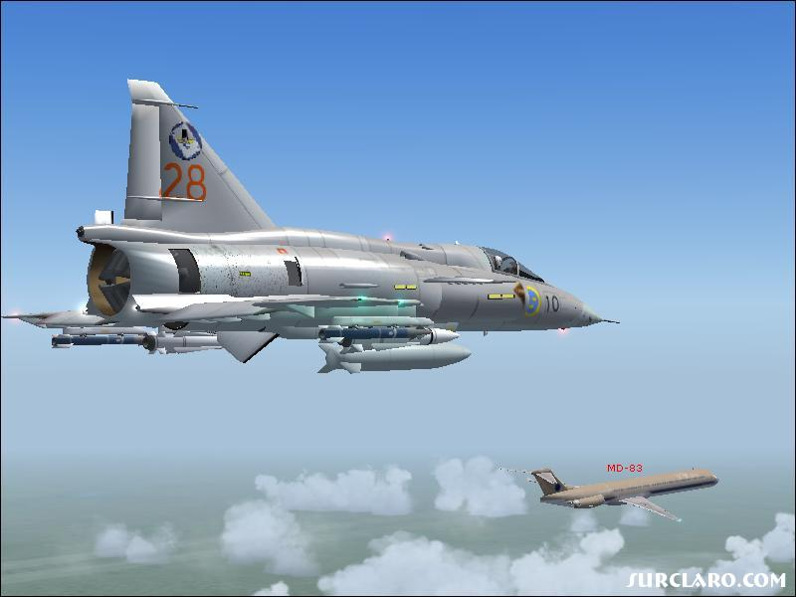
JA 37 Viggen
Saab
Swedish Air Force
Attack, fighter, reconnaissance
1 Engine
Crew: 1
Top Speed Mach 2.1
R/C 12, 200 ft/min

Slide 7
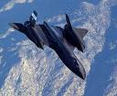
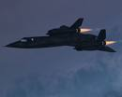
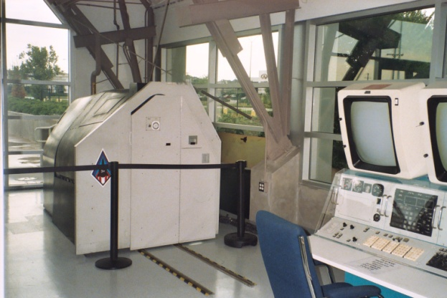
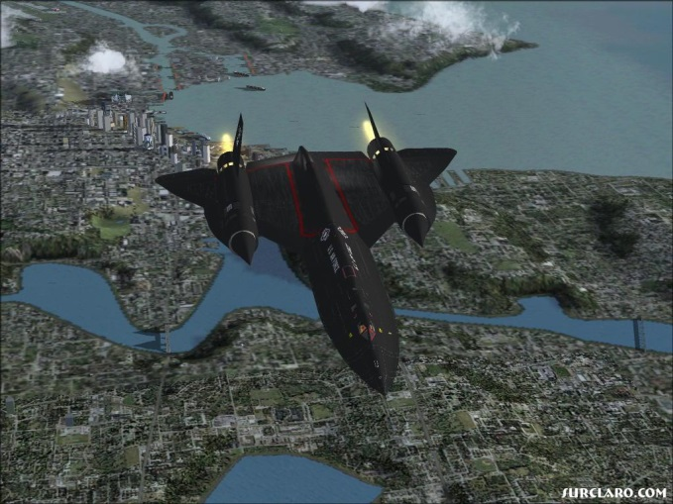
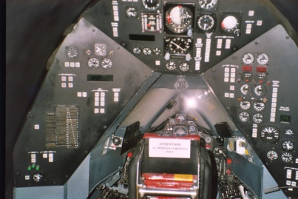
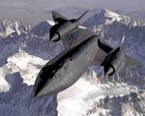

SR71 Blackbird
Lockheed
Air Force / NASA
Reconnaissance
2 engine
Crew: 2
Top Speed Mach 3.2+
R/C 11, 810 ft/min

Slide 8
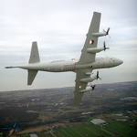

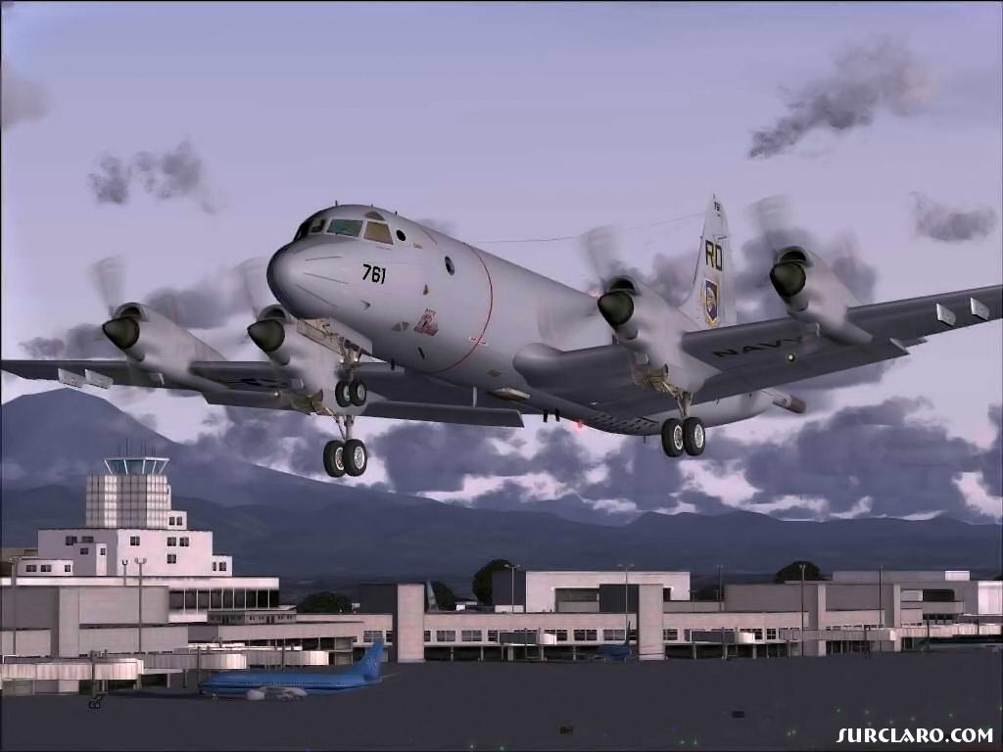
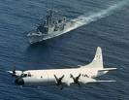
P3 Orion
Lockheed
Navy / Multiple Countries
Maritime Patrol
4 engines
Crew: 11

Slide 9
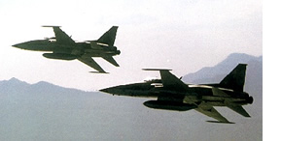
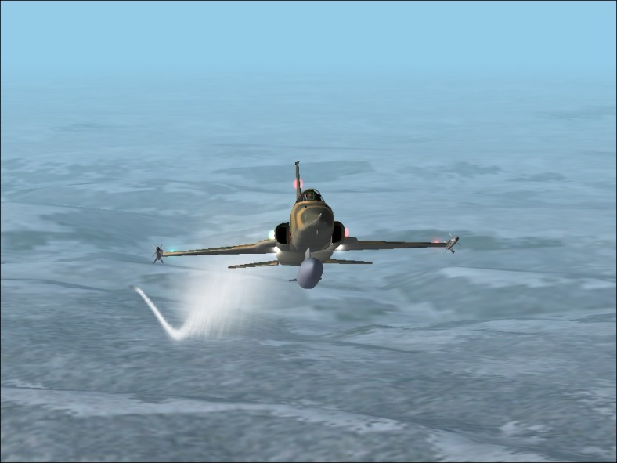
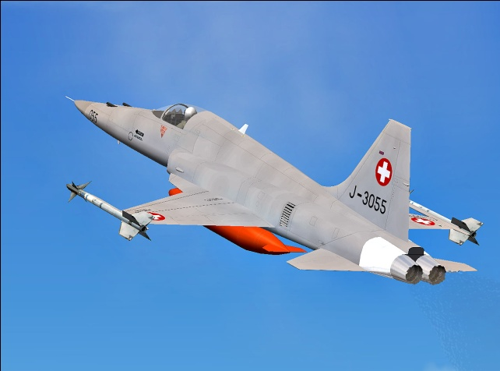
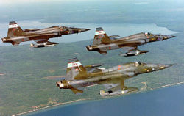
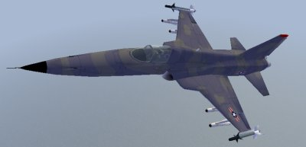
F5 Tiger / Tigershark
Northrop
Air Force / Multiple Countries
Fighter / Attack
2 engines
Crew: 1
Top Speed Mach 1.6
R/C 34, 400 ft/min

Slide 10
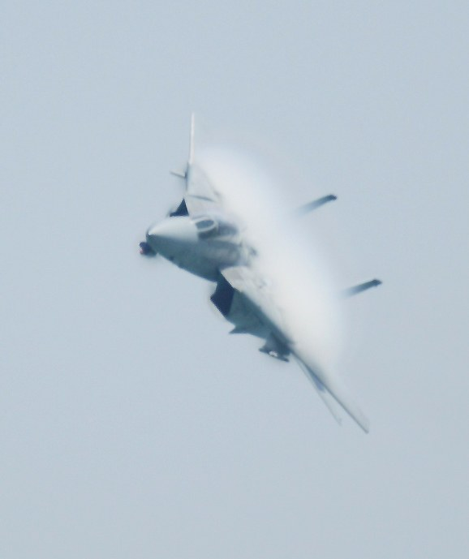
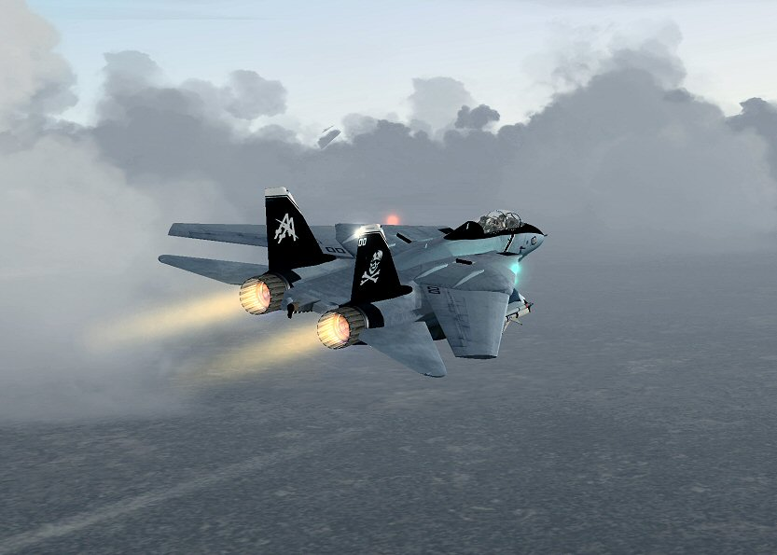
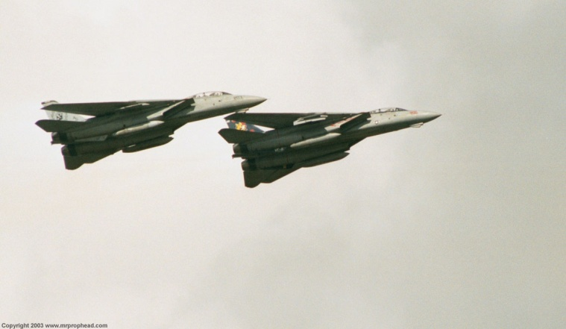
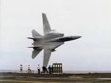
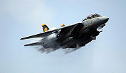
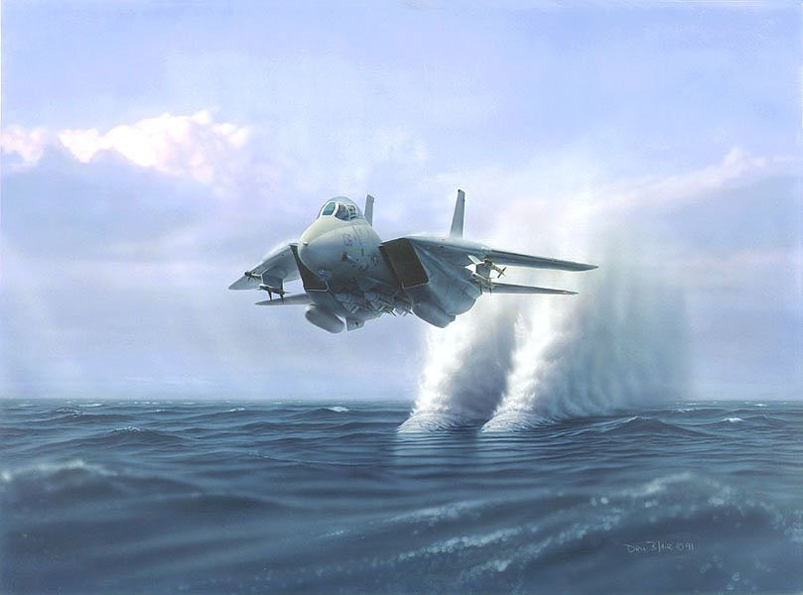
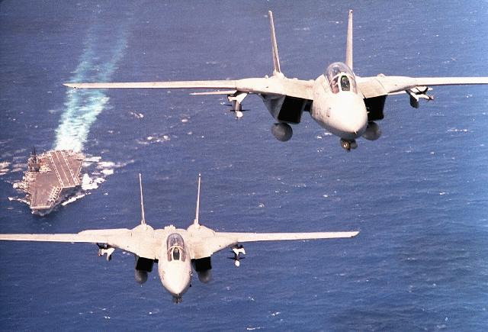
F14 Tomcat
Grumman
Navy
Interceptor / Multi-role Fighter
2 engine
Crew: 2
Top Speed Mach 2.34
R/C 45, 000+ ft/min

Slide 11






C130 Hercules
Lockheed
Air Force / Marines / Multiple Countries
Military Transport
Crew: 4 - 6
Range: 2.360 miles

Slide 12






F16 Falcon
General Dynamics / Lockheed Martin
Air Force / Multiple Countries
Multi-role Fighter
1 Engine
Crew: 1
Top Speed Mach 2+
R/C 50, 000 ft/min

Slide 13







F117 Nighthawk
Lockheed Martin
Air Force
Stealth Attack Aircraft
2 Engines
Crew: 1
Top Speed Mach .92

Slide 14







B2 Spirit
Northrop Grumman
Air Force
Stealth Bomber
Crew: 2
Top Speed Mach .95
Range: 6000 Miles

Slide 15







F18 Hornet
McDonnell Douglas
Navy / Marines / Multiple Countries
Multi-role fighter
2 engines
Crew: F18C – 1, F18D - 2
Top Speed Mach 1.8
Max R/C: 50, 000 ft/min

Slide 16






F22 Raptor
Lockheed Martin
Air Force
Stealth Air superiority fighter
2 engines (pitch thrust vector)
Crew: 1
Top Speed Mach 2.25
Super cruise speed: Mach 1.8

Slide 17


Aircraft Forces

Slide 18

Aircraft Forces
Forces - pounds
  Lift = CL*q*S
  Drag = CD*q*S
  Sideforce = CY*q*S
    CL = Lift Coefficient
    CD = Drag Coefficient
    CY=Side Force Coefficient
    Where q is dynamic pressure ($\frac{1}{2}pV²$)
      ρ= Air density
      V = velocity in feet per sec
    S = wing area in square feet

Slide 19

Aircraft Moments

Slide 20

Aircraft Moments
Moments – ft pounds
  Pitch = Cm*q*S*c
  Roll = Cl*q*S*c
  Yaw = Cn*q*S*c
    Where q is dynamic pressure ($\frac{1}{2}pV²$) in psf
      ρ= Air density
    c = wing cord in feet
    S = wing area in square feet

Slide 21
What is the Unique Characteristic of Each Aircraft?

Slide 22
Sep 27 – STEMosphere 2014
http://www.eventbrite.com/e/share-fair-nations-stemosphere-denver-2014-tickets-12919457445

