Slide 1
Engineering as a Career
With James Paradise, Lockheed Martin Space Systems
February 2016

Slide 2
Let’s Talk About Engineering
Definitions:
Engineering:
The application of science and mathematics by which the properties of matter and the sources of energy in nature are made useful to people
The design and manufacture of complex products
Engineer:
One who practices engineering is called an engineer.
Credit: http://www.merriam-webster.com/netdict/engineering
Notes:
Vision and Values

Slide 3
Engineering Has Many Fields
Civil
Biomedical
Chemical
Aerospace
Mechanical
Electrical
Software
Systems
Lots more disciplines not mentioned today
= Widely used in Aerospace
Notes:
Vision and Values

Slide 4



Civil Engineering
Civil engineering is the engineering discipline that deals with the design, construction and maintenance of bridges, roads, canals, dams and buildings.
Burj Dubai (August, 2009)
Notes:
Vision and Values

Slide 5

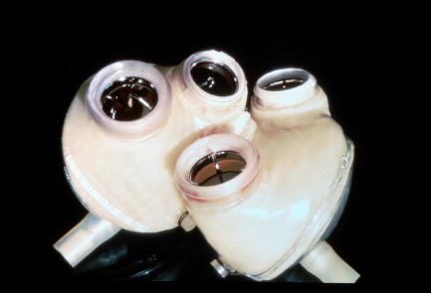
Biomedical Engineering
Biomedical engineering is the application of engineering principles and techniques to the medical field. It combines the design and problem solving skills of engineering with medical and biological sciences to improve healthcare diagnosis and treatment.
Credit: http://www.wikipedia.com
Notes:
Vision and Values

Slide 6
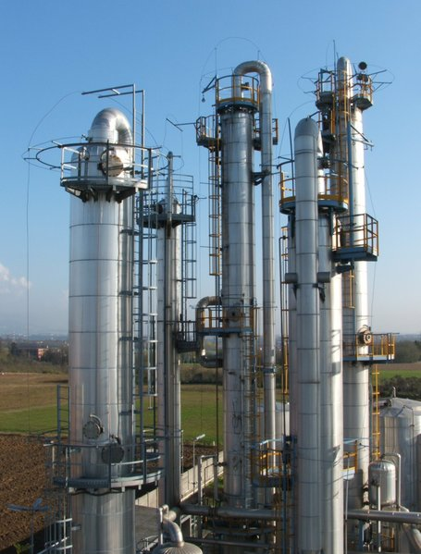
Chemical Engineering
Chemical Engineering applies science and mathematics to the process of converting raw materials or chemicals into more useful or valuable forms.
Credit: http://www.wikipedia.com
Notes:
Vision and Values

Slide 7

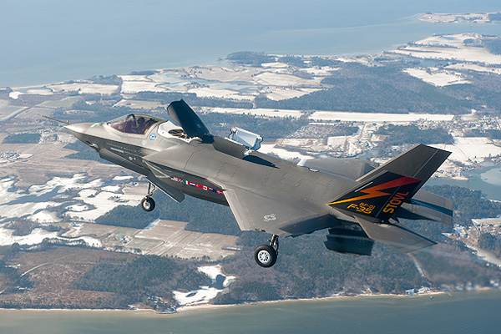
Aerospace Engineering
Aerospace engineering is the branch of engineering behind the design, construction and science of aircraft and spacecraft.
Credit: http://www.lockheedmartin.com
Credit: http://www.ksc.nasa.gov
Notes:
Vision and Values

Slide 8

F35

Slide 9
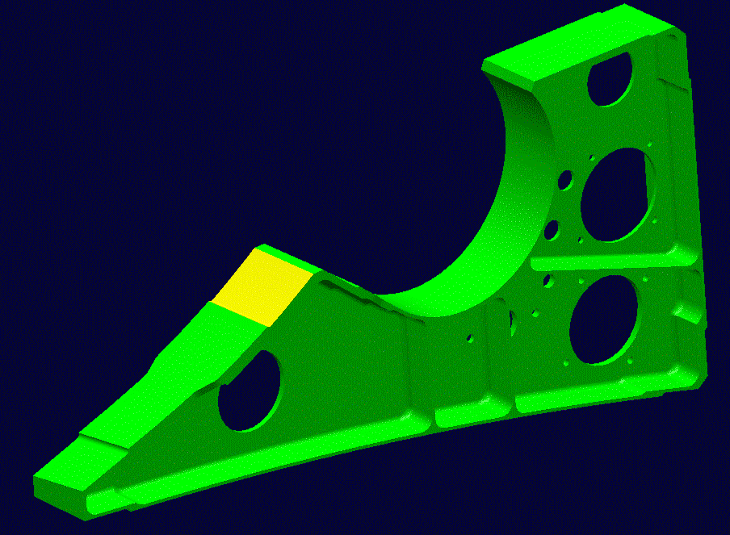
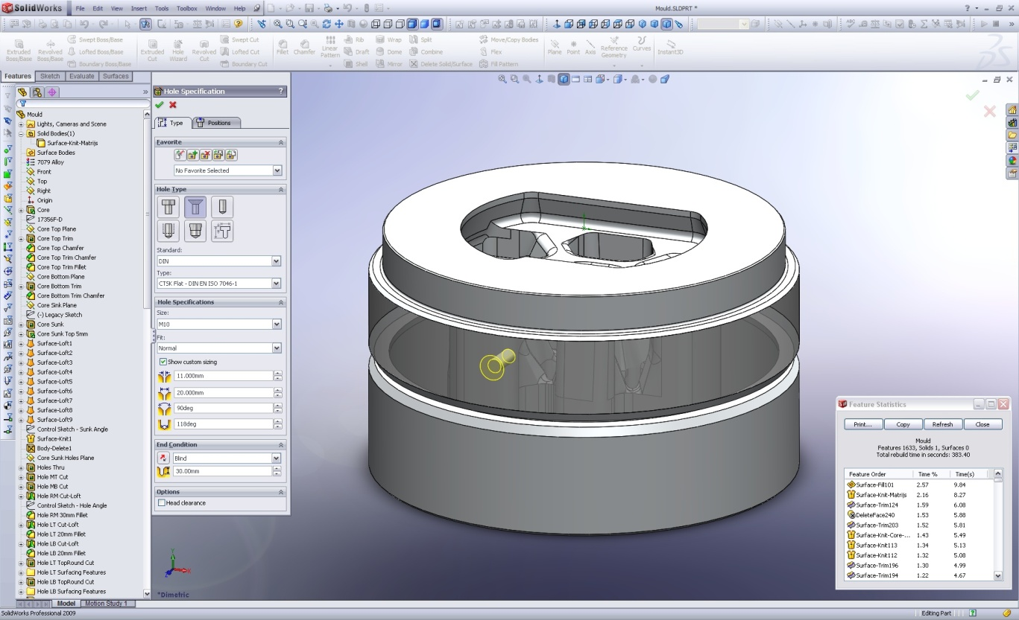
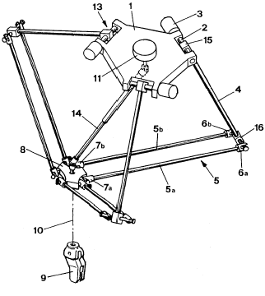
Mechanical Engineering
Mechanical engineering utilizes mechanics, kinematics, thermodynamics, fluid mechanics, heat transfer, materials science, and energy to design and analyze machinery and mechanical parts.
Credit: http://www.wikipedia.com
Notes:
Vision and Values

Slide 10
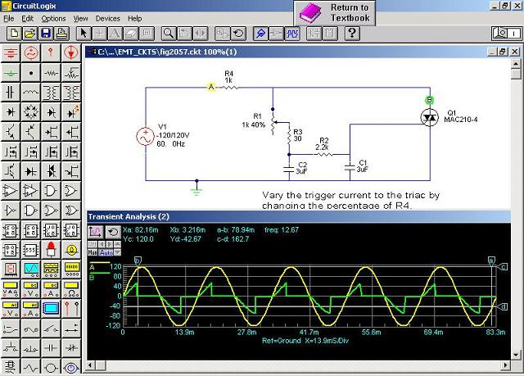
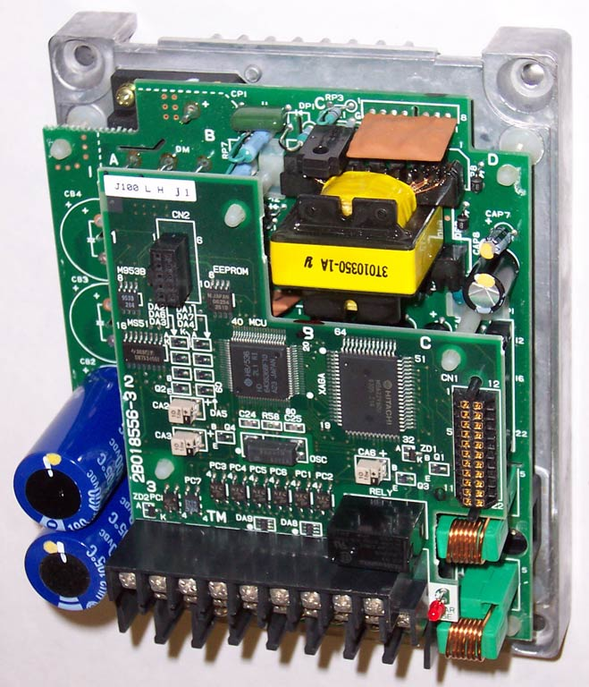
Electrical Engineering
Deals with the application of electricity, electronics and electromagnetism.
Covers a range of subtopics including power, electronics, control systems, signal processing and telecommunications.
Credit: http://www.wikipedia.com
Notes:
Vision and Values

Slide 11
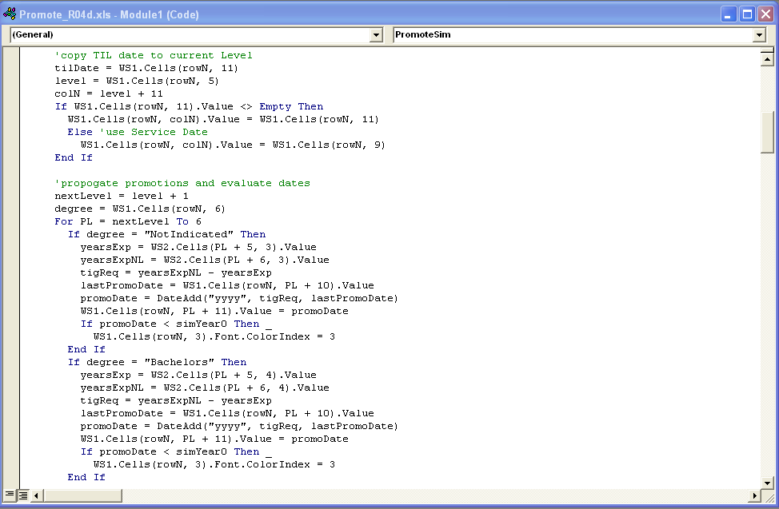
Software Engineering
Software Engineering is the application that develops, tests, operates, and maintains software.
Credit: http://www.wikipedia.com
Notes:
Vision and Values

Slide 12
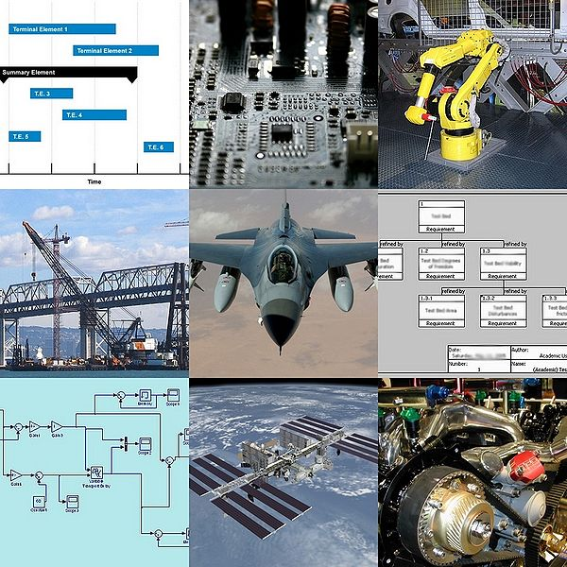
Systems Engineering
The interdisciplinary field of engineering that focuses the integration of electrical, mechanical, and software systems.
Credit: http://www.wikipedia.com
Notes:
Vision and Values

Slide 13
Engineering Has Many Disciplines/Specialties
Aerodynamics
Fluids
Thermal
Stress/Loads/Dynamics
Solar Arrays
Batteries
Lots more disciplines not mentioned today
= Widely used in Aerospace
Notes:
Vision and Values

Slide 14

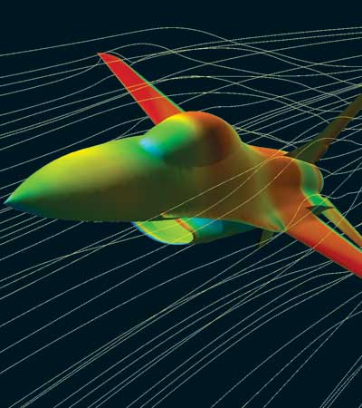
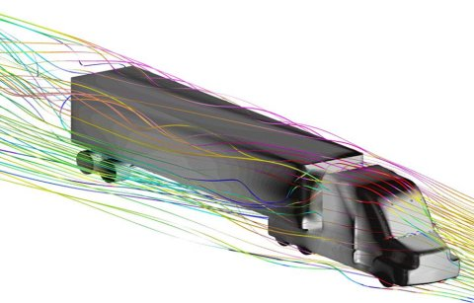
Aerodynamics
Optimize design to minimize drag
Notes:
Vision and Values

Slide 15

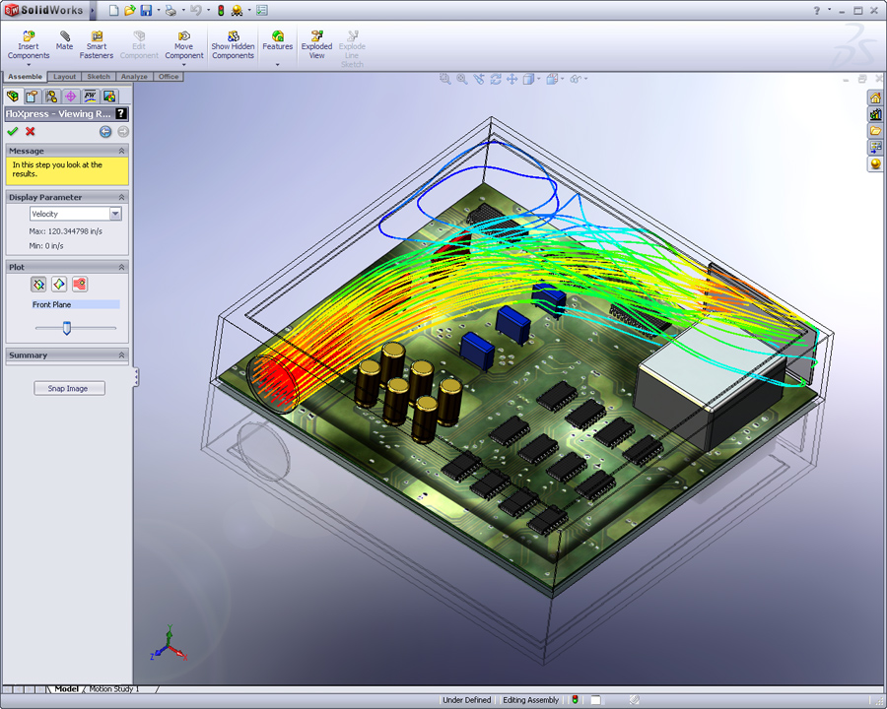
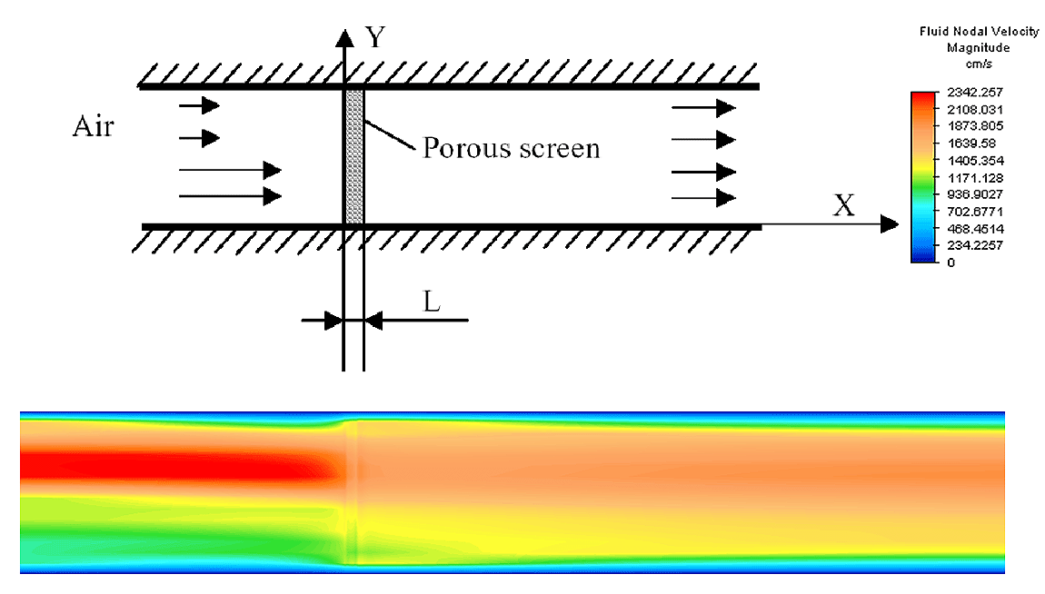
Fluid / Flow Analysis
Notes:
Vision and Values

Slide 16
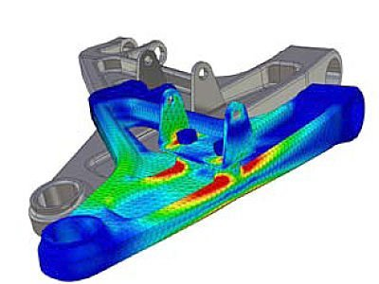

Thermal Engineering
responsible for the architecture, analysis, design, modeling, verification, technical evaluation and selection of hardware related to the thermal systems.
Thermal Model for a Mechanical Part
16

Slide 17
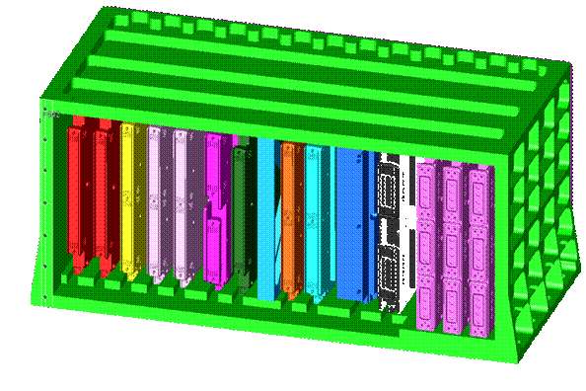
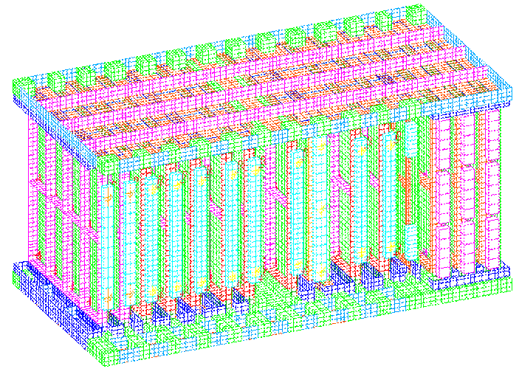
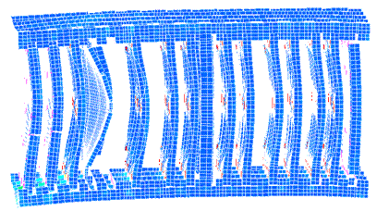
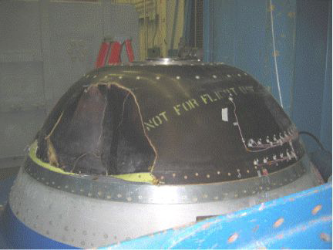
Stress, Loads & Dynamics Analysis and Test
Electronics Package Analysis
Nose Fairing & Cap Structural Test
Design Model
Finite Element Model
Results – Response Under Loading Conditions

Slide 18
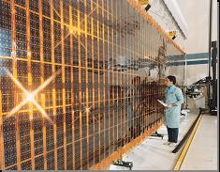
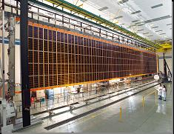
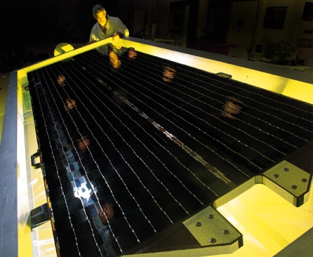
Solar Array Engineering
International Space Station
Product & component
design, development, qualification and acceptance
Analysis - Structural, dynamics, thermal, separation, tribology, power, radiation, magnetic dipole
Flexible Solar Arrays
Rigid Solar Arrays
Iridium Fleet

Slide 19
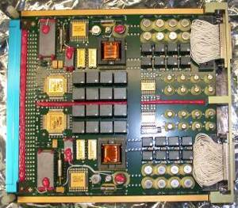
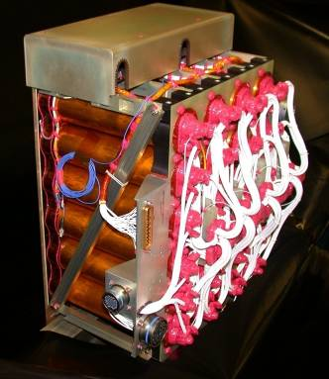
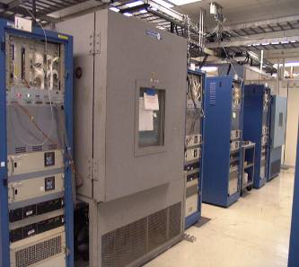
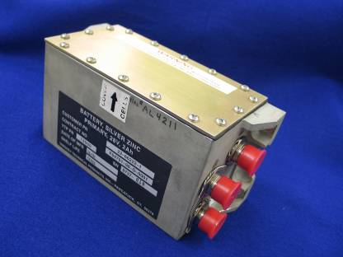
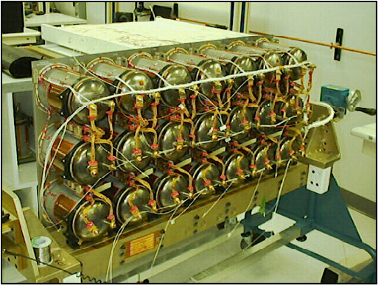
Battery Design
Battery types
  Nickel Hydrogen / Cadmium Batteries
  Lithium Ion / Polymer Batteries
  Lithium Metal / Oxyhalide Batteries
  Silver Oxide-Zinc Batteries
  Thermal Batteries
  Fuel Cells
Primary and secondary batteries
Protection Mechanisms
  Bypass switches, TABS, redundancy mgt
  Internal and external to cell
Charge/Discharge management
Thermal management

Slide 20
Engineering Statistics
Engineering Jobs in United States
  1.5 Million
Engineering Jobs Growth Rate
  10% annual growth
  Approximately 150,000 / year
Current Engineering Graduation Rate
  137,000 new engineers per year
Credit: http://www.careermarketplace.com
Notes:
Vision and Values

Slide 21
Engineering Career Projections
2013 – 1.5 Million Engineers
2023 2018 2013
Engineer Age Demographics
Qty of
Engineers
Lots
Not Many
Career Retirement
Tremendous
Opportunity for new
Engineering Graduates
Baby Boomers
Early Career Mid Career Late Career
Stage of Career
Age 55
Courtesy James Paradise

Slide 22
Engineering Salaries
Starting Salaries (by Degree)
Bachelor’s | Master’s | Ph.D.
$65,000 | $72,000 | $80,000
Notes:
Vision and Values

Slide 23
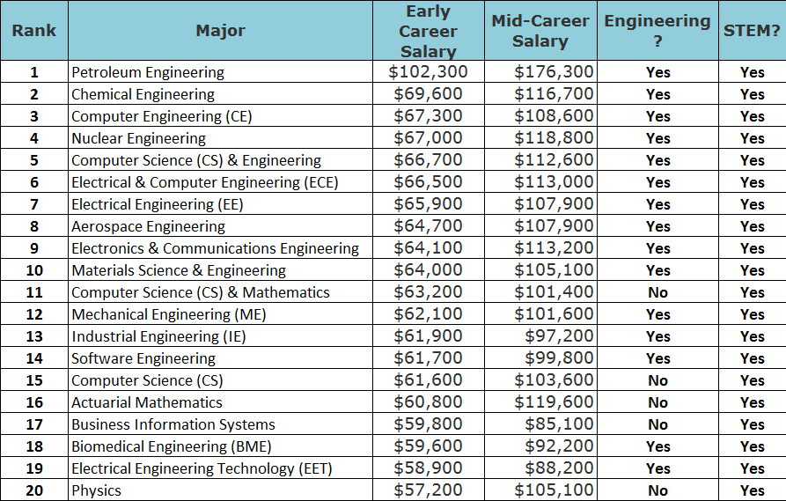
Top 20 Paying Early Career Majors
Source: Payscale.com 4/26/2015

Slide 24
Skills Used in Engineering
Hard Skills
  Math
  Science
  Problem Solving
Soft Skills
  Communication Skills
  Teamwork
  Leadership Qualities
  Creativity
Faster Progression
Credit: http://www.careermarketplace.com
Notes:
Vision and Values

Slide 25
Questions?

