Slide 1
Asteroids
Jim Paradise
Lockheed Martin

Slide 2
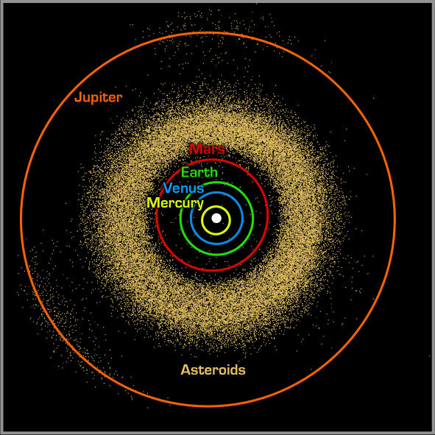
Asteroid Belt (gold colored specs)
Distance From Sun:
260 Million Miles to center
over 166,000 asteroids
Largest:
Ceres 1/3 of all mass
600 miles in diameter
Image credit: NASA/JPL-Caltech
Gaspra

Slide 3
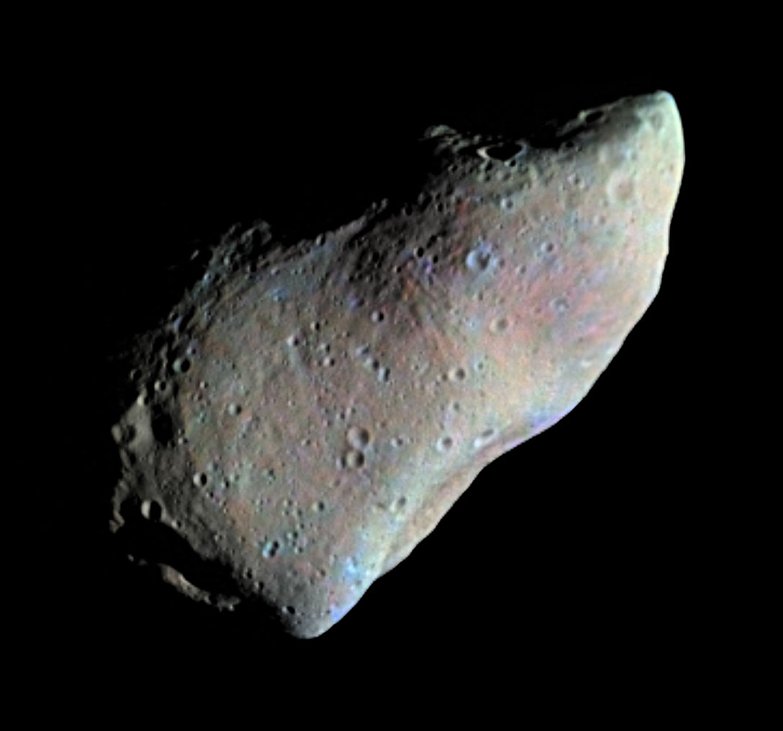
1st ever close-up
Asteroid: Gaspra
photo of an asteroid
Gaspra (12x7 miles)
Image credit: NASA/JPL-Caltech
Ida

Slide 4
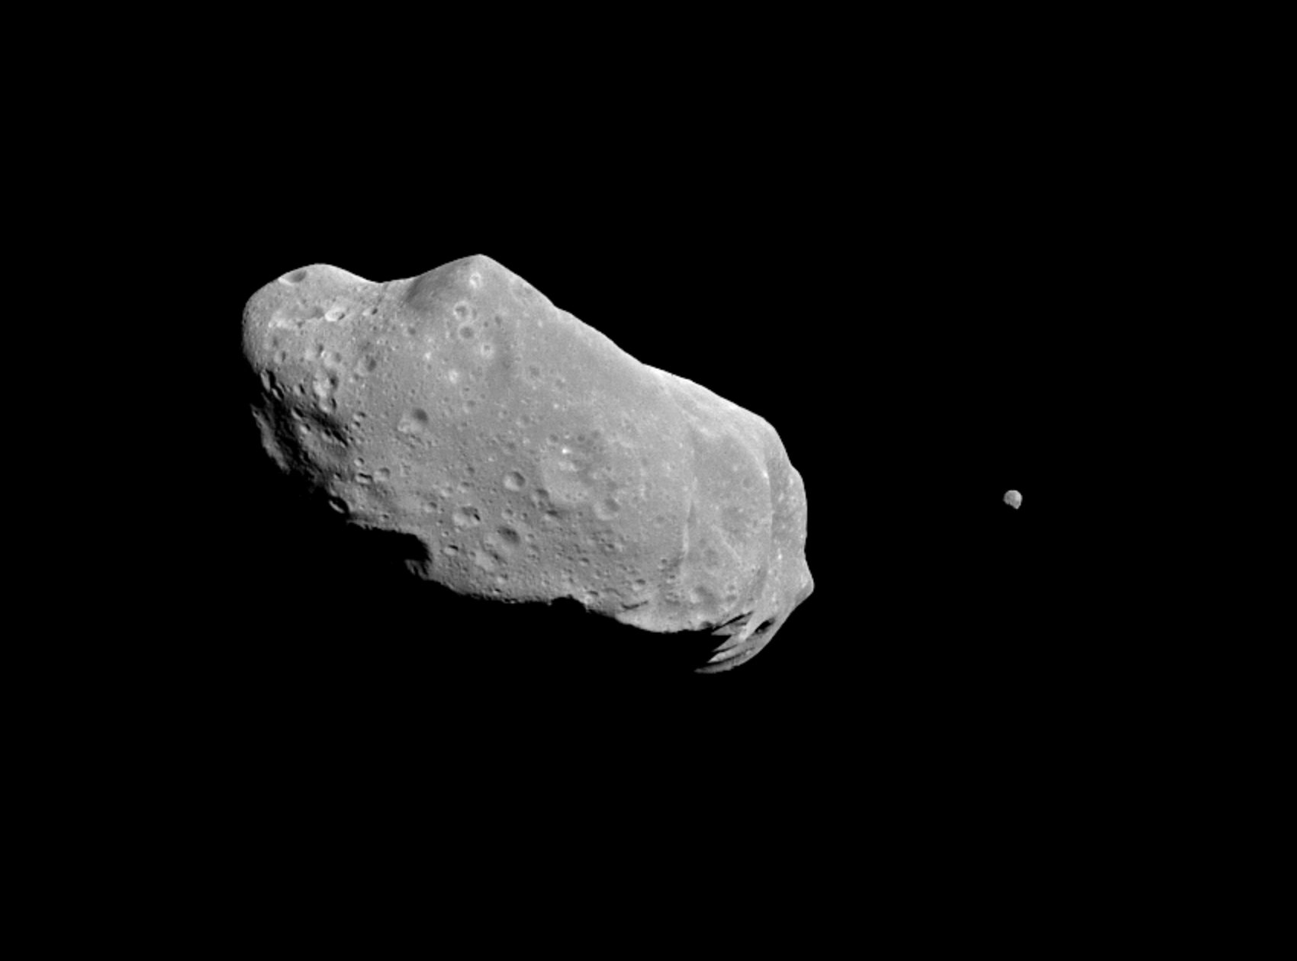
Asteroid Photos
Ida (35 miles long) and Dactyl (1 mile diameter)
Image credit: NASA/JPL-Caltech
Ceres Vesta

Slide 5
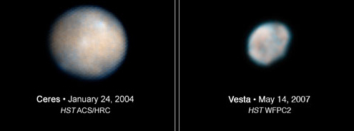
Hubble images of the two biggest asteroids
Now a Dwarf Planet 600 mi dia
Largest Asteroid 330 mi dia
A "dwarf planet" is a celestial body that
  is in orbit around the Sun,
  has sufficient mass for its self-gravity to overcome rigid body forces (nearly round),
  has not cleared the neighborhood around its orbit, and
  is not a satellite.
Image credit: NASA/JPL-Caltech
dawn

Slide 6
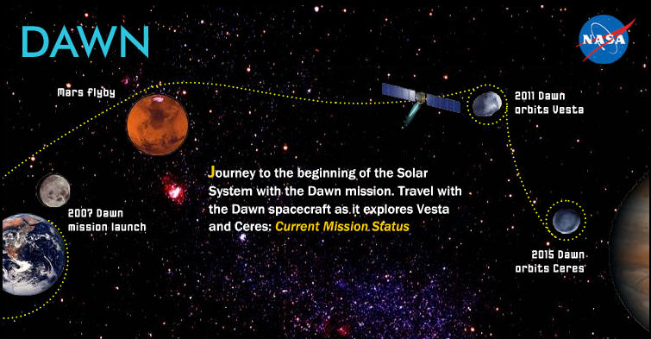
Launch: 9/27/07
Mars Flyby: 2/17/2009
Orbit Vesta: 7/15/2011
Depart Vesta: 9/4/2012
Orbit Ceres: Spring 2015
Image credit: NASA/JPL-Caltech
Vesta – close-up

Slide 7
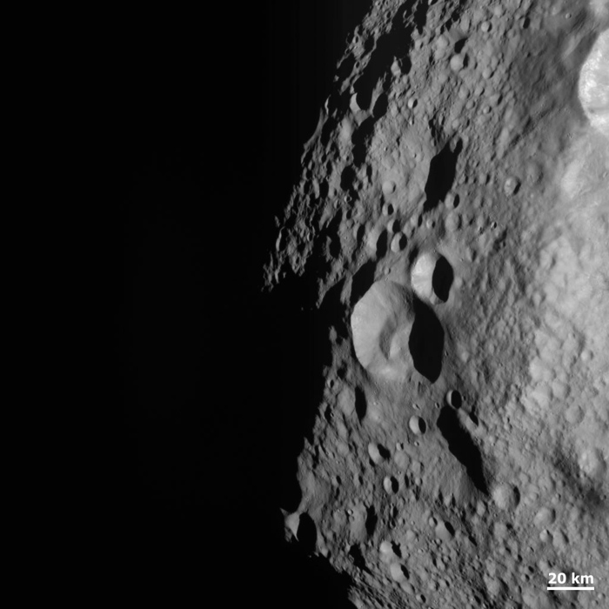
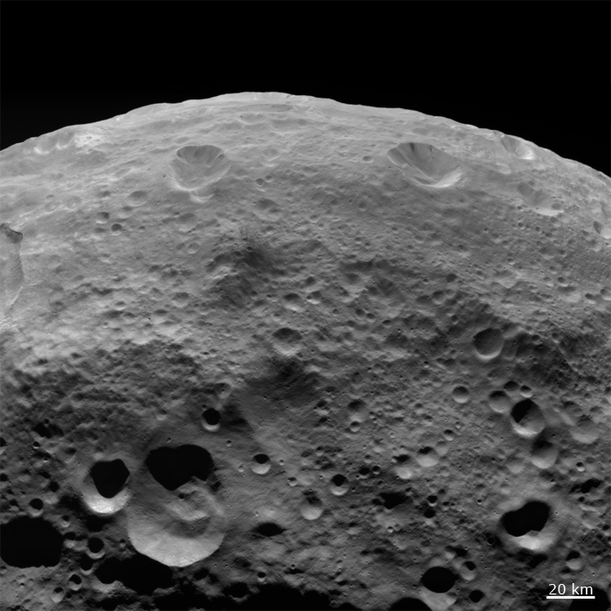
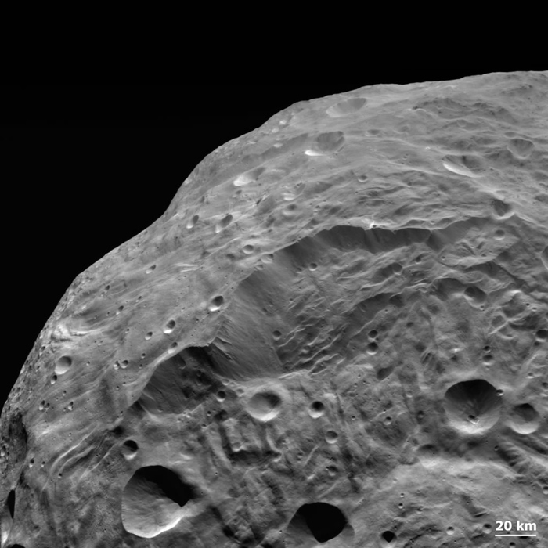
Asteroid: Vesta Close-up Images
Image credit: NASA/JPL-Caltech
Osirus Rex

Slide 8
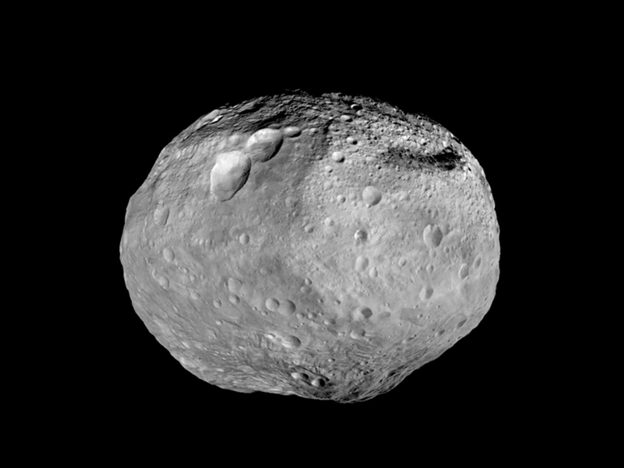
Looking Behind: Asteroid: Vesta – 326 miles in diameter
This photo taken Sept 5, 2012 as Dawn left Vesta’s orbit
Image credit: NASA/JPL-Caltech
Looking ahead

Slide 9
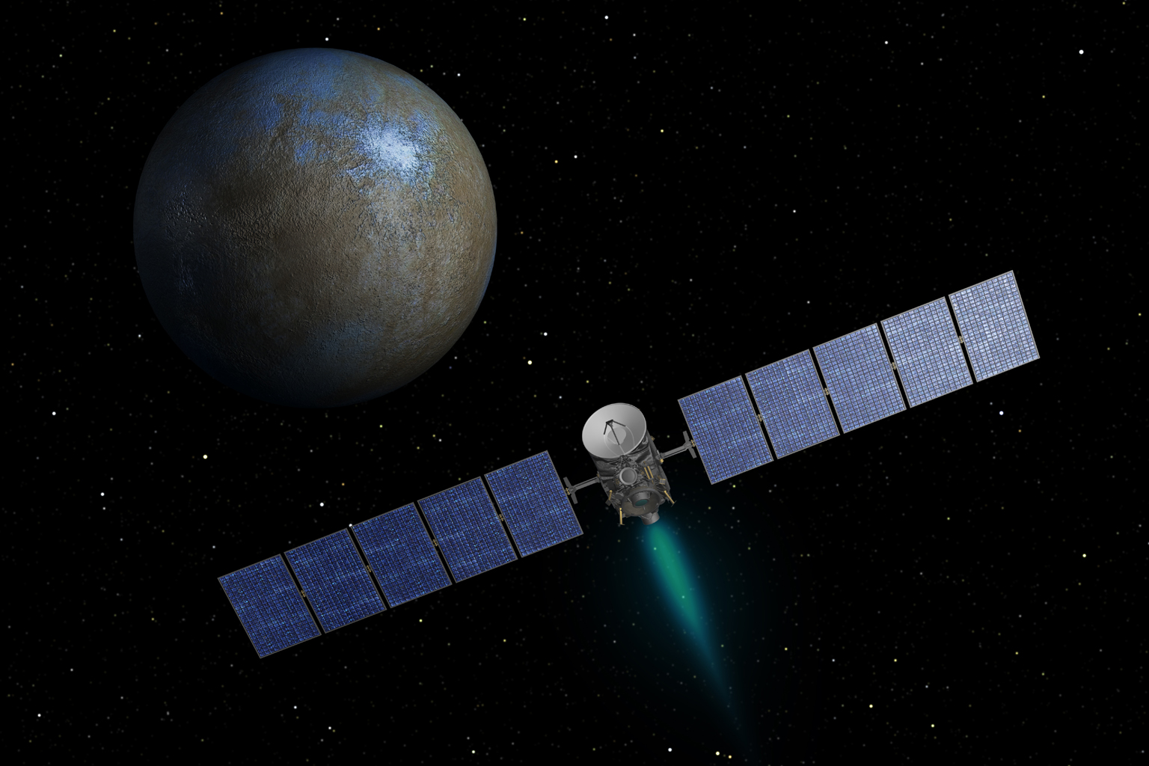
Asteroid: Ceres – 590 miles in diameter
Dawn arrives March 6, 2015
Image credit: NASA/JPL-Caltech
OSIRIS - Rex

Slide 10
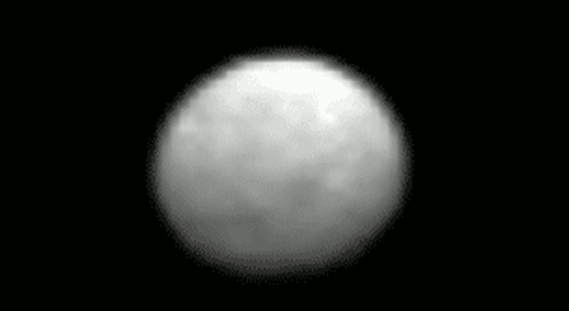
Ceres as of last week

Slide 11
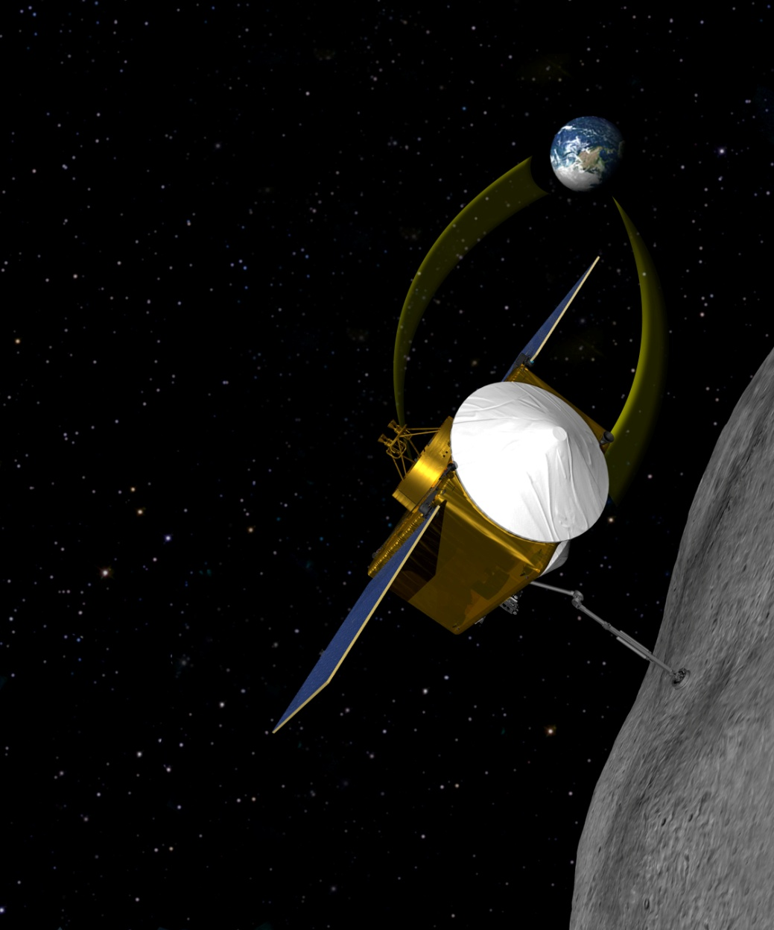
OSIRIS-Rex ( mission to asteroid 101955 Bennu )
Origins Spectral Interpretation Resource Identification Security Regolith Explorer
First US Asteroid Sample and Return Mission
Launch: 2016
Asteroid Orbit/Sample: 2019
Earth Return: 2023
101955 Bennu diameter: 1,900 ft
Image credit: NASA/JPL-Caltech
Jupiter

