Slide 1
Boom Supersonic 11/11/17 Agenda
- Who we are (5 min)
- About Boom (5-10 min)
- Airplanes 101

Slide 2
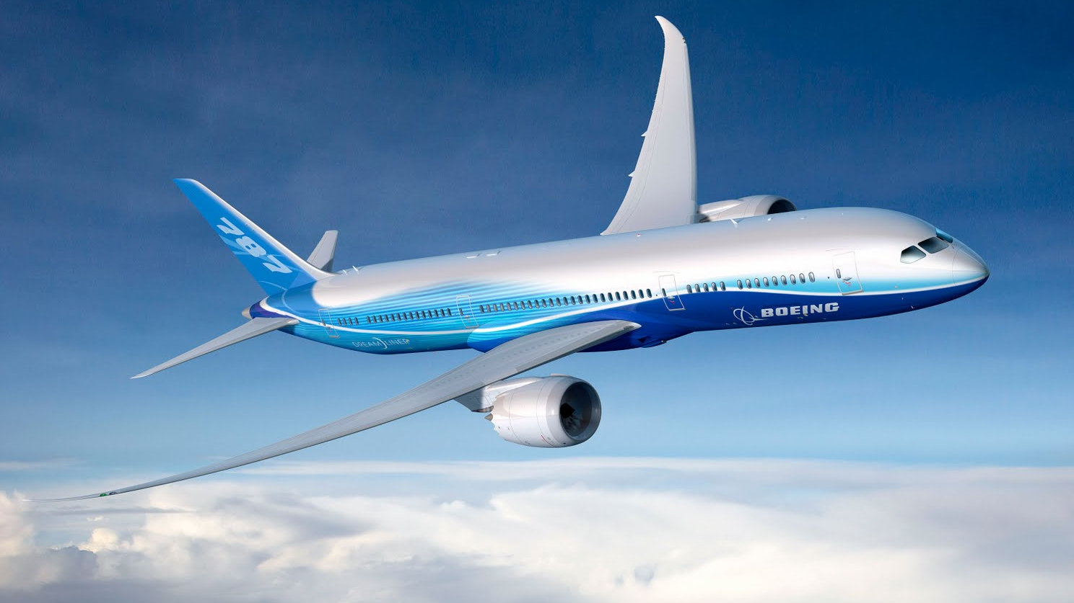

Slide 3
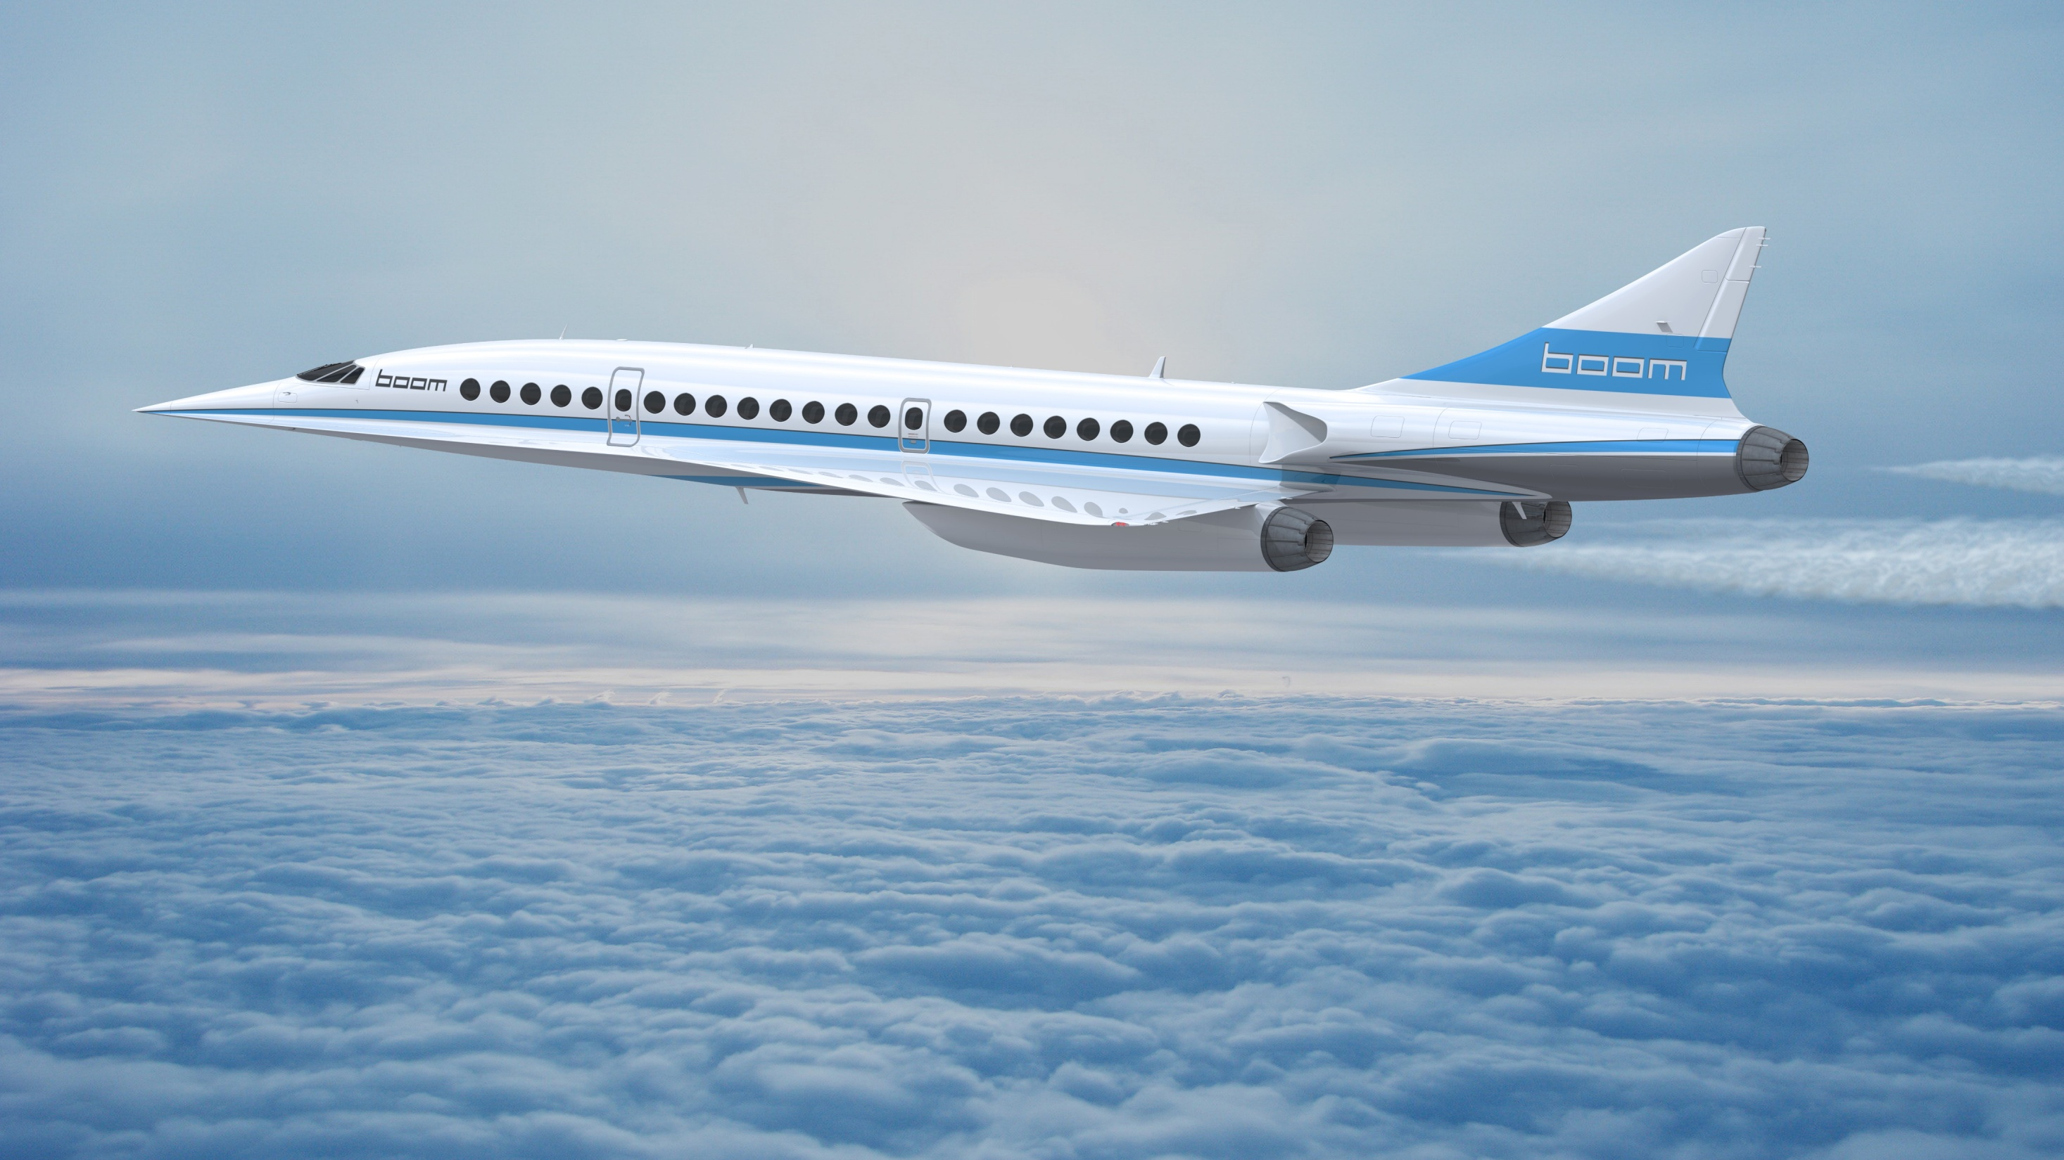

Slide 5
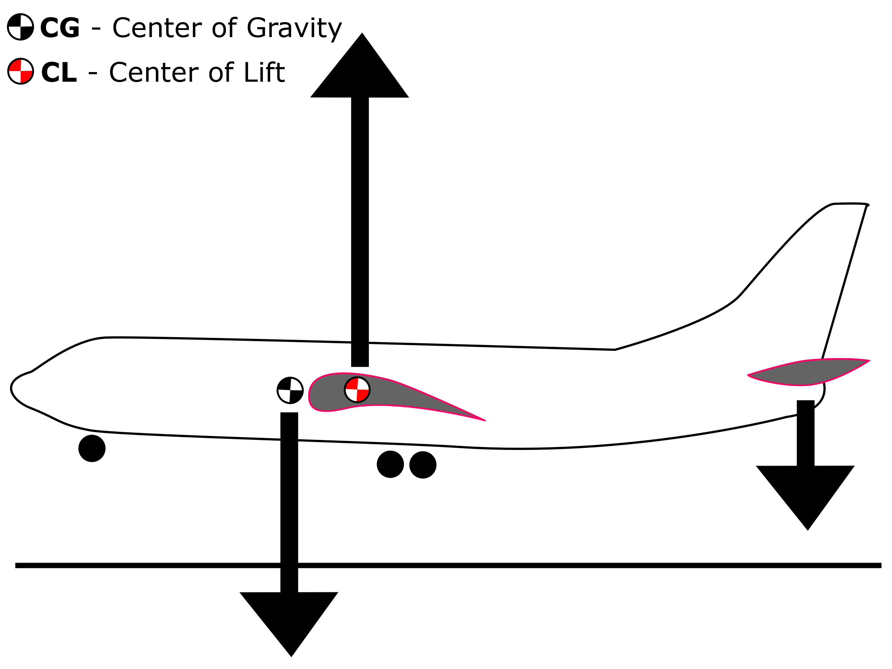

Slide 6
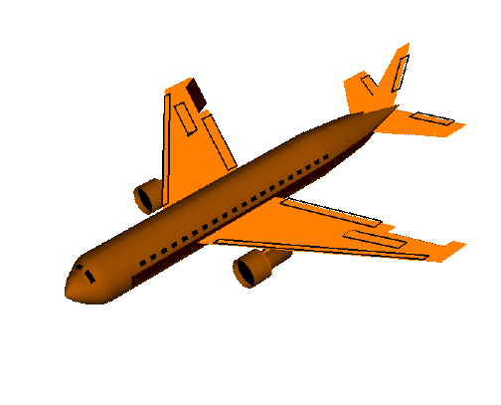
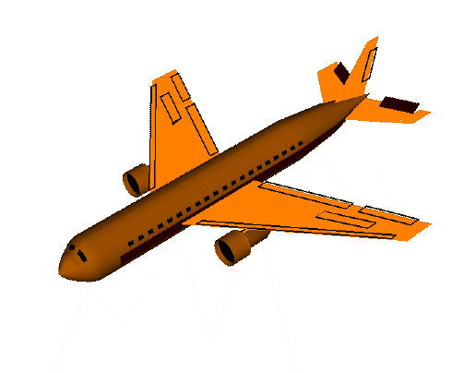
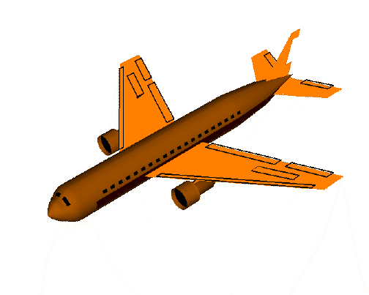
Ailerons - roll
Elevator - pitch
Rudder - yaw

Slide 7
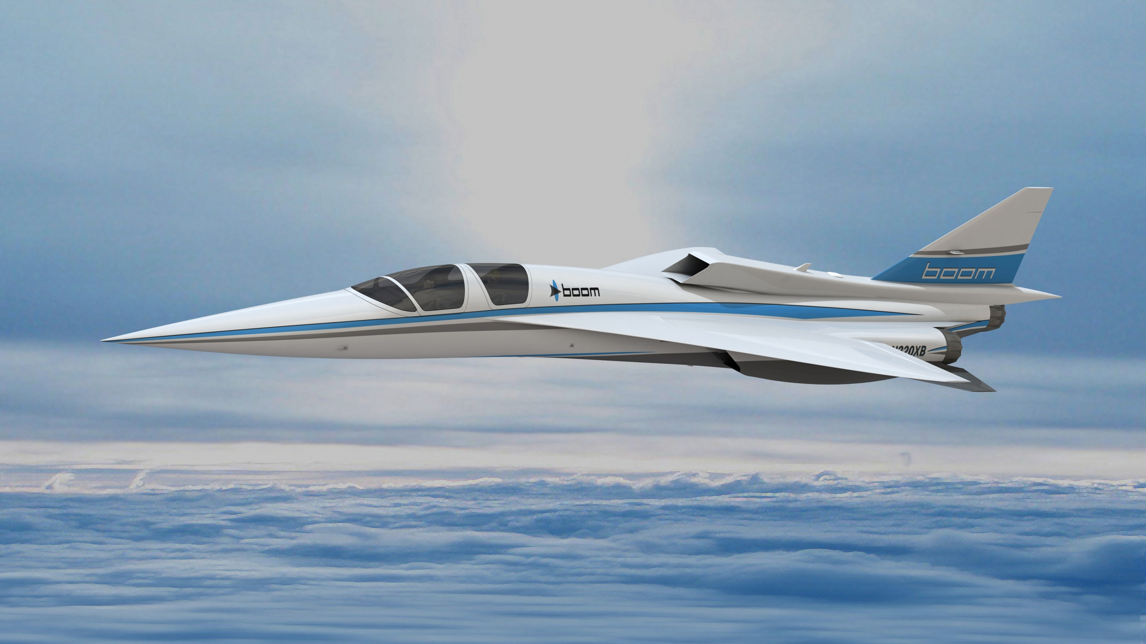
Questions

Slide 8
Engineering Development Schedule
TOP SECRET
Design: COMPLETE
Configuration: Balsa glider, conventional tail, mid wing
Wind Tunnel Test: SCHEDULED
Determine lift vs. angle of attack for wind tunnel test article
Flight Test: SCHEDULED
Determine wing position for maximum flight distance

Slide 9
Backup Slides

Slide 10
How does lift apply to propellers?

Slide 11
