Slide 1
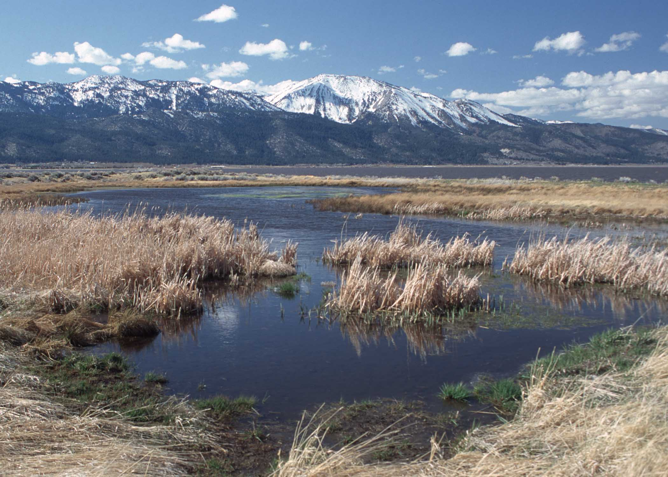
Liz Staten, PE Melanie Jollett, PE
Civil Engineering

Slide 2
Best Jobs in America
CNN Money Magazine ranked Civil Engineering as the 4th best job in America

Slide 3
What do you know about Civil Engineering?

Slide 4
Notes:
Civil Engineers are responsible for designing all of the infrastructure for communities. This includes the roadways, public transportation, storm sewer systems, drinking water supply, water distribution systems, sanitary sewer collection systems, wastewater treatment, and buildings.
Spend some time discussing each discipline.

Slide 5
Civil Engineering Specialties
Structural (Buildings/Bridges)
Transportation (Roadway/Traffic/Railroad/Airports)
Water/Waste Water
Storm Water
Environmental
Geotechnical
Planning

Slide 6
How do you become a Civil Engineer?

Slide 7
Education
Relevant High School Classes
College Engineering Curriculum
BS required - ~5 years
MS recommended - ~30 credit hours
ABET Accredited
ASCE
EI/PE
Notes:
High School Courses: math classes (up to calculus if possible), sciences (physics, chemistry), drafting
College Engineering Curriculum: core curriculum includes general engineering classes such as math (3 years of calculus and differential equations), physics, chemistry, statics, dynamics, thermodynamics. Obtaining your master’s in engineering is also prudent.
ABET: Civil Engineering is a professional degree, similar to a medical degree or a law degree. In practice, we obtain professional licensure, and as such, it is critical to complete an ABET accredited curriculum. (ABET is the recognized accreditor for college and university programs in applied science, computing, engineering, and technology).
ASCE: American Society of Civil Engineering. Most college programs have a student chapter of ASCE. ASCE is the professional society for civil engineers, and participating in college provides a hands on experience in engineering with the steel bridge and concrete canoe competitions.
EI/PE: Civil Engineers are professionally licensed. The first step to licensure is graduating from an ABET accredited college. The second step is obtaining your Engineer Intern license. 8 hour exam covering all courses you covered in college. After obtaining the EI, you must work for four years in Colorado, and then take your Professional Engineering Exam. Again, an 8 hour exam covering all aspects of civil engineering.

Slide 8
Education
ABET Accredited Programs
NMSU
UNM
CSU
CU
AFA
Colorado School of Mines
Notes:
High School Courses: math classes (up to calculus if possible), sciences (physics, chemistry), drafting
College Engineering Curriculum: core curriculum includes general engineering classes such as math (3 years of calculus and differential equations), physics, chemistry, statics, dynamics, thermodynamics. Obtaining your master’s in engineering is also prudent.
ABET: Civil Engineering is a professional degree, similar to a medical degree or a law degree. In practice, we obtain professional licensure, and as such, it is critical to complete an ABET accredited curriculum. (ABET is the recognized accreditor for college and university programs in applied science, computing, engineering, and technology).
ASCE: American Society of Civil Engineering. Most college programs have a student chapter of ASCE. ASCE is the professional society for civil engineers, and participating in college provides a hands on experience in engineering with the steel bridge and concrete canoe competitions.
EI/PE: Civil Engineers are professionally licensed. The first step to licensure is graduating from an ABET accredited college. The second step is obtaining your Engineer Intern license. 8 hour exam covering all courses you covered in college. After obtaining the EI, you must work for four years in Colorado, and then take your Professional Engineering Exam. Again, an 8 hour exam covering all aspects of civil engineering.

Slide 9
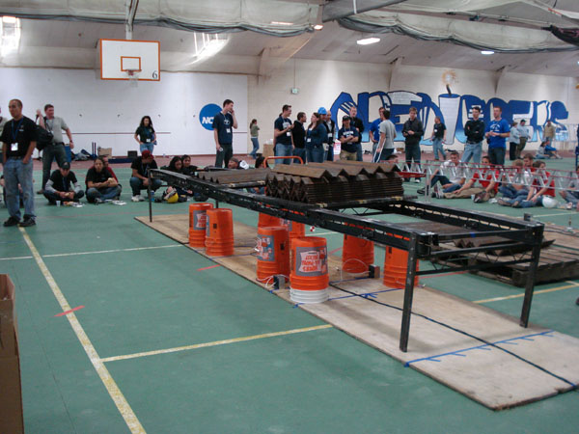
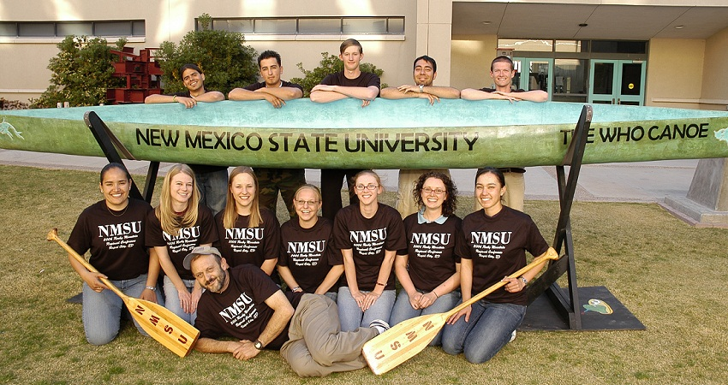
Extra Curricular Activities
Steel Bridge Competition
Concrete Canoe

Slide 10
Education Costs
In State Tuition
~$8,000 - $10,000 per year
Typically fully funded for graduate school
Scholarships
Women in Engineering Scholarships
ASCE
Salaries
~$40,000 entry level
$40,000 - $120,000 pay range over a career
Zero or minimal school debt
Notes:
Undergraduate in state tuition fees are relatively inexpensive. Graduate school should be completely free, because you are likely to be fully funded.
There is a plethora of engineering scholarships for women. It should be easy to earn enough scholarship money to pay for your undergraduate education because there is a lot of money available, and few women pursuing engineering degrees.
Civil engineers will never be the highest paid profession, or highest paid engineers. However, the average entry level pay vs school debt acquired is much lower than medical fields and other technology fields.

Slide 11
Civil Engineering Specialties
Structural (Buildings/Bridges)
Transportation (Roadway/Traffic/Railroad/Airports)
Water/Waste Water
Storm Water
Environmental
Geotechnical
Planning

Slide 12
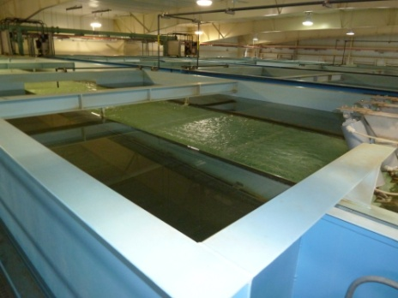
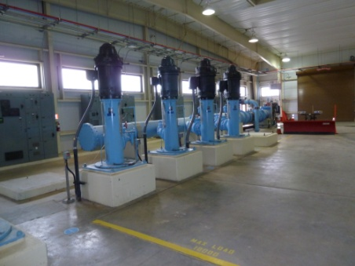
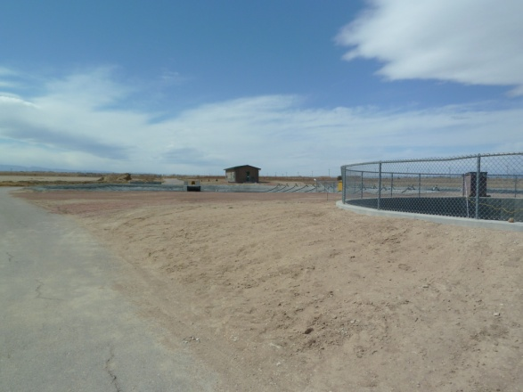
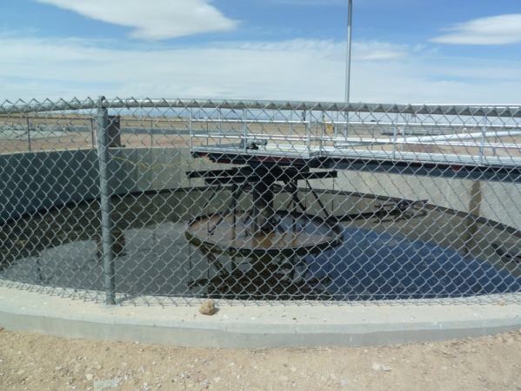
Water/Waste Water
Source Water
Filters
Distribution Pumps
Wastewater Treatment Plant
Primary Clarifier

Slide 13
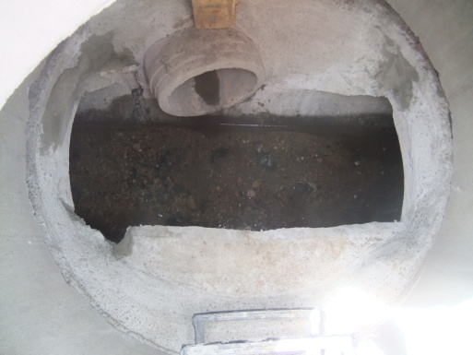
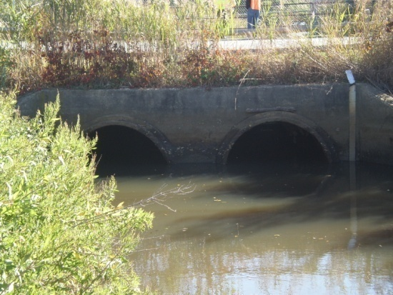
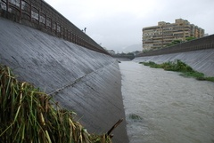
Storm Water
Storm Event
Inlet
Inside of Storm Manhole
Culverts
Channel

Slide 14
The Engineering Profession
Idea or Problem
Funding
Public Involvement
Evaluating Solutions
Project Design
Construction

Slide 15
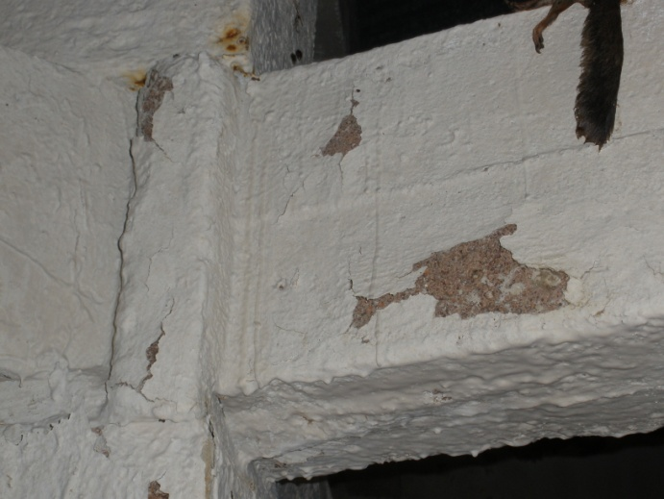
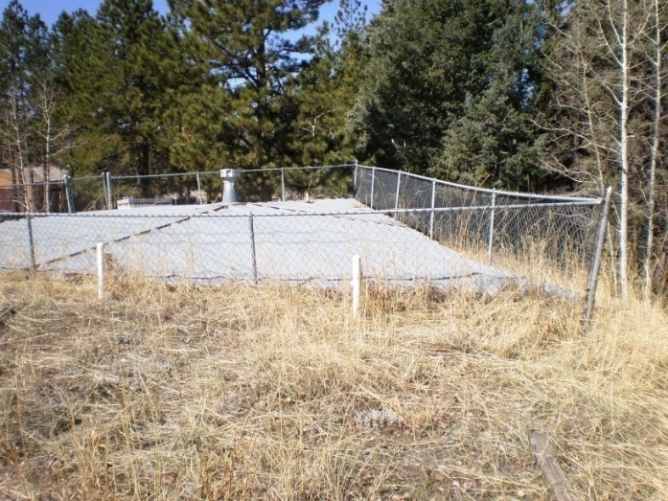
The Engineering Profession
Idea or Problem: Small water district has an old concrete potable water tank that needs repairs.
Notes:
Now that we’ve talked about the science and math required to be a civil engineer…..let’s talk about what the profession really is.
Every project starts with an idea or a problem that needs to be solved.

Slide 16
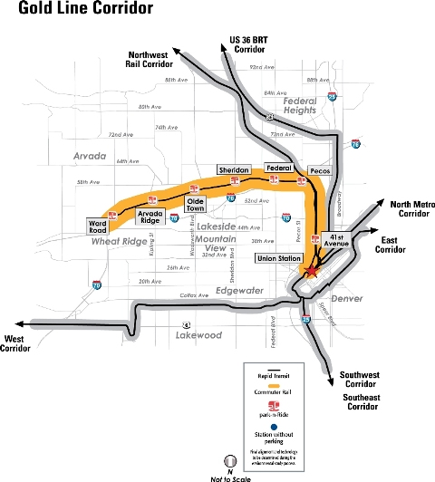
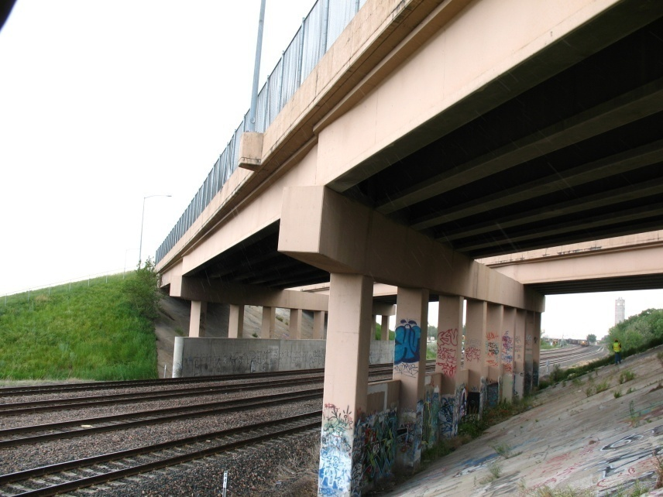
The Engineering Profession
Idea or Problem: A city has too much traffic congestion on the roadways.
Notes:
Now that we’ve talked about the science and math required to be a civil engineer…..let’s talk about what the profession really is.
Every project starts with an idea or a problem that needs to be solved.

Slide 17
The Engineering Profession
Funding:
Engineer’s Cost Estimate
Evaluate Client’s Finances – can they afford these improvements
Evaluate Possible Funding Sources
Grants
Loans
Taxes
Rate Increases
Notes:
The problem has been established, now we have to figure out how to fund this project.

Slide 18
The Engineering Profession
Public Involvement:
Public Meetings
Present Project Concept/Alternatives Analysis
Technical, Financial, Feasibility
Allow for Public’s Questions and Comments
Public Approval/Informed Consent
Could be Multiple Meetings for 1 Project
Revise Plans Based on Public Comments
Notes:
Now that we’ve secured some funding for this project, we have to talk about the project with the public to get their input, ideas, comments, and ultimately their approval to move forward with this project.
Many projects that Civil Engineers design are funded with tax money, the public input is very important.

Slide 19
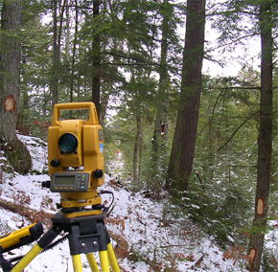
The Engineering Profession
Project Design:
Surveying
Design of Improvements
Construction Drawings
Specifications
Cost Estimate
Notes:
Time to design the improvements. As a civil engineer, you will work with surveyors and other civil engineers in different disciplines to complete a project.

Slide 20
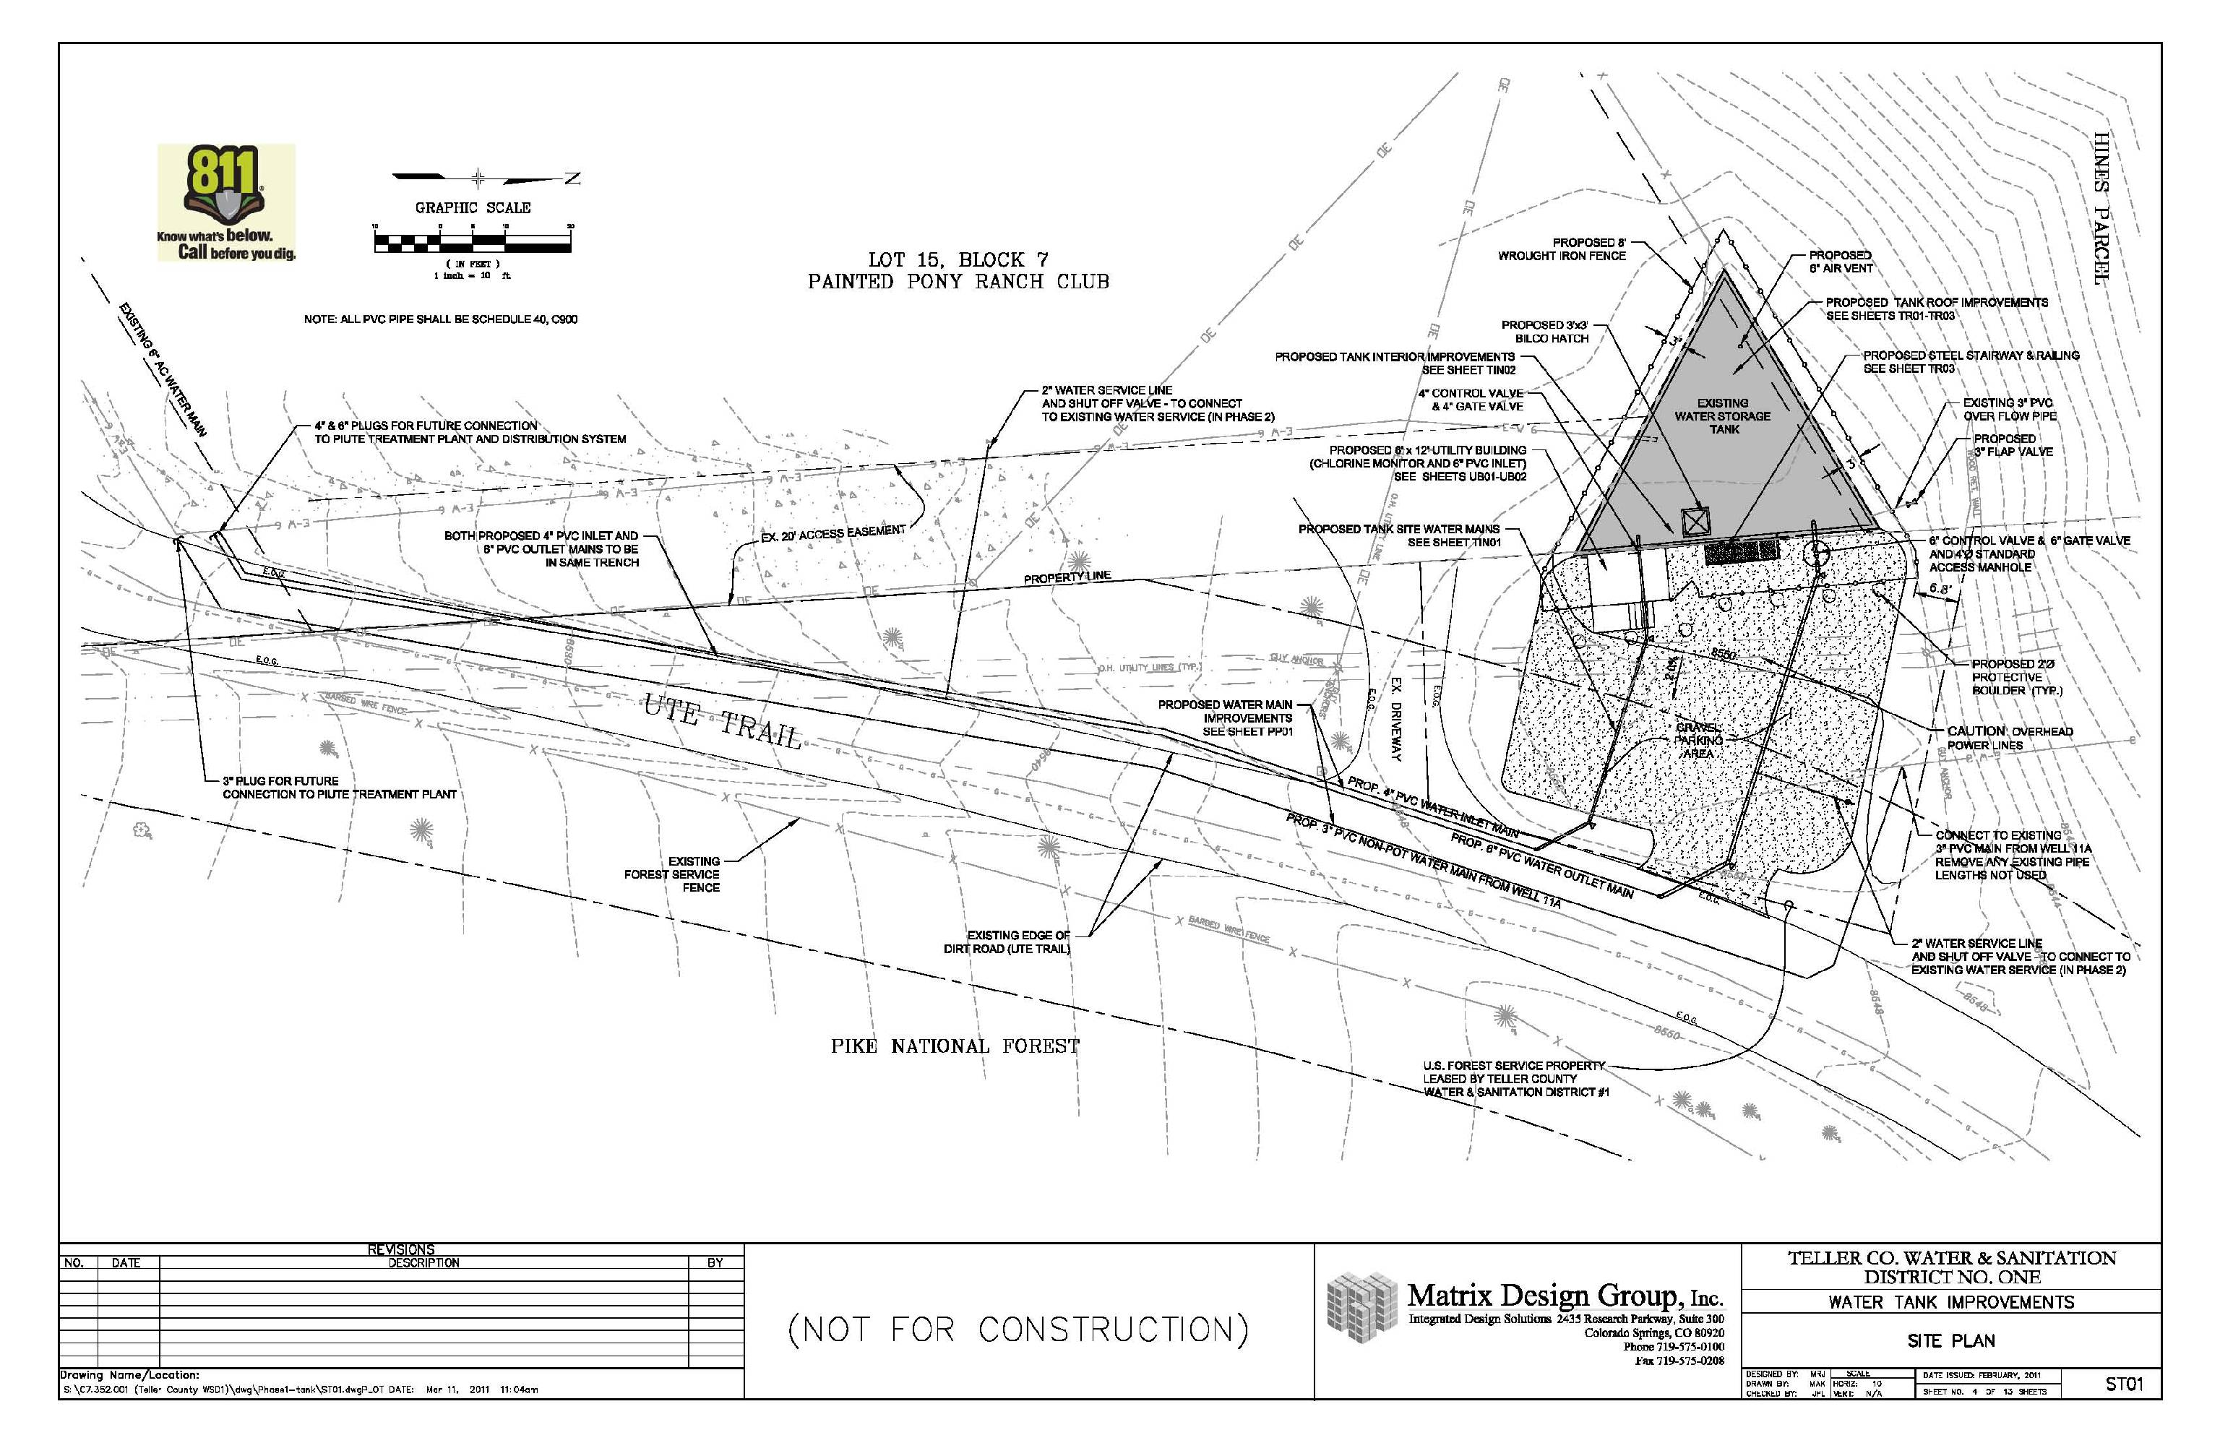
Notes:
Time to design the improvements. As a civil engineer, you will work with surveyors and other civil engineers in different disciplines to complete a project.

Slide 21
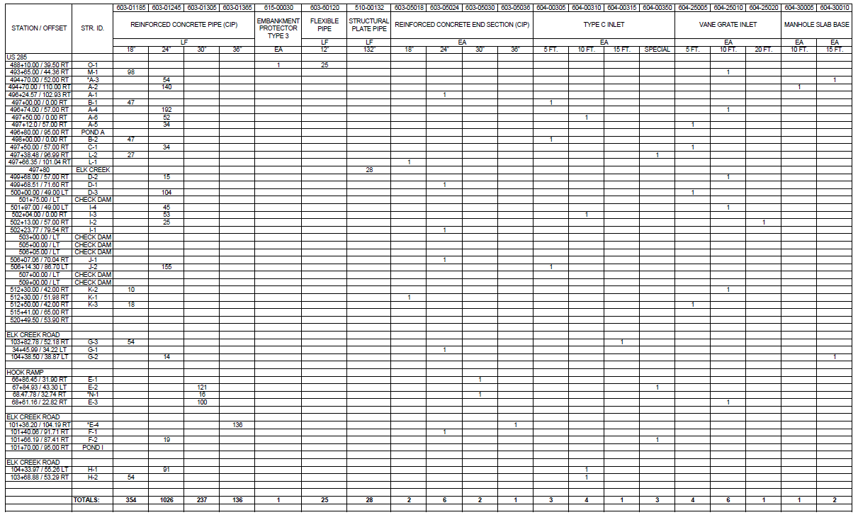

Slide 22
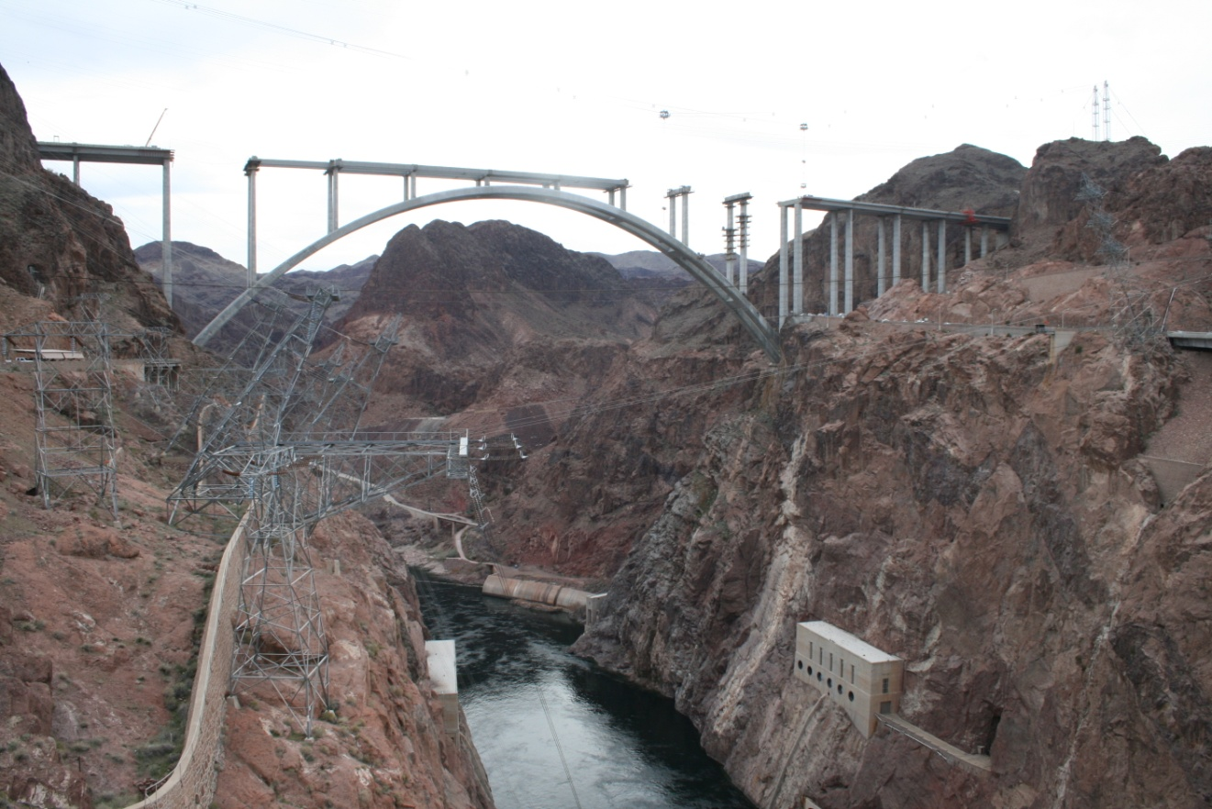
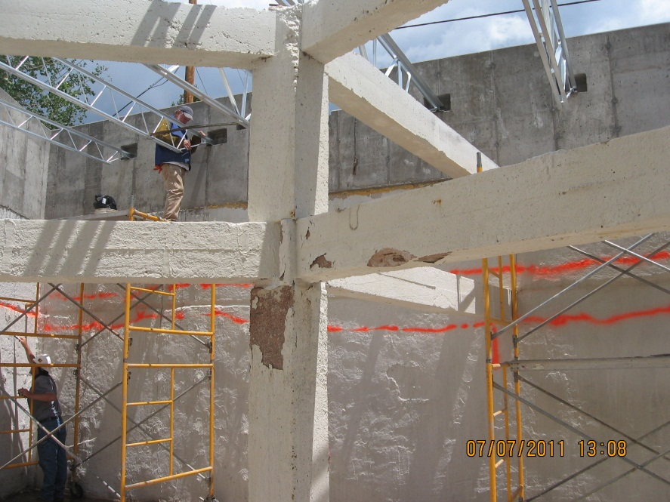
The Engineering Profession
Construction:
Bidding on Design
Construction Management
As Built Drawings

Slide 23
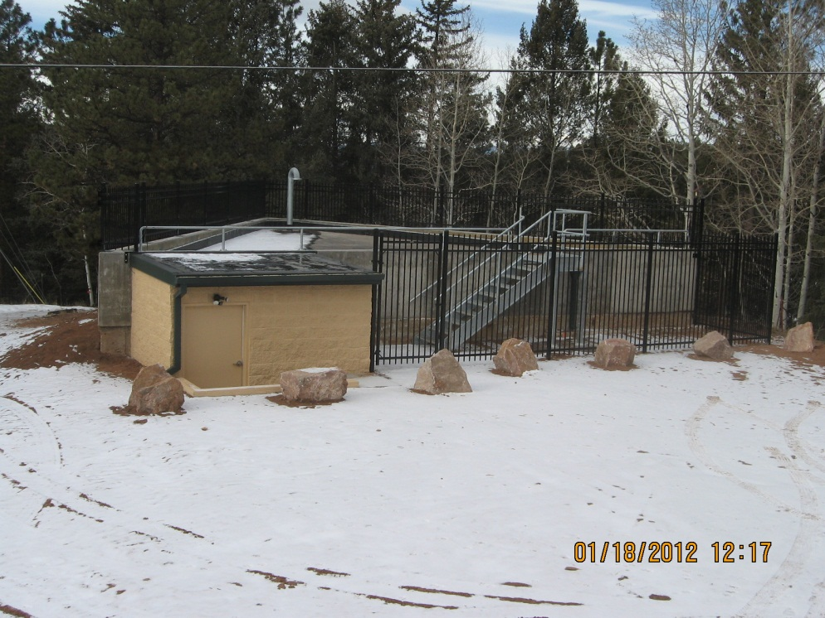
The Engineering Profession
Summary:
Civil Engineers are Problem Solvers
Our Solutions MUST be
Cost Effective
Address Public Concerns
Realistic

Slide 24
Questions?
Liz Staten:
liz.staten@hdrinc.com
Melanie Jollett:
mjollett@csu.org
http://www.asceville.org

Slide 25
Engineering Problems and Solutions
Notes:
Problems: Unsanitary drinking water – same water used for cleaning, bathing and drinking
Erosion
no roads
No water storage
Good: retaining walls are reducing erosion
Solutions: waste water treatment
finding a clean water source
constructing road/trail access
erosion control – adding more vegetation

