Slide 1
Introduction to Engineering Mathematics
With Jim Paradise

Slide 2
Objectives for Today
Our objective for today is not to teach you…
Algebra,
Geometry,
Trigonometry, and
Calculus,
but rather to give you a sound understanding of what each of these are and how, and why, they are used.
My hope is that this will allow you to make informed decisions in the future when choosing math classes.

Slide 3
Definitions
Algebra – the study of mathematical operations and their application to solving equations
Geometry – the study of shapes
Algebra is a prerequisite
Trigonometry – the study of triangles and the relationships between the lengths of their sides and the angles between those sides.
Algebra and Geometry are prerequisites
Calculus – the mathematical study of change
Differential Calculus – concerning rates of change and slopes of curves
Integral Calculus – concerning accumulation of quantities and the areas under curves
Algebra, Geometry, and Trigonometry are prerequisites

Slide 4
Who needs Calculus?
Math Courses Required for B.S. in Engineering Degree
Calculus 1 for Engineers
Calculus 2 for Engineers
Calculus 3 for Engineers
Linear Algebra & Differential Equations
Prerequisite Math Courses for Calculus 1
College Algebra and College Trigonometry or
Pre-Calculus
Partial List of Degrees requiring math through Calculus 1 or higher
Chemistry
Geology
Economics
Masters in Business Administration
Math
Physiology
Engineering
Physics

Slide 5
How Old is this stuff?
Algebra – Ancient Babylonians and Egyptians were using algebra by 1,800 B.C.
Geometry – Egypt, China, and India by 300 B.C.
Trigonometry – by 200 B.C.
Calculus and Differential Equations - by the 1,600’s

Slide 6
Algebra Properties
Commutative Property
a + b = b + a
ab = ba
Associative Property
(a + b) + c = a + (b + c)
(ab)c = a(bc)
Distributive Property
a (b + c) = ab + ac

Slide 7
Rules of signs
Negative (-) can go anywhere.
Two negatives = positive
Order of Operations
PEMDAS (Please Excuse My Dear Aunt Sally)
Parenthesis and Exponents first, then
Multiply and Divide, then
Add and Subtract

Slide 8
Exponents and Polynomials
Exponents
x² = x times x
x³ = x times x times x times
Polynomials
x² + 4x + 3
7x³ - 5x² + 12x - 7
Factoring
x² + 4x + 3 = (x + 1)(x + 3)

Slide 9
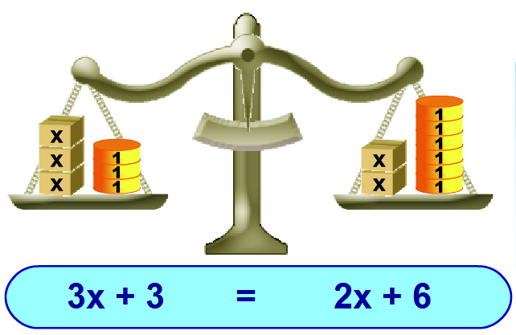
Solving Equations – Keep Balance
Try to get to form: x = value

Slide 10
Solving Equations
3x + 3 = 2x + 6 solve for x
Subtract 2x from each side
3x + 3 – 2x = 2x + 6 – 2x
x + 3 = 6
Subtract 3 from each side
x + 3 - 3 = 6 – 3
X = 3 (answer)

Slide 11
Equations of Lines
Standard Form: y = mx + b, where
m is slope of line and
Positive slope = ___
Negative slope = ___
Zero slope = ___
b is the y-axis intercept
a
b
c

Slide 12
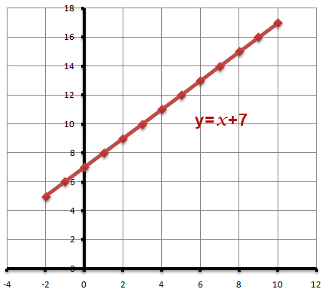
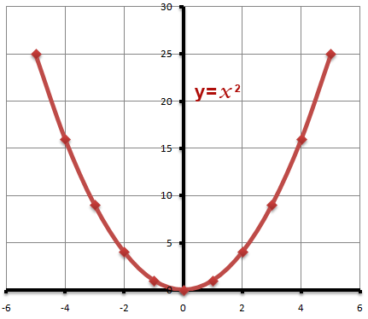
Graphing (2 dimensional)

Slide 13
Geometry – the study of shapes

Slide 14
Triangles
Area = ½ bh where b is base and h is height
Perimeter = a + b + c
Angles add up to 180º
a
c
h
b

Slide 15
Circles
Area = πr² where r is the radius of the circle
Circumference = 2πr = 2d
d (diameter) = 2r (radius)

Slide 16
Angles Geometry
Opposite angles are equal
angle a = angle d
angle b = angle c
Supplementary angles = 180º
a + b = 180º
b + d = 180º
c + d = 180º
a + c = 180º
a b
c d

Slide 17
Trigonometry – Study of Triangles
Every Right Triangle has three sides
Hypotenuse
Opposite
Adjacent
hypotenuse

Slide 18
Similar Triangles
Known Triangle
60º
2
1
30º
10
b
a
0.5
30º
30º

Slide 19
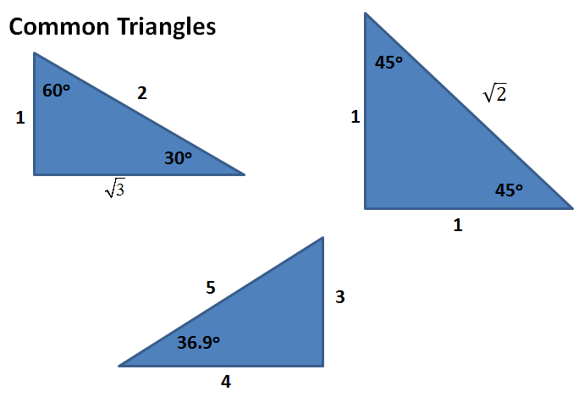
Common triangles

Slide 20
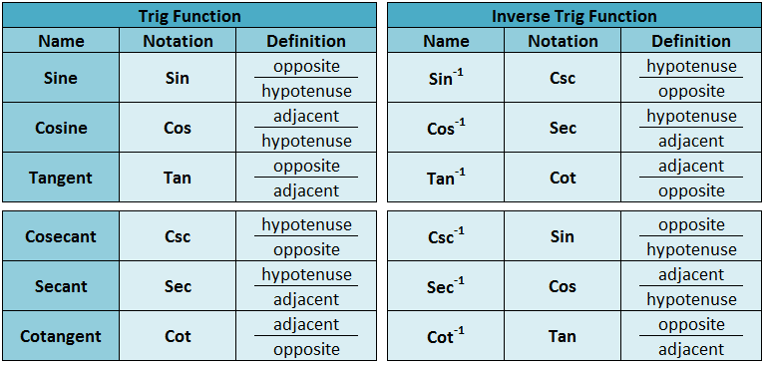
Trig Functions (ratios of triangle sides)

Slide 21
x
20
28º
2000
50º
20
x
xº
40

Slide 22
Real Trig Problems
How wide is the Missouri River?

Slide 23
Real Trig Problems
How wide is the Missouri River?

Slide 24
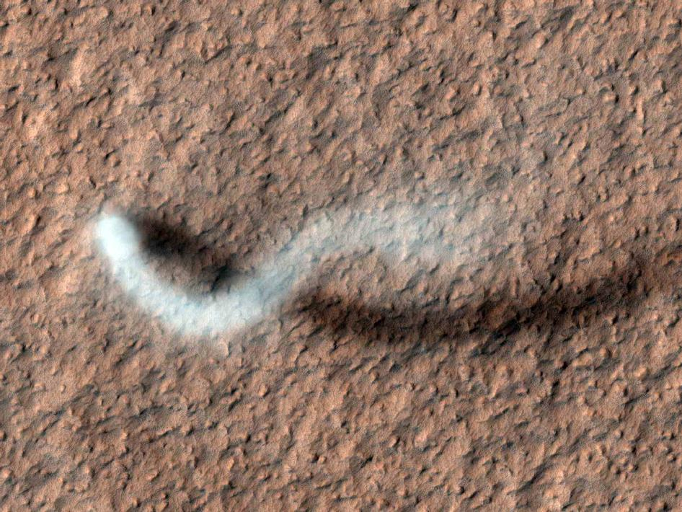
Mars Reconnaissance Orbiter Found an Enormous Dust Devil on Mars
Mars Mission Control
Image Courtesy NASA
We used trigonometry to calculate its height

Slide 25
How Tall is this Martian Dust Devil?
The length of the shadow is approximately 483 meters
The angle of the Sun over the ground is approximately 59 degrees
Calculate the height of the dust devil
Image Courtesy NASA
Dust Devil
h
59⁰
Shadow
483 m

Slide 26
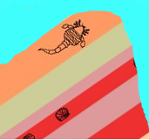
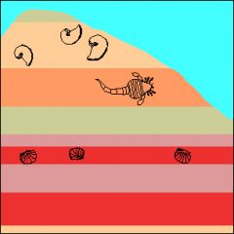
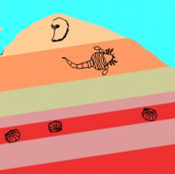
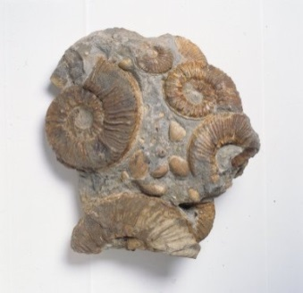
How Do You Hunt Dinosaurs?
Location 3
Where can you find ammonites?
Image Courtesy Berkeley
Location 2
Location 1
Image Courtesy DMNS
Learn where fossils have been found in the past, and identify the rock layer that had those fossils.
Trace that layer to new locations and search for new fossils.
We used trigonometry to measure rock layer thicknesses.
Digging Up Dinosaur Bones

Slide 27
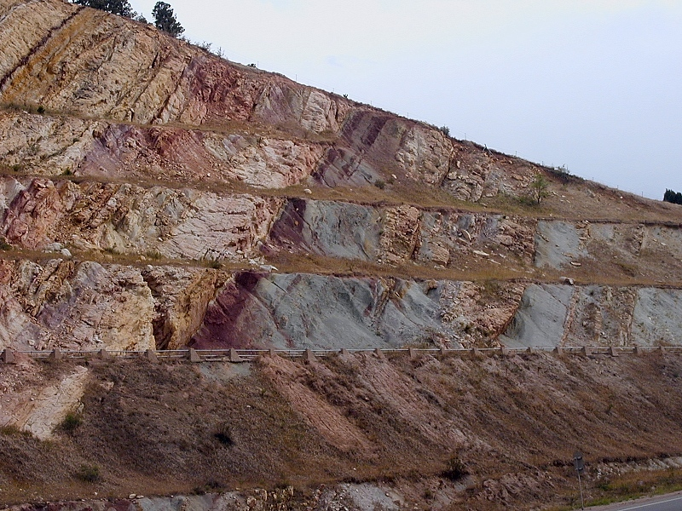
How Thick is This Rock Layer Near Dinosaur Ridge?
My paleontology class measured 5 m along the walkway
The angle of the layer to the walkway was 50 degrees
What is the height of the layer?
h
50⁰
5 m

Slide 28
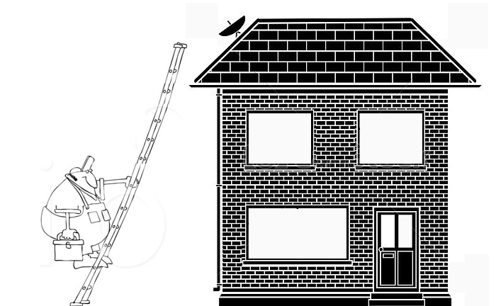
How long should the ladder be?
16 feet
75º

Slide 29
How tall is the tree?

Slide 30
How tall is the tree?
23º
200’
X
= tan 23º
200
x
X = 200 tan 23º
23º
200
X = 85’

Slide 31
Calculus – 3 Areas of Study
Limits
Used to understand undefined values
Used to derive derivatives and integrals
Differential Calculus
Uses derivatives to solve problems
Great for finding maximums and minimum values
Integral Calculus
Uses integrals to solve problems
Great for finding area under a curve
Great for finding volumes of 3 dimensional objects

Slide 32
Limits

Slide 33
Differential Calculus
Function derivative (slope of tangent line)
f(x) = x^{n}
f’(x) = nx^{n-1}

Slide 34
Find the dimensions for max area
You have 500 feet of fencing
Build a rectangular enclosure along the river
Find x and y dimensions such that area is max
Y
Maximum Area
X
X
River

Slide 35
Find the maximum value…
Using two non-negative numbers
Whose sum is 9
The Product of one number and the square of the other number is a maximum

Slide 36
Find dimensions that give max volume…
One square foot of metal material (12”x12”)
Cut identical squares out of the four corners
Fold up sides to made a square pan
What dimension of x gives the largest volume?
X
X
X
X
12 -2x
12
X
X
X
X

Slide 37
Slope of Tangent Line
Derivative gives slope of tangent line at point x
f(x) = x²
f’(x) = 2x
Point on Curve (1,1)
Slope of tangent = 2
Point on Curve (2,4)
Slope of tangent = 4

Slide 38
Integral Calculus
Function Anti-derivative
f(x) = x^{n} F(x) = x^{n+1}

Slide 39
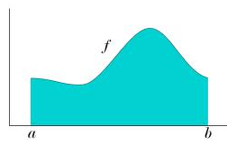
Integrals
Where G(a) is the anti-derivative of a

Slide 40
Area under a curve
Integral gives area under the curve
f(x) = x²
$\int_{0}^{4}{x2dx}$ = $\frac{x3}{3}$
$\frac{43}{3}−\frac{03}{3}=\frac{64−0}{3}=\frac{64}{3}$

Slide 41
Where can you get Math help?
Math help for Free: http://www.khanacademy.org/

