Slide 1
Shades of Blue Hovercraft
Feb 23 2013

Slide 2
Agenda
Terms and Concepts
What is a Hovercraft?
Questions
Experiment Set Up
Compile Results
Conclusion

Slide 3
Terms and Concepts
Hovercraft
Air cushion
Friction
Volume
Ground Effects

Slide 4
What is a Hovercraft?
Vehicle that glides over a smooth surface
Hovers upon an air cushion
Also called Air-Cushion Vehicle (ACV)
How is the air cushion made?
Slow-moving, low pressure air that is pushed downward against the surface below the hovercraft
Use of fans to create the air
Flexible skirt (curtain) surrounding base traps the air current
How do you steer a hovercraft

Slide 5
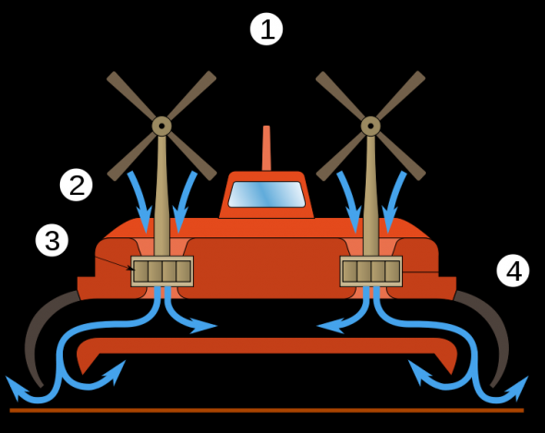
Principle of a Hovercraft
The Propellers (1) are used to propel the hovercraft forward, but also used to drive the fans (3) through which air is sucked (2), forcing the skirt (4) to billow out, and the hovercraft to float above the ground.

Slide 6
Hovercraft Film
http://www.youtube.com/watch?v=BvzetZSxuIc
http://www.youtube.com/watch?v=kwC8MP6uOiQ
http://www.youtube.com/watch?v=vqAAEHgN5zk
http://www.youtube.com/watch?v=e1xDkmd0qFY

Slide 7
Let’s Experiment
Materials
Pop-top lid from a plastic drinking bottle. (Reusable plastic drinking bottles sometimes use these kinds of lids.)
A CD or DVD
Craft glue or Super Glue
Measuring Device
A medium-size balloon (should be able to inflate up to at least 30 inches)
Stopwatch or timer
Large flat surface for testing the hovercraft

Slide 8
Preparation
Remove a pop-top lid from a plastic drinking bottle.
Glue the base of the lid to the CD (or DVD) so that the lid covers the hole in the center. Use caution, and follow all of the instructions and safety warnings on the packaging.
Allow the glue to dry completely.

Slide 9
Roles
Team Lead
Person to inflate balloon
Person to measure
Time Keeper
Recorder

Slide 10
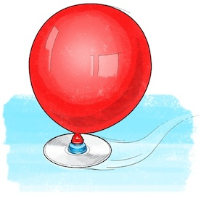
Procedure
Blow the balloon up to the desired size as shown on the marked yarn (2nd mark 30” circumference, 1st mark 20” circumference), then pinch the neck so that no air can escape.
Stretch the neck of the balloon over the pop-top lid, being careful not to let any air escape. Carefully center the balloon's opening above the pop-top lid opening. Your completed hovercraft should have CD flat on the bottom, pop-tip lid above and the inflated balloon's neck stretched snugly around the closed lid.
Your hovercraft is now ready to do some hovering!

Slide 11
Instructions
Place the hovercraft on a flat surface. Start your stopwatch or timer, open the pop-top lid and push the hovercraft. Stop the stopwatch when the hovercraft stops hovering.
Write down how long the hovercraft hovered
Detach the balloon from the pop-top lid.
Repeat this process two more times, inflating the balloon as large as you safely can, reattaching it to the pop-top lid, and timing how long the hovercraft hovers.
Calculate the average of the three test cases

Slide 12
Instructions
Repeat this process three more times, but this time only inflate the balloon to the first mark (20”).
How long did the CD hover using the 30” circumference inflated balloon? Did the craft hover for about the same amount of time each of the three times you tested it using a small balloon?
What about the 20” circumference?

Slide 13
Capture Your Results
Trial | Circumference 30 inches | Circumference 20 inches
#1
#2
#3
Average Time
Air Volume

Slide 14
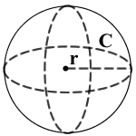
Estimate Volume of Air in Balloon
The formula for the volume of a sphere is traditionally given as a function of the radius. However, in practical applications, it is not always easy to determine the diameter or radius of a round object.
The circumference of a ball of sphere is much easier to measure. Simply wrap the pre-marked yarn around the widest part of the sphere (the equator) . And since the circumference and radius are related by a simple formula, you can then determine the radius of the object, and finally the volume.
3

Slide 15
Equation for Volume
The Equation for Volume in Terms of the Circumference
First recall the formulas for volume (v) and circumference (c) in terms of the radius (r).
v = (4/3)πr³
c = 2πr
If you solve the second equation for r, you get
c/(2π) = r
Now plug this into the volume equation. That is, you replace r with the expression c/(2π).
v = (4/3)π[c/(2π)]³
= (4/3)π[c³/(8π³)]
= c³/(6π²)

Slide 16
Equation for Volume
The Equation for Volume in Terms of the Circumference
First recall the formulas for volume (v) and circumference (c) in terms of the radius (r).
v = (4/3)πr³
c = 2πr
C=30”
If you solve the second equation for r, you get
c/(2π) = r
Now plug this into the volume equation. That is, you replace r with the expression c/(2π).
v = (4/3)π[c/(2π)]³
= (4/3)π[c³/(8π³)]
= c³/(6π²)
=27000/59.15
=456 cu inches of air

Slide 17
Now Let’s Solve it for a 20” Circumference
The Equation for Volume in Terms of the Circumference
First recall the formulas for volume (v) and circumference (c) in terms of the radius (r).
v = (4/3)πr³
c = 2πr
C=20”
If you solve the second equation for r, you get
c/(2π) = r
Now plug this into the volume equation. That is, you replace r with the expression c/(2π).
v = (4/3)π[c/(2π)]³
= (4/3)π[c³/(8π³)]
= c³/(6π²)
= c³ /59.15
=8000/59.15
=135 cu inches of air

