Slide 1
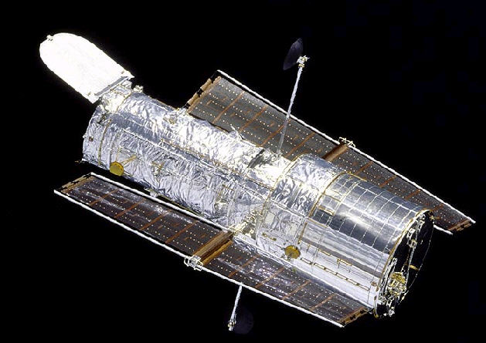
HUBBLE Space Telescope
1st of 4 Great Observatories
Launched 24 April 1990
Images credit: NASA/JPL-Caltech

Slide 2
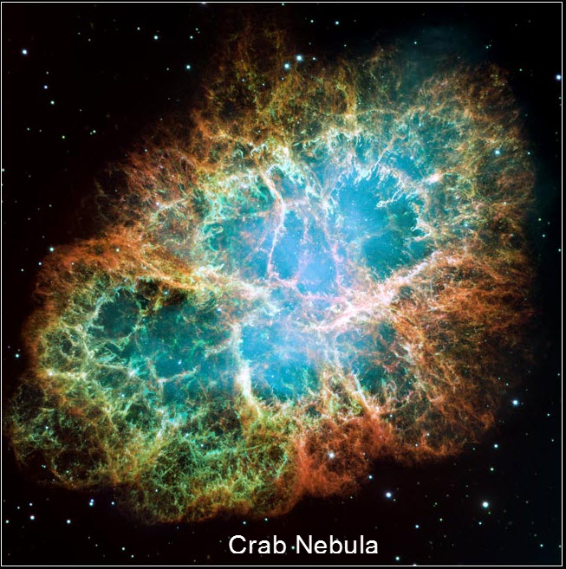
Images credit: NASA/JPL-Caltech

Slide 3
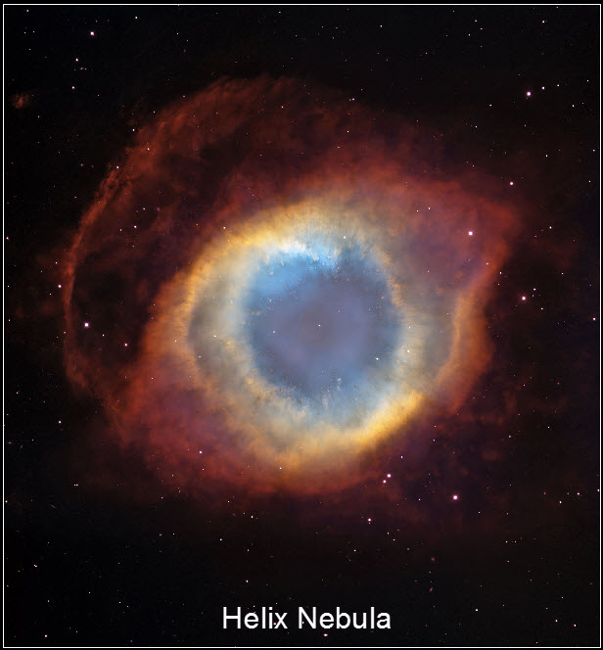
Images credit: NASA/JPL-Caltech

Slide 4
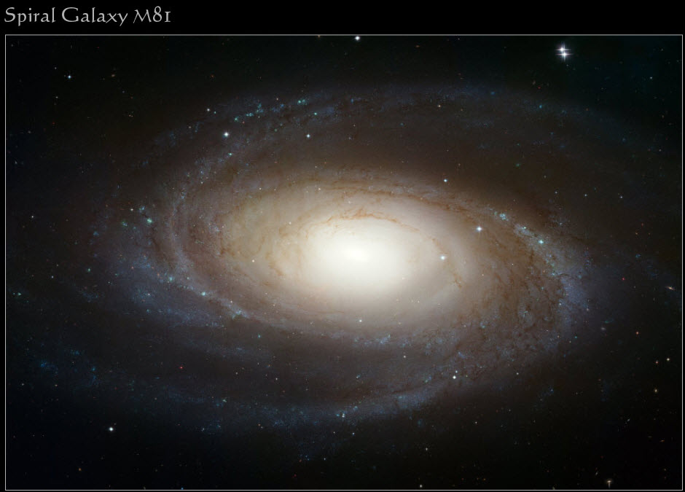
HUBBLE Photo of Cat’s Eye Nebula
Images credit: NASA/JPL-Caltech

Slide 5
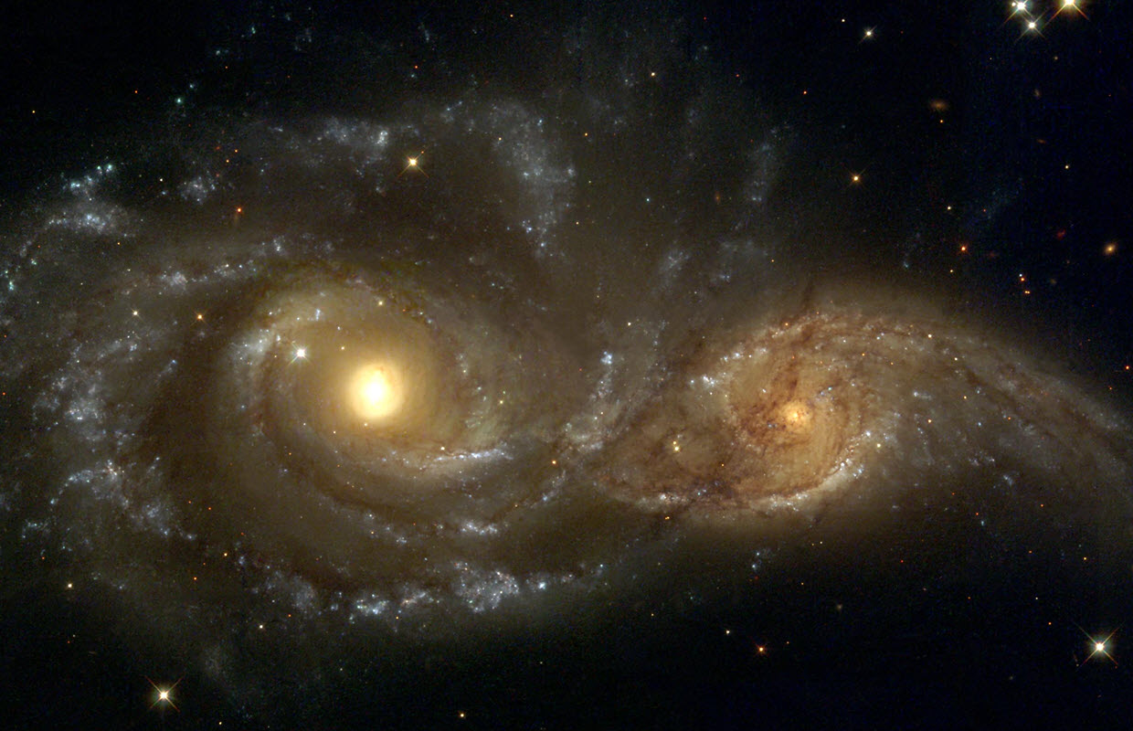
Two Galaxies Colliding
Images credit: NASA/JPL-Caltech

Slide 6
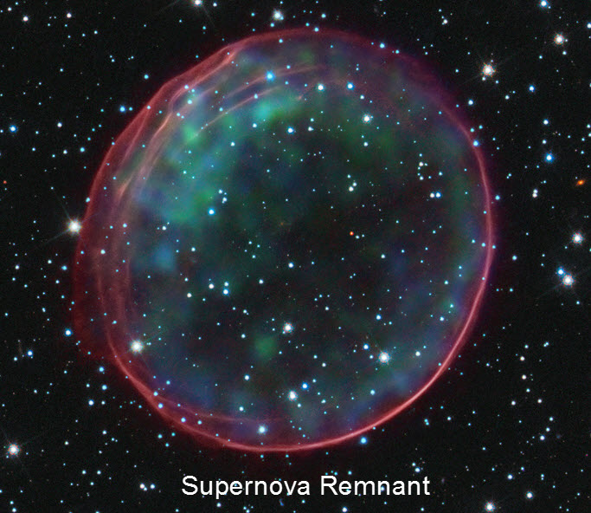
Images credit: NASA/JPL-Caltech

Slide 7
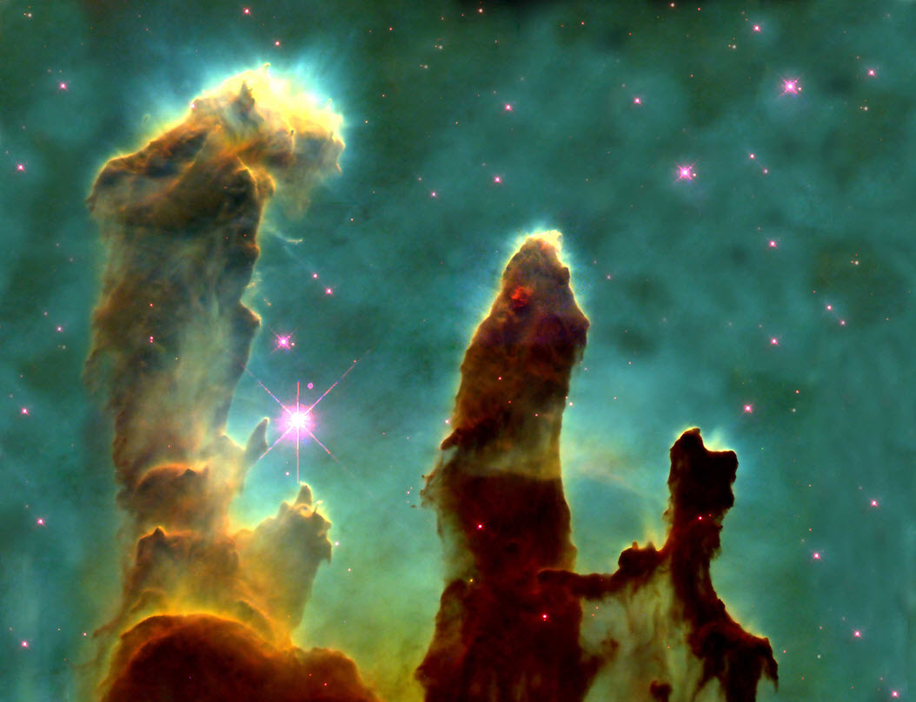

Slide 8
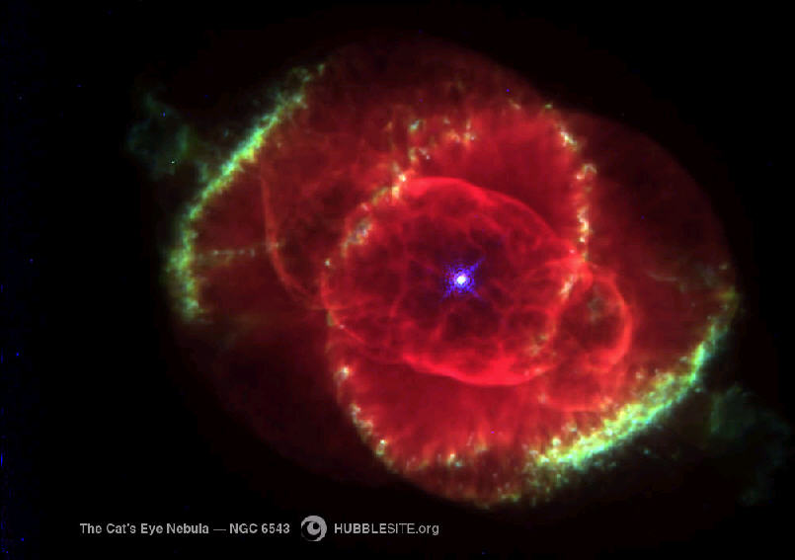
HUBBLE Photo of Cat’s Eye Nebula
So……….How good is Hubble?
Images credit: NASA/JPL-Caltech

Slide 9
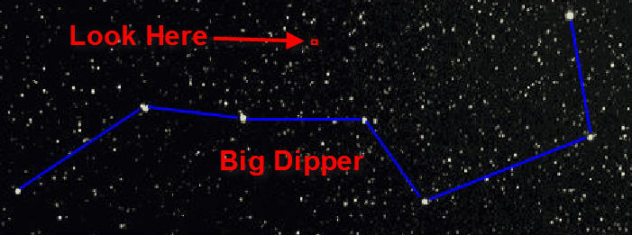
After servicing……How good is Hubble?
No Earth-based telescopes can see anythign in the red square, so…
let’s have Hubble look there
Images credit: NASA/JPL-Caltech

Slide 10
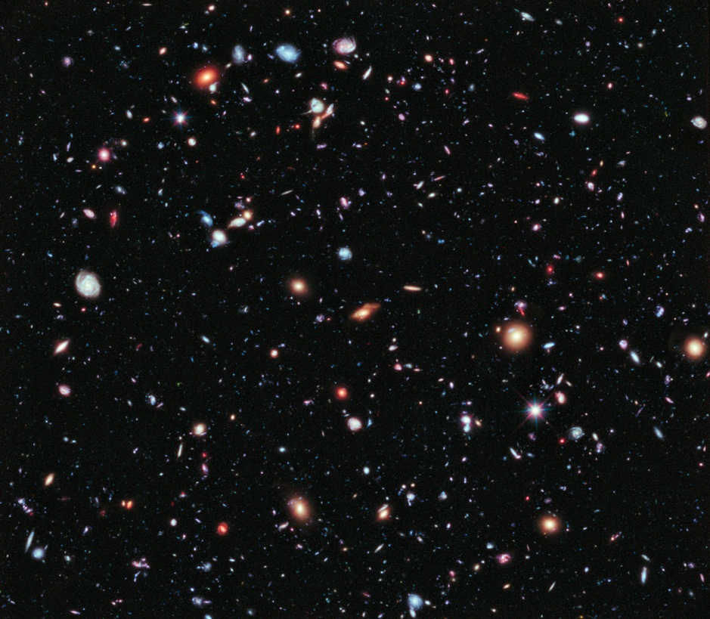
Images credit: NASA/JPL-Caltech

