Slide 1
Human Exploration Update
Jim Paradise

Slide 2
International Space Station (ISS)
This is the furthest we have gone in 42 years

Slide 3
The Old: Space Shuttle (now retired)
Image credit: NASA/JPL-Caltech
SLS

Slide 4
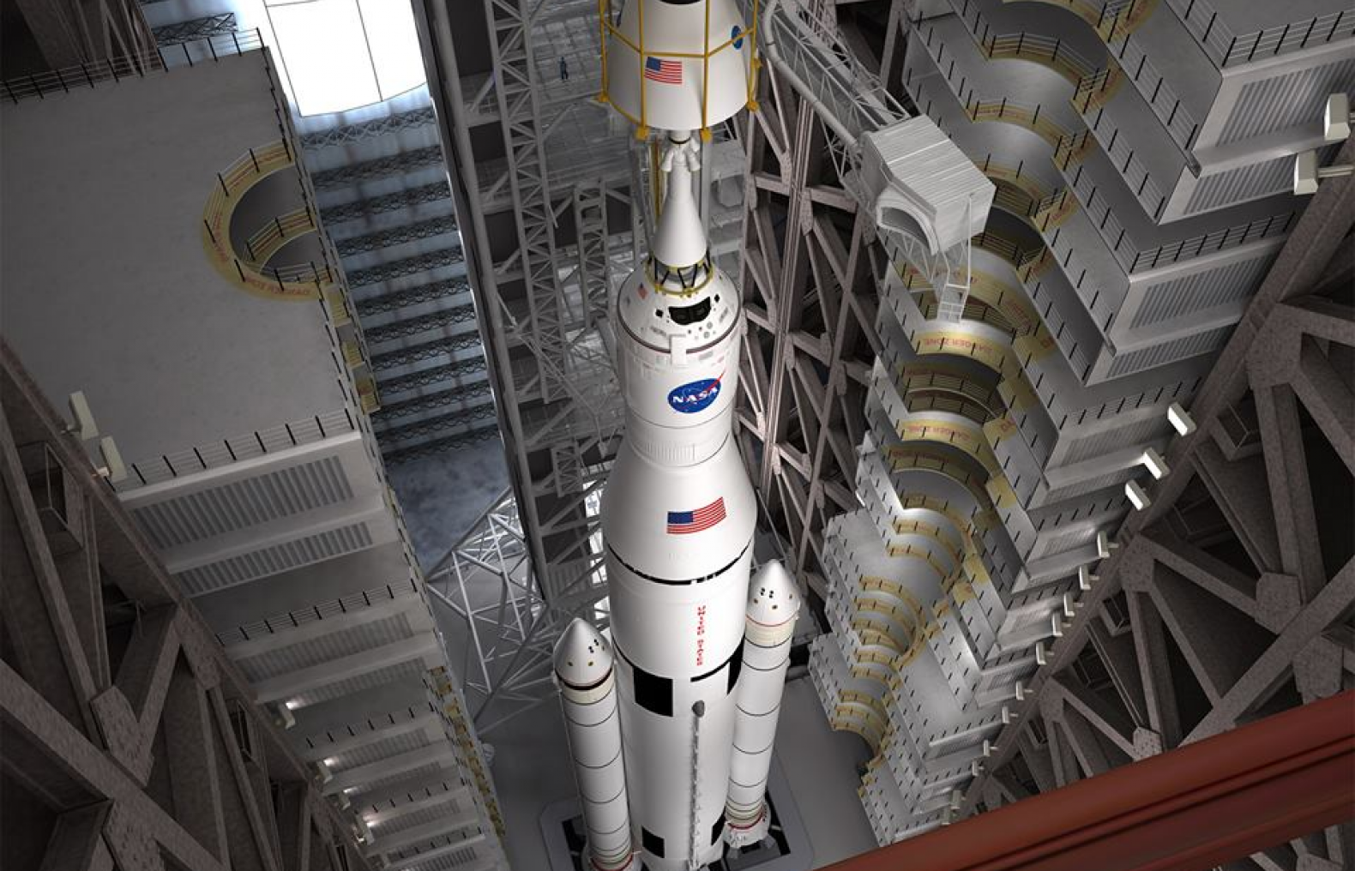
The New - Exploration Systems Development
Orion Program
Space Launch System (SLS)
Ground System Development
Notes:
Exploration Systems Development:
The Exploration Systems Development, or ESD, team is made up of the Orion Program, based at the Johnson Space Center in Houston, Texas; the Space Launch System (SLS) Program based at Marshall Space Flight Center in Huntsville, Alabama; and the Ground Systems Development and Operations Program based at Kennedy Space Center in Florida.
The Orion spacecraft is currently being assembled and tested in preparation for it’s first launch later this year on Exploration Flight Test-1. The flight will give engineers the opportunity to evaluate critical systems, such as Orion’s heat shield, parachutes, avionics and attitude control.
Engineers and technicians at NASA’s Marshall Space Flight Center are building the Orion-to-launch-vehicle adapter flight hardware for the first mission, which provides early flight experience for SLS hardware and a chance to fine-tune processes.
The Ground Systems Development and Operations team will process and launch the Orion spacecraft as well as perform the full mission recovery activities for Orion’s first mission, including the West Coast recovery, de-servicing and land transport back to NASA’s Kennedy Space Center. Kennedy’s Firing Room-1, updated from its shuttle days, will actively follow the mission and recovery, providing valuable developmental learning opportunities for future flights.

Slide 5
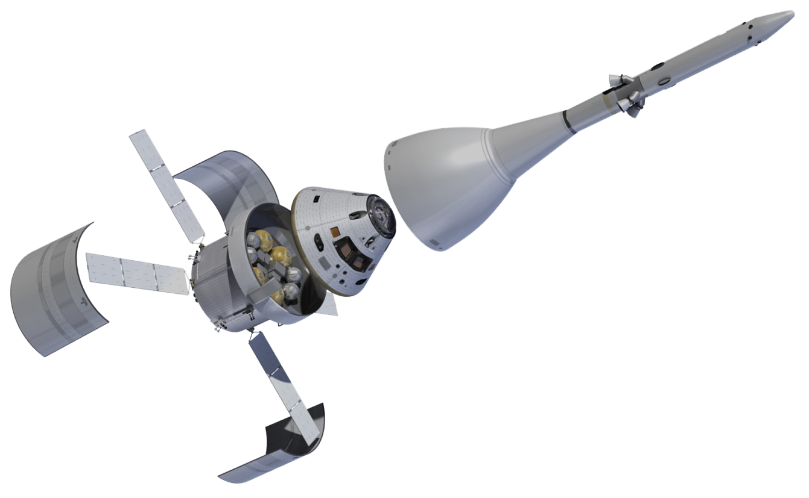
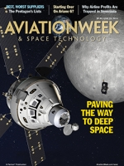
Orion
Objective:
Take humans safely beyond LEO …
… and return them safely back to Earth
Launch Abort System
Protection for the CM
Jettison after first stage flight
Crew Module
Service Module
June 23, 2014 Aviation Week

Slide 6
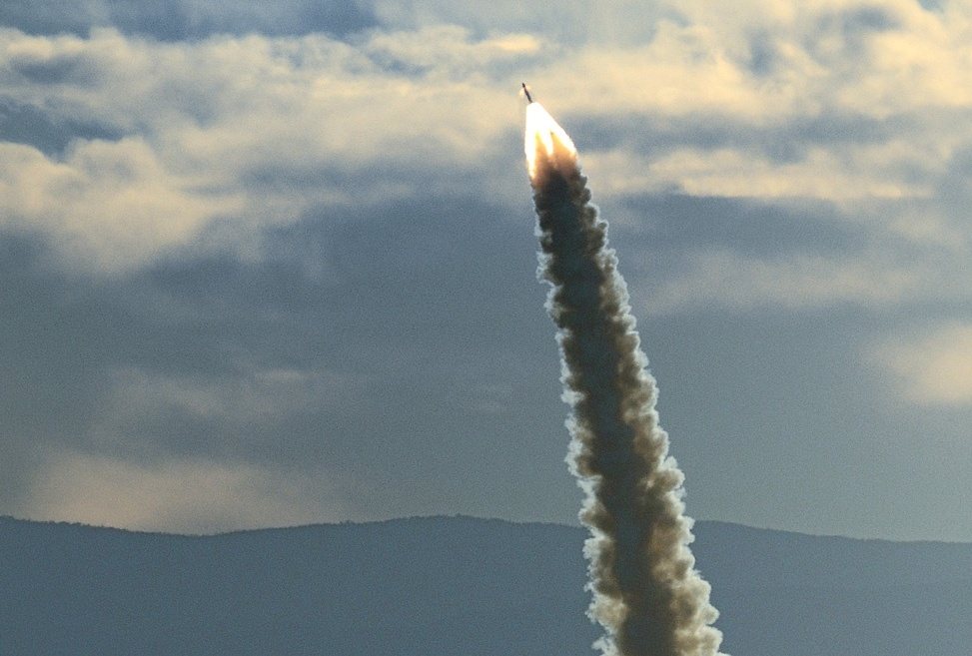
Orion Pad Abort Test (2010)
3 new solid rocket motors, successfully fired and operated together as a system during the successful Pad Abort 1 flight test
Enhances crew safety
by providing crew escape capability in the event of pad or ascent emergencies
Expands the envelope
of survivable abort conditions over previous abort systems by providing active attitude control during aborts.
Pad Abort 1 Flight Test Vehicle
Built
Notes:
From Wanda Sigur presentation to NEROP in Sunnyvale, CA, September 2014 and has prior PIRA approval
In a launch pad abort, Orion’s launch abort system would accelerate from 0 to 500 mph in 2 seconds – nearly six times faster than the average roller coaster!
A typical high performance sports car goes 0 to 60 mph in about 4 seconds. It would take those kinds of cars 32 seconds to get to 500 mph, which is impossible since they cannot go that fast!
At take-off, a Boeing 747 is going approximately 225 mph and requires at least 10 seconds to get to that speed; its fastest cruising speed is 570 mph.
An aircraft carrier catapult can loft 45,000 pounds from 0 to 165 mph in 2 seconds – not bad, but Orion’s launch abort system is still nearly three times faster.
A power plant with Orion’s launch abort motor’s energy would be able to power 13,000 houses for a day.

Slide 7
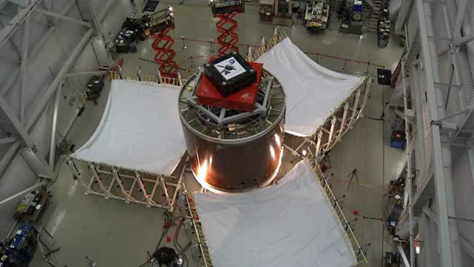
Service Module Fairing Separation Test
Notes:
From Wanda Sigur presentation to NEROP in Sunnyvale, CA, September 2014 and has prior PIRA approval
Service Module Fairings:
Three massive Exploration Flight Test-1 (EFT-1) spacecraft fairing panels encase Orion’s service module and shield it from the heat, wind and acoustics it will experience during the spacecraft’s climb into space.
Unlike conventional rocket fairings, these panels are designed to support half of the weight of Orion’s crew module and launch abort system during launch and ascent, which improves performance, saves weight and maximizes the size and capability of the spacecraft.
The fairings’ work is done soon after launch. They must be jettisoned when Orion has reached an altitude of about 560,000 feet.
To make that possible, six breakable joints and six explosive separation bolts are used to connect the fairing panels to the rocket and each other.
In a carefully timed sequence, the joints are fired apart, followed shortly by the bolts. Once all of the pyrotechnics have detonated, six spring assemblies will push the three panels away, leaving the service and crew module exposed to space as they travel onward.
Statistics:
Each panel is 14 feet high and 13 feet wide.
During the first test in June 2013, one of the three fairing panels did not completely detach. Engineers determined the issue was caused when the top edge of the fairing came into contact with the adapter ring and kept it from rotating away and releasing from the spacecraft.

Slide 8
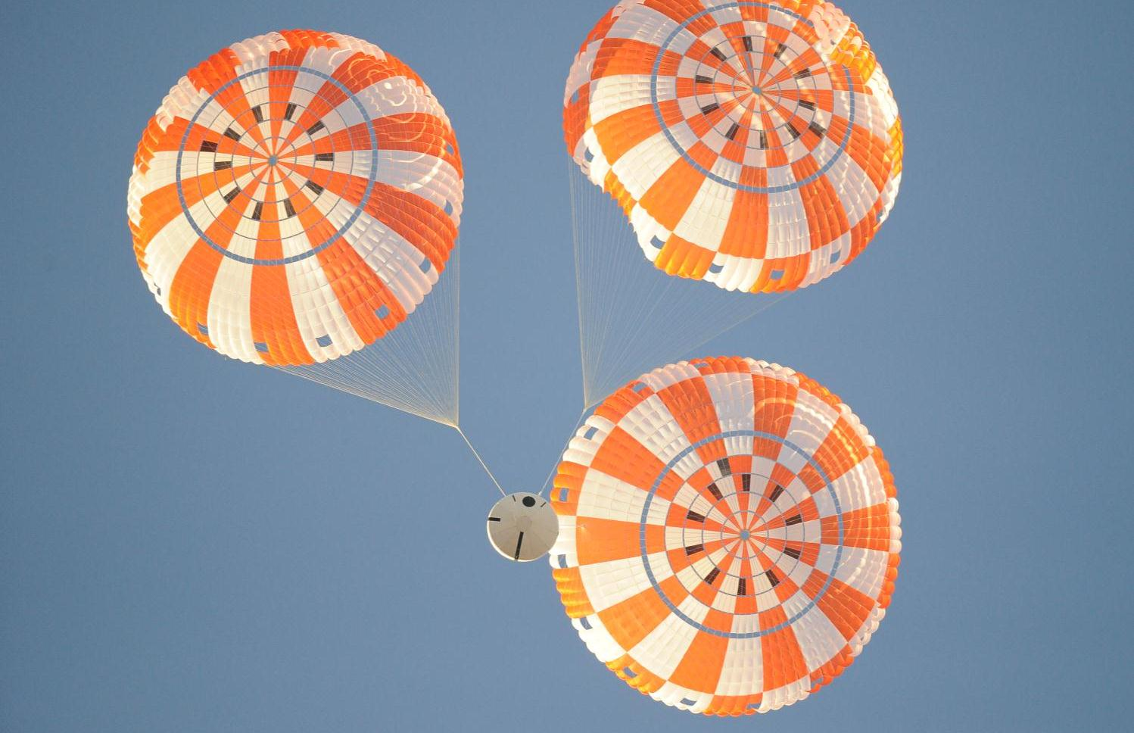
Parachute Drop Tests
ARMY YUMA PROVING GROUND, AZ
Notes:
From Wanda Sigur presentation to NEROP in Sunnyvale, CA, September 2014. Image credit: NASA
Parachute Drop Tests:
Orion’s Capsule Parachute System (CPAS) is a system of 11 parachutes that will slow the Orion crew module during the last part of re-entry from 324 mph to 17 mph at splashdown.
The first set of parachutes will be used to pull off the forward bay cover, which protects the parachutes during flight.
Next, drogue parachutes slow the spacecraft down to 307 mph after which pilot parachutes help direct the deployment of three main parachutes.
The massive main parachutes used in the final stages of landing slow the spacecraft to a safe splashdown speed.
Interesting Facts:
All three main parachutes combined would cover a football field from 10 yard line to 10 yard line.
The suspension lines on the three main parachutes combined are approximately 10 miles total length.

Slide 9
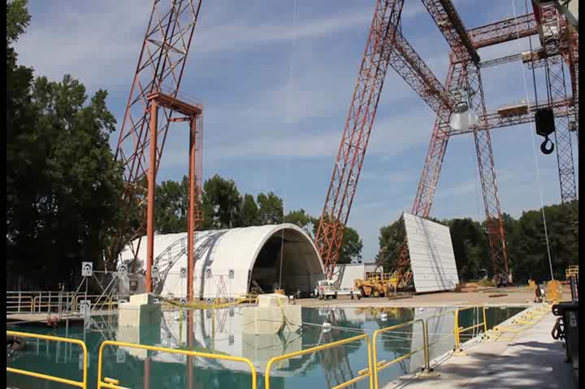
HIB Drop Tests
Notes:
From Wanda Sigur presentation to NEROP in Sunnyvale, CA, September 2014 and is NASA open content
Parachute Drop Tests:
Orion’s Capsule Parachute System (CPAS) is a system of 11 parachutes that will slow the Orion crew module during the last part of re-entry from 324 mph to 17 mph at splashdown.
The first set of parachutes will be used to pull off the forward bay cover, which protects the parachutes during flight.
Next, drogue parachutes slow the spacecraft down to 307 mph after which pilot parachutes help direct the deployment of three main parachutes.
The massive main parachutes used in the final stages of landing slow the spacecraft to a safe splashdown speed.
Interesting Facts:
All three main parachutes combined would cover a football field from 10 yard line to 10 yard line.
The suspension lines on the three main parachutes combined are approximately 10 miles total length.

Slide 10
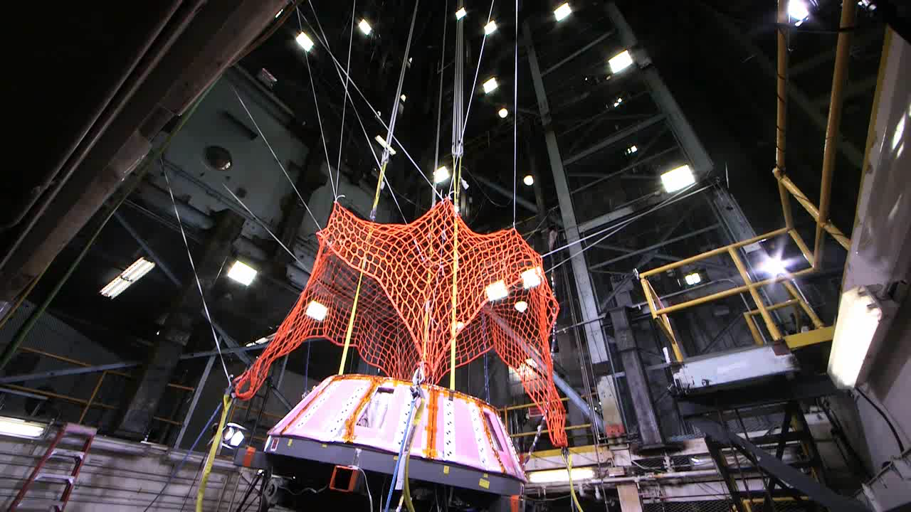
Forward Bay Cover Separation Test
Notes:
From Wanda Sigur presentation to NEROP in Sunnyvale, CA, September 2014 and has prior PIRA approval
Forward Bay Cover:
The forward bay cover (FBC) protects the top portion of the crew module during launch, orbital flight, and reentry. When Orion reenters the Earth’s atmosphere from deep space, the FBC will be jettisoned at an altitude of approximately 23,000 feet.
Since jettison of the cover is a complex event required for subsequent deployment of the main parachutes, deceleration of the vehicle and landing the crew safely, it is considered one of the top risk drivers.
Ground testing as well as testing during parachute drop tests provides critical verification data and represents a significant risk reduction for the program.

Slide 11
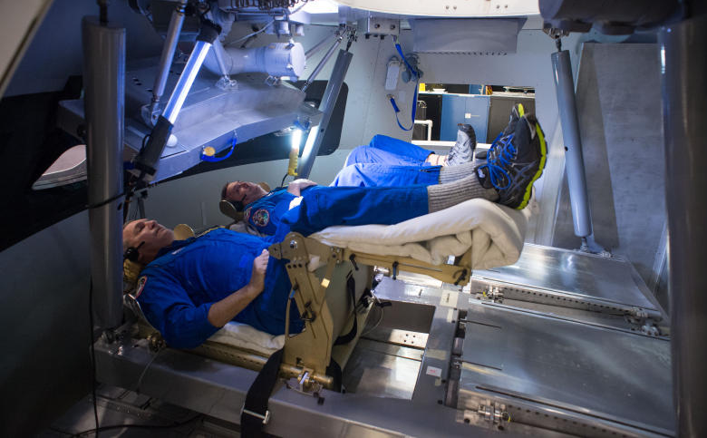
Crew Ascent Simulations
JOHNSON SPACE CENTER, TX
Notes:
From Wanda Sigur presentation to NEROP in Sunnyvale, CA, September 2014
Crew Ascent Simulations:
The first Orion ascent simulations in preparation for future crewed missions took place last September, when groups of astronauts had the opportunity to try out a prototype display and control system inside an Orion spacecraft mock-up at Johnson Space Center’s Space Vehicle Mock-up Facility.
Ascent simulations are precise rehearsals of the steps a spacecraft’s crew will be responsible for — including things that could go wrong — during their climb into space. They can be generic and apply to any future deep space mission, or very specific to a launch that’s been planned down to the second.
Photo shown here: NASA Astronauts Rick Linnehan and Mike Foreman

Slide 12
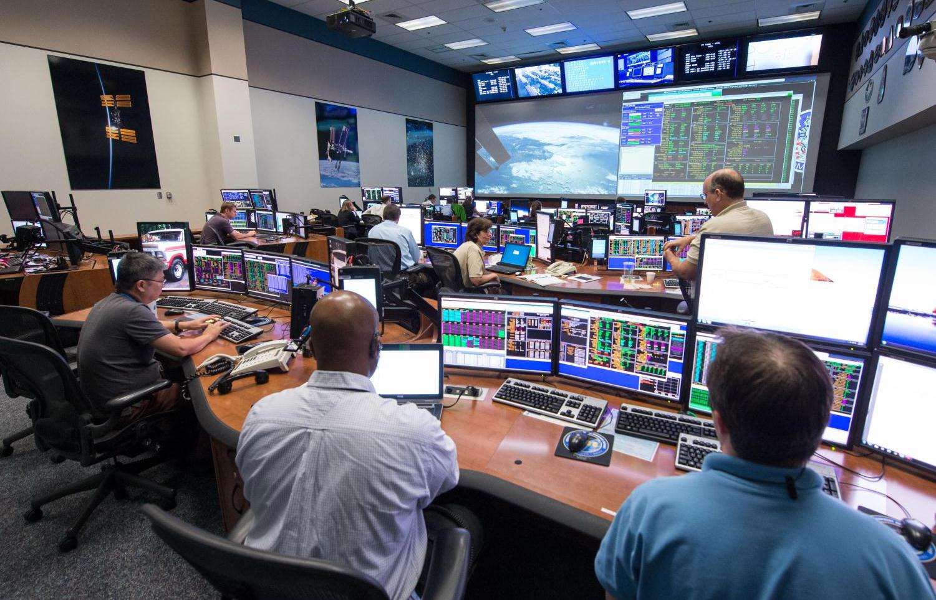
Mission Control Center Ready
JOHNSON SPACE CENTER, TX
Notes:
From Wanda Sigur presentation to NEROP in Sunnyvale, CA, September 2014
Mission Control Center:
NASA and Lockheed Martin management continue to conduct a series of operations simulation tests. These training simulations exercise the flight control teams that will monitor the Exploration Flight Test-1 (EFT-1) mission.
Interesting Facts:
The Blue Flight Control Room in Mission Control was used for the first International Space Station mission more than 15 years ago.

Slide 13
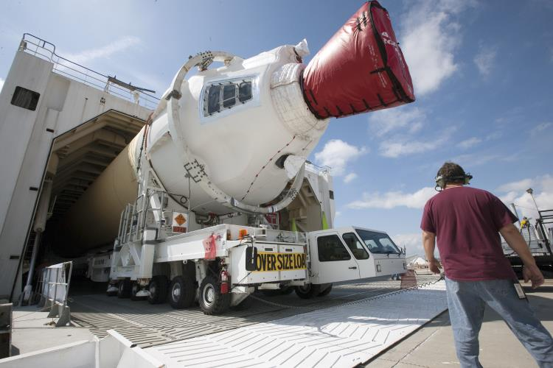
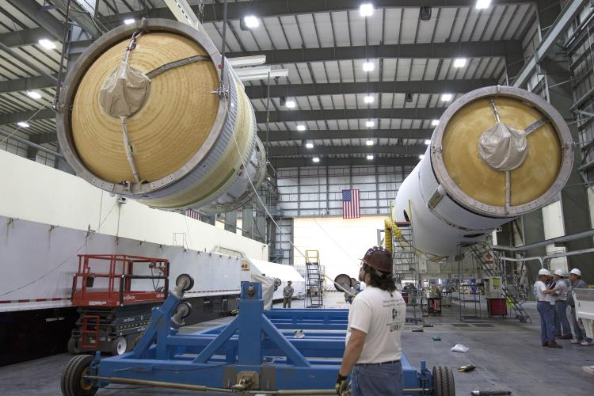
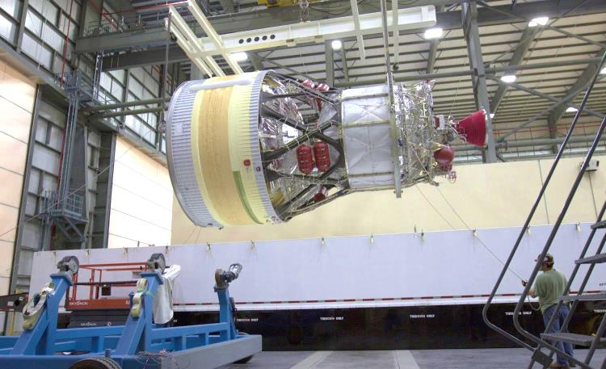
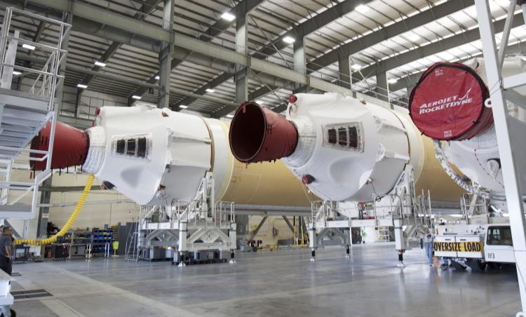
EFT-1 Delta IV Heavy Launch Vehicle
CAPE CANAVERAL AIR FORCE STATION, FL
Notes:
From Wanda Sigur presentation to NEROP in Sunnyvale, CA, September 2014

Slide 14
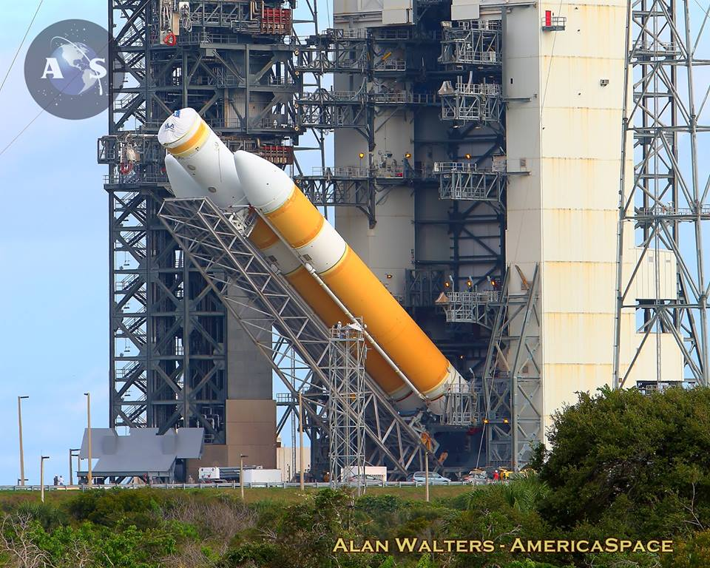
ULA Delta IV Heavy at the launch pad
JOHNSON SPACE CENTER, TX
Notes:
Image credit: NASA

Slide 15
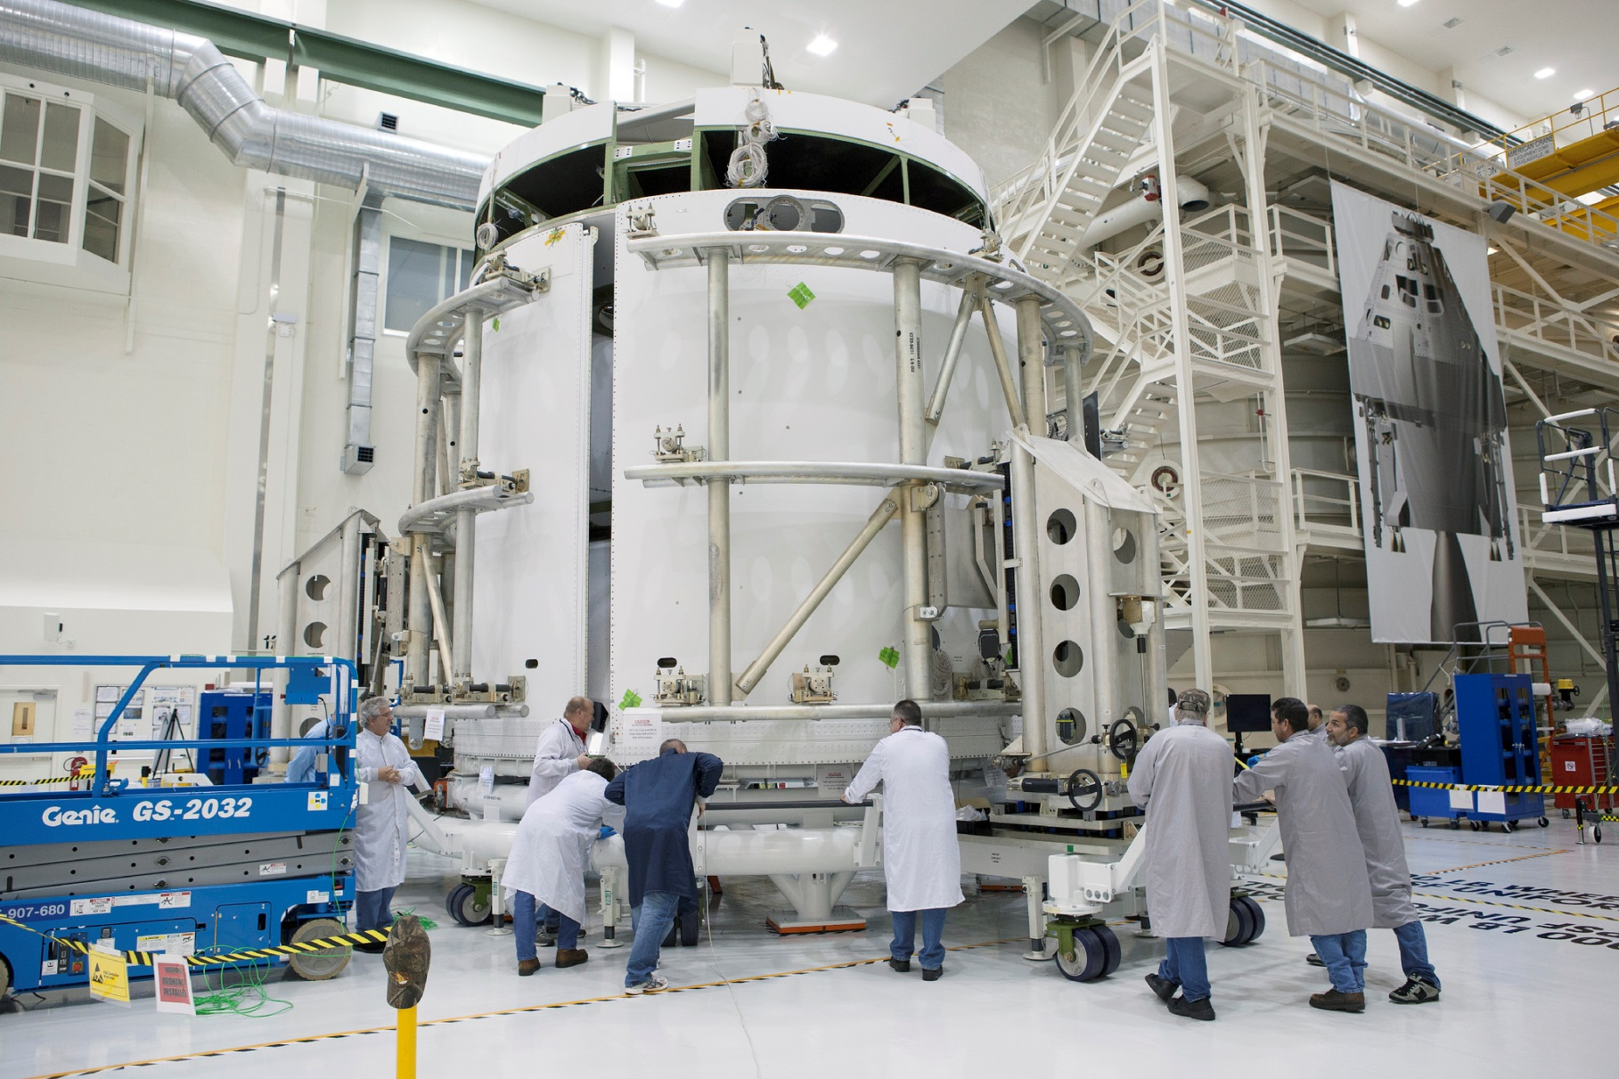
ESA Service Module Readied
KENNEDY SPACE CENTER, FL
Notes:
Image credit: NASA https://www.flickr.com/photos/nasaorion/13927100215/in/set-72157641969853204

Slide 16
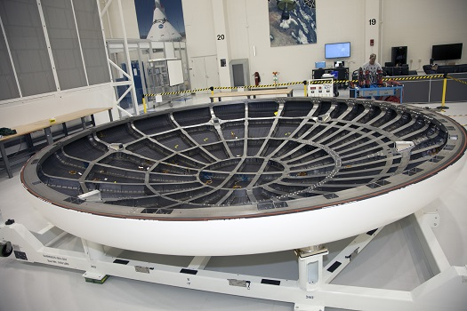
Heat Shield prepped and ready
KENNEDY SPACE CENTER, FL
Notes:
Image credit: NASA http://spacefellowship.com/news/art36556/work-on-nasa-s-new-orion-spacecraft-progresses-as-engineers-pivot-to-2014.html

Slide 17
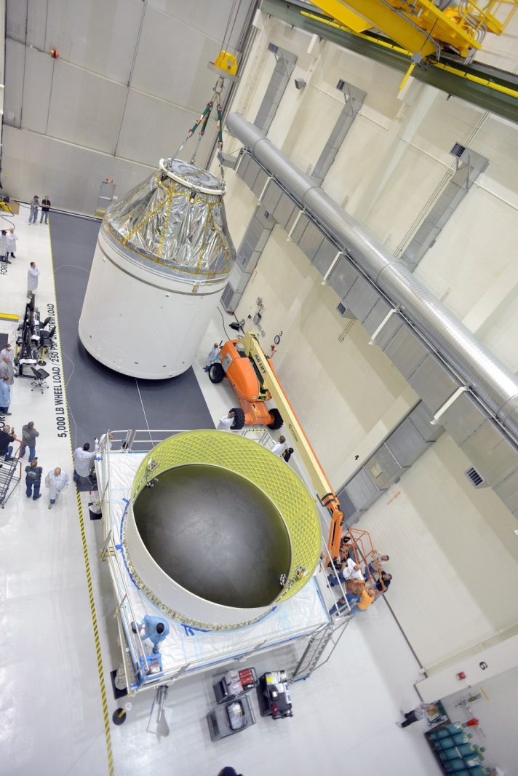
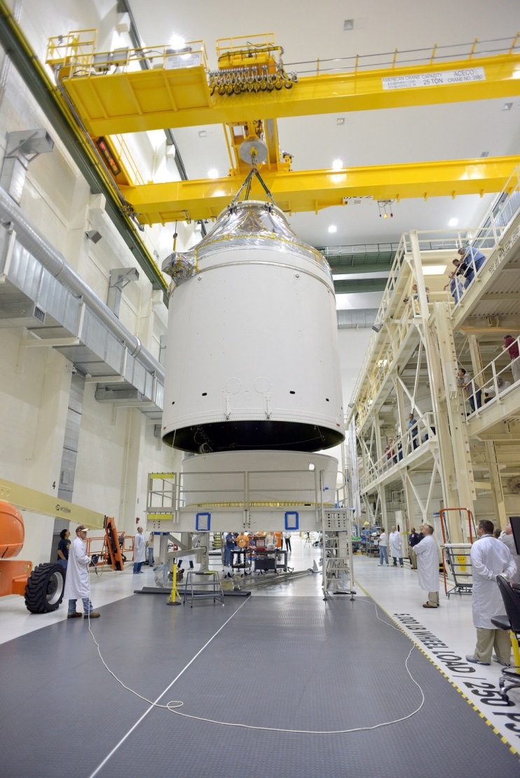
Orion-to-stage Adapter Ring Installation
Notes:
Image credit: NASA https://www.flickr.com/photos/nasaorion/15016723518/in/set-72157641969853204/ and https://www.flickr.com/photos/nasaorion/15202917792/in/set-72157641969853204

Slide 18
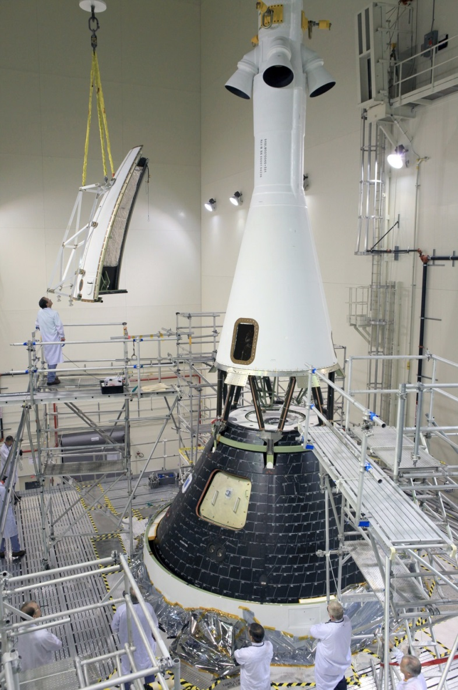
Launch Abort System Installation
Notes:
Image credit: NASA https://www.flickr.com/photos/nasaorion/15514650026/in/set-72157641969853204
And https://www.flickr.com/photos/nasaorion/15538352205/in/set-72157641969853204

Slide 19
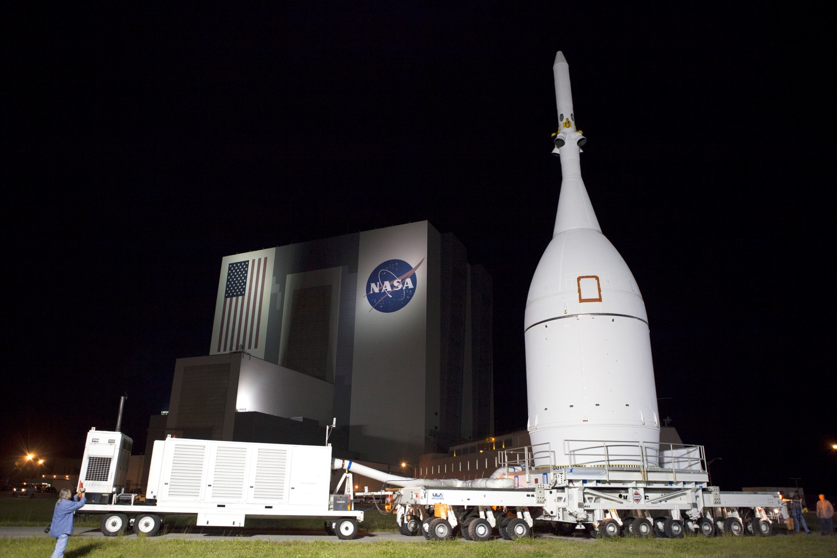
Orion stacked and moving to the launch pad
KENNEDY SPACE CENTER, FL
Notes:
Image credit: NASA http://www.nasa.gov/sites/default/files/close-up_of_orion_at_vab.jpg

Slide 20
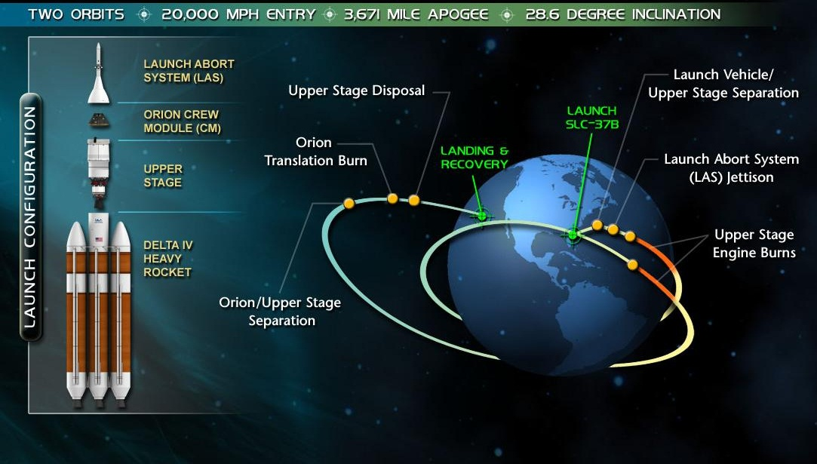
Exploration Flight Test – 1
2014
Notes:
From Wanda Sigur presentation to NEROP in Sunnyvale, CA, September 2014

Slide 21
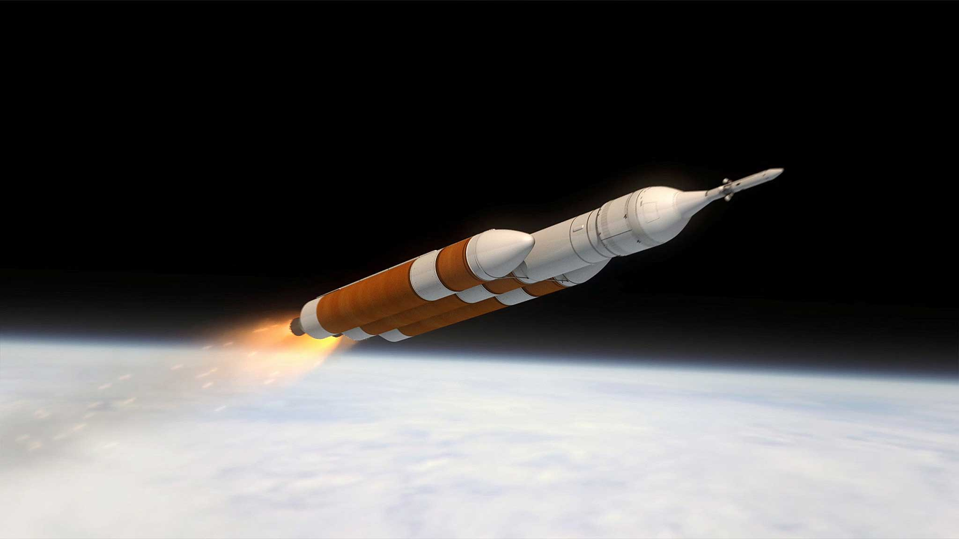
BECO
Notes:
http://www.multivu.com/players/English/7385151-kennedy-space-center-visitor-complex-orion-spacecraft-december-4/gallery//image/17c69375-1435-4b7e-8b33-d3a0f0896baa.HR.jpg

Slide 22
Booster Separation
Notes:
https://www.flickr.com/photos/nasaorion/15311382379/in/set-72157633479431041/

Slide 23
Upper Stage MES1 – Panel/LAS Jettison
Notes:
Image credit: NASA https://cbsdenver.files.wordpress.com/2014/12/orion2.jpg

Slide 24
MECO1
Image credit: NASA/JPL-Caltech
ISS
Notes:
Image credit: Lockheed Martin http://www.lockheedmartin.com/content/dam/lockheed/data/space/photo/feature/orion-eft1-nasa-feature.jpg

Slide 25
MES2
Notes:
Image credit NASA: http://blogs.nasa.gov/orion/wp-content/uploads/sites/239/2014/12/03b-UpperStageRe-Ignition.gif

Slide 26
Crew Module beginning Re-entry
Notes:
Image credit: NASA http://img.youtube.com/vi/KyZqSWWKmHQ/0.jpg

Slide 27
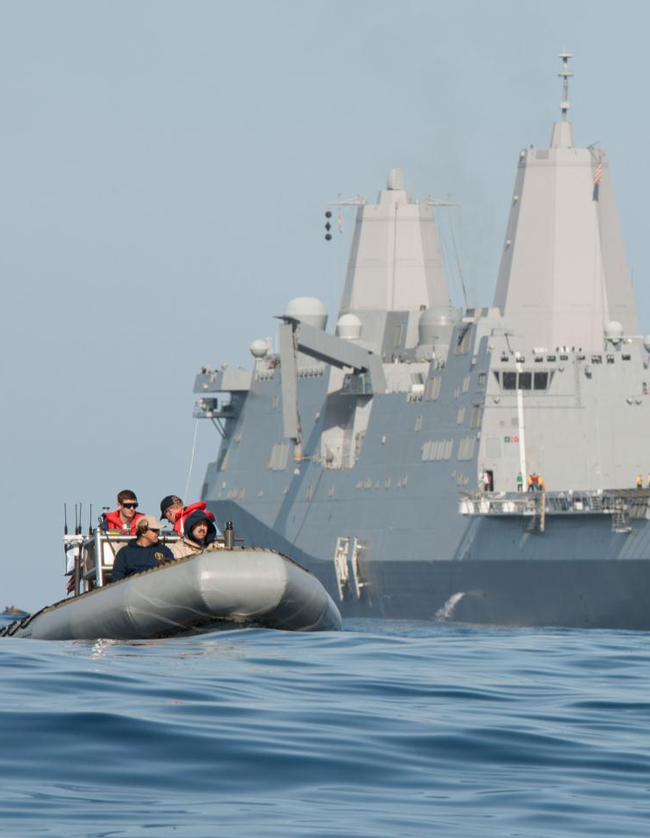
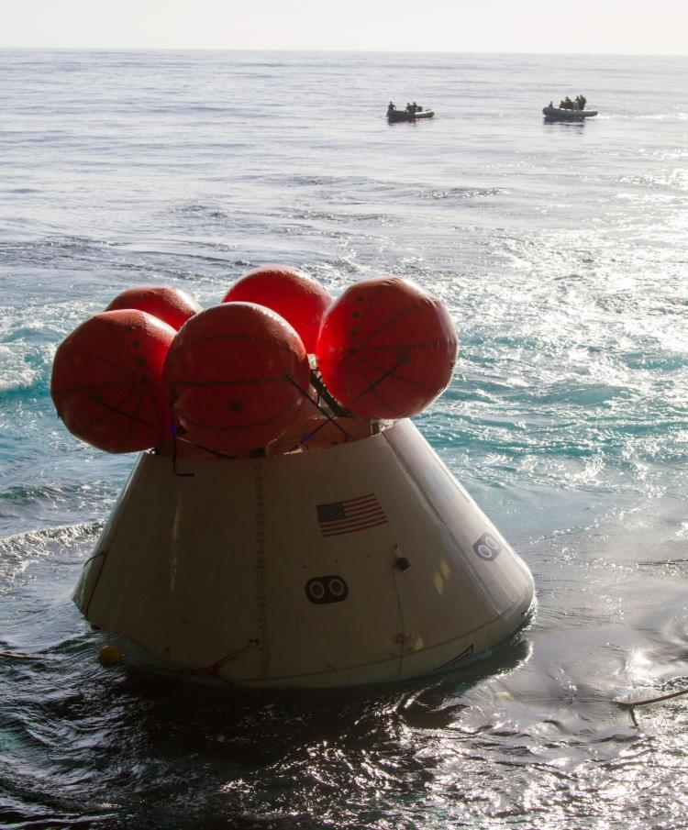
Recovery Testing Complete
SAN DIEGO, CA
Notes:
From Wanda Sigur presentation to NEROP in Sunnyvale, CA, September 2014. Image credit: NASA and NAVY
Underway Recovery Test:
The work to recover Orion after its splashdown during Exploration Flight Test-1 (EFT-1) is an integrated team effort across NASA centers, the Navy and Lockheed Martin.
This past February, Orion recovery testing was conducted in the Pacific Ocean off the coast of San Diego with participation of the Navy’s U.S.S. San Diego well deck ship.
It was a full dress rehearsal for EFT-1 and is helping the teams demonstrate and evaluate recovery processes, procedures, hardware and personnel.
The testing was suspended after the team experienced issues with handling lines securing the test version of Orion inside the well deck of the U.S.S. San Diego. testing has provided important data that is being used to improve recovery procedures and hardware ahead of Orion’s first flight test.

Slide 28
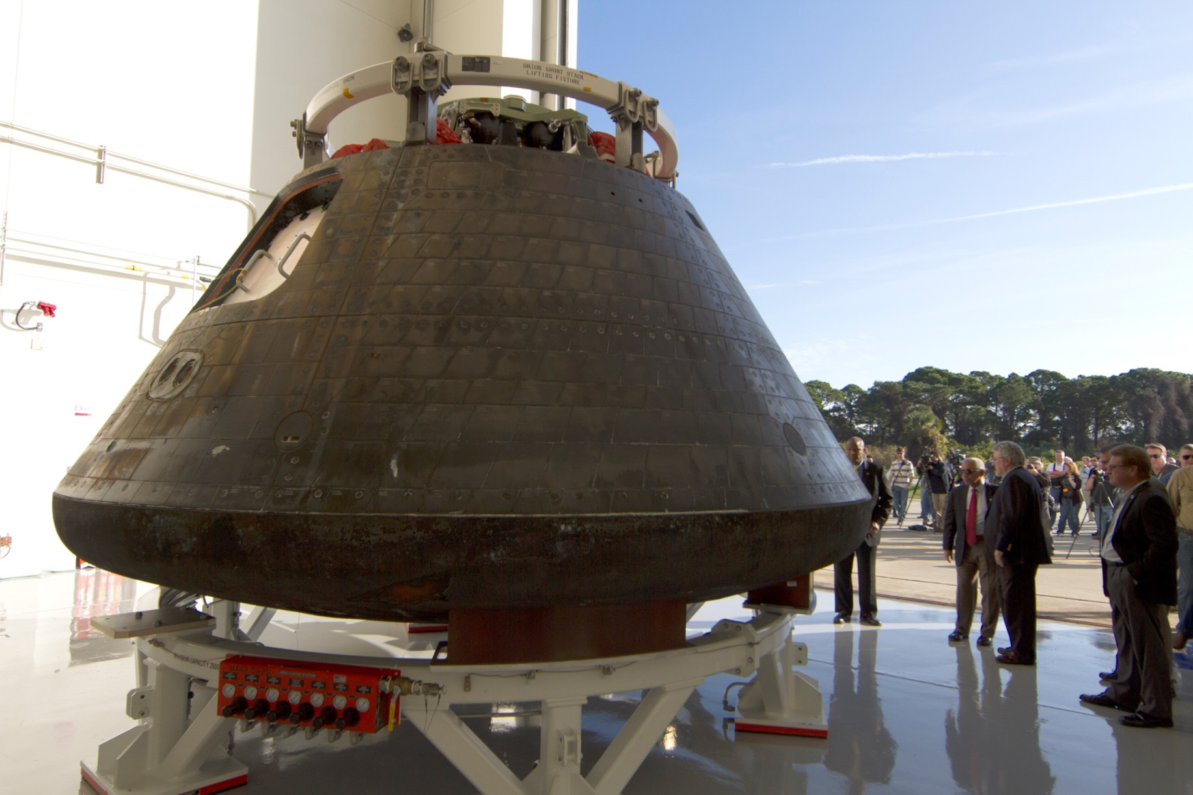
Orion back at KSC
Notes:
Image Credit: NASA http://blogs.nasa.gov/orion/wp-content/uploads/sites/239/2015/01/2015-1020.jpg

Slide 29
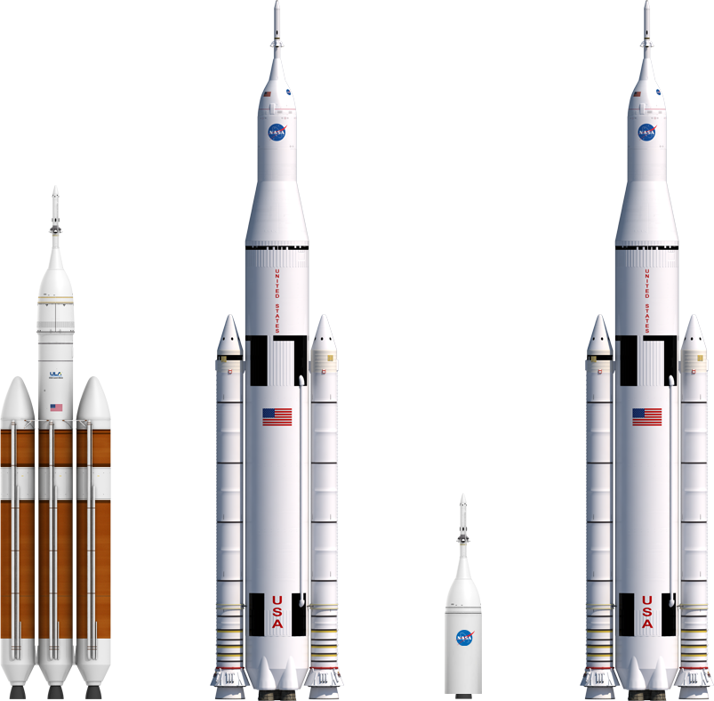
What’s Next? Orion Mission Timeline
2014
EFT-1
2018
EM-1
2018
AA2
2021
EM-2
Notes:
From Wanda Sigur presentation to NEROP in Sunnyvale, CA, September 2014
Orion Mission Timeline:
EFT-1 (Fall 2014): This mission will test Orion in a real flight environment, which cannot be duplicated in ground simulations by subjecting the systems that are most critical to crew safety to the same rigors they will see when carrying humans. Systems to be verified include: thermal protection system, hardware separation events and the parachute system.
EM-1: Exploration Mission-1 currently targeted for 2017, will be the first flight of Orion atop the agency's deep space rocket, the Space Launch System. During the mission, an uncrewed Orion will travel to a stable orbit around the moon where an asteroid could be relocated. The service module for this flight will be provided by the European Space Agency.
AA2: Test of the Ascent abort system.
EM-2: Orion’s first crewed mission will be on this flight.

Slide 30
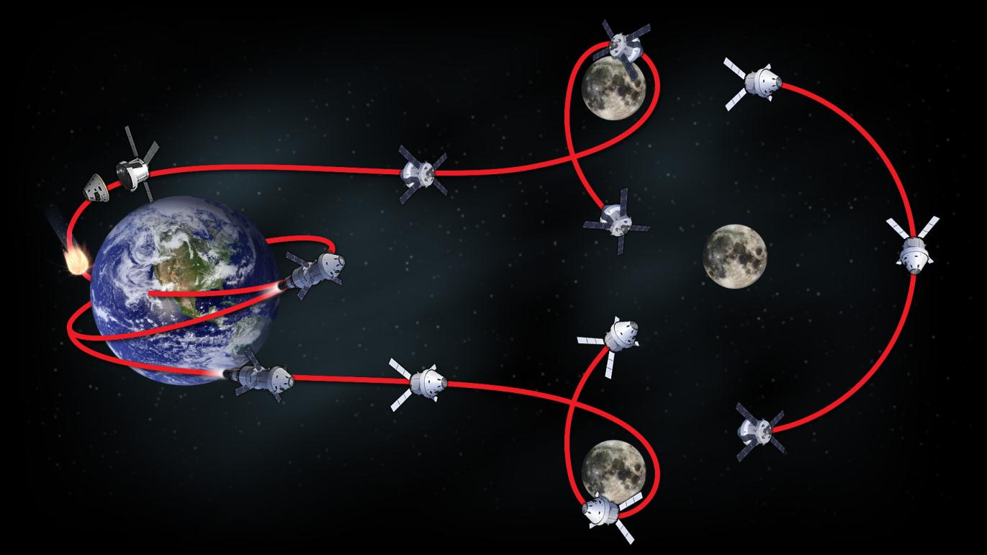
EM-1: Distant Retrograde Orbit 2018
Return Lunar
Gravity Assist
9
DRO Arrival Burn
6
CM/SM Separation
El-20 min
Inbound: ~9 days
11
10
Distant Retrograde Orbit
70,000 KM
(Not strictly circular)
Entry & Landing
Trajectory Correction Maneuvers
Orion
7
12
1
LAUNCH
Perigee Raise Maneuver
ICPS – 100x975 nmi
2
3
Trans Lunar
Injection
ICPS
4
8
DRO Departure Burn
Outbound: ~10 days
Outbound Lunar
Gravity Assist
5
Objectives:
Demonstrate spacecraft systems performance prior to crewed flight
Demonstrate high speed entry (~11 km/s) and TPS performance prior to crewed flight
DRM - Uncrewed MPCV
Lunar capable heat shield
4 tank SM with full prop load
EM-2 systems not included: ECLSS, Crew Systems, LAS Abort Motors (Inert)
Interim Cryogenic Propulsion Stage (ICPS) used to provide TLI burn
Notes:
From Wanda Sigur presentation to NEROP class 2014

Slide 31
Notes:
From Wanda Sigur presentation to NEROP class 2014

Slide 32
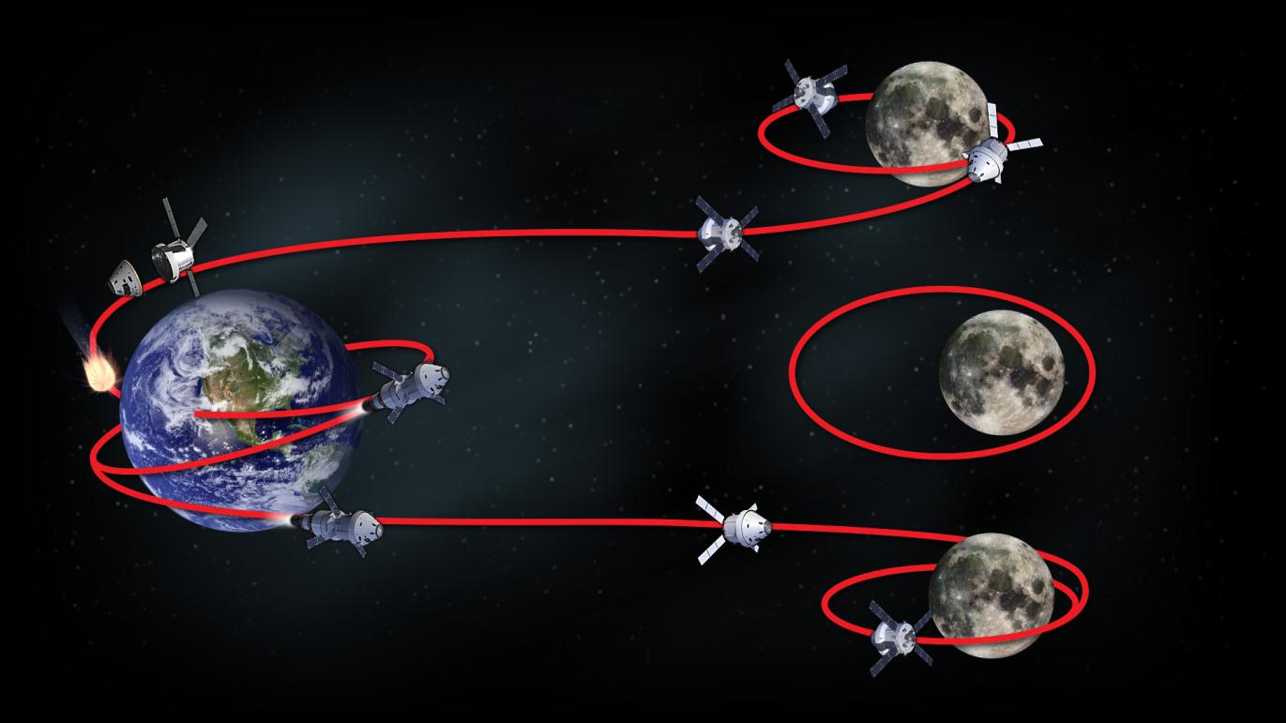
EM-2: Crewed High Lunar Orbit 2021
DRO Arrival Burn
6
CM/SM Separation
El-20 min
Inbound: 3-6 days
7
8
Lunar Parking Orbit
54x2160-5,400 nmi
Entry & Landing
LAUNCH
Trajectory Correction Maneuvers
Orion
9
1
Perigee Raise Maneuver
ICPS – 100x975 nmi
2
3
Trans Lunar
Injection
ICPS
4
Outbound: 3-6 days
5
Outbound Lunar
Gravity Assist
Lunar Orbit Insertion
Orion
Objectives:
Demonstrate crewed flight beyond LEO
DRM - Crewed MPCV
Lunar capable heat shield
4 tank SM with full prop load
Up to 4 crew
Interim Cryogenic Propulsion Stage (ICPS) used to provide TLI burn
Notes:
From Wanda Sigur presentation to NEROP class 2014

