Slide 1
ARCHITECTURE
November 16, 2013
Presented by:
David Fisher, Architect/Engineer Fisher Associates Architects & Engineers Littleton, CO
Cydney McGlothlin, Architect, University of Florida, Gainesville FL
Mark McGlothlin, Professor of Architecture, University of Florida, Gainesville FL

Slide 2
Architecture Photos
by David Fisher

Slide 3
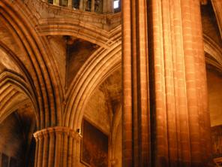
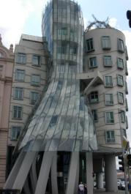

Slide 4
Architecture as a Career
Why become an Architect?
Is it rewarding and fun?
What does an Architect really do?
Course of studies – Education
Do Architects only design buildings?
Opportunities in Architecture
Licensing as an Architect

Slide 5
Architectural Firm Profile
Many architectural firm have experience working with government agencies, schools boards, homeowner associations, private clients and many other various committees.
A firm of individuals joined together by a commitment to be creative while providing a beautiful yet functional design.
A firm with a strong identity and commitment to our clients and our ourselves.
A firm with a strong commitment to sustainability and green building design.

Slide 6
Fisher Associates Architects Project Photos
Representative Project

Slide 7
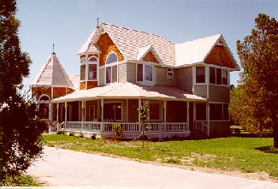
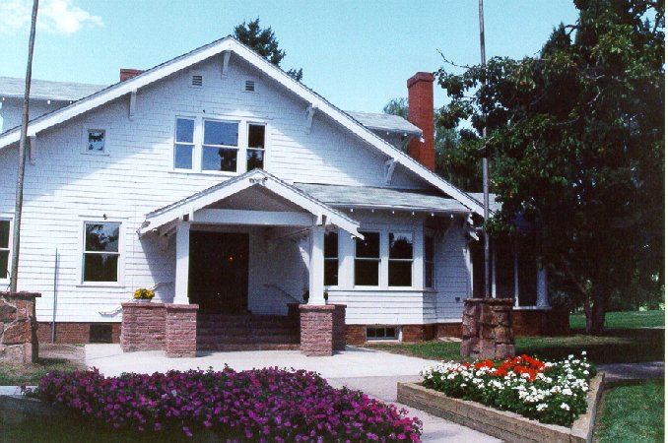
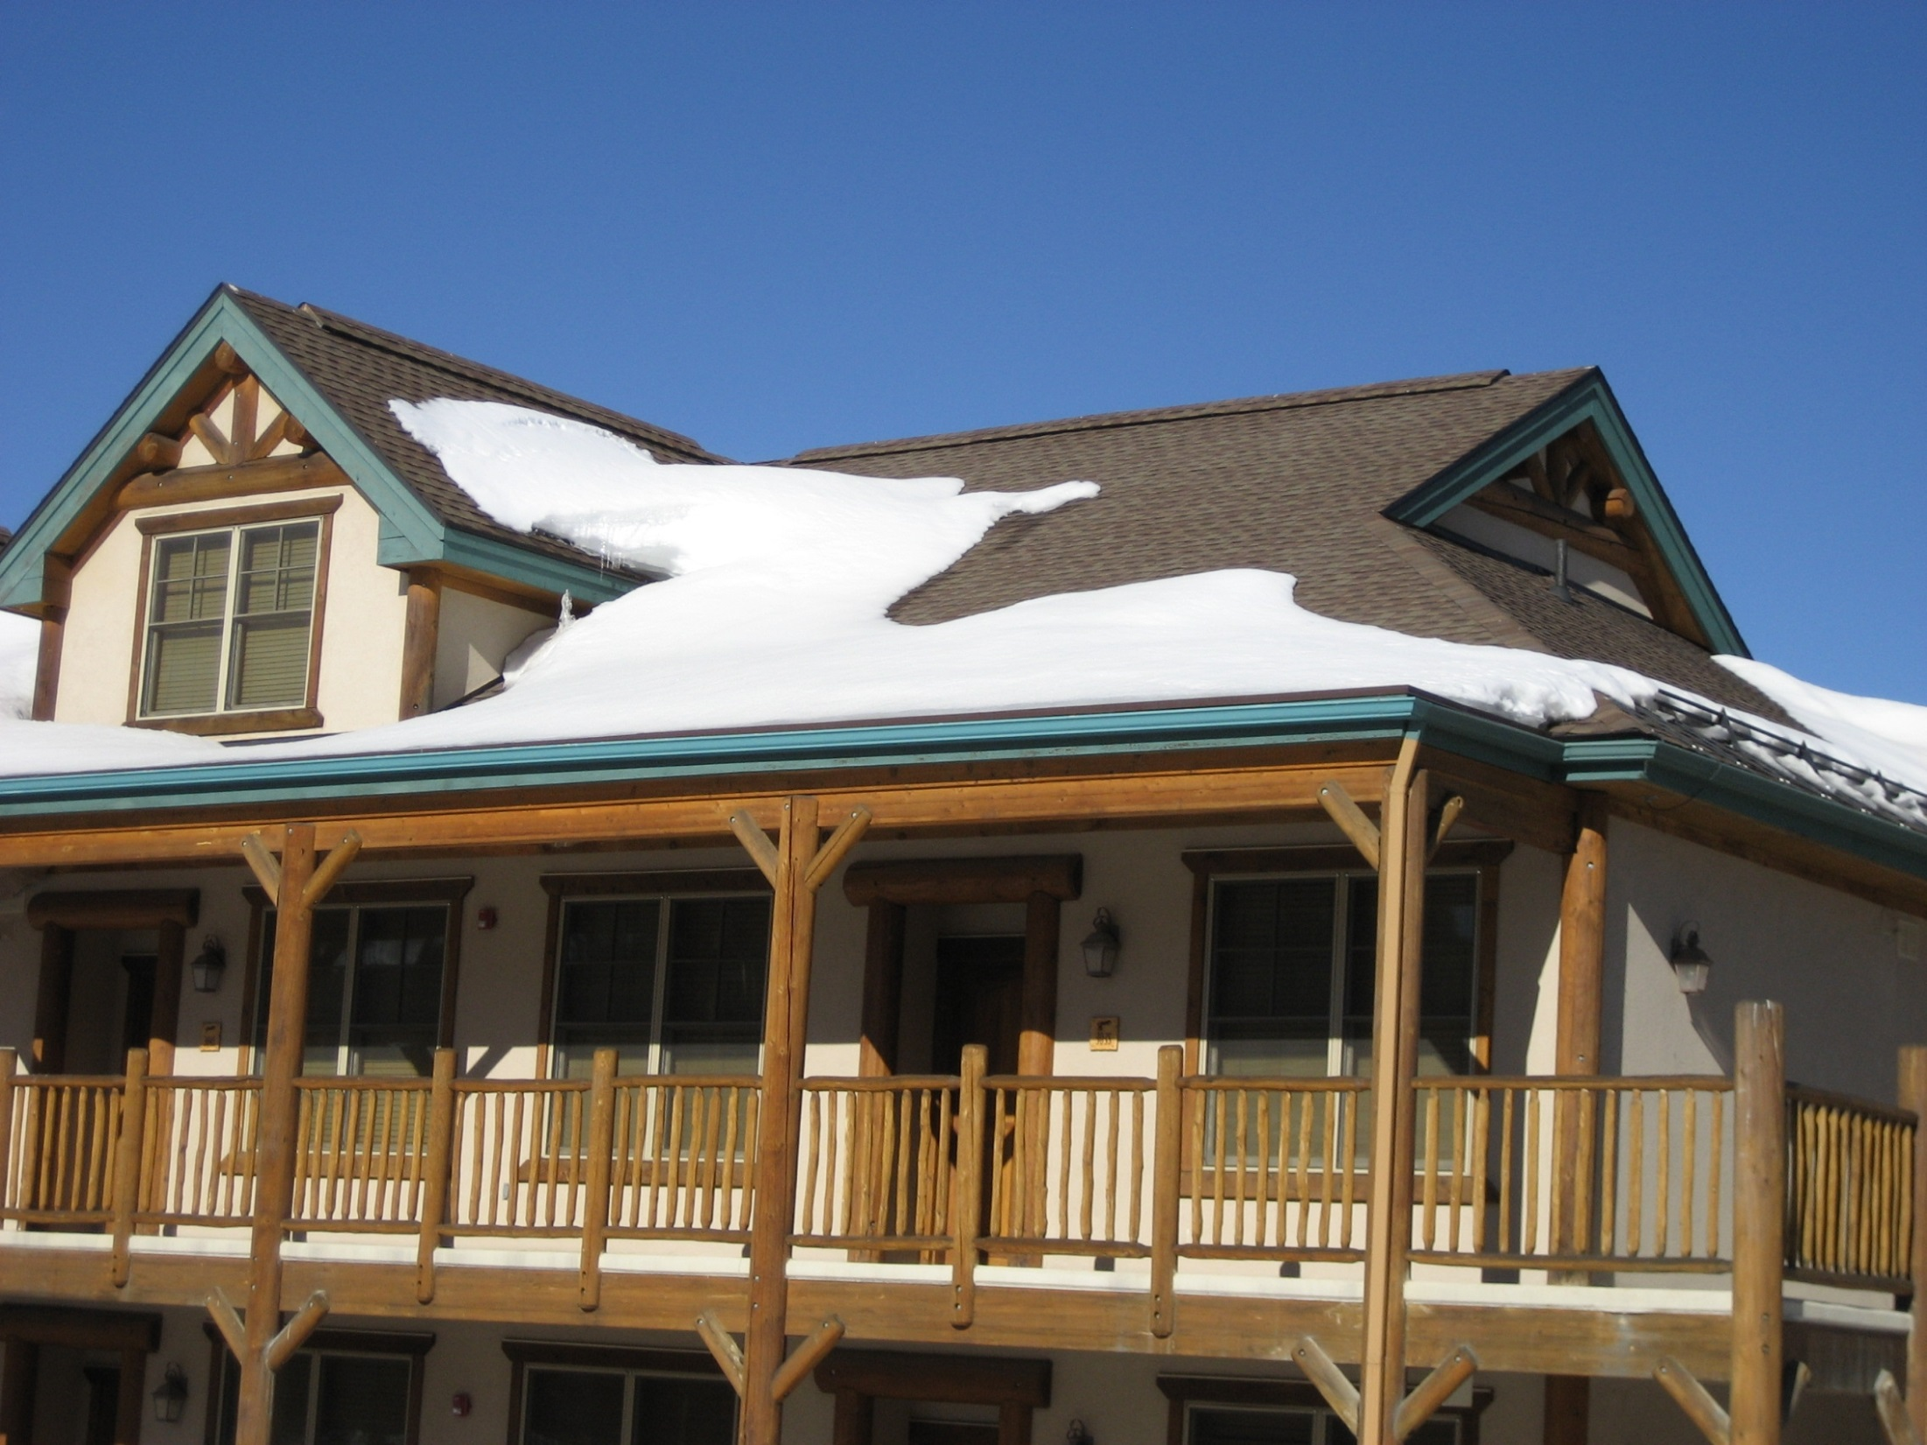
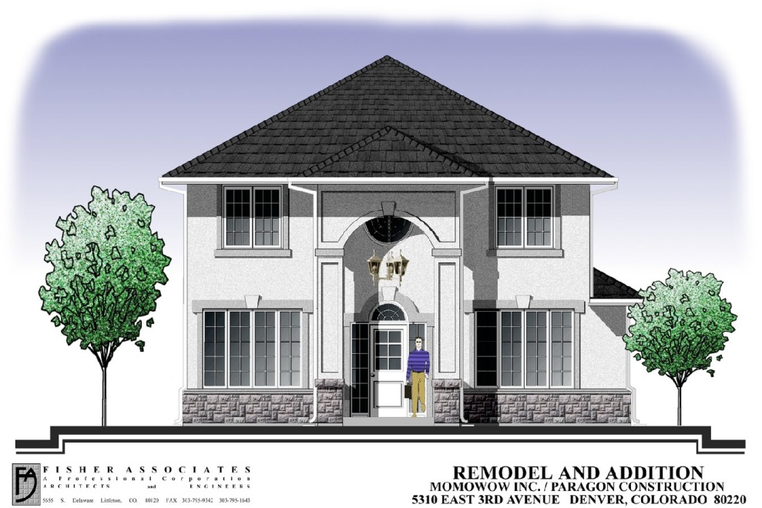
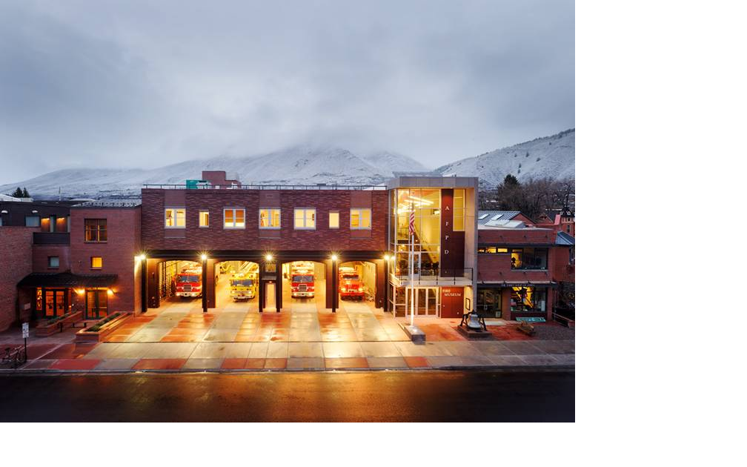
Notes:
FA Historic Building and Office

Slide 8
Services Provided by an Architectural Design Team
The type of services provided to clients include:
Architect ~ team leader
Mechanical engineering
Electrical engineering
Structural engineering
Civil engineering
Landscaping
Interior Design and Layouts
Other specialties as the project requires

Slide 9
Pre-Design Process…
Develop Questionnaire
Visit Other Facilities
Program Meetings to Develop a Written Program
Building Program
Site Development and Civil Engineering Needs
Master Plan
Code and Zoning Research
Understand Goals, Think About Details, Analyze Site and Apply Reality
Finalize Space Needs Program
Review, Modify, Approve and Publish Written Program

Slide 10
Schematic Design Process…
Assist in Site Selection & Evaluation
Prepare Conceptual Floor Plans
Prepare Conceptual Site Plans
Develop Building Elevations
Quality Assurance
Do Plans Meet Program Needs and Established Budget
Does Design meet Building Code Requirements
Does Site Plan Accommodate Other Users
Prepare Budget Analysis
Review and Modify as necessary to meet all requirements
Receive Approval of Designs

Slide 11
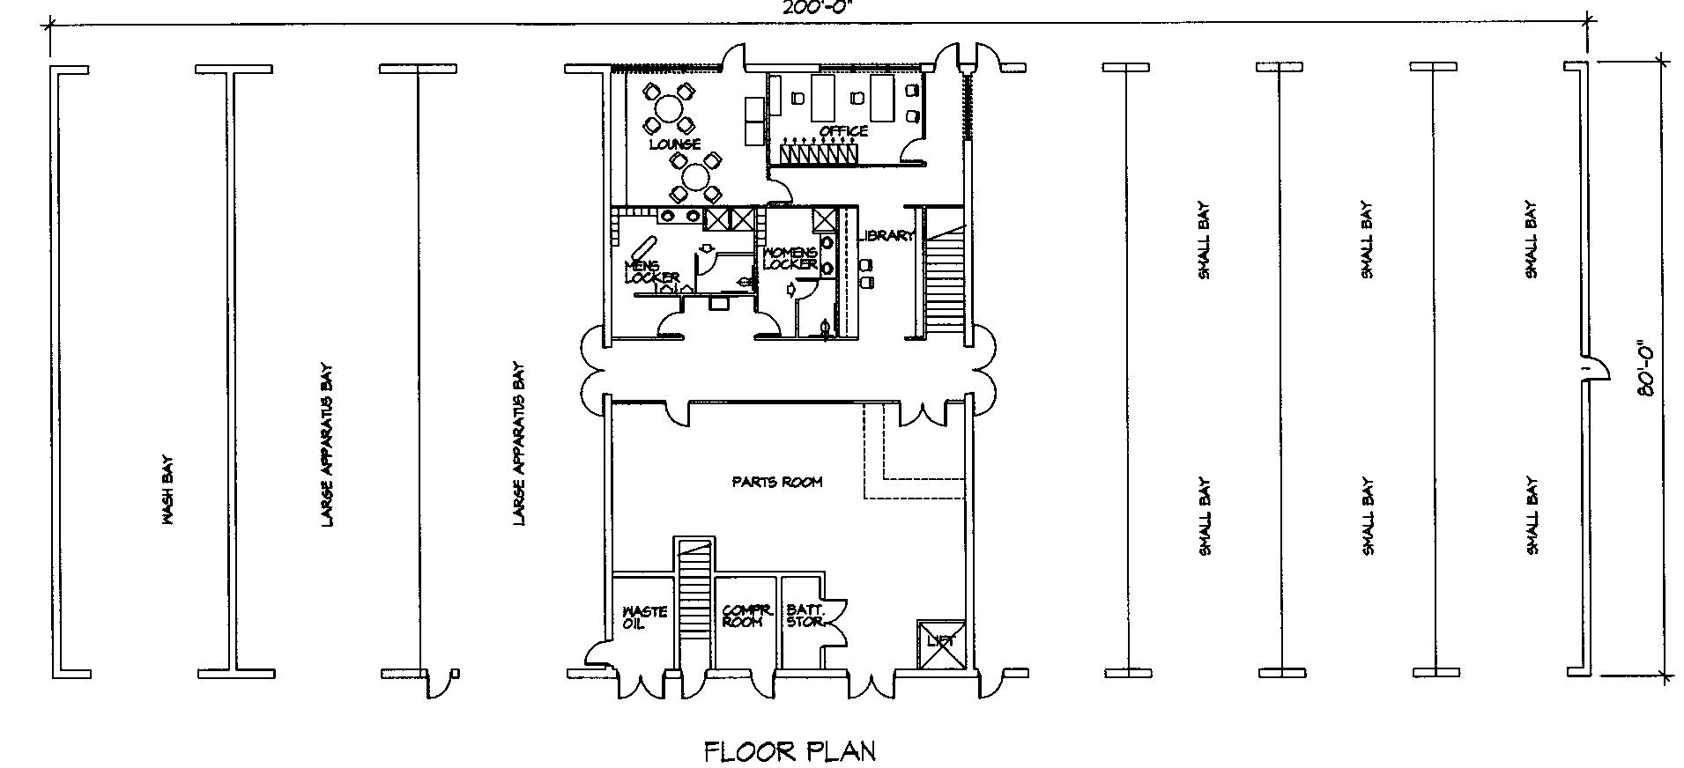
Preliminary Floor Plan

Slide 12
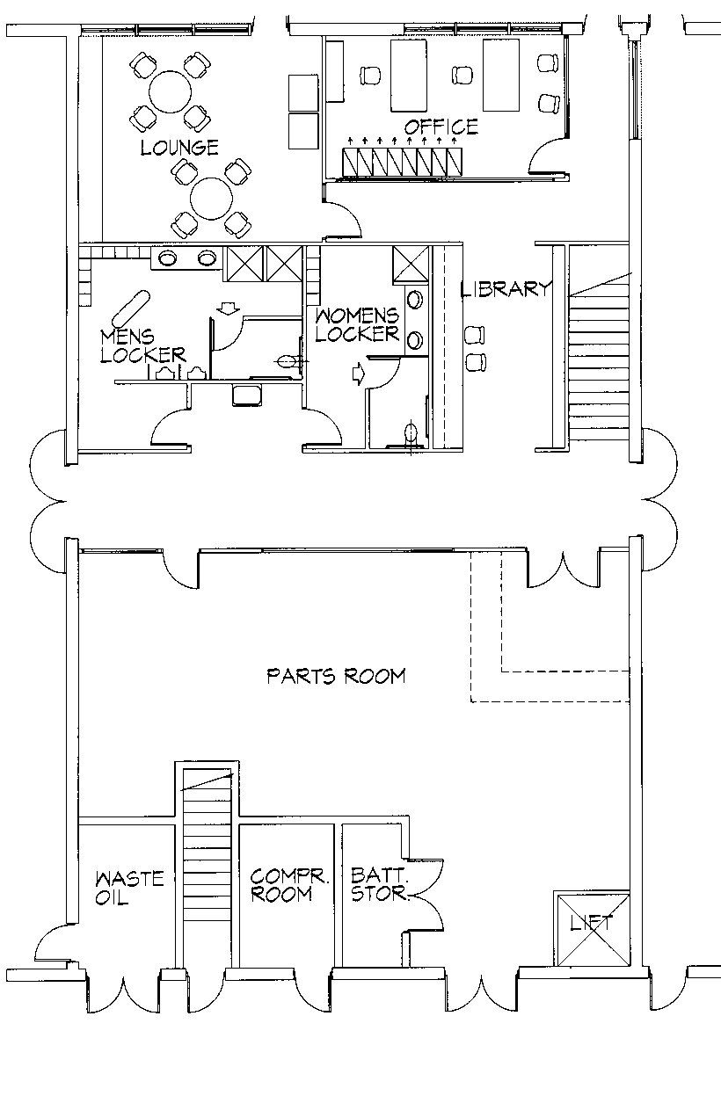
Preliminary Floor Plan

Slide 13
Design Development Process…
Finalize Site Plan, Floor Plans, Sections and Elevations
Structural Design
Mechanical Design
Electrical Design
Civil Engineering
Materials and Finishes
Prepare Statement of Probable Construction Cost
Submittals to Owner for Approvals
Receive Approval of Designs

Slide 14
Construction Documents
Architectural
Structural
Mechanical
Electrical
Civil Engineering
Finalize Materials, Finishes and Details
Specifications
Review and Update Statement of Probable Construction Cost
Submittals to Owner for Approvals
Review and Modify as Necessary
Release for Bidding

Slide 15
Bidding and Negotiation Process…
Release documents to Contractors, Sub-Contractors, Plan Rooms, etc.
Submit to Building Department for Review
Respond to Inquiries and Questions
Prepare Addenda
Assist in Pre-Proposal Meeting
Assist in Receipt of Bids
Make Recommendations for Award
Assist in Preparation of Contract

Slide 16
Construction Administration
Perform Job Site Observations
Review Shop Drawings and Submittals
Review Pay Requests
Review Change Order Requests
Prepare Request For Information documents and Field Orders
Conduct Final Inspection
Assure Warranties and Instruction Manuals are Submitted
Perform 6 and 11 Month Follow-Up Inspections

Slide 17
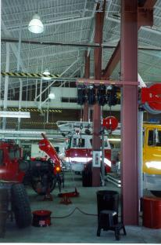
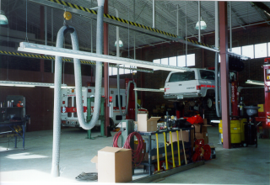
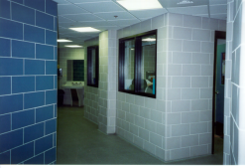
Representative Projects

Slide 18
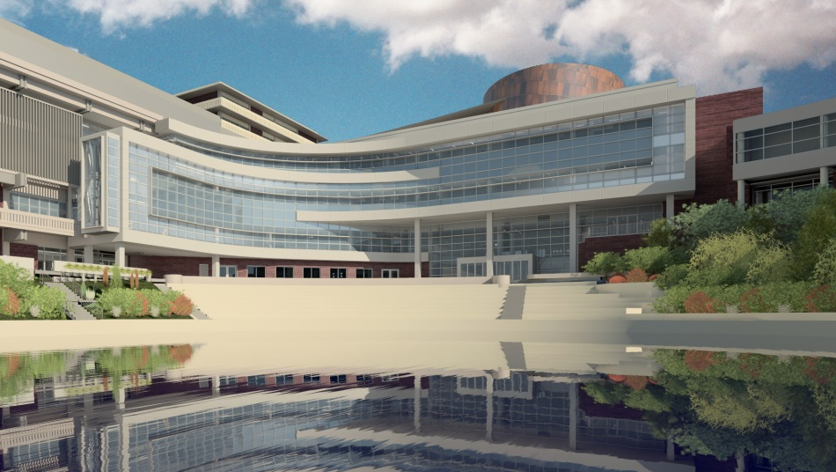
Representative Projects

Slide 19
Representative Projects

Slide 20
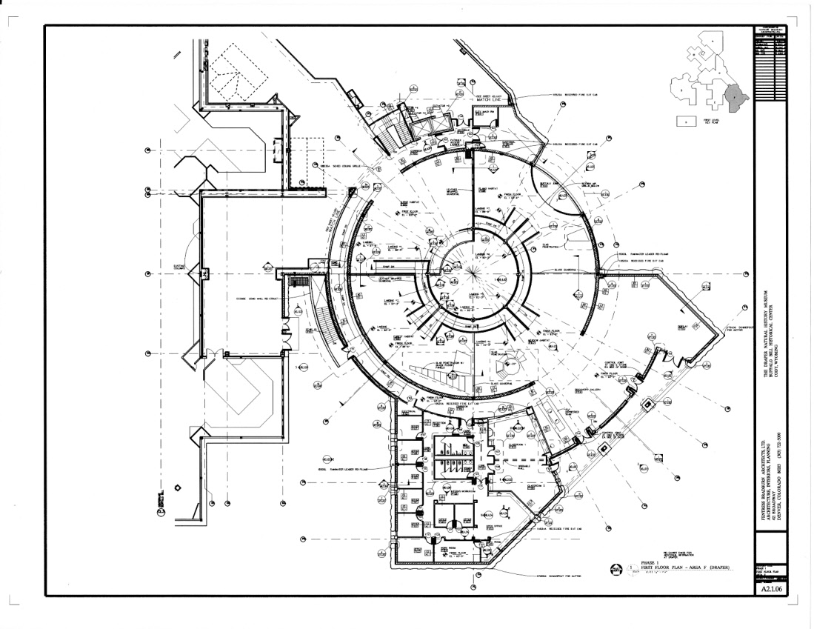
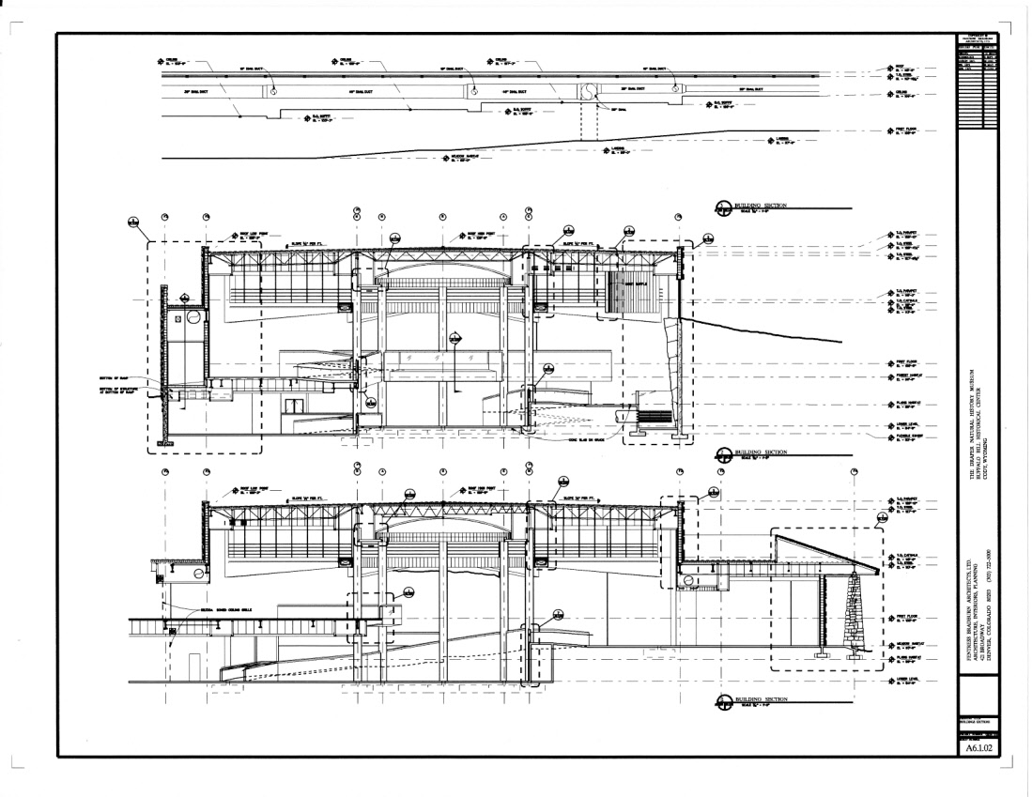
Representative Projects

Slide 21
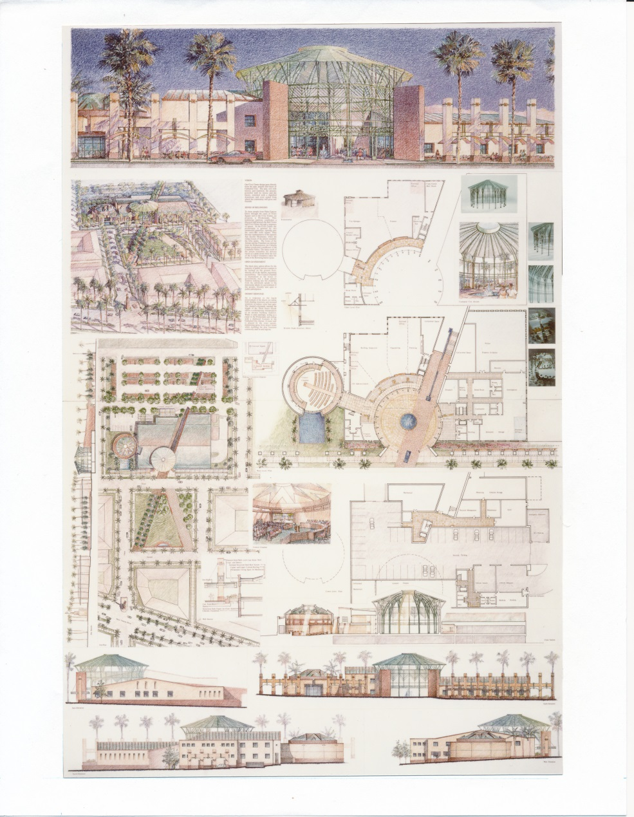
Representative Projects

Slide 22
Career Opportunities within Architecture
Found your own Architectural Firm
Work in a small, medium or large firm
University & School Facilities Architect
Professor/Instructor of Architecture
Historic Preservation Architect

Slide 23
Other Career Opportunities
Developer
Design/Build Contractor or General Contractor
Construction Manager
Space Planning & Furniture Design
Materials Sales Representative
Materials Research
Construction Investigation and Litigation Expert
Computer Programmer and Games Programing
Designer or CAD Operator or Project Manager
Product Design
Car Interior Design
Movie Set Design
Computer Software Design

Slide 24
Suggested Course Studies
Math (Algebra and Trigonometry as a minimum)
Art including freehand sketching and colors
Writing
Social Studies
Computer Science and Technology
History
Some drafting including computer drafting
Observe buildings and spaces. How do they function? How about color and texture of materials? How do they make you feel?

Slide 25
Licensing Requirements
Graduation from an accredited university with a 5 year program for a Bachelor of Architecture or a 6 year program for a Master of Architecture.
Degrees in Environmental Sciences or Architectural studies are not the same as a degree in Architecture.
Three or four years as an intern working for an architect.
Passing a four day national license exam on design, site planning, structures, mechanical design, electrical design and materials

Slide 26
Employee Compensation Graph
Architect 3 $88,200 (10 years)
Unlicensed 3 $68,400
Architect 2 $72,500 (8 years)
Unlicensed 2 $62,900
Architect 1 $59,700 (5 years)
Unlicensed 1 $54,100)
Intern 3 $49,200 (3-6 years)
Intern 2 $45,400 (1-3 years)
Intern 1 $40,000 (Entry)
Bonuses range from $1500 to over $900 per year

Slide 27
2013 AIA Architect Design Award Winners
American Institute of Architects

Slide 28
