Slide 1
Jupiter and Saturn
Jim Paradise
Lockheed Martin

Slide 2
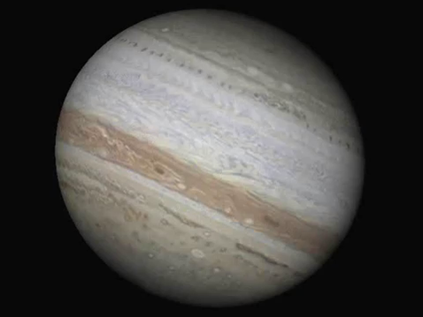
Jupiter
Distance From Sun:
483 Million Miles
Average Temp: -166ºF
Diameter: 88,000 miles
Orbital Period: 12 years
Moons: 67
galileo
Image credit: NASA/JPL-Caltech

Slide 3
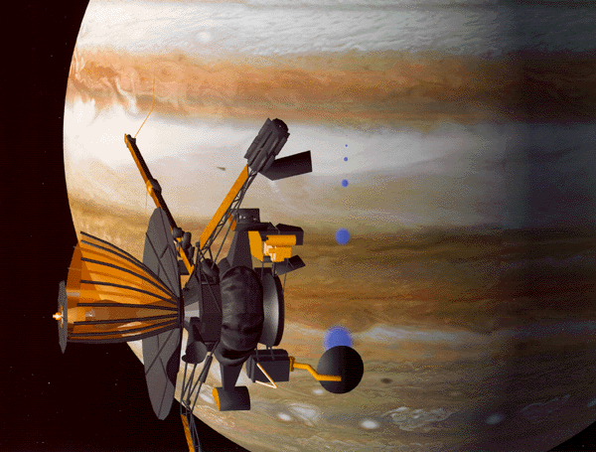
Galileo
Launch: 1989
Orbit Jupiter: 1995
Mission End: 2003
First two years focused on Jupiter.
Extended mission (6 years) focused on Jupiter's moons,
with emphasis on Europa, Callisto, Ganymede, and Io.
Image credit: NASA/JPL-Caltech

Slide 4
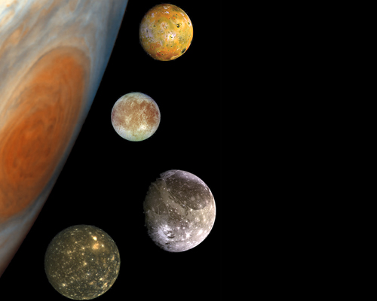
4 of Jupiter’s 61 moons
Io (with active volcanoes)
Europa
3 with Liquid Oceans?
Ganymede
Callisto
Image credit: NASA/JPL-Caltech
Lots of moons

Slide 5
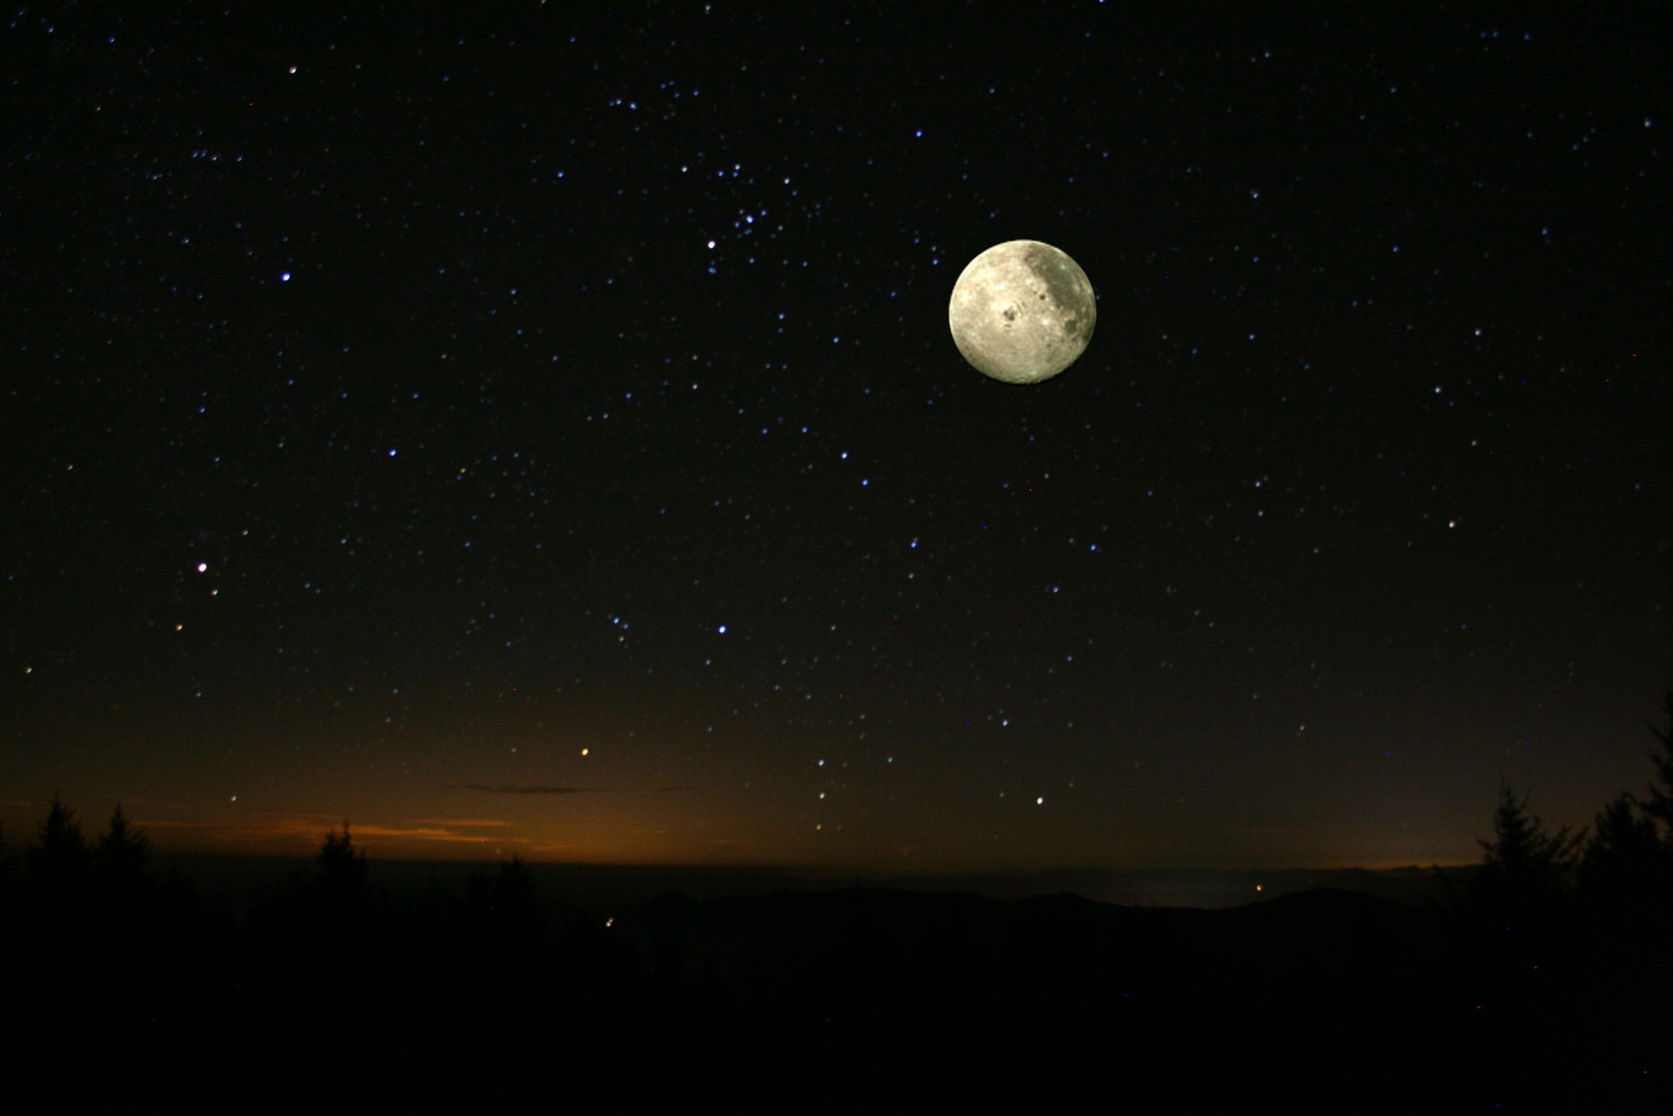
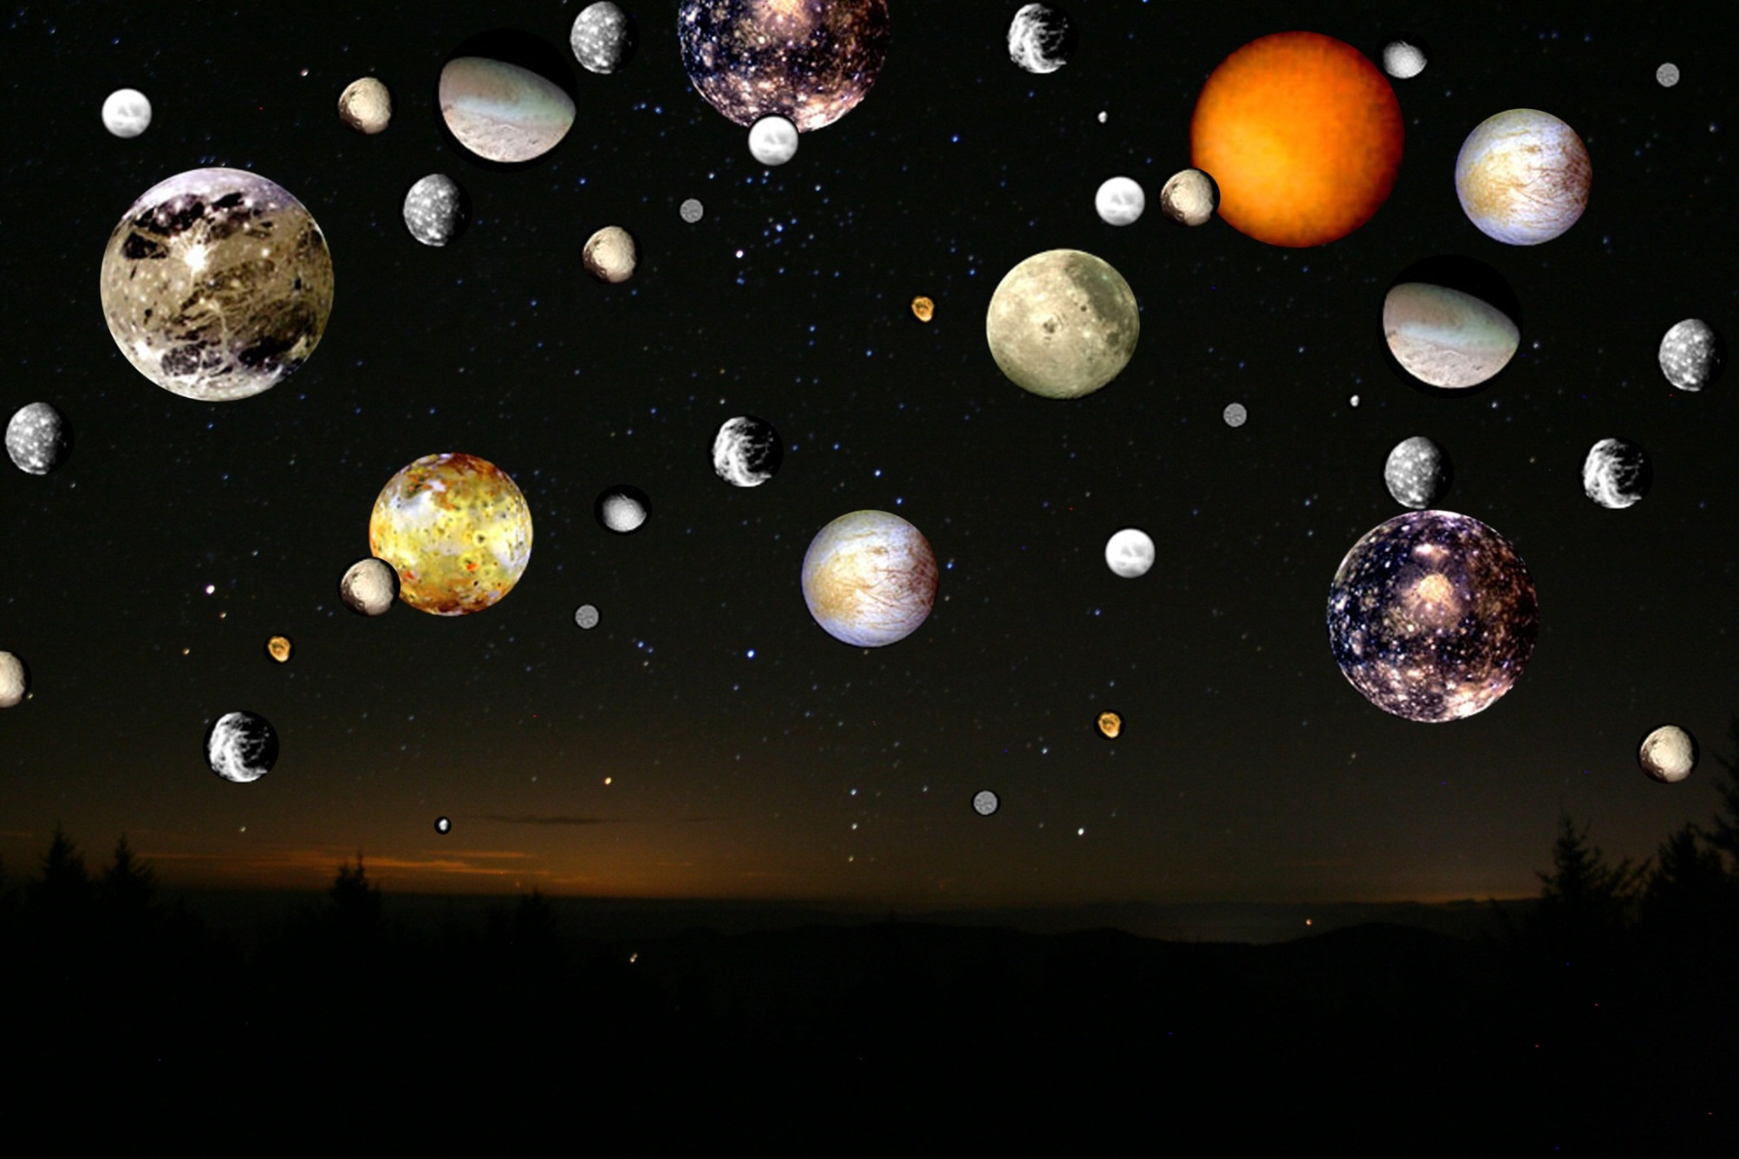
Imagine if Earth had 61 moons
Io

Slide 6
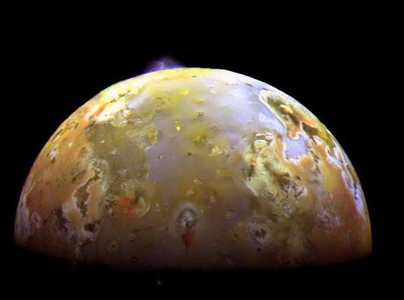
Volcanic Eruption on IO
Image credit: NASA/JPL-Caltech
Europa

Slide 7
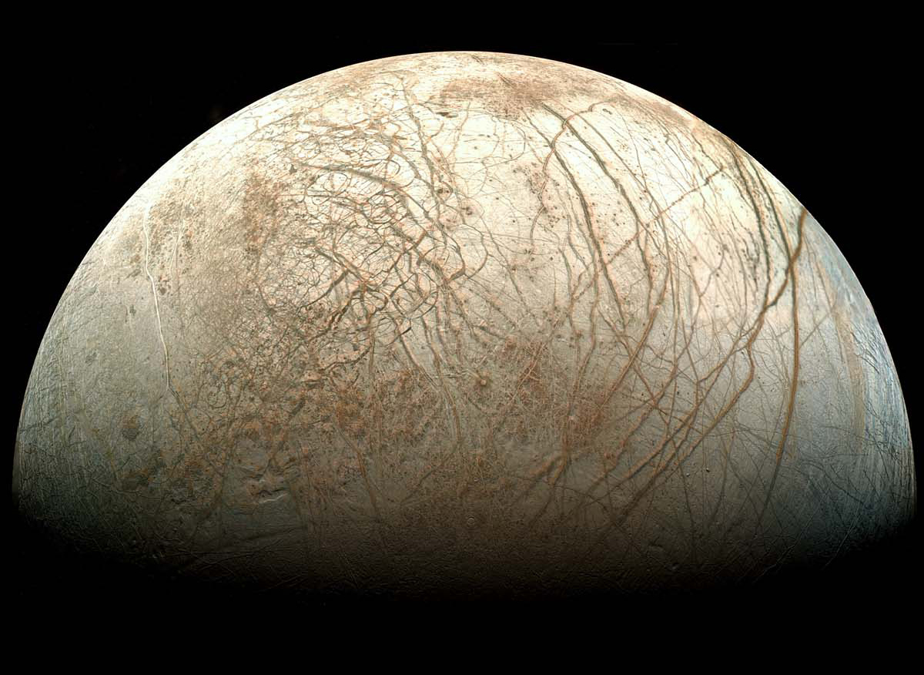
Europa
Ice – 3 miles thick with liquid salt water ocean beneath
Io
(with active volcanos)
Europa
Liquid Oceans?
Ganymede
Callisto
Image credit: NASA/JPL-Caltech
Deep Ocean

Slide 8
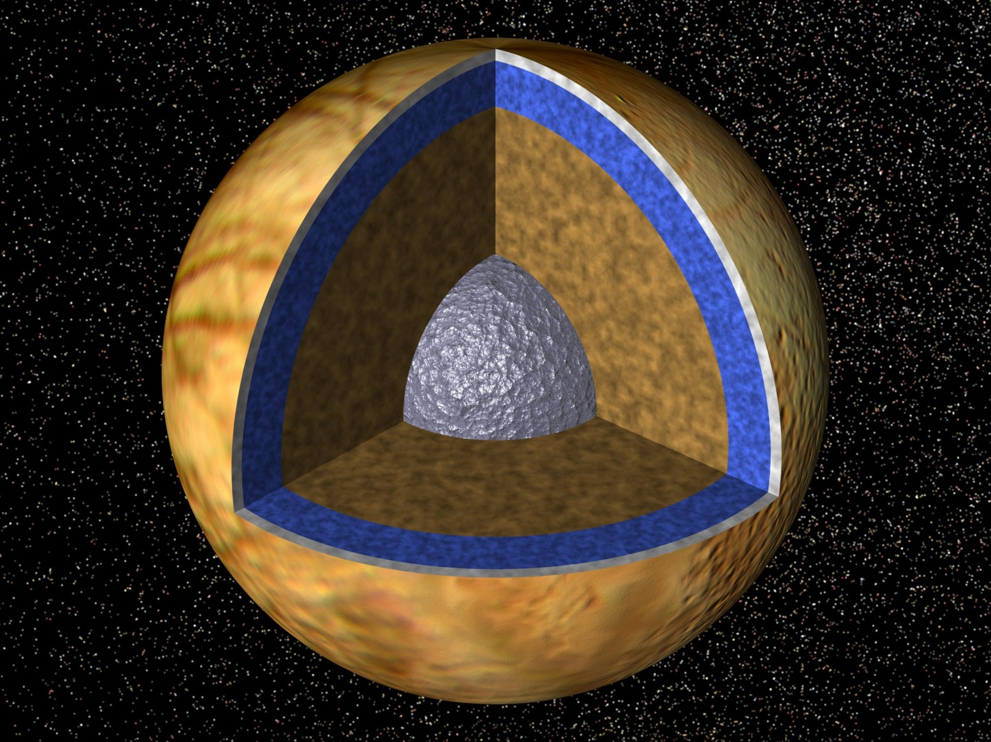
Europa
Ice – 3 miles thick with
Liquid salt water ocean beneath (40 – 100 miles deep)
Io
(with active volcanos)
Europa
Liquid Oceans?
Ganymede
Callisto
Image credit: NASA/JPL-Caltech
Lakes

Slide 9
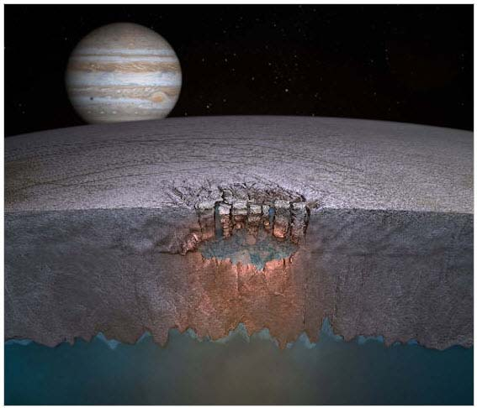
Liquid lakes in the ice
Image credit: NASA/JPL-Caltech
Juno

Slide 10
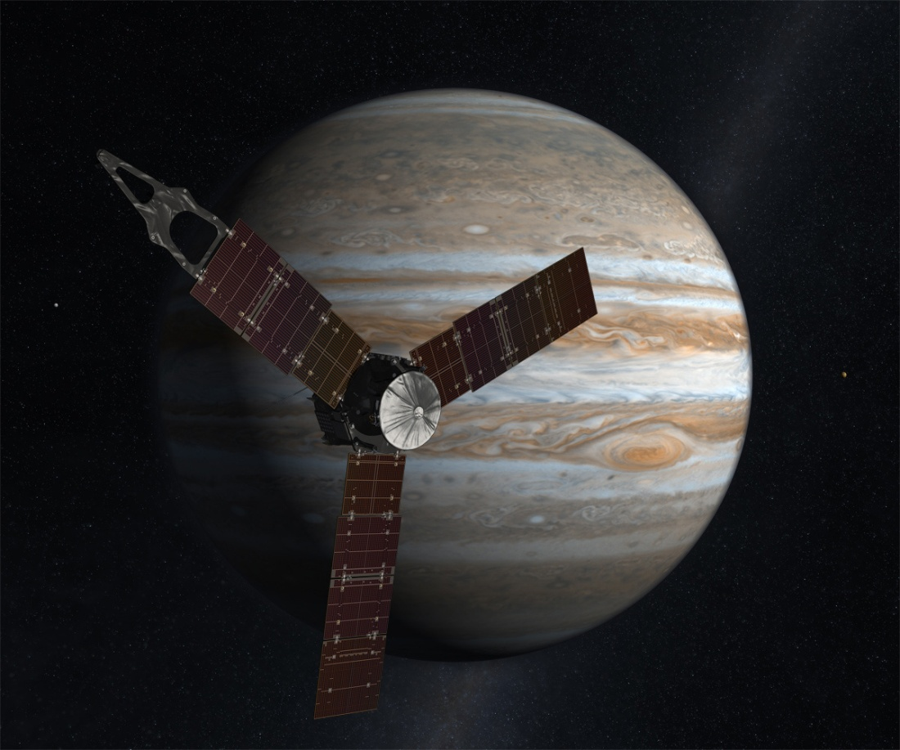
JUNO - Launched August 5, 2011
Polar Orbit of Jupiter Solar Powered
Arrives at Jupiter: July 4, 2016
Image credit: NASA/JPL-Caltech
Earth and Moon

Slide 11
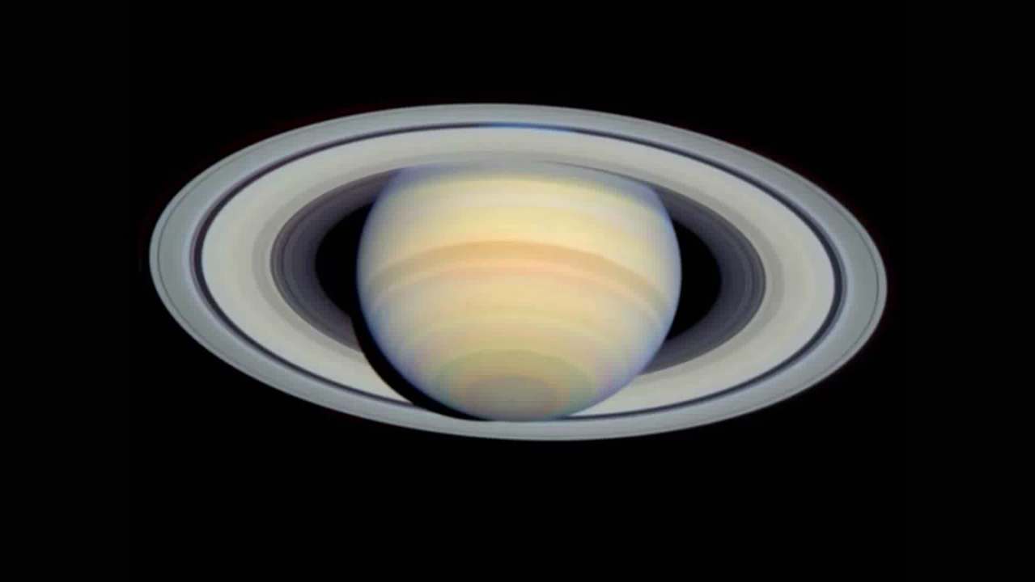
Saturn
Distance From Sun: 888 Million Miles
Average Temp: -220ºF
Diameter: 75,000 miles
Orbital Period: 29 years
Moons: 62
Cassini

Slide 12
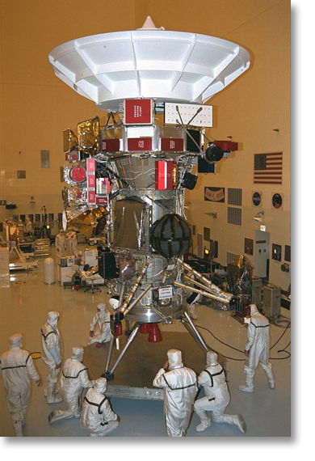
Cassini and Huygens
Mission to Saturn and its largest moon Titan.
Launch: 10/15/1997
Orbit Saturn: 7/1/2004
Huygens Release: 12/2004
Landed on Titan: 1/12/2005
Image credit: NASA/JPL-Caltech

Slide 13
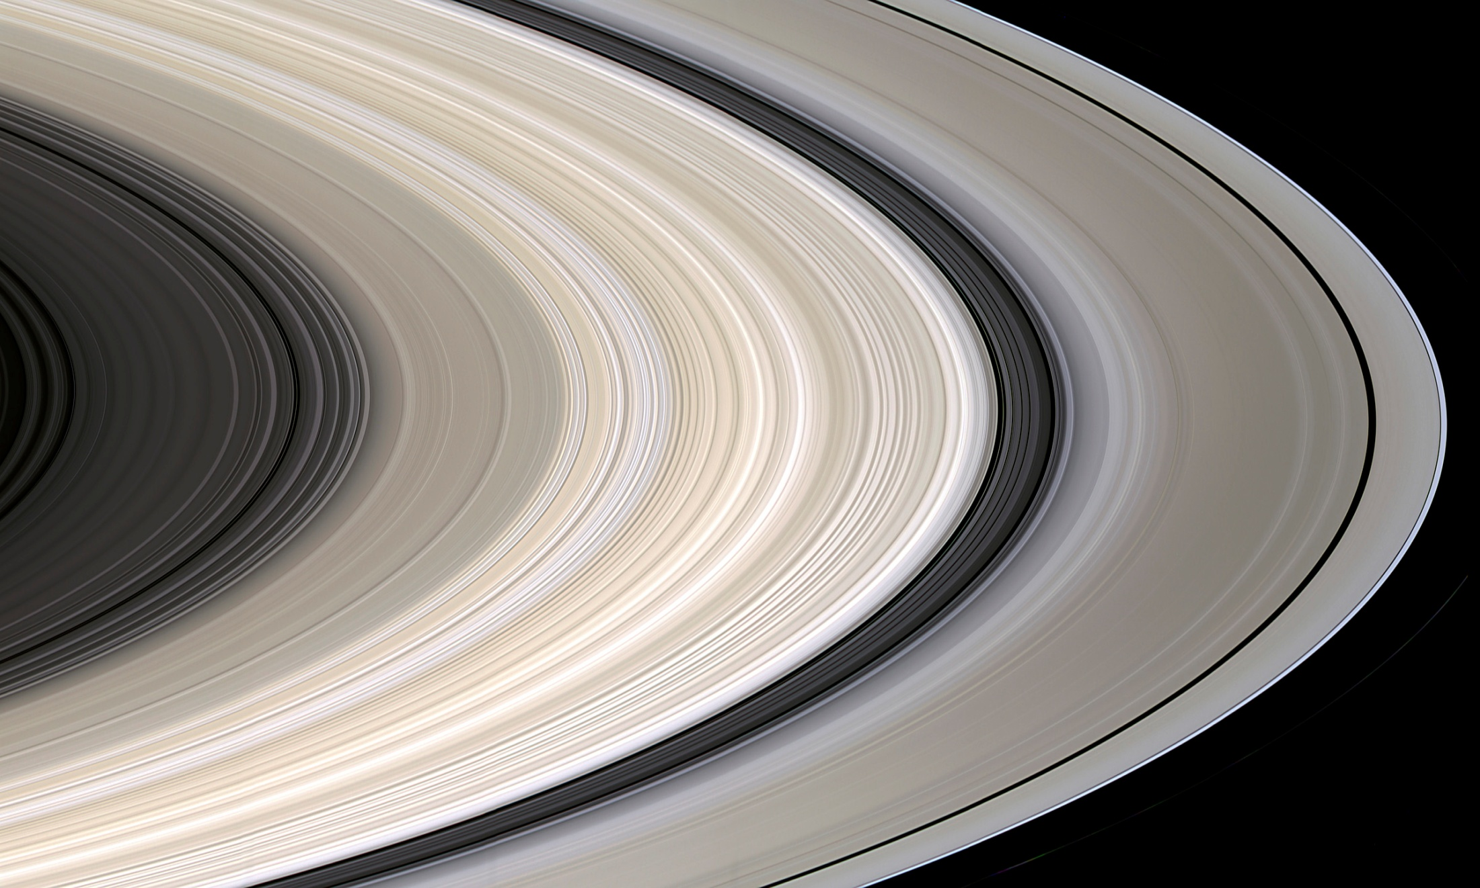
Rings in true color
B
Image credit: NASA/JPL-Caltech
Earth from Saturn
Notes:
NOTE IRREGULAR STRUCTURE, FAINT HUES. NOTE C RING REGULAR PLATEAUS
NOTE CASSINI DIVISION BANDS. NOTE COLOR OF TRANS-KEELER REGION.

Slide 14
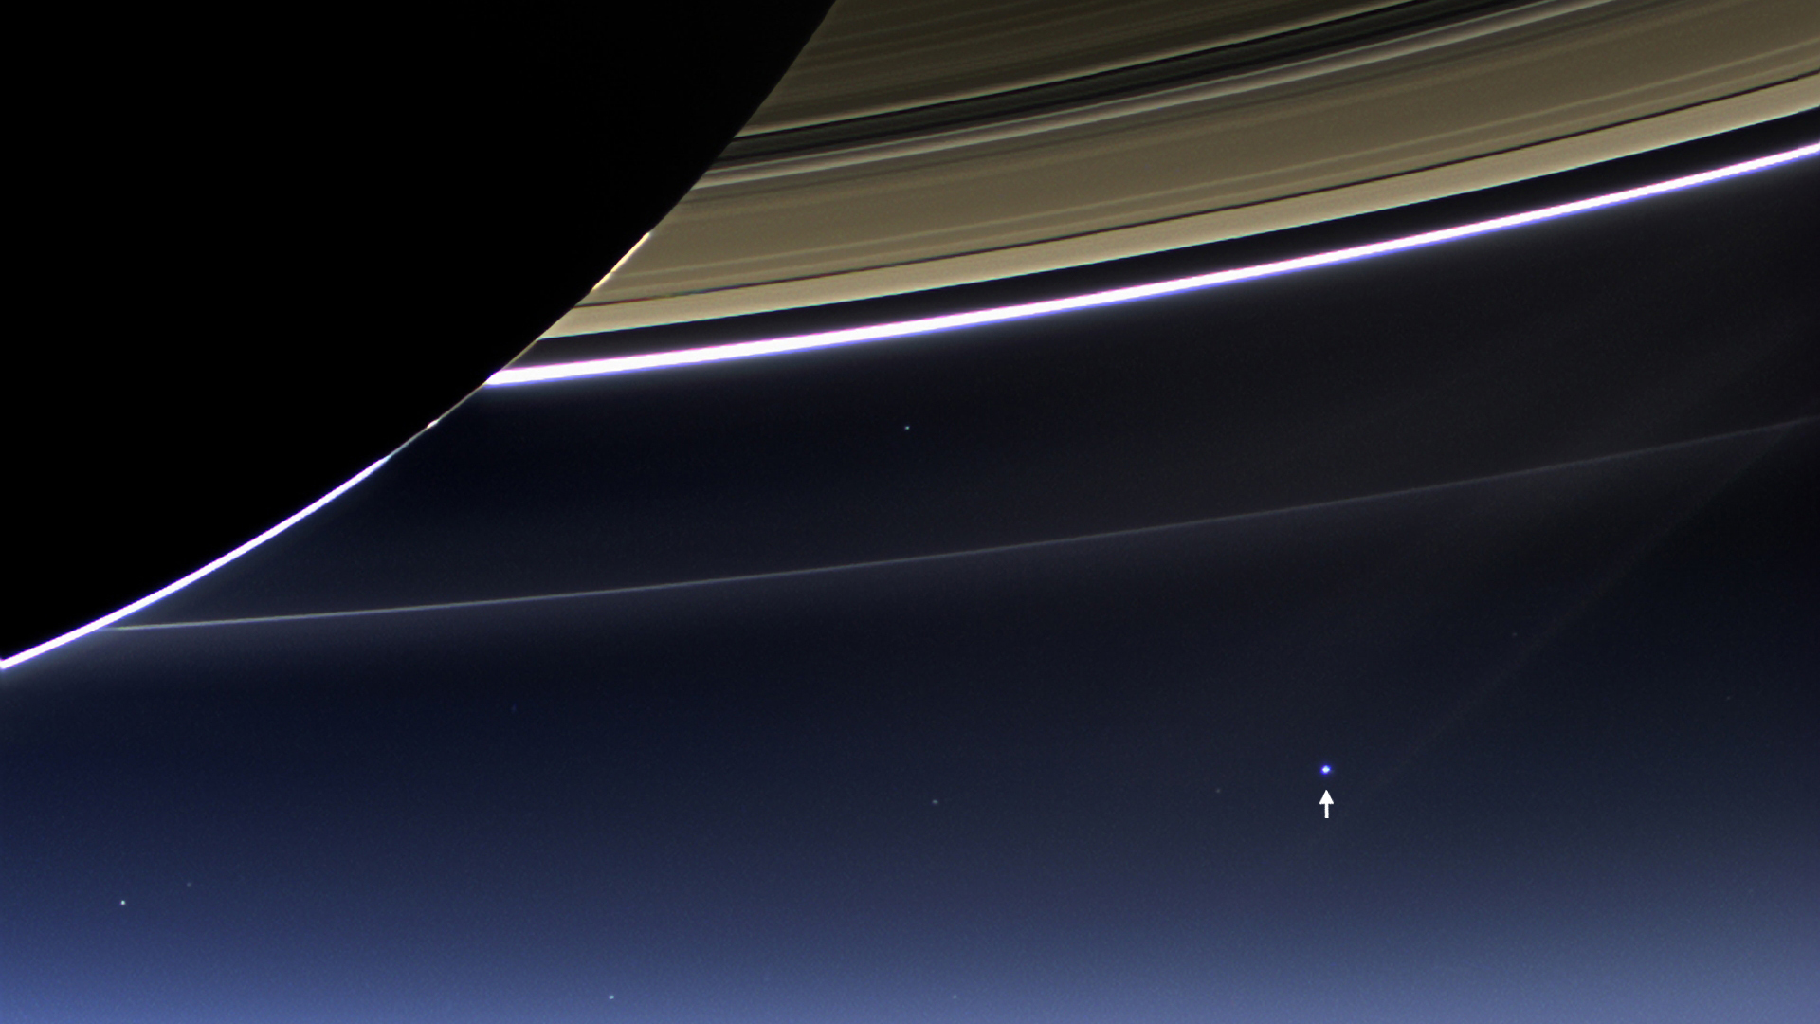
Cassini snaps a photo of Earth
On 7/19/2013, earthlings were told to go outside and wave at the sky. Cassini took the photo. Shall we zoom in?
Earth
Notes:
NOTE IRREGULAR STRUCTURE, FAINT HUES. NOTE C RING REGULAR PLATEAUS
NOTE CASSINI DIVISION BANDS. NOTE COLOR OF TRANS-KEELER REGION.

Slide 15
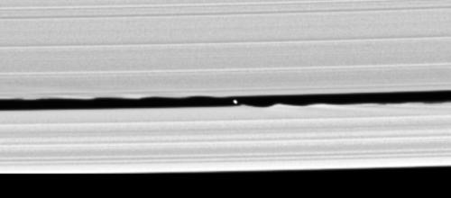
What causes the gaps in the Saturn rings?
A moon in the rings (where are the ripples?)
Image credit: NASA/JPL-Caltech
Aurora

Slide 16
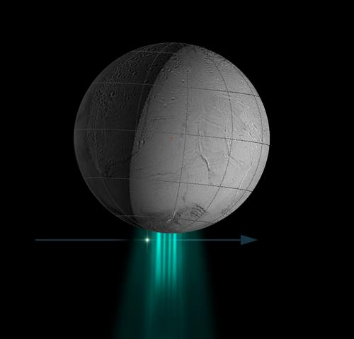
Water plumes shooting from Enceladus south pole
Image credit: NASA/JPL-Caltech
Spectroscopy

Slide 17
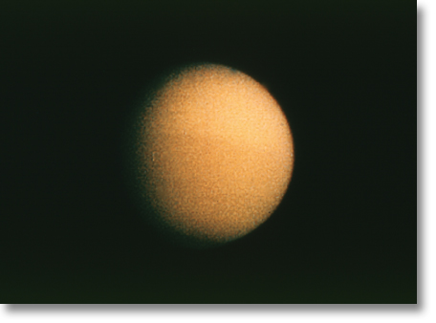
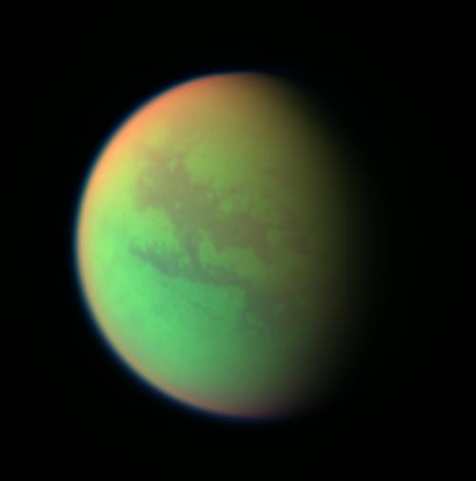
Images of Saturn’s moon Titan
Dense atmosphere
Continents/Oceans visible?
Hubble Image
Cassini Image
Image credit: NASA/JPL-Caltech

Slide 18
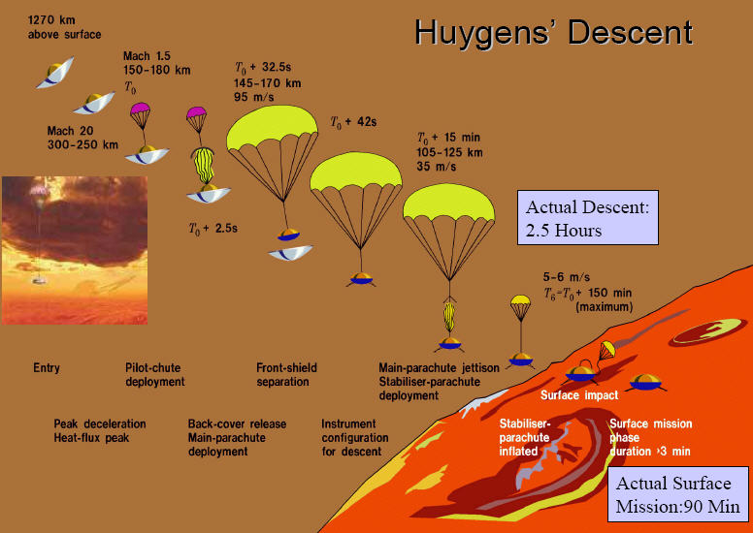
Image credit: NASA/JPL-Caltech

Slide 19
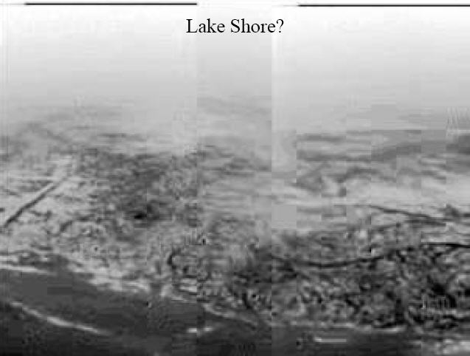
Cassini images of Saturn’s moon Titan
Image credit: NASA/JPL-Caltech

Slide 20
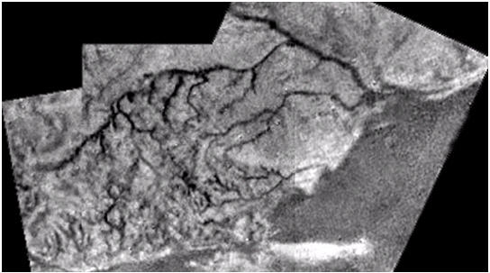
Liquid flow erosion on Titan
Image credit: NASA/JPL-Caltech

Slide 21
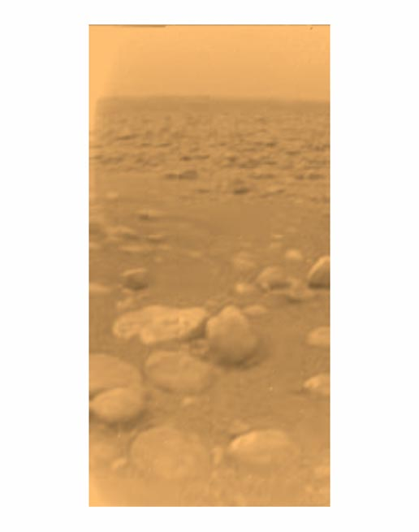
Huygens Probe image from the Surface of Titan
Image credit: NASA/JPL-Caltech
Liquid lakes

Slide 22
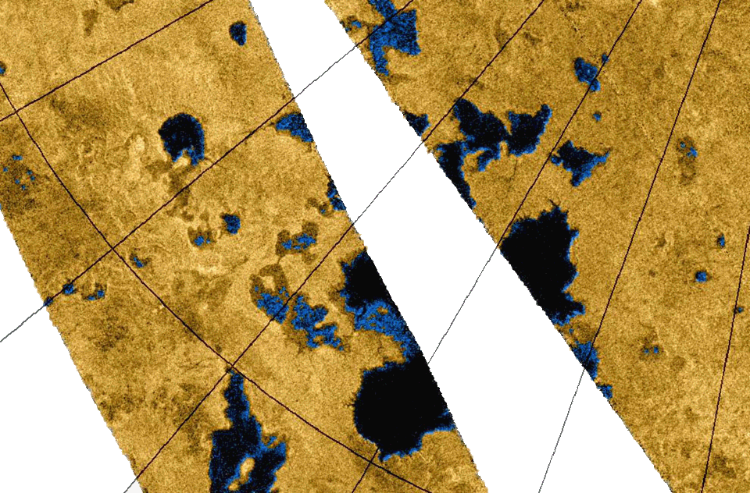
Liquid Hydrocarbon Lakes on Titan
Image credit: NASA/JPL-Caltech
Uranus

Slide 23
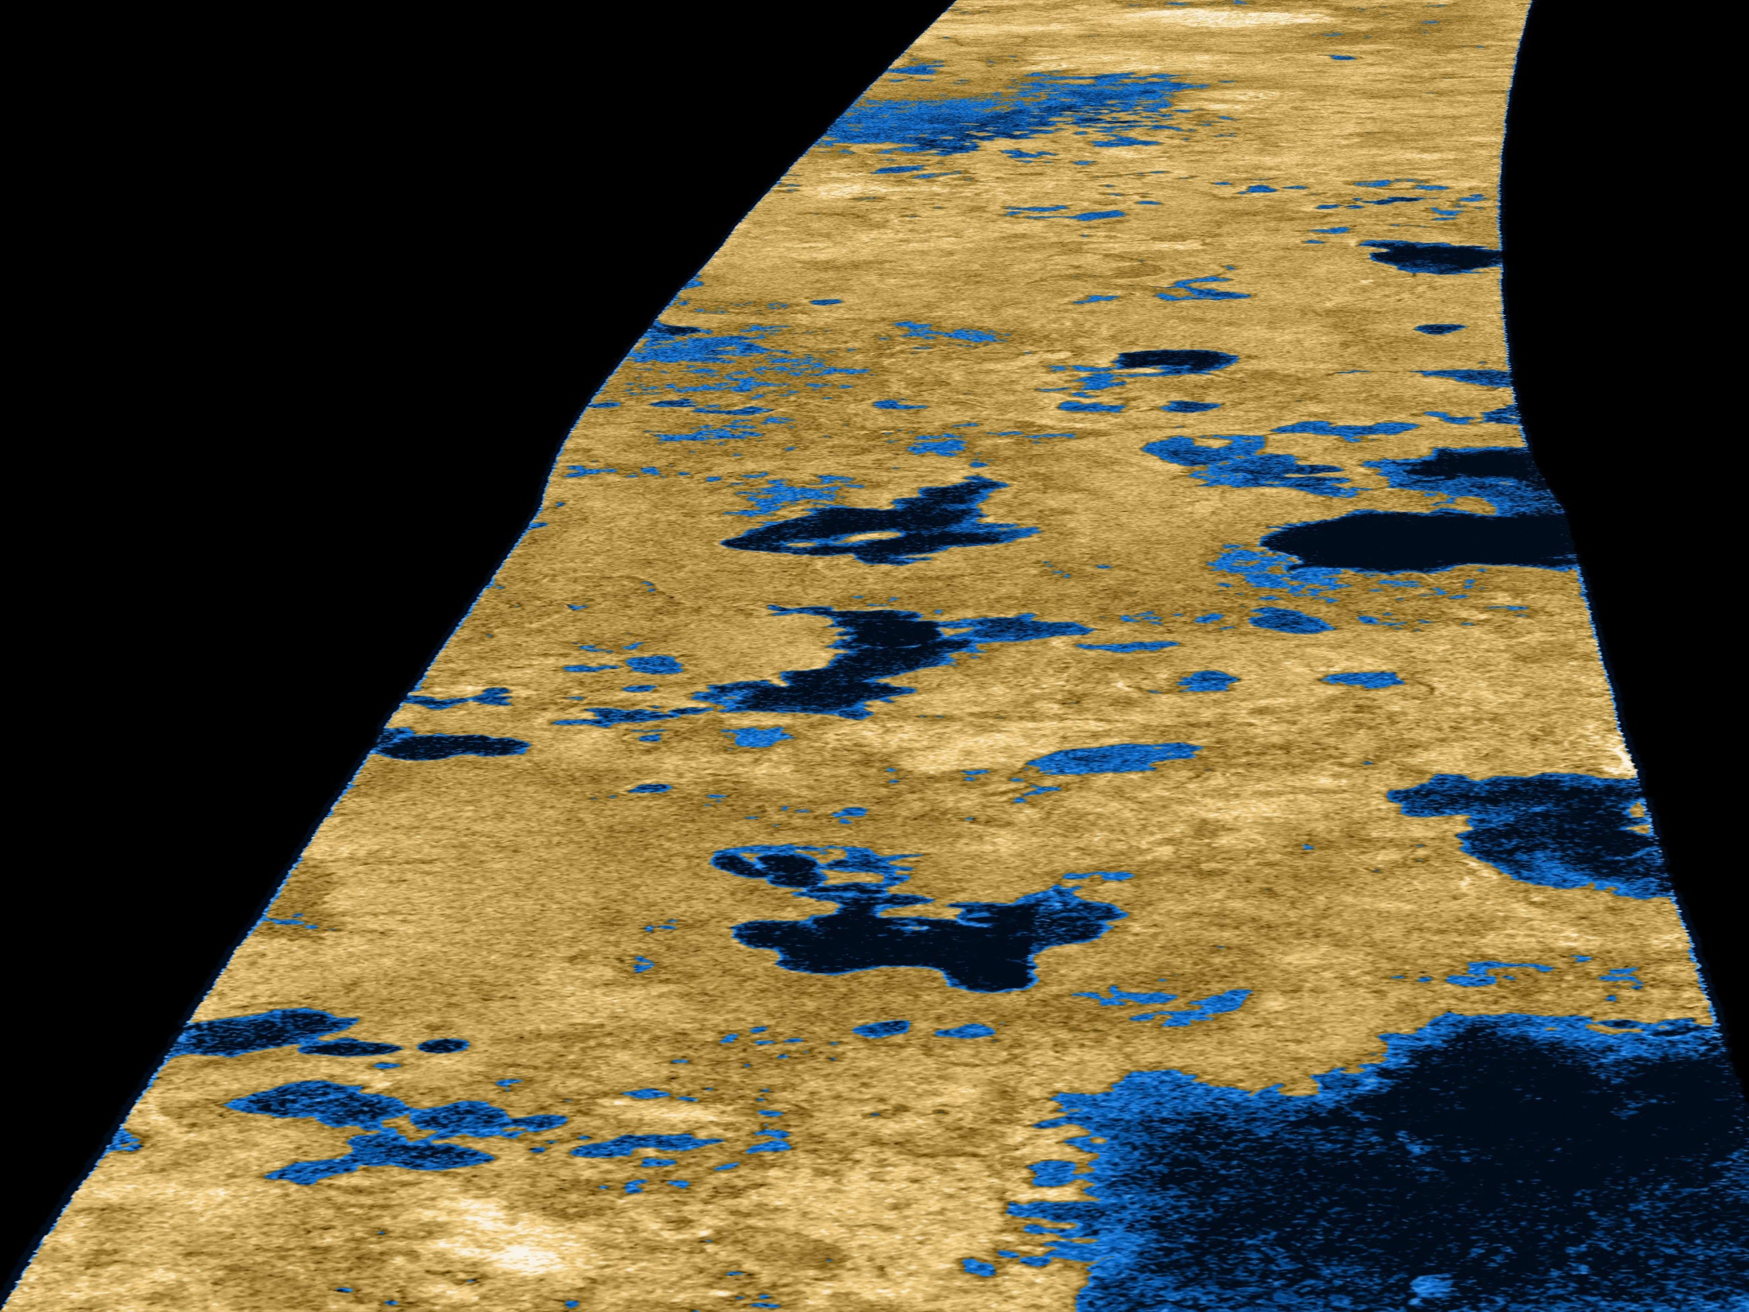
Image credit: NASA/JPL-Caltech
Uranus

Slide 24
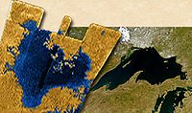
Size: Titan Sea vs. Earth’s Lake Superior
Image credit: NASA/JPL-Caltech
Uranus

Slide 25
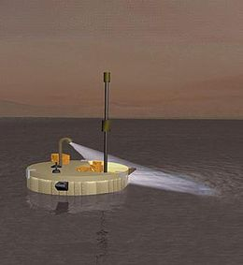
Mission to land a boat on the seas of Titan
Titan Mare Lander
Titan Sea vs. Lake Superior
Uranus
Image credit: NASA/JPL-Caltech

Slide 26
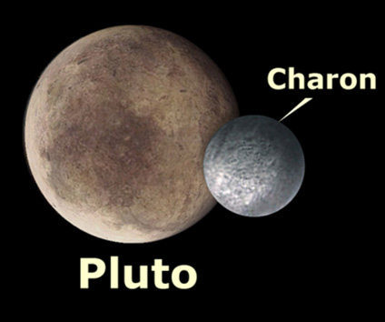
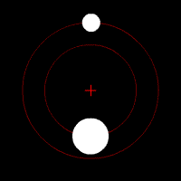
Pluto (1978)
Distance From Sun: 3.7 Billion Miles
Average Temp: -400ºF
Pluto diameter: 1,500 miles, Charon diameter: 750 miles
Orbital Period: 248 years
Moons: 1 (known in 1978)
Charon found in 1978
Artist Rendering
Image credit: NASA/JPL-Caltech

Slide 27
Hubble Best View
Image credit: NASA/JPL-Caltech

Slide 28
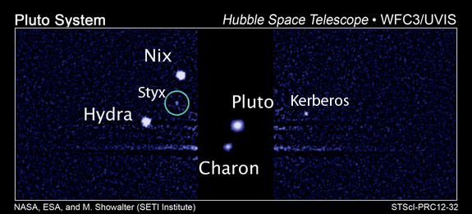
Pluto (7/1/2013)
Introducing: Styx and Kerberos
Pluto Moons: Now at 5
Charon found in 1978
Nix and Hydra found in 2005
Kerberos found in 2011
Styx found in 2012
New Horizons

Slide 29
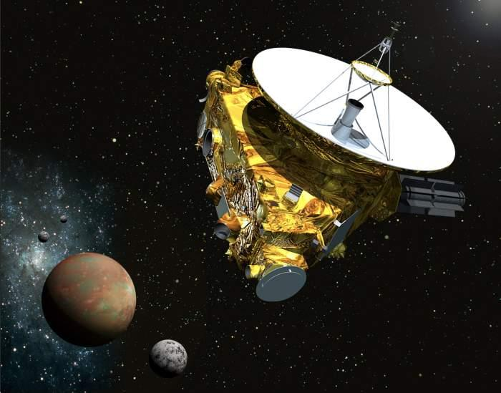
New Horizons (Pluto - Kuiper Belt Mission)
Launched: Jan 17, 2006
Pluto Flyby: July 14, 2015
Image credit: NASA/JPL-Caltech

