Slide 1
Aurora Public Schools Engineering Session
Electrical Engineering &
Lighting Design Concepts
March 1, 2014
Notes:
Sandra welcome the group and start presentation

Slide 2
SSG MEP, Inc.
And
Visual Interest Lighting Solutions
Notes:
Sandra speaks:
Chris and I are here representing our companies – SSG MEP and Visual Interest

Slide 3
Who Are We?
Sandra Scanlon, PE, LEED AP
President & Owner SSG MEP, Inc.
Chris Berry
Principal & Owner, Visual Interest
Notes:
Sandra introduces herself – tells about:
grew up in Chicago
went to college at Valparaiso University, got elec engineering degree and computer science minor
been in Denver since about 1997
licensed professional engineer (PE) and LEED AP
owner of SSG
SSG does…
Chris introduces himself similarly

Slide 4
The art of Lighting Design
Engineering
Lighting
Art
Notes:
Sandra explains that lighting design is a bit of art and engineering combined.
Light can be used in an “artful” way to light things or spaces.
Lighting design is sometimes referred to as an art.
Many engineering principals are used in lighting design. We use a software program called AGi to perform lighting calculations.

Slide 5
3 Main Categories of Lighting
General or Ambient Lighting
Task Lighting
Accent Lighting
Notes:
Sandra continues:
General Lighting or ambient lighting
Stairways need proper lighting to ensure the safety of residents and guests.
Provides uniform light throughout a room.
give an example of a type of light – point to something in classroom
Task lighting
Desk lamp for doing homework or detailed tasks on a work bench. Light the task being performed.
Accent lighting
Relatively high levels of light illuminate pictures and art objects often placed on large walls.
floodlight in a restaurant sign

Slide 6
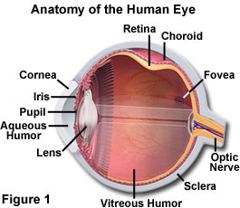
Visual Perception
Visual perception is the ability to interpret the surrounding environment by processing information that is contained in visible light. The resulting perception is also known as eyesight, sight, or vision.
Notes:
Sandra continues and gets a little nerdy…
The human eye is equipped with a variety of optical components including the cornea, iris, pupil, aqueous and vitreous humors, a variable-focus lens, and the retina (as illustrated in Figure 1). Together, these elements work to form images of the objects that fall into the field of view for each eye.
Chris finish with more in visual perception.

Slide 7
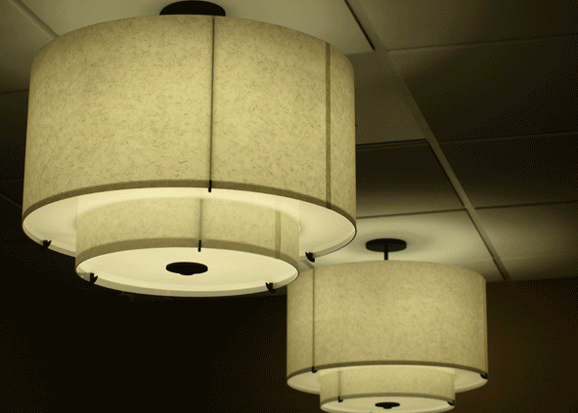
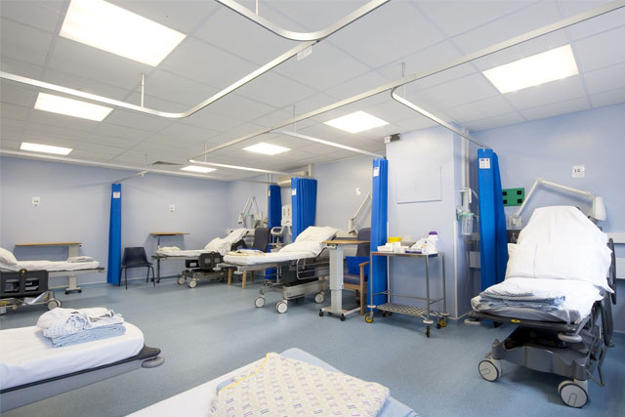
Project Examples at Denver Health
Montbello Clinic Peri - Op
Notes:
Chris talks about this project.
Reasons for picking the types of lights.

Slide 8
Notes:
More denver health

Slide 9
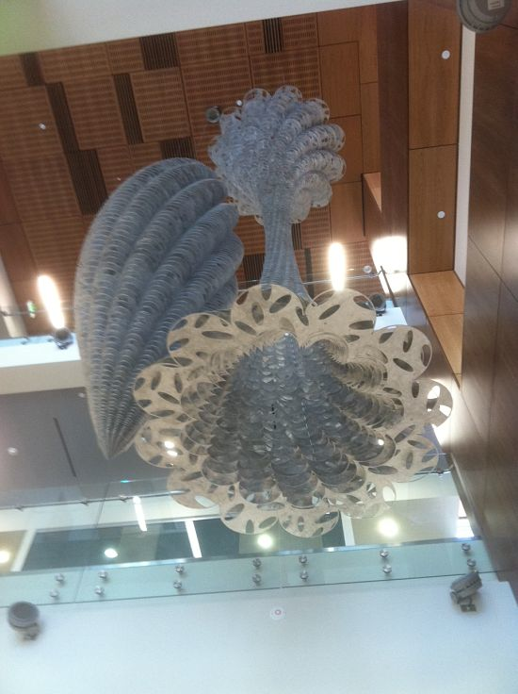
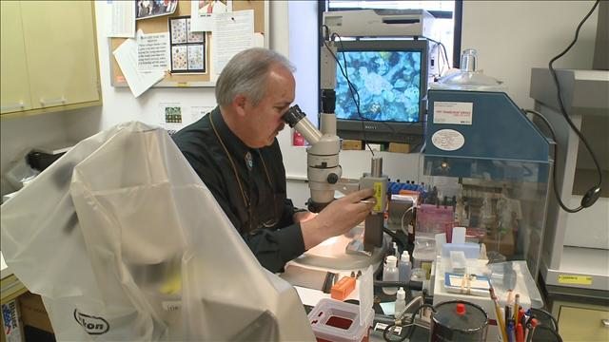
Denver Crime Lab
Notes:
Sandra mentions lighting for artwork in lobby and requirements for lab workers processing evidence.
And the “test” we did in our office for color lamps.

Slide 10
DIA Canopy
Notes:
Sandra and Chris wing it to talk about the types of lights used

Slide 11
King Center Recital Hall at Auraria
Notes:
Sandra and Chris wing it to talk about the types of lights used

Slide 12
Gymnasium
Notes:
Sandra and Chris wing it to talk about the types of lights used

Slide 13
City Park Fountain
Notes:
Sandra and Chris wing it to talk about the types of lights used

Slide 14
Library Indirect Lighting
Notes:
Sandra and Chris wing it to talk about the types of lights used

Slide 15
Show and Tell Time
Notes:
Chris shows off his samples

Slide 16
SSG MEP, Inc.
And
Visual Interest Lighting Solutions
Notes:
Sandra speaks:
Chris and I are here representing our companies – SSG MEP and Visual Interest

