Slide 1
Why I’m an Engineer
Alya Elhawary

Slide 2
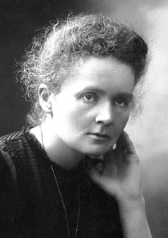
How I Began My Career

Slide 3
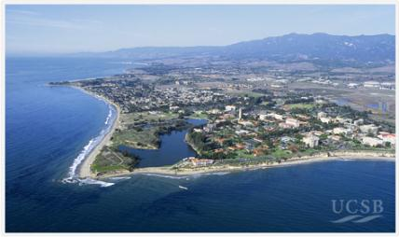
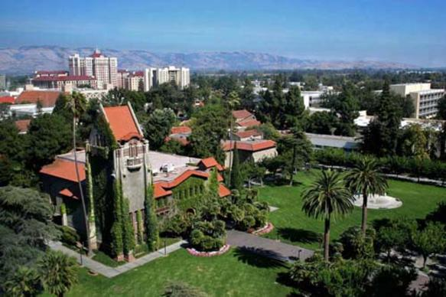
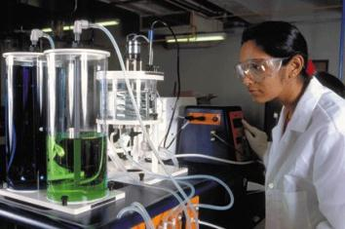
My Background

Slide 4
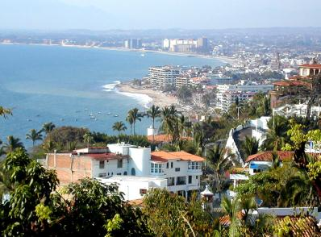
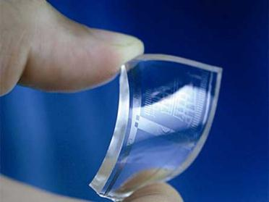
What I do now

Slide 5
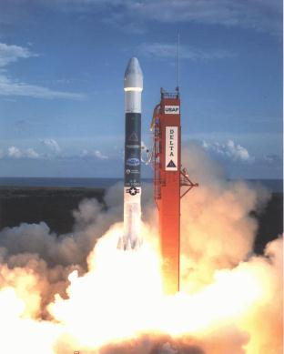
How I got here

Slide 6
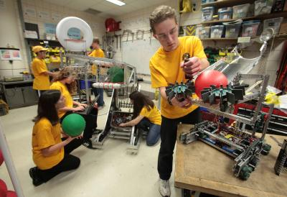
What I do besides work

Slide 7
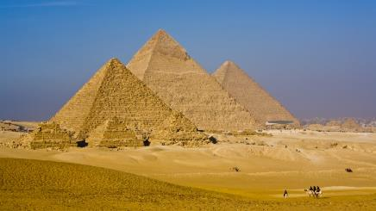
Challenges Then
& Now

Slide 8
It’s Worth It

Slide 9
What you need to do

Slide 10
Most Important

