Slide 1

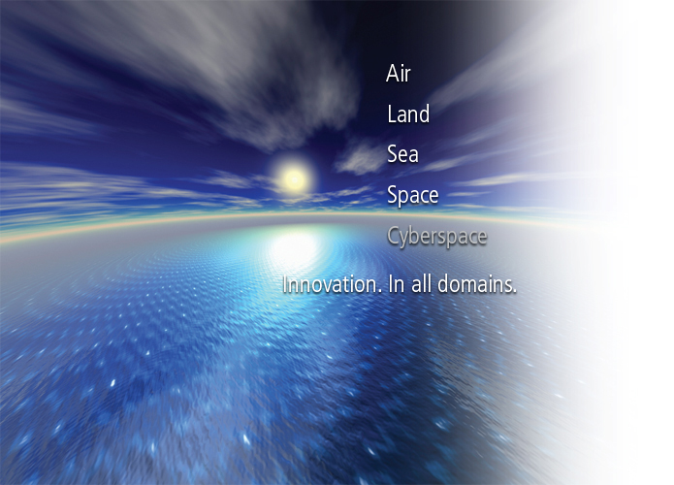
Observing Earth From Space: Engineering to Change the World
Kerry Grant
JPSS CGS Chief Scientist
Bret Lowell
JPSS CGS Program Engineer
April 12, 2014

Slide 2
Agenda
Introduction
Societal Benefits
  Interactive exercise: environmental effects on daily life
  How weather affects us
  How improvements in technology improves life
Phenomena
  What's relevant and how do we detect it?
  Interactive demonstration. Interaction between environment & photons
Engineering
  Sensors to Products to Actionable Information
Conclusion
Resources

Slide 3
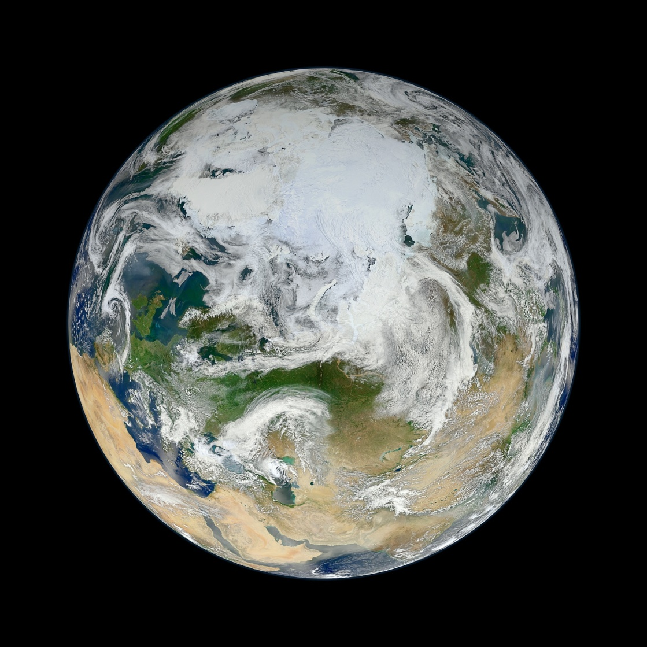
Earth Observation – what’s that?
Earth observation is the gathering of information about planet Earth’s physical, chemical and biological systems via remote sensing technologies
Remote sensing is the acquisition of information about an object or phenomenon without making physical contact with the object
Image courtesy of NASA

Slide 4
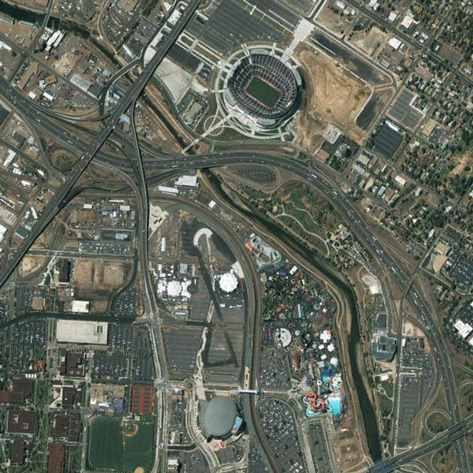
Classes of Earth Observation Missions
Weather
  Geostationary
  Polar Orbiting
Climate
Land Use
  Vegetation
  Urbanization
Ocean
  Biology
  Winds and currents
  Ice
Intelligence, Surveillance, & Reconnaissance (ISR)
  Imagery
  Signals
Digitalglobe image

Slide 5
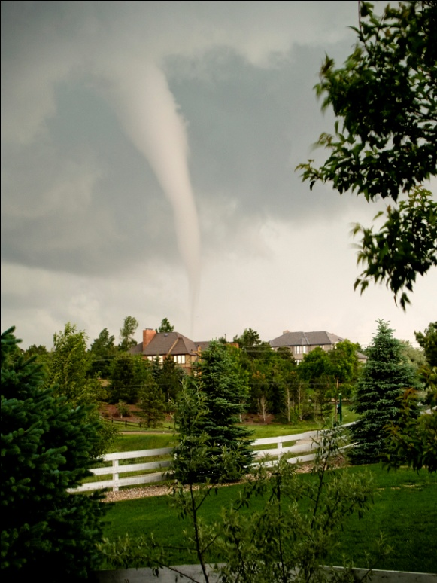
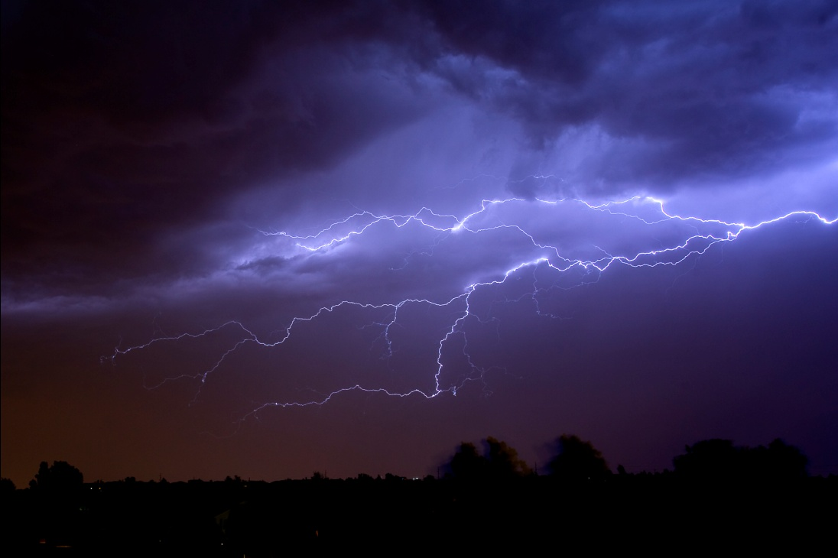
Focus: Weather and Climate
Who wants environmental information?
How does environmental information get to these people?
Why is technology so important?
How do people benefit?
Photos © Kerry D. Grant, 2014

Slide 6
Activity: Choosing Environmental Parameters to Describe a Given Location
Preparation for the activity
  Form a team
  Each team will elect a spokesperson
  Total time to complete activity: 15 minutes
Description of activity
  Each team will be assigned a city (or location)
  Each team will brainstorm and provide 5 environmental parameters for their assigned city
  Each team will discuss their parameters with the class
  The class gets to guess the team’s location
Notes:
The purpose of this fairly simple activity is to get the students to start thinking in terms of environmental parameters when describing a location that they may be familiar with.

Slide 7
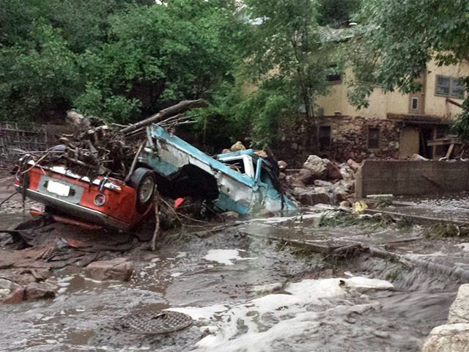
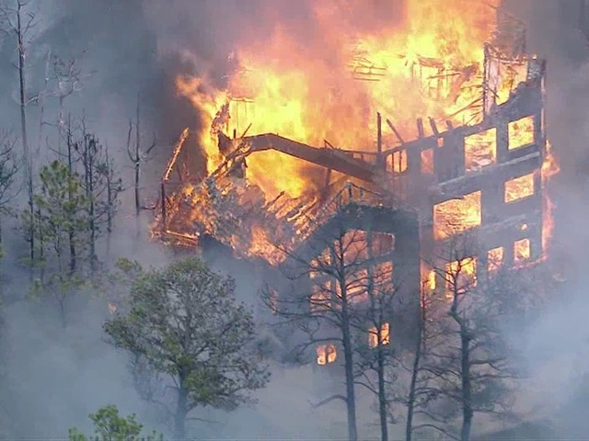
Interesting facts about weather impacts
Weather disasters with impacts exceeding $1 billion have hit the US 151 times since 1980.
Federal disaster declarations have risen from 65 in 2004 to 98 in 2012
Average value of all US daily weather forecast information is around $109 per household; $11.4 billion in total
Photos courtesy of CBS 4 (Colorado Springs)

Slide 8
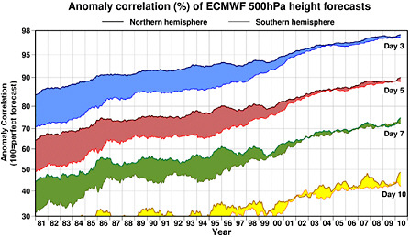
How is life better today?
Weather forecasts have become more accurate
Weather forecasts can be made further out in time
Climate forecasts are more accurate
These technology driven changes allow people to plan better
  Prepare for bad weather events (blizzards, hurricanes, tornados)
  Plan for changes in climate (longer periods of drought, more violent weather, rising sea levels)
  Schedule outdoor activities (want to go swimming? climb a mountain? fly a kite?)

Slide 9
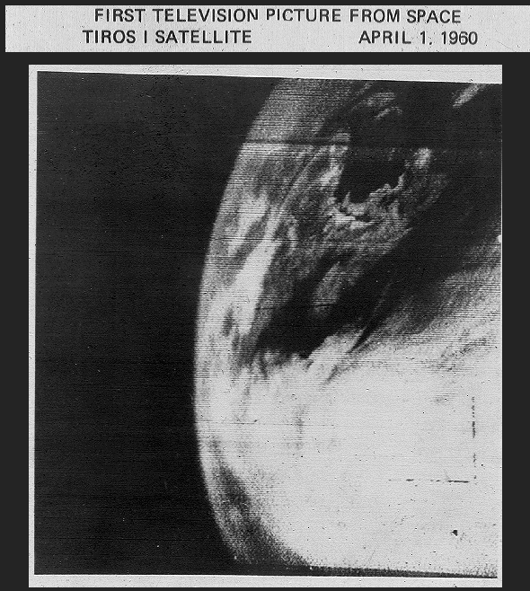
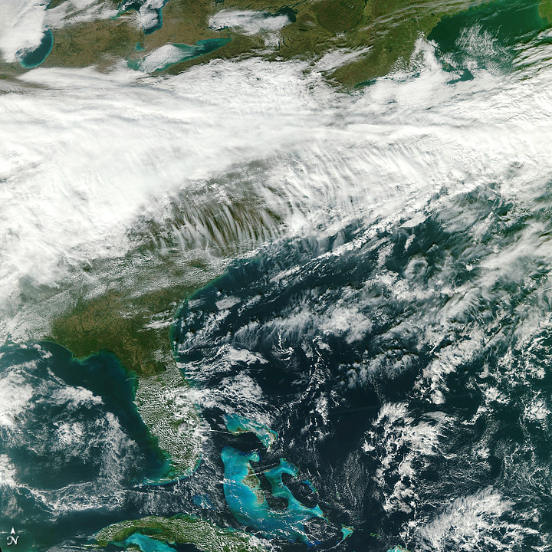
Building A More Capable System
The Historical Context
First Image from TIROS-1 (April 1, 1960)
S-NPP VIIRS Image-375 m
New Brunswick and Nova Scotia
VIIRS First Light – US East Coast
Images courtesy of NASA
Notes:
We have made great progress in the area of satellite remote sensing over the past four decades. The first environmental satellite launched by the U.S. was the inaugural Television and InfraRed Operational Satellite (TIROS-1), launched in April of 1960. TIROS-1 provided a handful of black and white images of poor resolution and had an operational lifetime of only 78 days, but proved that satellites could be useful tools for surveying global weather conditions from space. The current state of the science comes from the NASA funded Earth Observing System (EOS), which includes three satellites on orbit. The second of these, Aqua, was launched in May of 2002 and has been providing valuable multi-spectral images from such instruments as the Moderate Resolution Imaging Spectroradiometer (MODIS). It is easy to see the enhanced utility of the images now available to weather forecasters and environmental scientists. In addition, the typical environmental satellites of the future will have operational lifetimes of 7 years or longer.

Slide 10
The problem of remote sensing
What do we need to measure?
  Temperature
  Pressure
  Humidity
  Cloud properties
  Wind speed and direction
  Precipitation
What can we actually measure from space?
Does what we can measure have anything to do with what we need to measure?

Slide 11
What we can measure
Some things we can see – so take a picture
  Clouds (where they are, type)
  Taking a number of pictures shows movement, so we can measure winds
  But a picture is an incomplete measurement
The solution
  Electromagnetic energy can be measured directly
  The energy we measure is affected by the things we care about in very predictable ways: temperature, humidity, winds, clouds, precipitation
  By measuring electromagnetic energy very precisely, and understanding how this energy is changed by the environment, we can derive the actual physical conditions of the earth

Slide 12
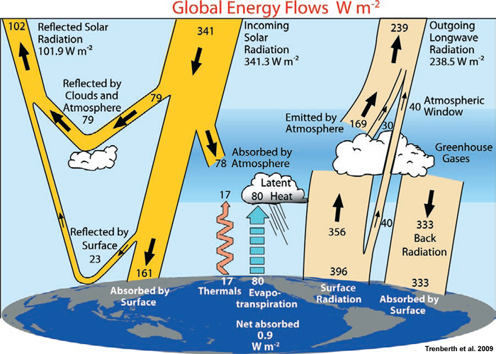
Electromagnetic Energy Flow
Source: Tropical Meteorology, 2nd Edition, © 2011 COMET

Slide 13
Demonstration
How does a cloud affect electromagnetic energy at two different wavelengths?

Slide 14
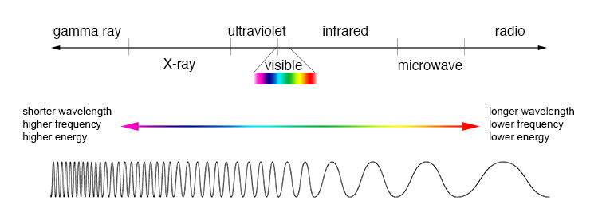
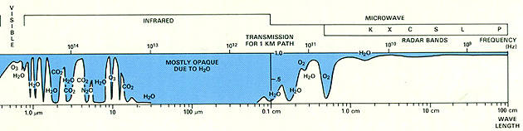
The Electromagnetic Spectrum and the Atmosphere

Slide 15
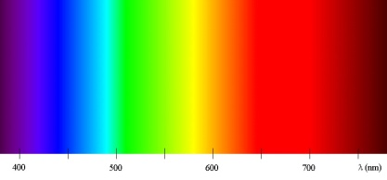
Observing the Electromagnetic Spectrum – the Suomi NPP spacecraft
ultraviolet
visible
infrared
microwave
ozone
temperature, moisture
layers
temperature, moisture
layers
clouds, ice, vegetation, snow
ocean color, dust, smoke, lights

Slide 16
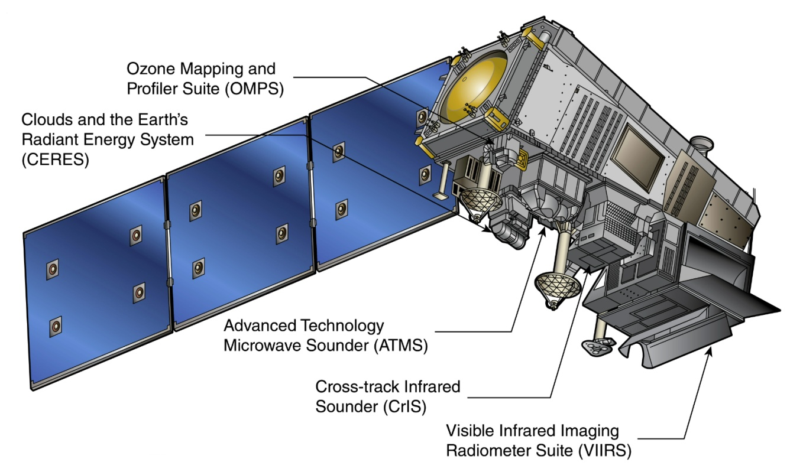
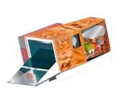
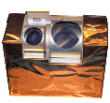
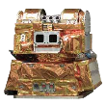
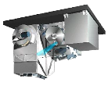
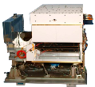
The Suomi NPP Satellite
VIIRS
ATMS
CERES
OMPS
CrIS

Slide 17
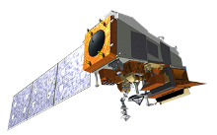
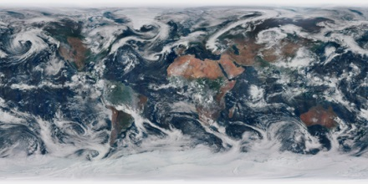
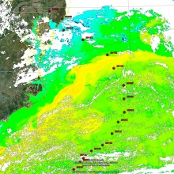
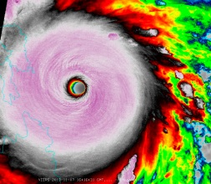
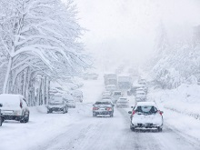
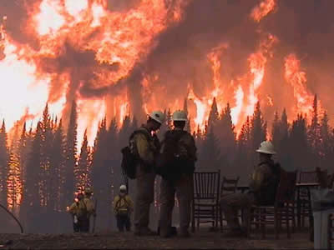
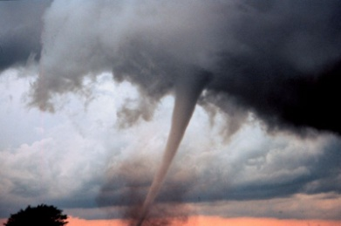
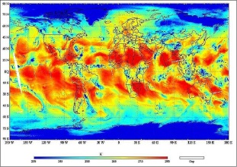
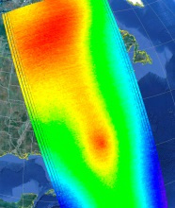
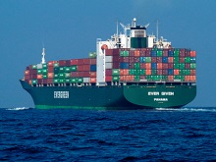
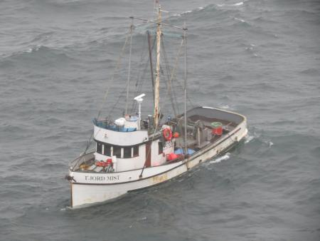
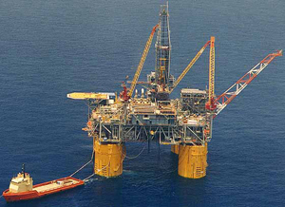
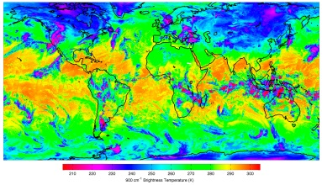
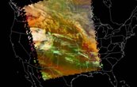
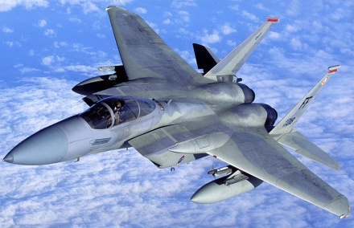
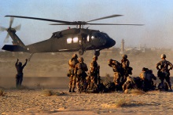
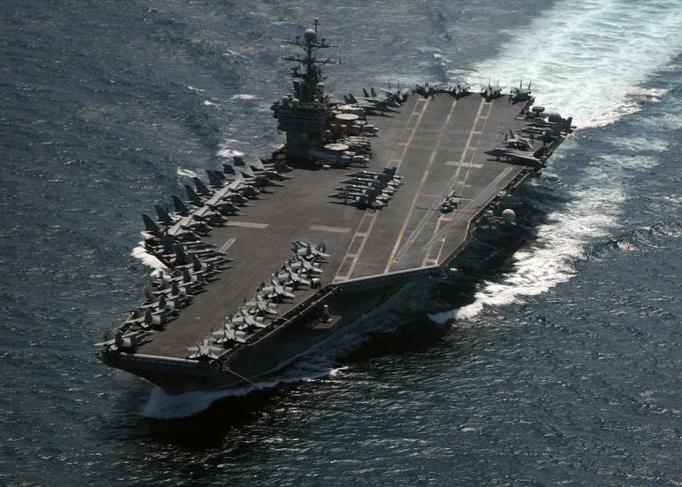
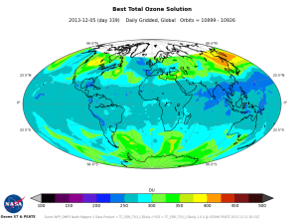
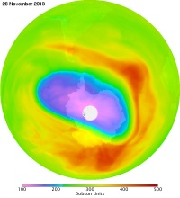
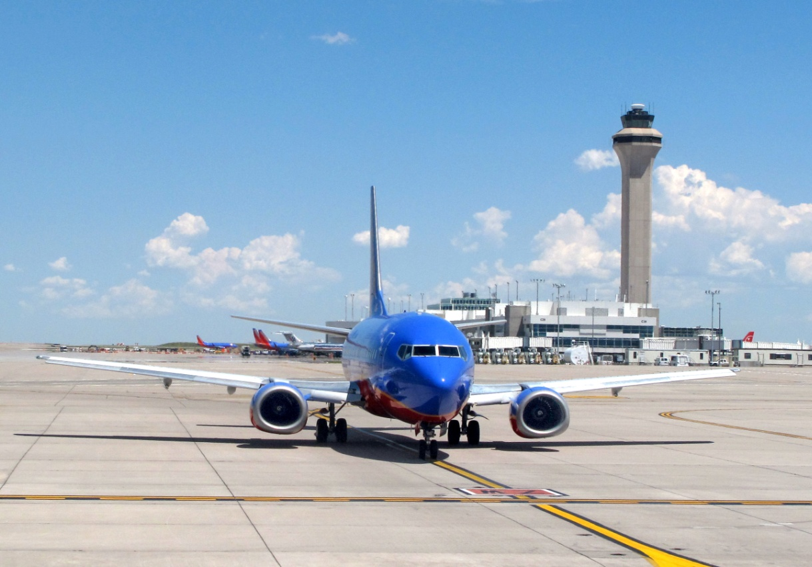
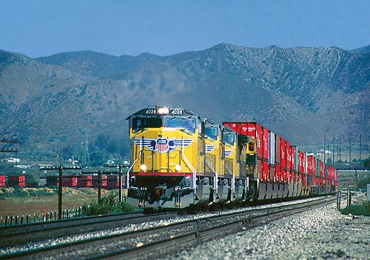
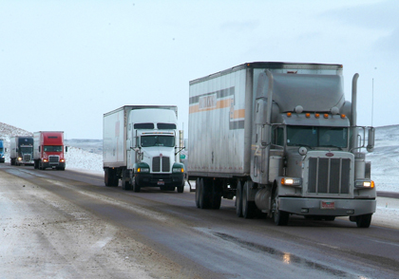
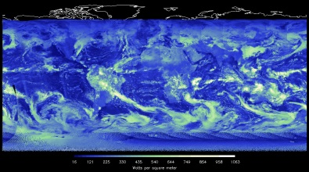
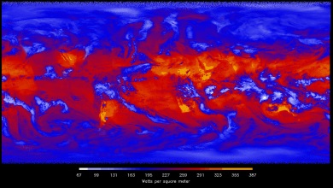
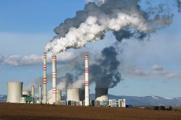
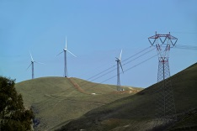
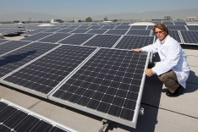
Sensors to Products to Actionable Info
S-NPP Data Products
Benefits for Decision Makers
VIIRS
Weather
Consumer
Maritime
Operations
ATMS
Military
Operations
CrIS
Transportation
OMPS
Public
Utilities
CERES
4/9/2014

Slide 18
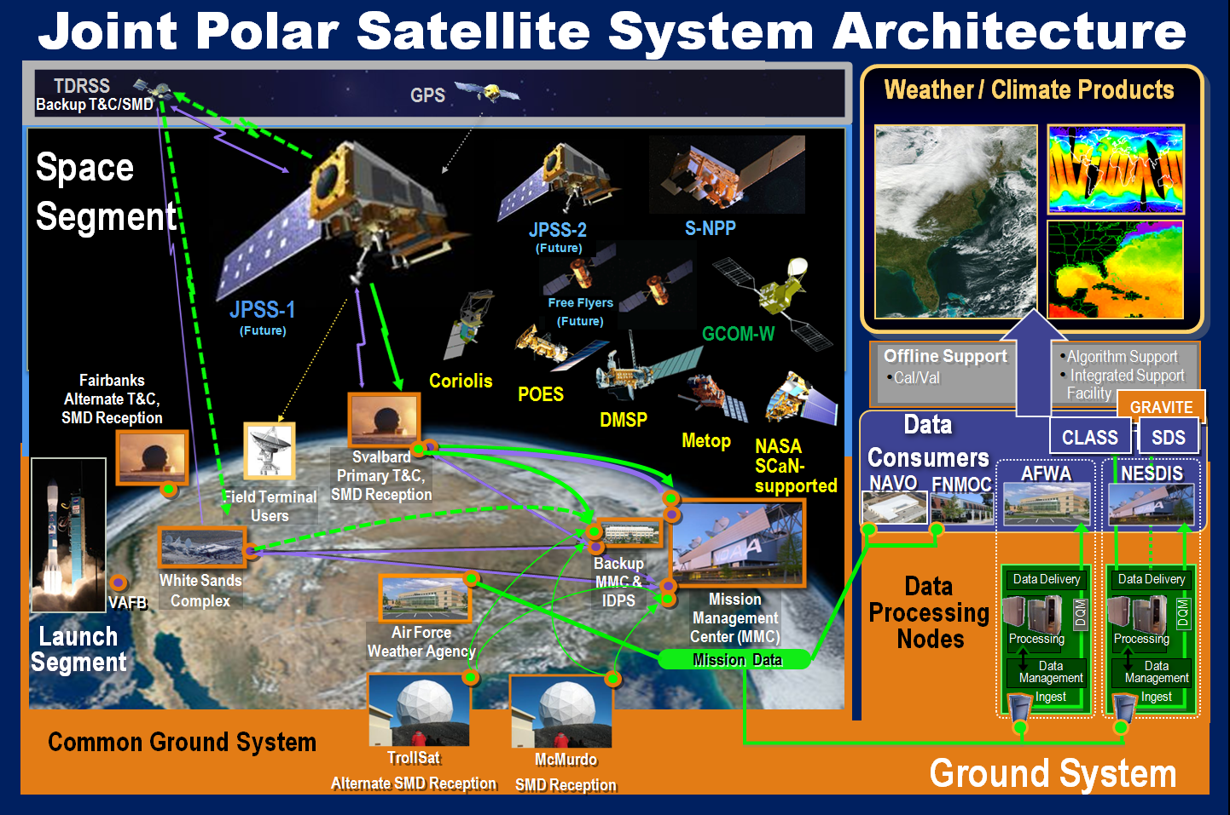
Daily Operations

Slide 19
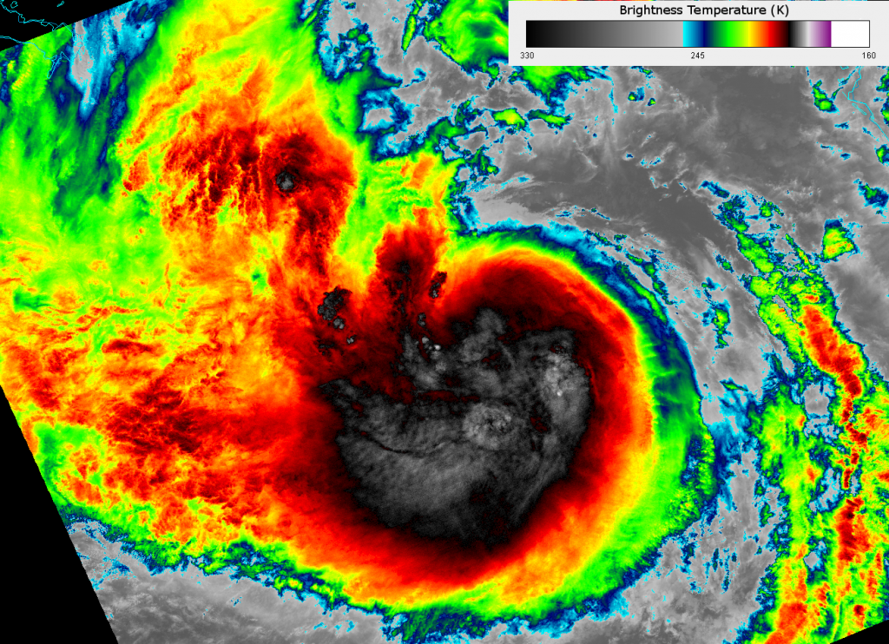
Hurricane Isaac in Infrared
Image courtesy of NASA

Slide 20
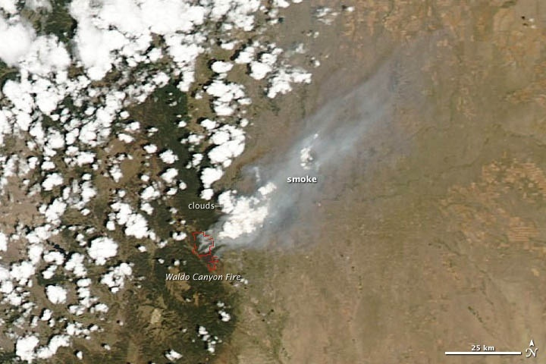
VIIRS True Color – Waldo Canyon Fire
Image courtesy of NASA

Slide 21

VIIRS Night Visible Fire Detection
Image courtesy of NASA

Slide 22

OMPS Smoke (Aerosol) Detection
Image courtesy of NASA

Slide 23

OMPS Measurement of Ozone Hole
Image courtesy of NASA

Slide 24


VIIRS Ice Detection – Day and Night
Night
Day
Images courtesy of NASA

Slide 25
Conclusion
Understanding the environment provides direct benefits to people in terms of safety, quality of life, and future needs
Measuring the environment in great detail allows people to understand its current state and predict its future
Only way to measure the entire globe in detail is by using remote sensing techniques
Understanding how electromagnetic energy interacts with the environment makes remote sensing possible
Engineering brings it all together – building sensors, flying satellites, processing the data, making forecasts, delivering the information

Slide 26
Resources
Interactive blue marble http://www.raytheon.com/newsroom/technology/rtn12_bluemarble/
S-NPP information
http://npp.gsfc.nasa.gov/suomi.html
http://www.nasa.gov/mission_pages/NPP/main/
Instrument overviews
http://npp.gsfc.nasa.gov/viirs.html http://npp.gsfc.nasa.gov/cris.html http://npp.gsfc.nasa.gov/atms.html http://npp.gsfc.nasa.gov/omps.html http://npp.gsfc.nasa.gov/ceres.html

