Slide 1
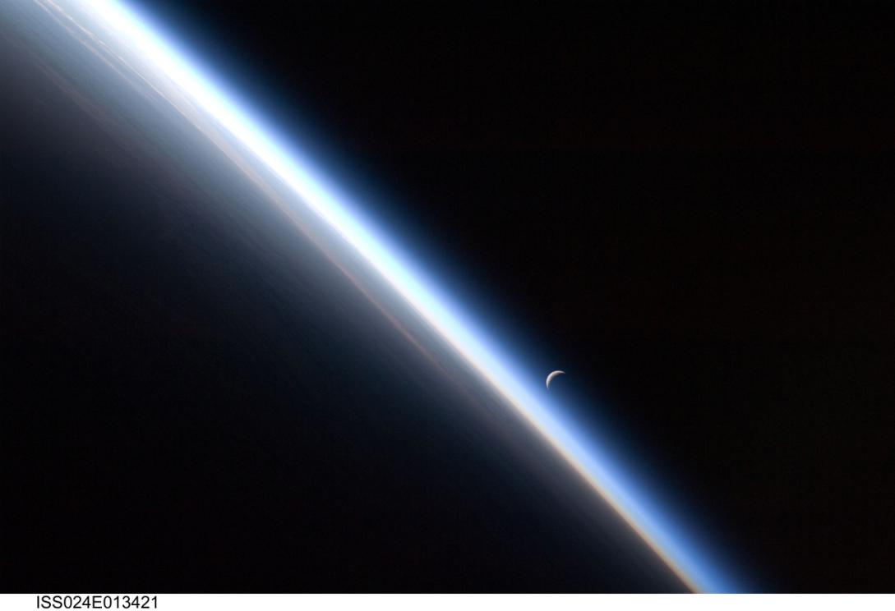
Lunar and Planetary Spacecraft
Christy Edwards-Stewart
Solar System Ambassador
Lockheed Martin Aerospace Engineer
Christine Kryscio
Lockheed Martin Materials Engineer
Image Courtesy NASA

Slide 2
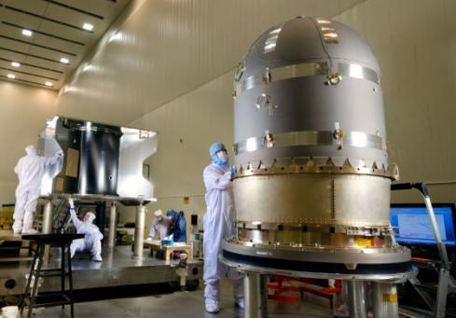
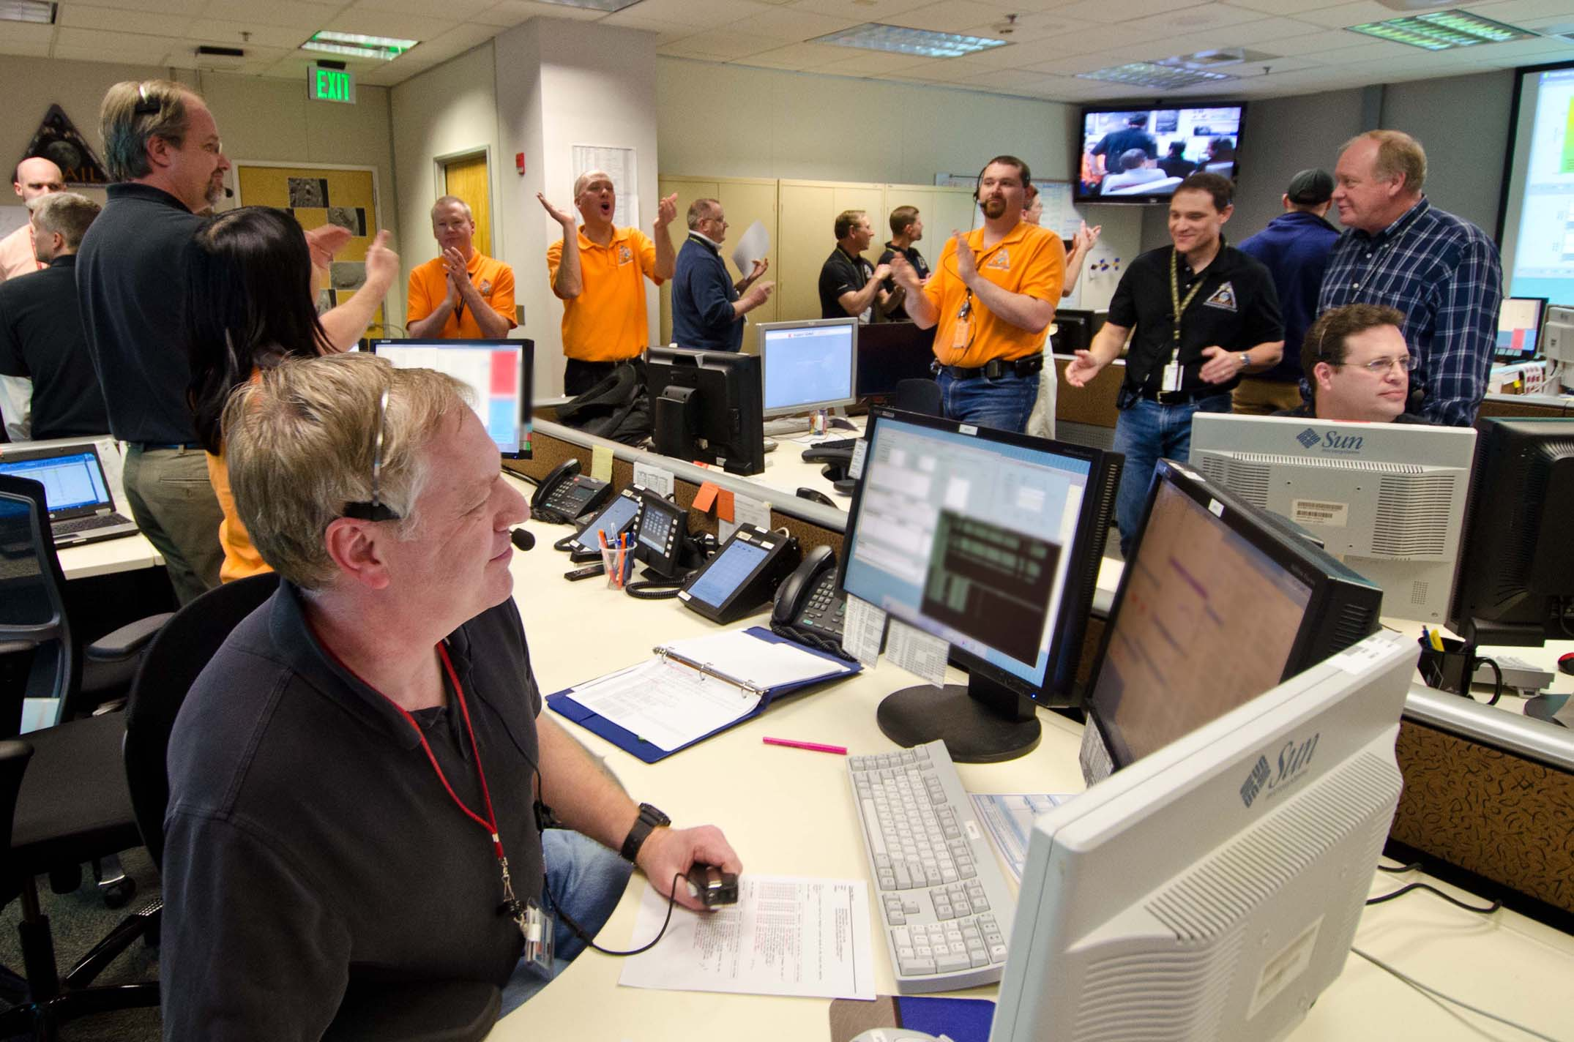
Spacecraft Engineering and Operations in Colorado
Images Courtesy Lockheed Martin
Spacecraft are built in the high-bay at Lockheed Martin
Engineers and technicians wear “bunny suits” to protect spacecraft
MAVEN, a Mars orbiter, was the most recent spacecraft to be assembled
Many NASA robotic spacecraft are flown from Lockheed Martin
The mission control center has consoles for each subsystem
Joint team: Lockheed Martin and JPL
Notes:
http://www.google.com/imgres?imgurl=http://msnbcmedia2.msn.com/j/msnbc/Components/Photos/031229/mars_911.grid-6x2.jpg&imgrefurl=http://www.msnbc.msn.com/id/3832494/ns/technology_and_science-space/t/mars-emergency-who-ya-gonna-call/&usg=__bYAE6Mbpi6sx8CcCFCKXkvTlgsY=&h=336&w=474&sz=32&hl=en&start=2&zoom=1&tbnid=i5x-3yAGDTjZfM:&tbnh=91&tbnw=129&ei=c_SpT5vHNIWq8ATptJmuBw&prev=/search%3Fq%3DLockheed%2BMartin%2B%2522mission%2Bsupport%2Barea%2522%26um%3D1%26hl%3Den%26sa%3DN%26gbv%3D2%26tbm%3Disch&um=1&itbs=1
http://lasp.colorado.edu/home/maven/files/2012/04/MAVEN-Tank_reduced.jpg

Slide 3
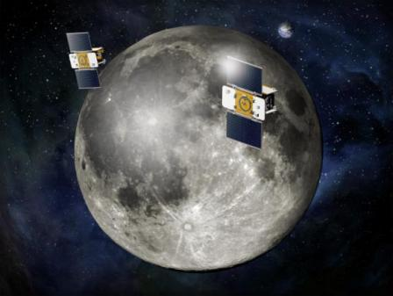
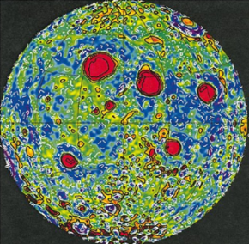
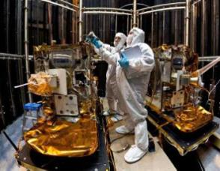
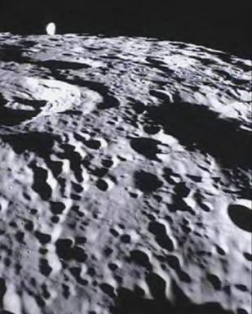
GRAIL
GRAIL Facts - Mission 2011-2012
Mission: Mapping the Moon’s gravity
Geomorphology and Geology – how Moon formed
Spacecraft Size: Washer and Dryer Machines
Flew in formation with 200 km separation distance
Cruise altitude as low as 8 km (5 miles) above the mountains in extended mission
Flew as low as an airplane
MoonKam provided the opportunity for middle-school students to take pictures of Moon’s surface
End of mission – smashed into the Moon
Images Courtesy NASA/JPL-Caltech

Slide 4
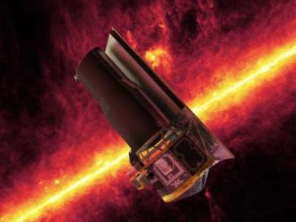
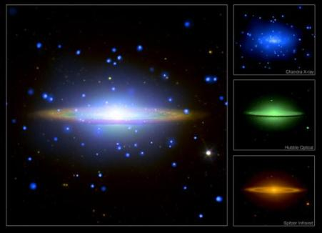
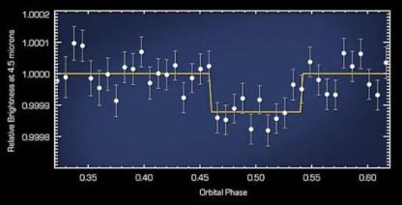
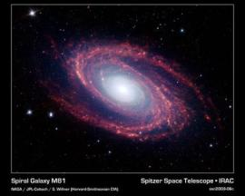
Spitzer
Spitzer Facts – Launched 2003
One of NASA’s Great Observatories
Looks at Infrared light, the heat signature of the universe
Can see things that Hubble cannot see, through interstellar dust clouds to the stars forming or exploding inside
During extended mission, discovered that Spitzer can find planets around other stars
Images Courtesy NASA/JPL-Caltech

Slide 5
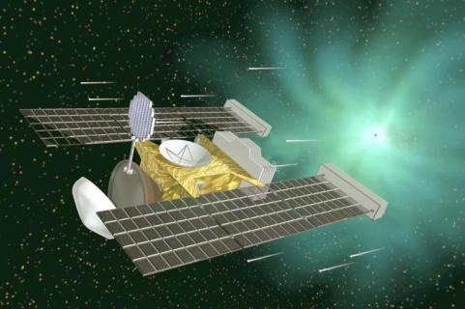
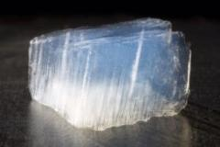
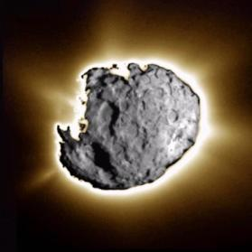
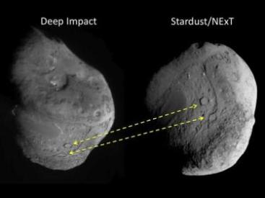
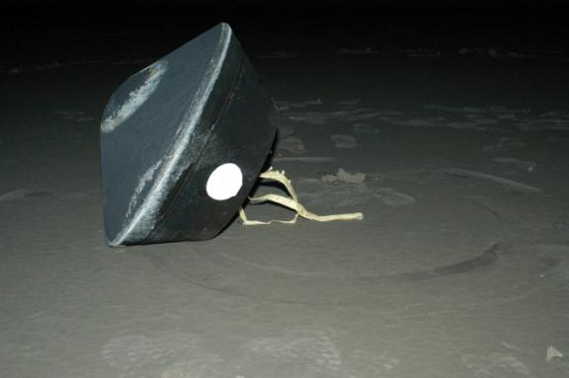
Stardust
Stardust Facts – Launched 1999
Flew by the asteroid Annefrank and the comets Wild 2 and Tempel 1
Captured comet dust inside material called Aerogel, nicknamed “solid smoke,” and brought them to Earth
Revisited the Deep Impact crater site
Basis for new mission OSIRIS-REx
Images Courtesy NASA/JPL-Caltech

Slide 6
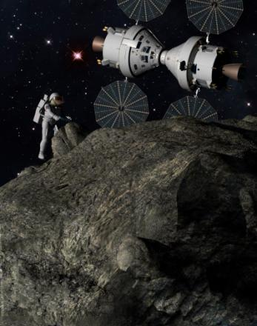
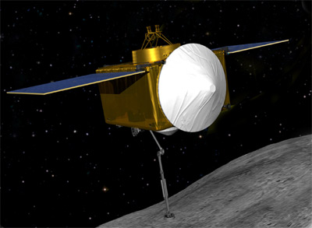
OSIRIS-REx and Orion
Osiris-REx Facts - Launches 2016
Asteroid sample return mission
Orion Facts – Test Flight 2014
Spacecraft designed to carry astronauts to deep space locations including asteroids
Images Courtesy NASA

Slide 7
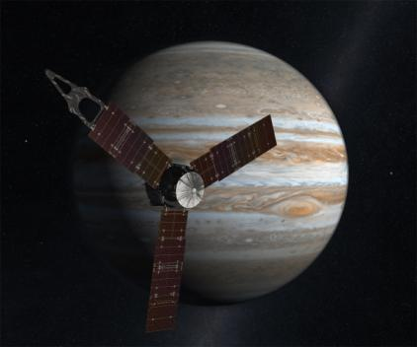
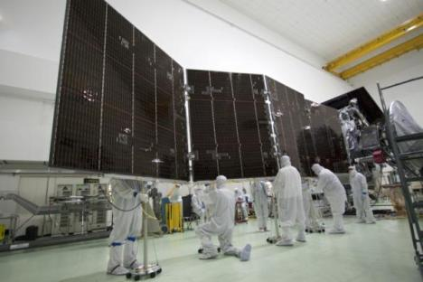
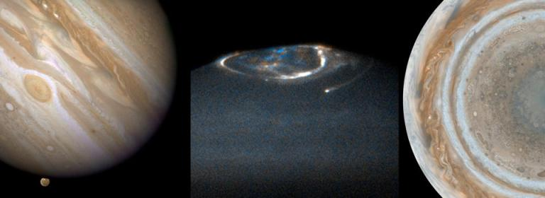
Juno
Juno Facts – Launched 2011
Mission: Study what Jupiter is made of, its gravity and magnetic fields, and its auroras
Journeyed past Mars in 2012
Earth Fly-by was October 2013
Arrives at Jupiter in 2016
Images Courtesy NASA/JPL-Caltech

Slide 9
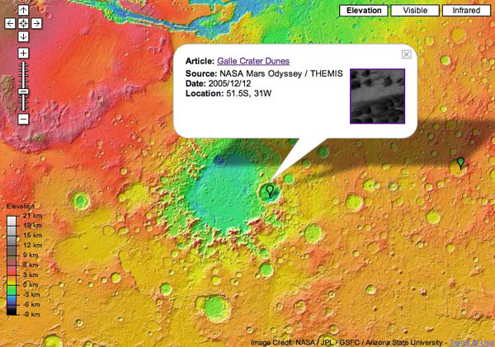
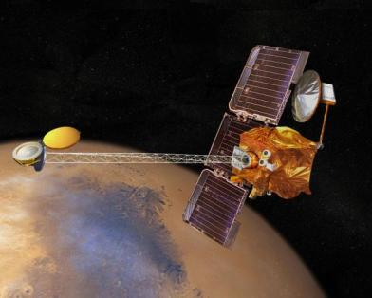
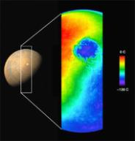
Mars Odyssey
Mars Odyssey Facts – Launched 2001
Mission: Mapping the Mars Surface and Rover Relay
Infrared camera - looks at the heat signature of Mars
Communication with Mars rovers Opportunity and Curiosity
Aerobraking – used Mars atmosphere to slow down
Detected water ice at the Martian poles
Images Courtesy NASA/JPL-Caltech

Slide 10
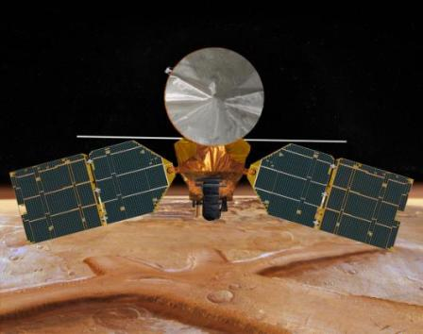
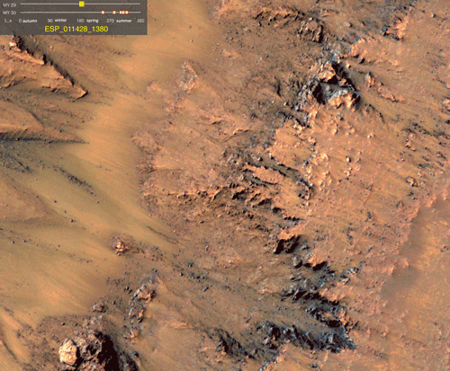
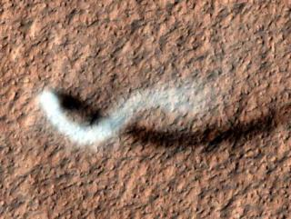
Mars Reconnaissance Orbiter
MRO Facts – Launched 2005
Mission: Mapping the Mars Surface and Rover Relay
Martian geology in visible spectrum
Communication with Opportunity and Curiosity
Camera can see rocks the size of beach balls, rover tracks, dust devils
Took pictures of rover landing sites
Discovered what appears to be flowing water on Mars in 2011
Images Courtesy NASA/JPL-Caltech
Notes:
http://www.nasa.gov/mission_pages/MRO/news/mro20110804.html

Slide 11
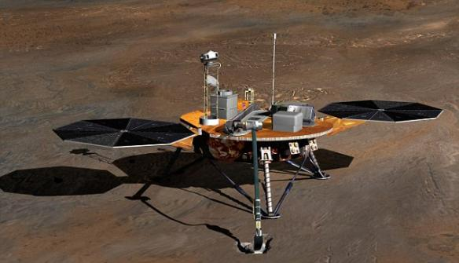
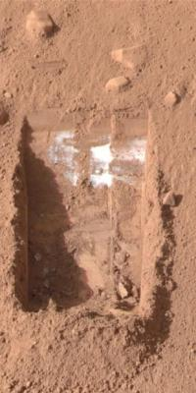
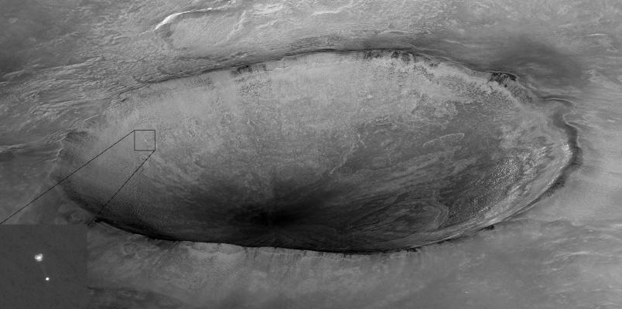
Phoenix and InSight
Phoenix – Launched 2007
MRO’s famous picture: first time a spacecraft has been imaged landing on another planet
Found water ice beneath the Mars soil, using a scoop
InSight – Launches 2016
Spacecraft will look like Phoenix
Will measure Mars-quakes
Images Courtesy NASA/JPL-Caltech

Slide 12
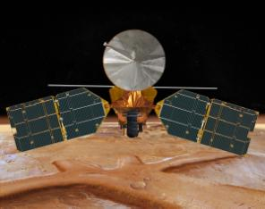
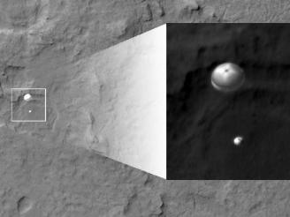
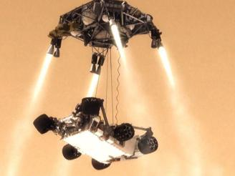
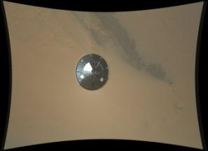
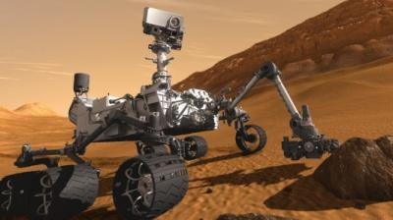
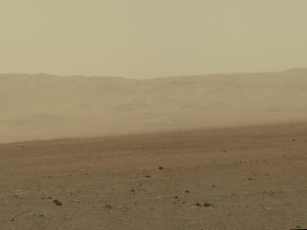
Mars Curiosity Rover Landed in 2012!
Curiosity Landing Facts
Heat shield build in Colorado
Odyssey was communication satellite for rover to send data and pictures to Earth
MRO took picture of Curiosity parachute and lander
Images Courtesy NASA/JPL-Caltech

Slide 13
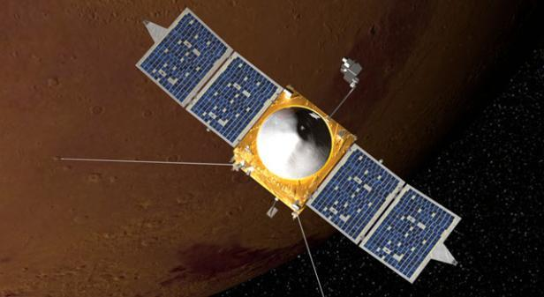
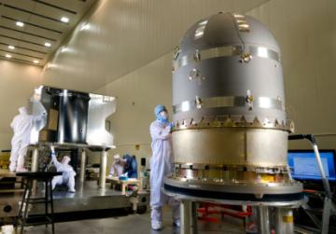
Maven
Maven Facts – Launches 2013
Mission: Study Mars atmosphere and climate
Will perform “deep dives” into atmosphere
Images Courtesy NASA/JPL-Caltech

Slide 14
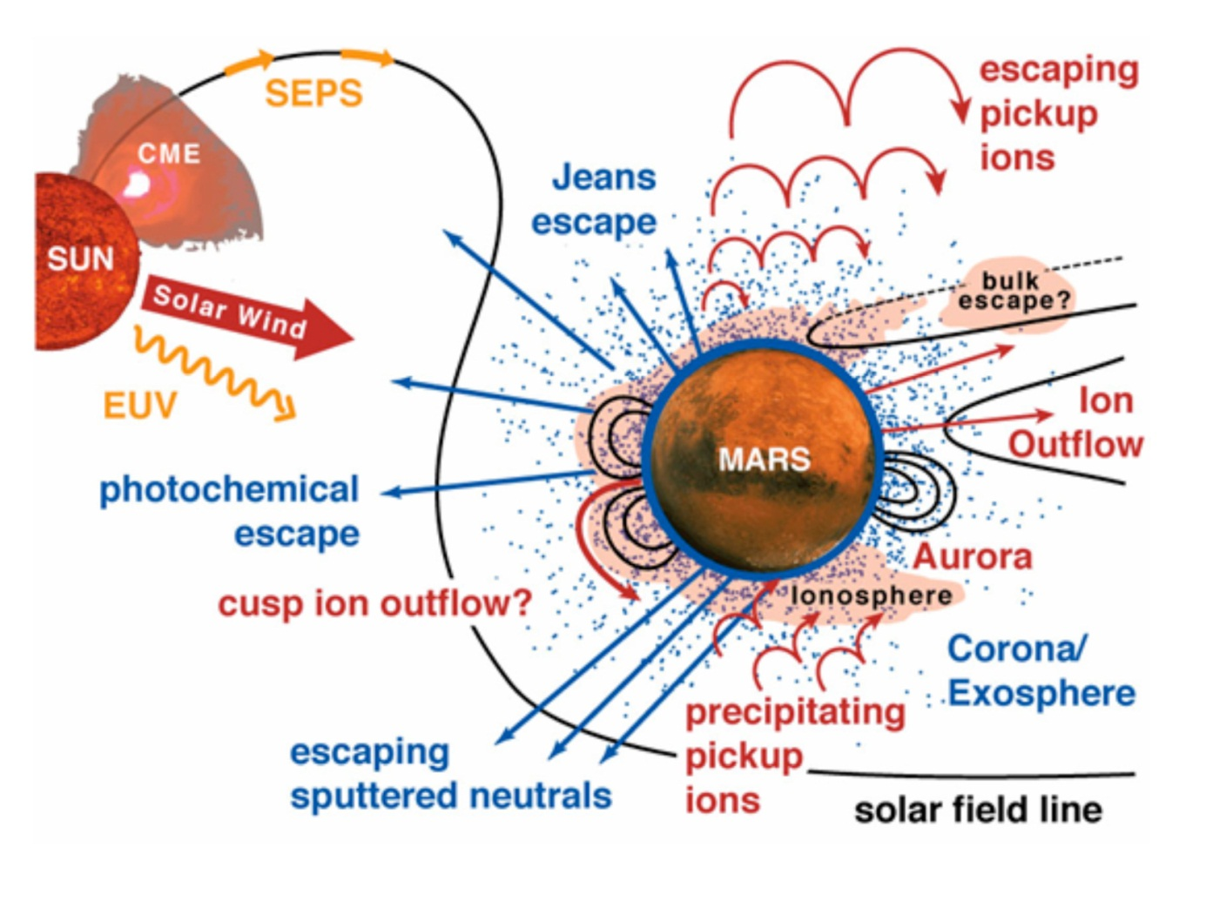
MAVEN Will Allow Us To Understand Escape Of Atmospheric Gases To Space
MAVEN will determine the present state of the upper atmosphere and today’s rates of loss to space.
Measurements will allow determination of the net integrated loss to space through time.
Notes:
Main points: (1) MAVEN measures all external drivers at Mars, measures the neutral and ion reservoirs that supply the exosphere, places multiple constraints on all known loss processes, and measures the escape products themselves. (2) MAVEN addresses the different loss processes as an interrelated system, including supply of the escape reservoir and feedback mechanisms. (3) The MAVEN mission will sample a wide range of solar activity, from the quiet Sun to extreme events.

Slide 15
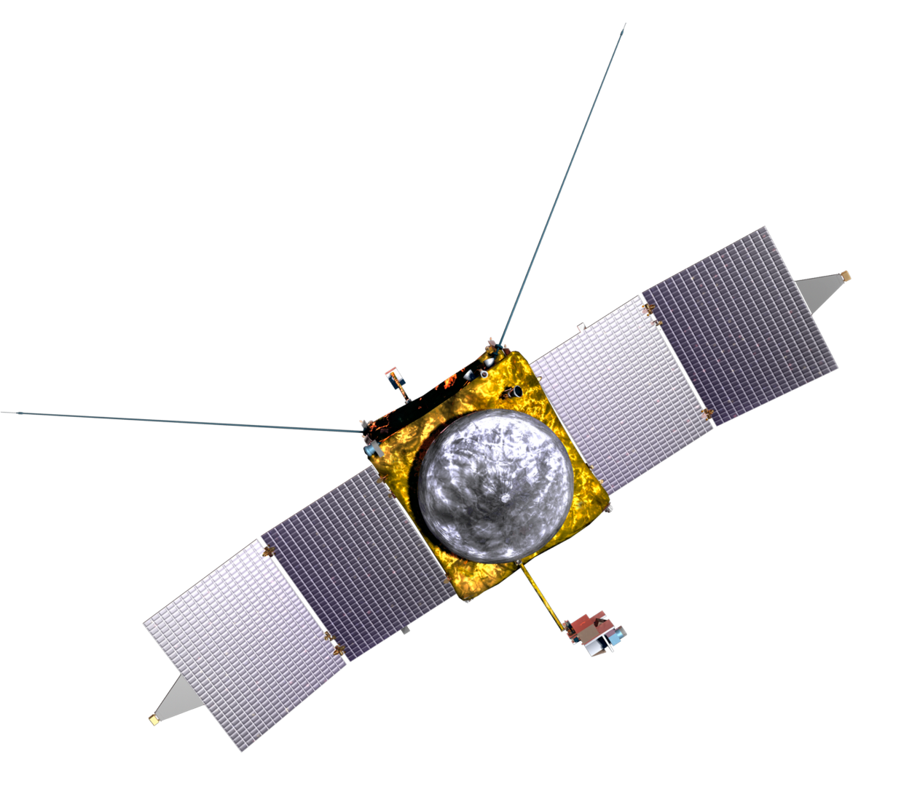
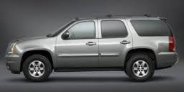
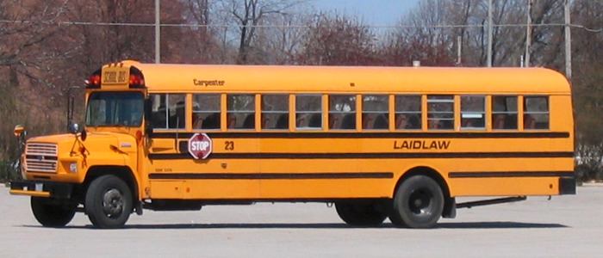
The MAVEN Spacecraft
Same weight fully loaded as a GMC Yukon – 2550 kg.
Same length as a school bus – wingtip-to-wingtip length of 37ft.

Slide 16
MAVEN Fun Facts
Average power required is ~300 Watts. You could power six spacecraft with the energy required to run the average blow dryer.
296 connectors, 1637 splices, 10,396 wire terminations with over 10 miles of wire.
The MAVEN communication system can transmit data to Earth up to 550,000 bits per second, which is similar to 3G cellphone service.
The MAVEN fuel tank holds about 500 gallons of hydrazine propellant, or nearly 900 (889) six packs of Coke.
If MAVEN uses up all its fuel at the end of the mission, it will have traveled about 300 million miles and have gotten about 600,000 miles per gallon.
The MAVEN spacecraft has two 55 A-hr 28V batteries. That’s enough energy to run your iPad continuously for about a year and a half on a single charge.

