Slide 1
Women In STEM and the Science of Fracking
Members of CO Ivy+ Women’s STEM Initiative’s Team:
Ellen Scott
Kris Walsh
Julia Kimmerly

Slide 2
Agenda
Panel: Women in STEM
Lecture
Energy Basics
Impacts of Energy on our World
Oil and Gas and Hydraulic Fracturing
Workshop: Fracking with Jello

Slide 3
Energy as a STEM Career
Working in Energy has challenges not faced in other Engineering Careers
Energy is a commodity
Price can fluctuate rapidly and significantly
Price reduction for fossil fuels hurts competition (renewable energy)
Price increases for fossil fuels improves opportunities for competition
Energy is highly regulated
Federal (Environmental Protection Agency, US Dept of Energy, Federal Energy Regulatory Commission, etc)
State (Colorado Public Utilities Commission)
Highly political/controversial (jobs, environment, consumer pricing)

Slide 4
Fossil Fuels
Fossil fuels were once alive
Oil and Natural Gas
Created from organisims that lived in water and were buried under ocean or river sediments Oil and Natural Gas
Heat, pressure and bacteria “cooked” organic material
Oil and gas worked its way to the surface until encountering “cap rocks
Coal
Created from trees, ferns, plants that existed 300-400 millions years ago
Heat, pressure and bacteria “cooked” organic material
US East Coast coal formed from swamps covered by sea water
US West Coast coal formed from fresh water swamps

Slide 5
Coal – Pros and Cons
Pros
Cheap
Abundant and available in industrialized countries
Mature industry
High Load Factor
Cons
Non-renewable
Largest contributor to global warming (CO2 per BTU)
High transportation cost
Other environmental factors (toxicity, radiation, methane)

Slide 6
Oil – Pros and Cons
Pros
No other energy source can move vehicles faster and longer than any other energy source
Abundant
Currently cheap
Easy to use and transport
Cons
Non-renewable
Environmental impact from drilling, transporting, burning
Dangerous

Slide 7
Natural Gas – Pros and Cons
Pros
Abundant
Produces less soot than other fossil fuels
Abundant supply
Infrastructure in place
Cons
Non-renewable
Highly flammable
Greenhouse gas emissions
Expensive pipelines

Slide 8
Renewable Energy
Energy that is collected from resources that are naturally replenished on a human timescale
Solar
Wind
Hydroelectric power
Tidal
Biomass
Geothermal

Slide 9
Solar - Pros and Cons
Pros
Renewable
Unlimited supply
No water or air pollution
Cons
Not currently cost effective
Reliability depends on sunlight
Storage and backup are necessary

Slide 10
Wind – Pros and Cons
Pros
Renewable
Produces no water or air pollution
Farmers can receive an income
Relatively cheap to build a wind farm
Cons
Constant wind required
Visual impact of wind farms
Significant land needed
Environmental impacts to wildlife still being investigated

Slide 11
Hydroelectric Power- Pros and Cons
Pros
Renewable
Abundant, clean and safe
Easily stored in reservoirs
Recreational benefits such as boating, fishing
Cons
Significant environmental impacts (dams)
Can only be used near a water supply

Slide 12
History of Energy and Human Development

Slide 13
Economy

Slide 14
Environment
Wood: deforestation, emissions from consumption
Coal: aquifer contamination, mining impacts, emissions from consumption
Hydro: fish populations, water temperature and flow changes
Oil and Gas: aquifer contamination, spills, emissions from consumption
Nuclear: nuclear waste, radioactive contamination, water consumption
Wind: bird and bat populations
Solar: land intensive, toxic production materials, water usage for maintenance
Biomass: land intensive, water intensive, evaporative emissions
Geothermal: siting intensive, emissions of sulfur and carbon dioxide

Slide 15
Politics
Energy Planning
Legislation on energy activities (transportation, storage)
Legislation on energy use (energy efficiency, emissions standards)
Fiscal policies (taxes, subsidies)
Energy Security (international treaties, trade agreements, strategic relationships)

Slide 16
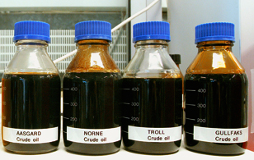
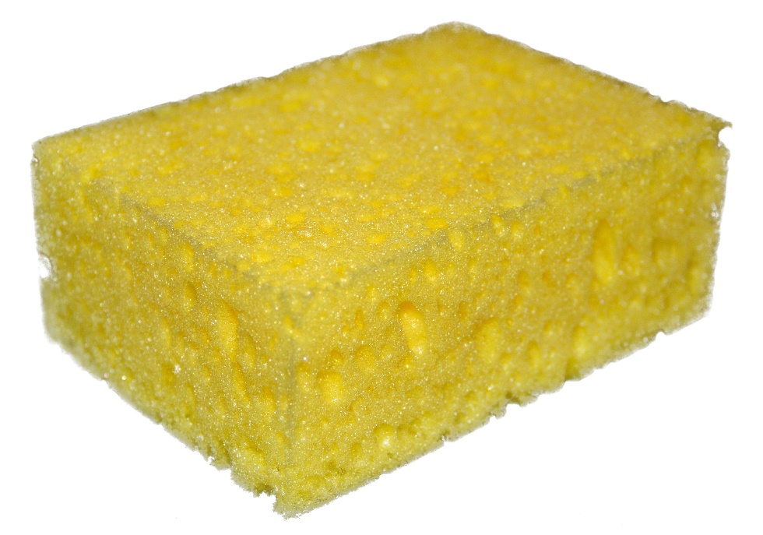
Where Do Oil and Gas Come From?

Slide 17
How Do We Extract Oil and Gas?
Oil drops in grains of sand
1 - 2 Miles
Microscopic View

Slide 18
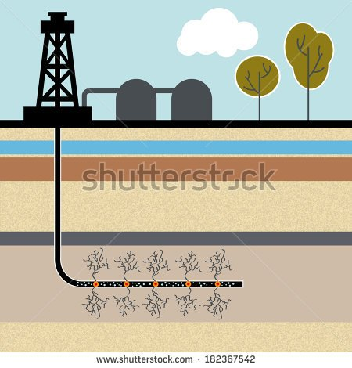
Why Do We Hydraulically Fracture Wells?
Gas
Permeability: How easily oil or gas can flow through rock
Unit: Darcy

Slide 19
How Do We Hydraulically Fracture Wells?

Slide 20
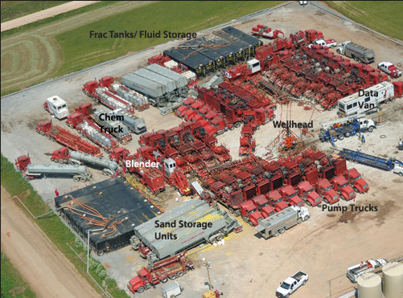
How Do We Hydraulically Fracture Wells?

Slide 21
Workshop Introduction
Understand the process of hydraulic fracturing
Form a hypothesis of what will happen to the jello when injected with syrup
Observe the fracture pattern and any variations that may change it
Understand why the syrup in jello may behave differently from a hydraulically fractured underground rock

Slide 22
Next
Move into cafeteria
Split into groups of 4-5

