Slide 1



Welcome to Earthquake Engineering
Welcome to Earthquake
Engineering
February 25, 2017
Notes:
What is civil engineering? What is structural engineering?

Slide 2
What is Structural Engineering?
Building structures…
with respect for forces of nature
What are these forces?

Slide 3
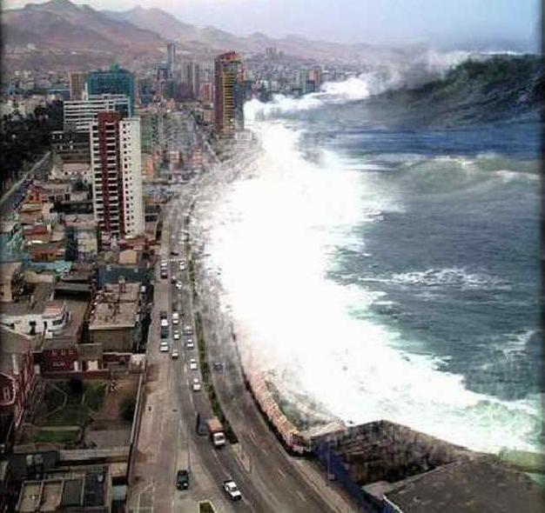
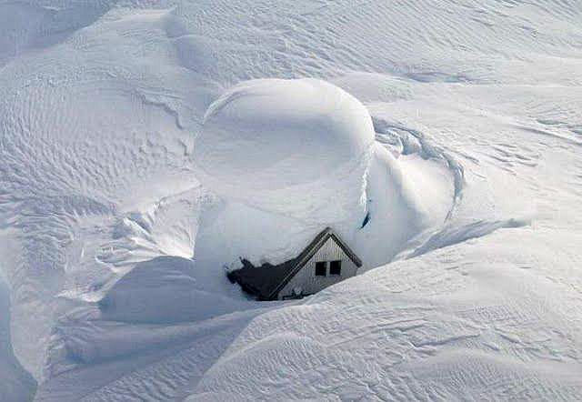
What is Structural Engineering?
Building structures…
with respect for forces of nature
Water
Soil
Wind
Seismic

Slide 4
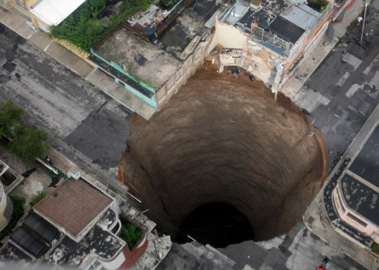
What is Structural Engineering?
Building structures…
with respect for forces of nature
Water
Soil
Wind
Seismic

Slide 5
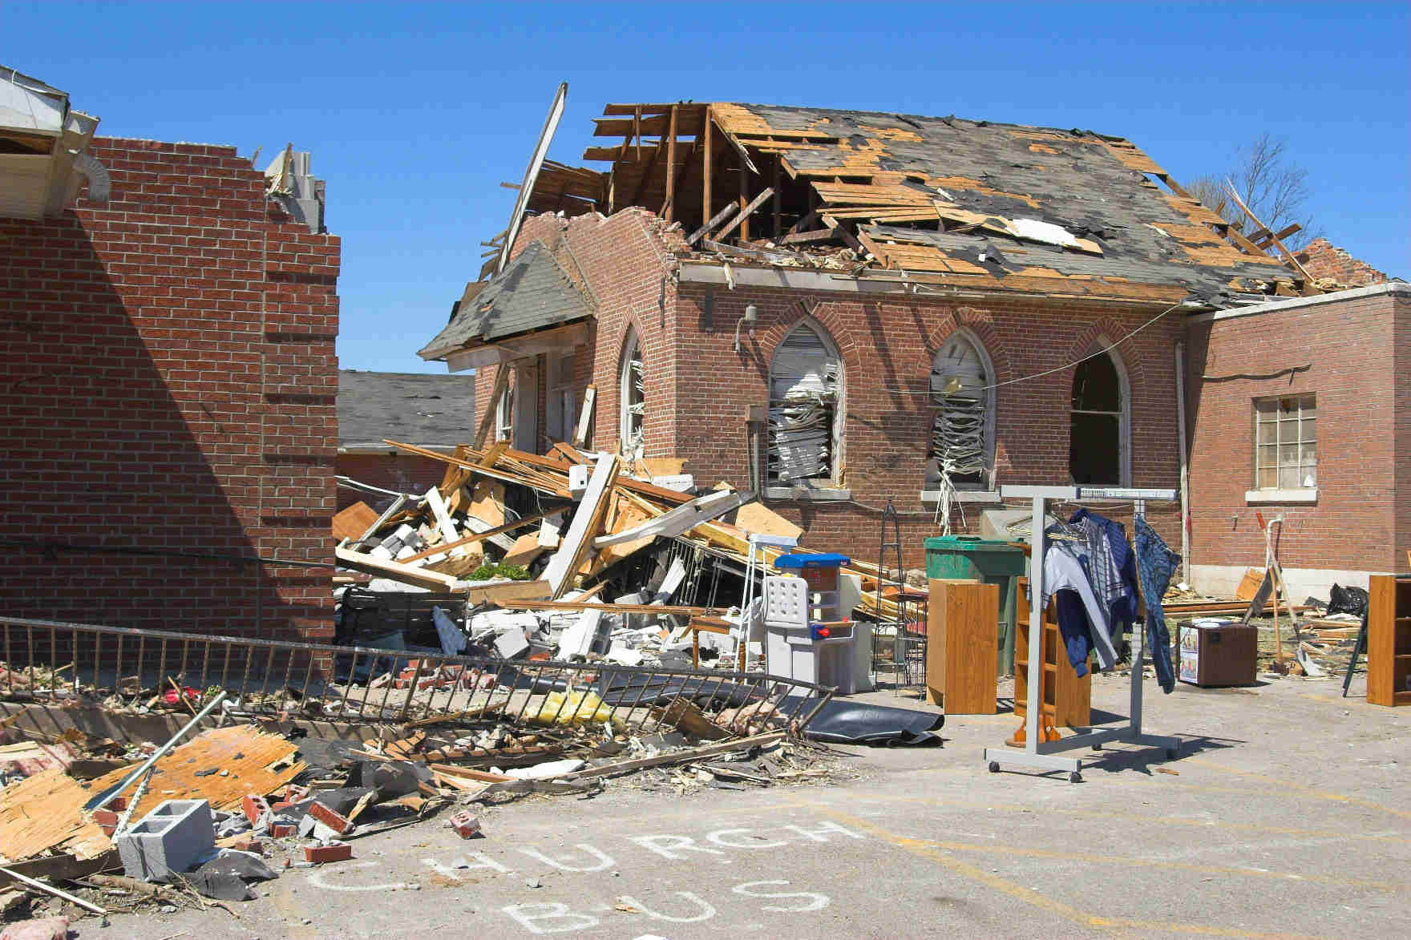
What is Structural Engineering?
Building structures…
with respect for forces of nature
Water
Soil
Wind
Seismic

Slide 6
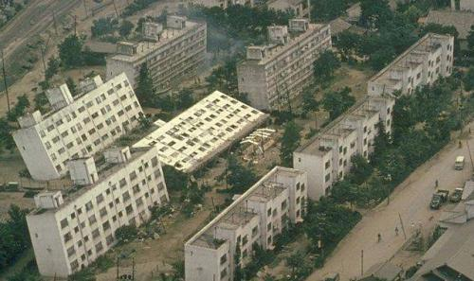
What is Structural Engineering?
Building structures…
with respect for forces of nature
Water
Soil
Wind
Seismic

Slide 7
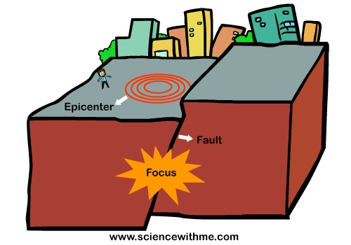
What is an Earthquake?
Notes:
Earthquakes are one of the dynamic loads that structural engineers worry about. If a building is not designed or constructed to perform well during an earthquake, people’s lives and property are in danger

Slide 8
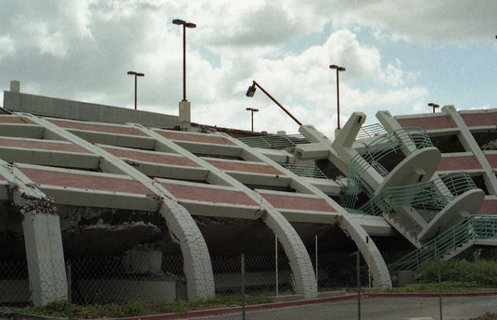
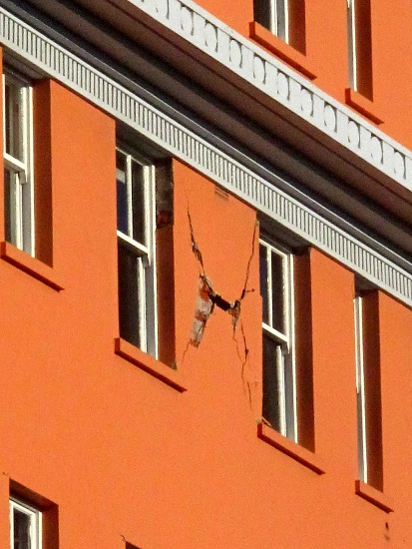
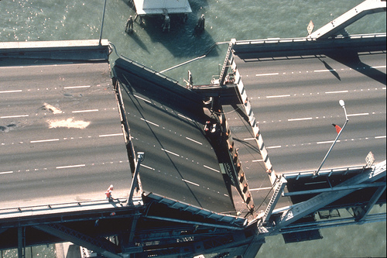
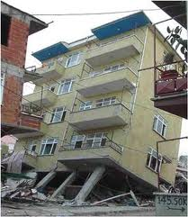
Why Care About Earthquakes?

Slide 9
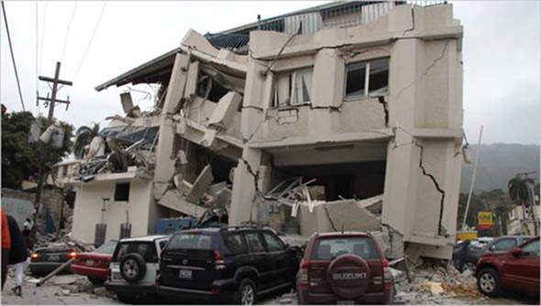
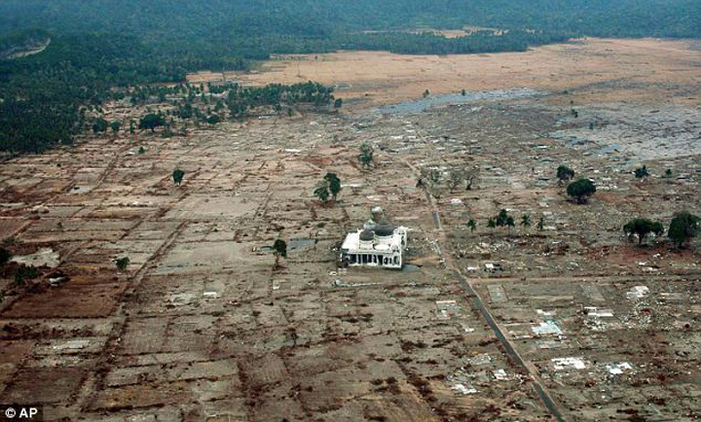
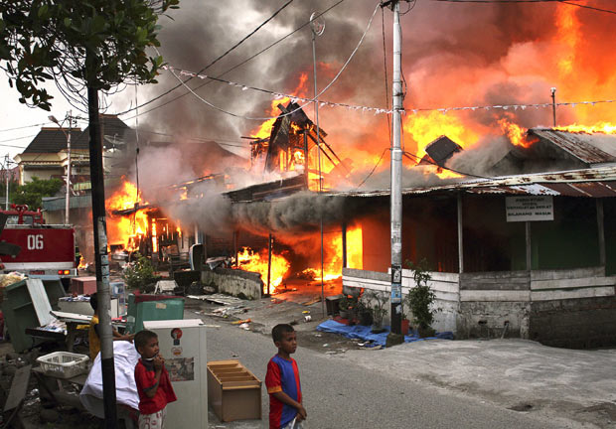
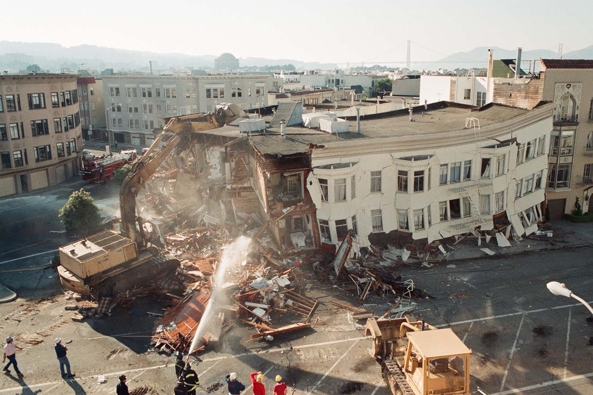
Why Care About Earthquakes?

Slide 10
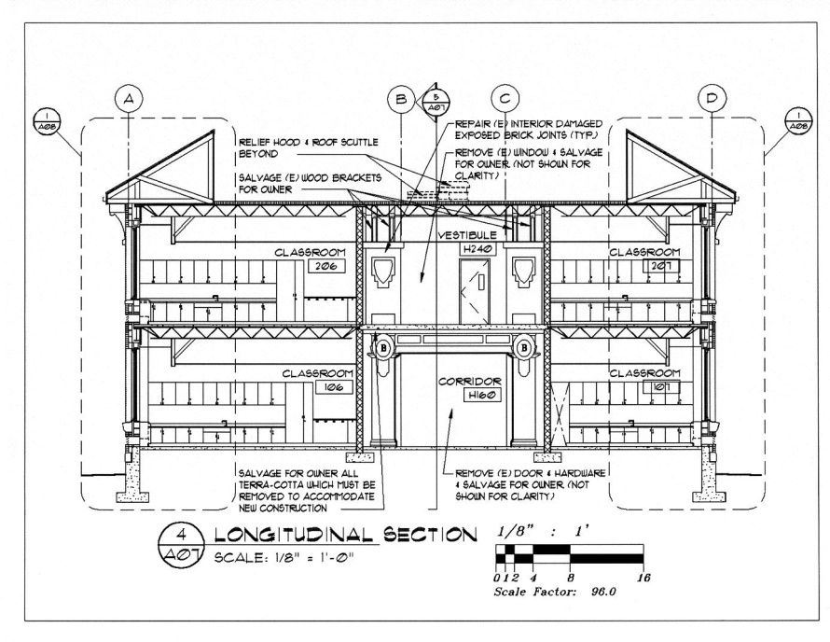

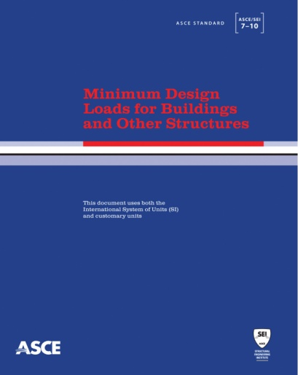
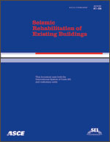
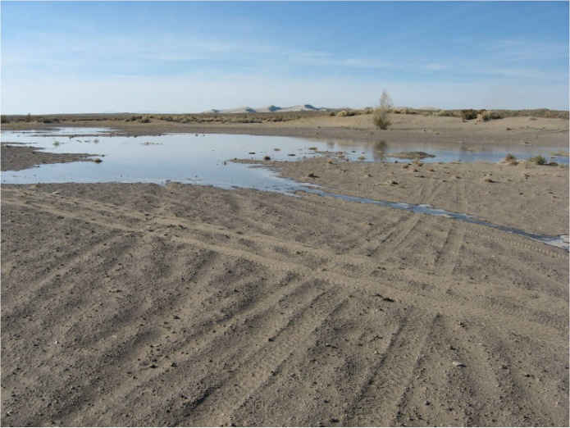

What Can We Do?
Notes:
Hazard maps (what dynamic loads will it encounter)
Building plan (what do the clients want, and how will those elements be supported)
Building codes and standards that say how a building should be designed
Site conditions (what is ground like underneath the structure)

Slide 11
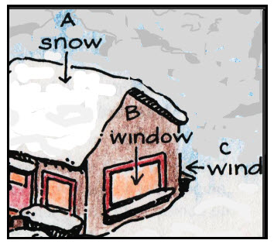



What Do We Need to Know?
STATICS
DYNAMICS
COST
SAFETY
Notes:
Statics = weight of the building and its contents
Dynamics = outside forces that push on or down on the building (snow, wind, earthquakes)
Cost = Materials
Safety = Who uses the building, what risks will it face

Slide 12




How Will We Design Our Buildings?
Notes:
Load path = how will the loads travel through your structure
Lateral force resistance = what resists the forces coming sideways

Slide 13
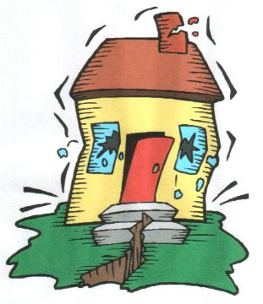


Today’s Activity
Your Task:
Design a marshmallow building to perform well during a human-powered earthquake

Slide 14

Today’s Activity
Client Needs
  Minimum height = 12 inches
  Floor area fits onto site plan
Aesthetic Appeal
  Visually interesting
Static Performance
  Resists gravity load
Dynamic Response
  Resists earthquake load

